Slide 1

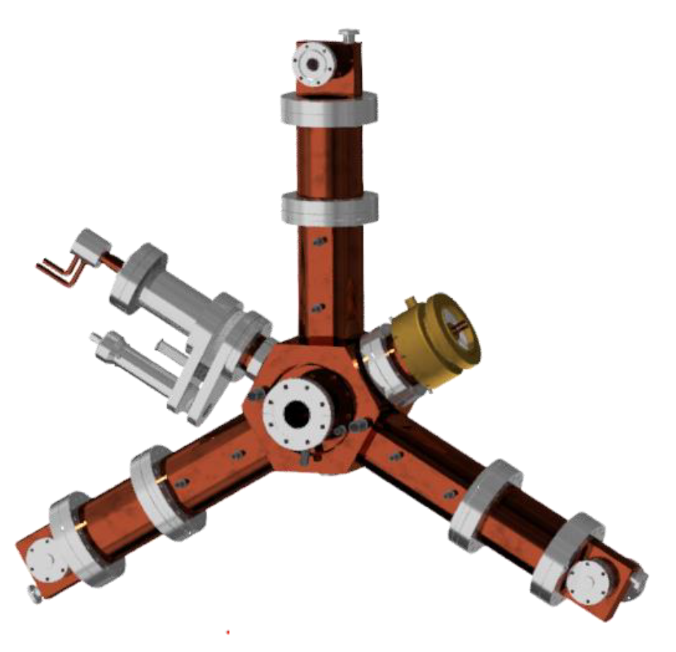
ALBA 3rd Harmonic Active Cavity Project: Prototype and test collaboration with BESSY and DESY
Angela Salom
on behalf of RF Group:
Francis Pérez, Beatriz Bravo*, Jesús Ocampo, Pol Solans, Agustín Gómez and Ignasi Bellafont

Slide 2
Overview
1.Introduction
2. Third harmonic cavity
active operation
3.Electromagnetic and
mechanical design
4. 3HC Status: Prototype and Collaboration BESSY-DESY-ALBA

Slide 3
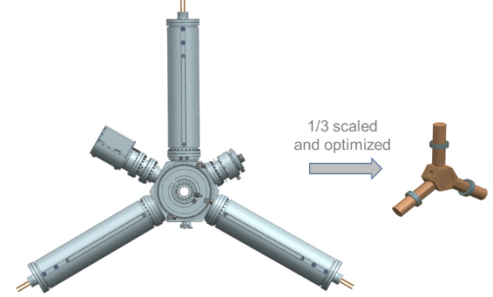
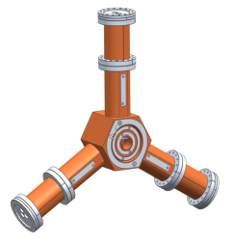
Introduction
Proposal for
3rd Harmonic Cavity (1.5GHz) for ALBA:
Scaled and optimized HOM damped cavity
500 MHz HOM damped normal conducting cavity
1500 MHz ACTIVE HOM damped NC cavity
Notes:
In a collaboration framework between CERN and ALBA, we are designing a normal conducting active 1.5 GHz cavity, based on the 500 MHz European Higher Order Mode (HOM) damped normal conducting, which could serve as main RF system for the Damping Ring of CLIC and as an active third harmonic cavity for the ALBA Storage Ring. The third harmonic cavity at ALBA will be used to increase the bunch length in order to improve the beam lifetime and increase the beam stability thresholds. The main advantage of an active third harmonic cavity is that optim um conditions can be reached for any beam current.

Slide 4

Introduction
Active cavity Proposal
Scaled and optimized HOM damped cavity
REQUIREMENTS
Total VOLTAGE | 1 MV
φoptimum | -2.8 degrees
FREQUENCY | 1,5 GHz
Nominal ∕ maximum power dissipated per cavity | 16∕20 kW
Number of cavities | 4 or 5?

Slide 5
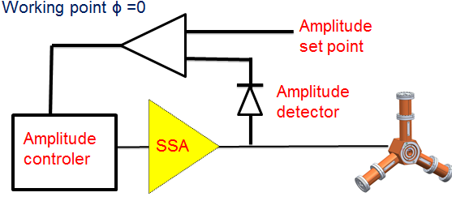
Active Operation
OPERATION
Phase of the cavity set to ϕ=-2.8º
IQ Cavity Voltage Control.
ϕh | Pforw∕cav (i=0 mA) | Pforw∕cav (I=0,2A) | Pbeam∕cav | Bunch length
-2.8 | 16kW | 8 kW | -8 kW | 3.3 σ
It was considered 4 cavities that provide 1.1 MV and shunt impedance, Rs=2.4MΩ.
Notes:
The working point will be set to ϕ=0 all other conditions will remain the same as in the optimum case. This operating point will allow implementing a simple control loop.
With no beam, the transmitter drives the cavity at resonance through a near matched input loop. As beam is injected, the tuning loop compensates for the
reactive beam loading

Slide 6
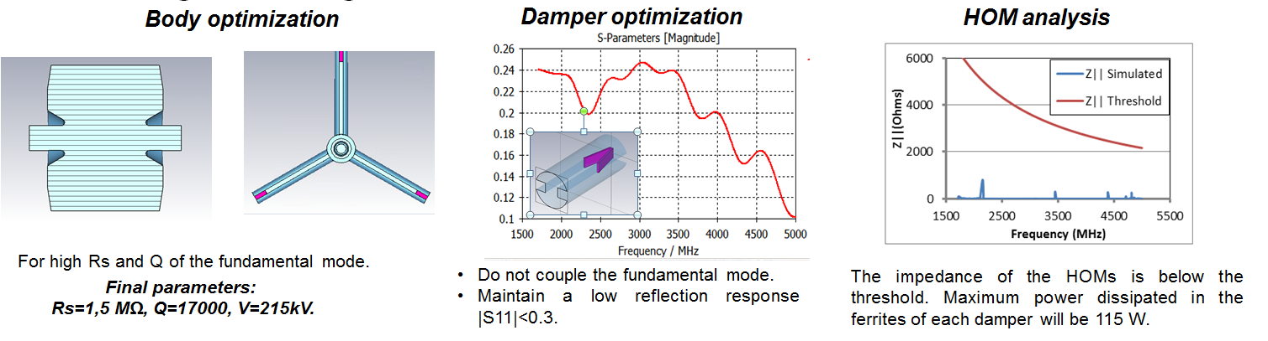
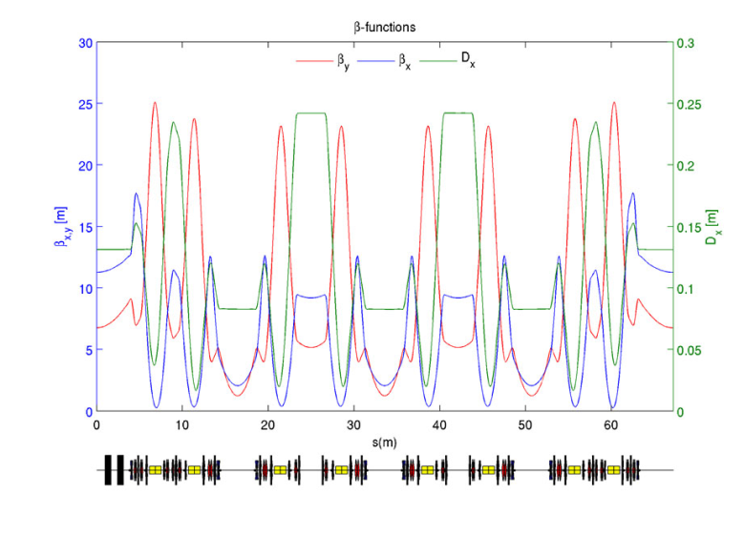
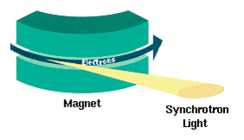
Cavity design: Beam aperture
Rs dependence strongly on the beam pipe dimensions.
Constrains beam pipe diameter:
Electron beam aperture. Lattice
Synchrotron radiation.

Slide 7
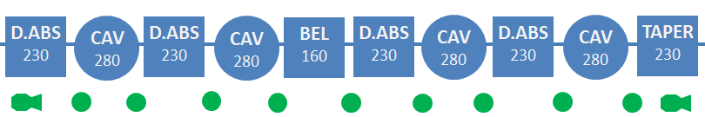
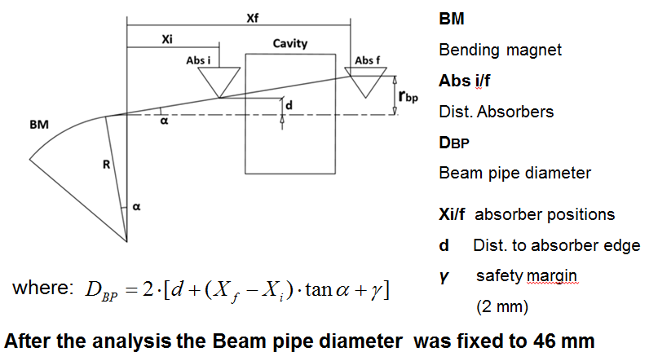
Cavity design: Beam aperture
2. Synchrotron radiation
Ray Tracing
Notes:
Layout of the third harmonic cavity system, with component longitudinal dimensions and beam pipe shape
A key feature and a starting element in the design of the
cavity is the beam pipe diameter. Since synchrotron radiation
and electron beam aperture constrain the beam pipe
diameter above a minimum value it is worth to study how
to optimise it. The electron beam aperture is determined
by the lattice. The synchrotron radiation comes from the
dipoles and can impact onto the cavities leading to damaging
them. To avoid these problems careful raytracing
analysis is done, using an appropriate design of the absorbers
and placing them in the system.

Slide 8
Cavity design: Electromagnetic design
Preliminary parameters
Rs = 1.5MOhms, Q = 17000, V = 215kV
Notes:
The cavity geometry was optimized for high shunt impedance
and a high quality factor of the fundamental
mode. The final parameters after the optimization are:
shunt impedance, Rs= 1.5 MΩ, quality factor Q=17000,
nominal voltage induced in each cavity Vcav=215 kV.
With this design, five cavities will be needed to reach the
optimum bunch lengthening. As, for the moment, it is
foreseen to install only four cavities to allow also space
for an ID in the long straight, the bunch length will increase
to 2 0 σ , below the optimum, but realistic

Slide 9
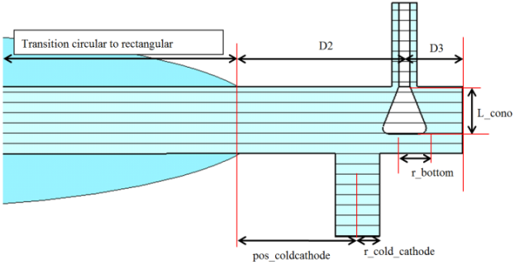
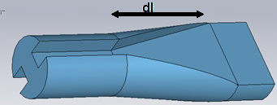
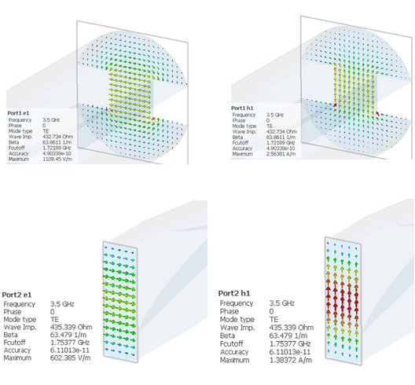
Cavity design: Electromagnetic design
Trans Damper
(to avoid installation of ferrites in vacuum)
Ridge circular to rectangular waveguide
Antenna to extract HOM power at the end of trans-dampers – no ferrites nor brazing needed
Notes:
The cavity geometry was optimized for high shunt impedance
and a high quality factor of the fundamental
mode. The final parameters after the optimization are:
shunt impedance, Rs= 1.5 MΩ, quality factor Q=17000,
nominal voltage induced in each cavity Vcav=215 kV.
With this design, five cavities will be needed to reach the
optimum bunch lengthening. As, for the moment, it is
foreseen to install only four cavities to allow also space
for an ID in the long straight, the bunch length will increase
to 2 0 σ , below the optimum, but realistic

Slide 10
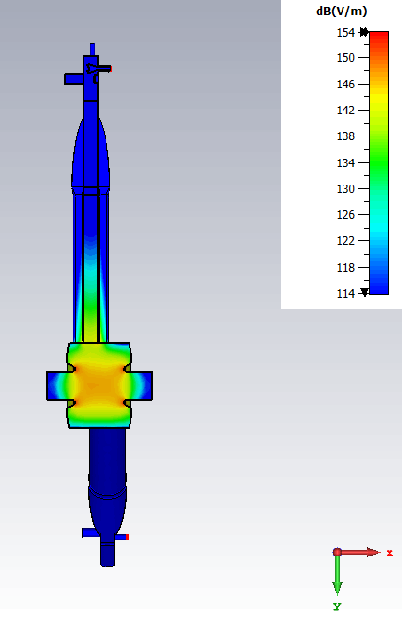
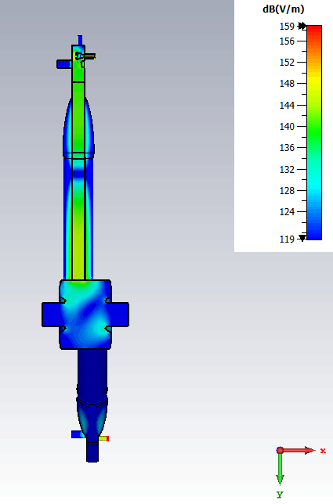
Cavity design: Electromagnetic design
Fundamental mode (1.5 GHz)
HOM (1.86 GHz)
* Info from J. OCampo

Slide 11
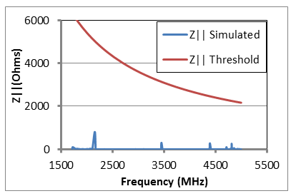
Cavity design: Electromagnetic design
HOM analysis
Maximum power at each damper will be 115W

Slide 12
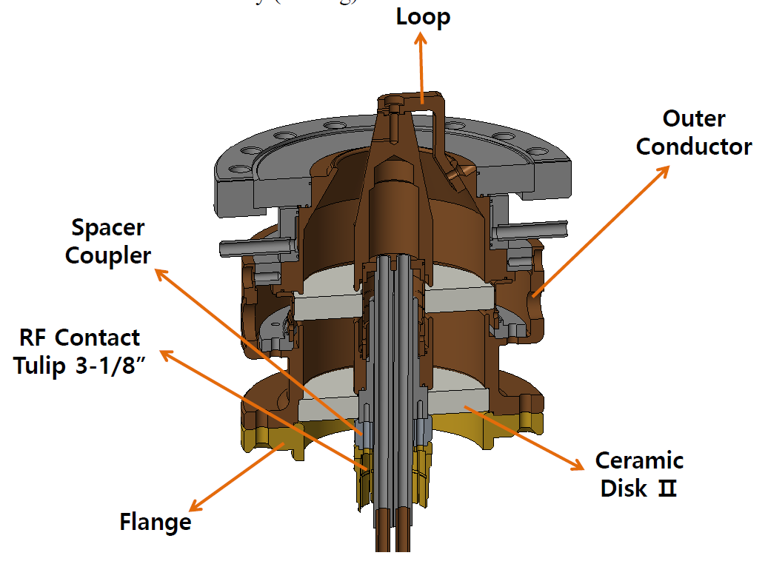


Cavity design: Electromagnetic design
INPUT COUPLER
Power handling 32kW.
Inductive coaxial loop.
Distance between the aluminas, the width and the shape of the aluminas highly affects the matching.
* Info from AVS - Vitzro

Slide 13
Cavity design: Electromagnetic design
Pick-up loop
In vacuum pick-up loop
Commercial feed-through with inductive loop. Already tested in Dampy

Slide 14
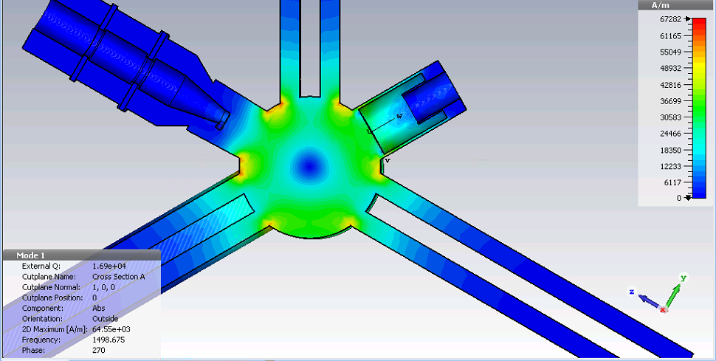
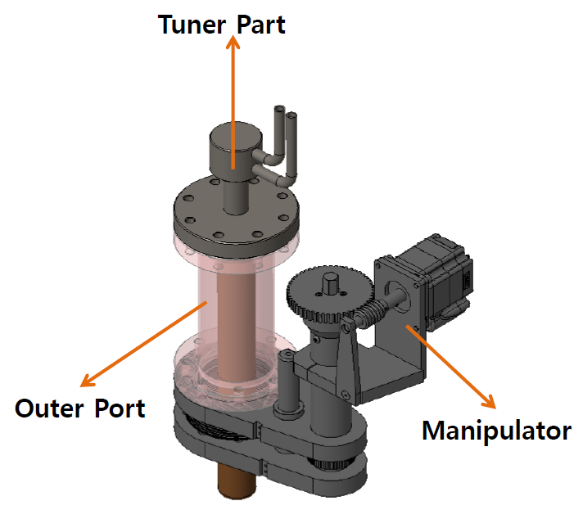
Cavity design: Electromagnetic design
PLUNGER
New design based on the Bessy plunger (no fingers)
Movement range ±20mm ➔ 6MHz
COTS manipulator

Slide 15
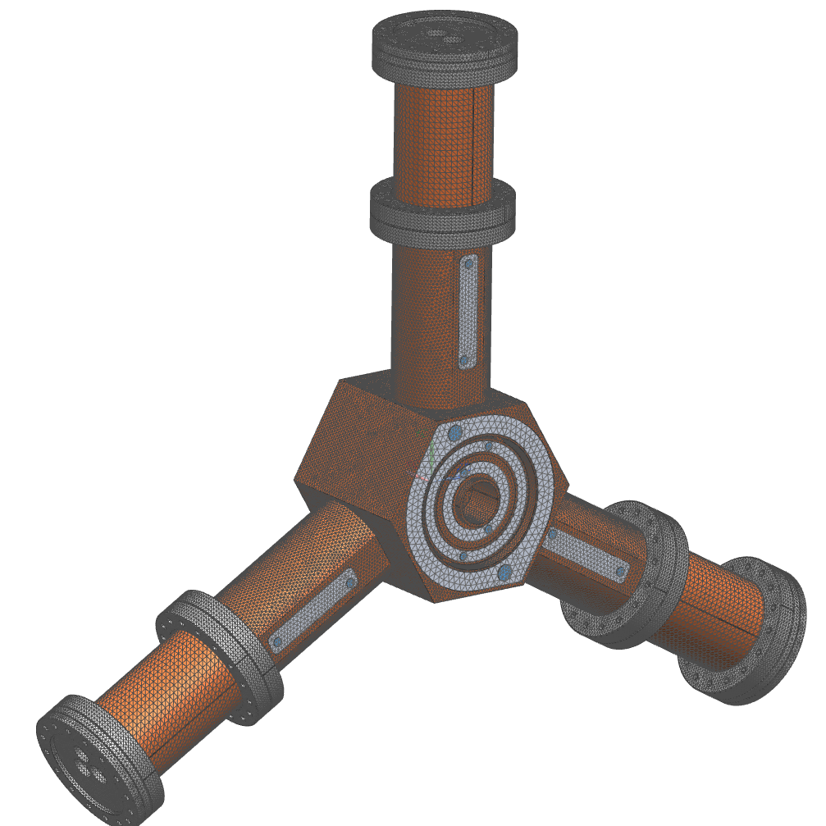
Thermo/Fluid Calculations by J.Alvarez
FEM thermo-fluid simulations
Solver NX thermal flow
Materials:
OFHC Cooper, Stainless steel and water.
Boundary conditions
Total power dissipated in the body of the cavity is 20 kW.
Perfect thermal contact between welded components
Cooling: Water 30 l/min (Main body), 10 l/min (Front and Rear Lid). Inlet Temp 23 ºC.
Radiation and convection to environment
Constraints
Max water velocity 2 m/s.
Notes:
Coupled thermal-fluid simulations have been performed,
using Siemens NX as FEA package. The surface
heat deposition, calculated with the electromagnetic model,
has been imported as a heat load distribution. Flowing
through the cavity body, the cavity body lids and dampers,
deionised water at 23 ºC is used as coolant.
Figure 6 shows the result of temperature distribution in
the cavity. In the picture is shown the cavity sectioned
making visible the nose cone and the damper ridges. Itis
precisely in the damper ridge edge where the temperature
reaches its maximum value, 66.7 ºC

Slide 16
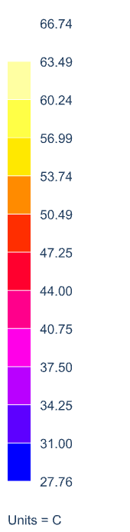
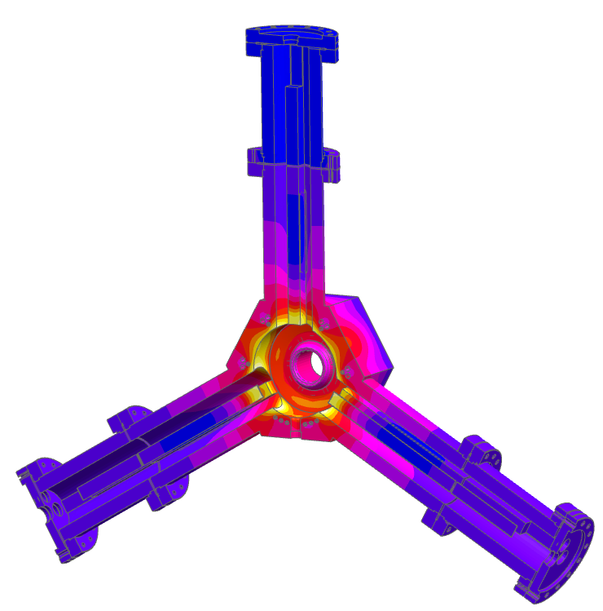
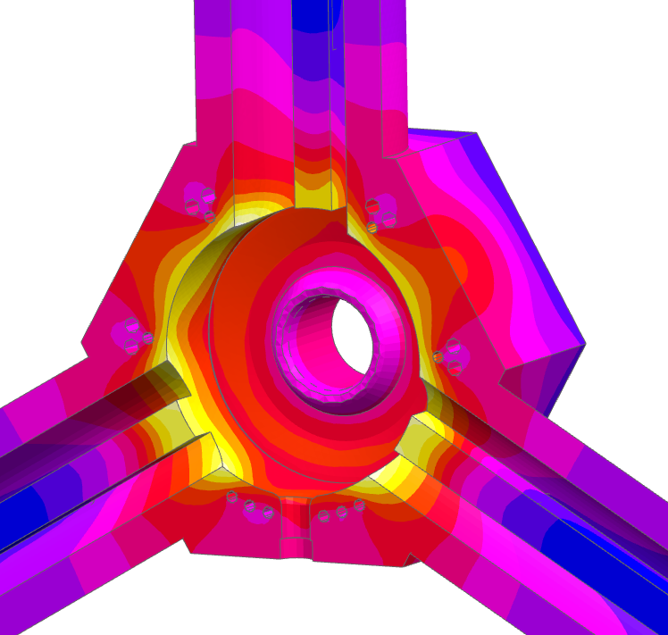
Thermo/Fluid Simulations by J.Alvarez
Temperature (ᴼC)
Steady state simulation
Max. Copper Temp. 66.74 ºC
After several design/simulation iterations, the simulation results shows a maximum temperature of 67 ºC that is reached in the ridges edges located in the inner face of the cavity.

Slide 17
Cavity design: Electromagnetic designed
Final Cavity Parameters with all elements
  Quality factor 14000
  Shunt impedance 1.2 MOhms
  Max voltage per cavity 185kV
  Number of cavities necessary 5

Slide 18
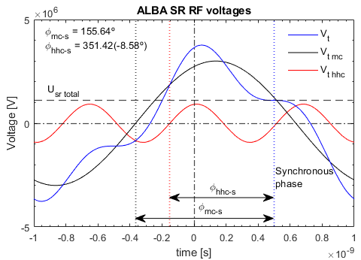
Cavity design: Performance summary
3HC Performance for Present SR Operation: 3 MV main RF system voltage, 3 GeV, 250 mA
Main parameters
HH RF system total voltage | 921.28 kV
HH cavity voltage (5 cavities) | 184.26 kV
Supplied RF power/cavity (P_{g}) | 7.27 kW
Dissipated power/cavity (P_{c}) | 14.14kW
Reflected power/cavity (P_{r}) | ~0 kW
Nominal beam power/cavity (P_{b}) | -6.87 kW
Total RF power for the HHC system | 36.35 kW
Bunch lengthening factor (u) | 3.3
Optimal bunch length (σ_{z}) with 3HC | 57 ps (17mm)
Bunch length without 3HC | 17.3ps (5.2mm)
After an interlock causing the RF power in one HH cavity to be lost, around 18 kW would be subtracted from the beam and 6.1 kW would be reflected, acceptable numbers
* Info from I. Bellafont

Slide 19
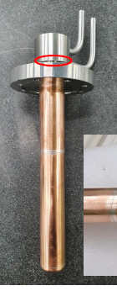
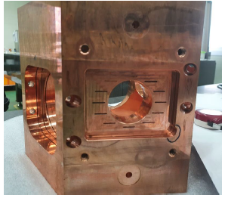
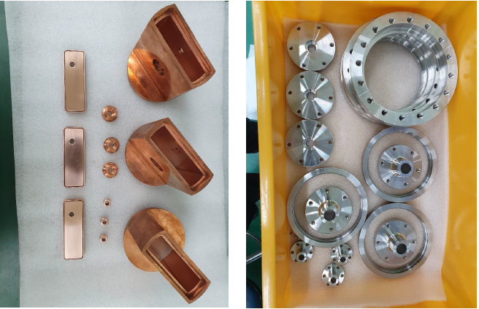
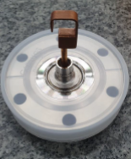
3HC Prototype Construction
In September 2019 : Tender awarded to AVS & Vitzro for the construction of 1st prototype of 3HC
Machining of all subcomponents finished
Final brazing foreseen Dec 20 – Jan 21
FAT in Feb 21. Delivery March 21
Plunger
Cavity Body
Transdampers
Flanges
* Pictures from AVS - Vitzro
Pick-up

Slide 20
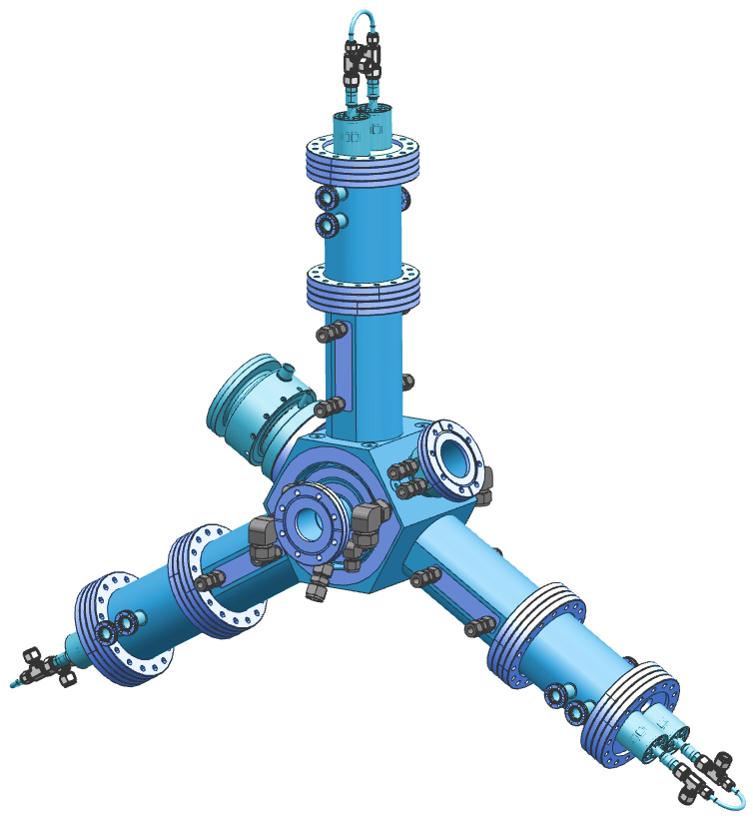
3HC Collaboration Status with BESSY and DESY

Slide 21
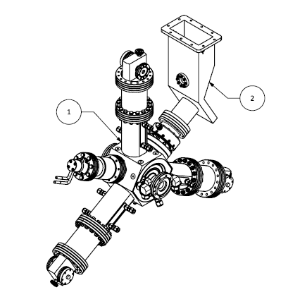
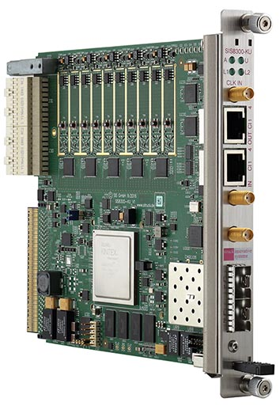
3HC Collaboration status with BESSY & DESY
Collaboration agreement between BESSY, DESY and ALBA for studies of 3HC
ALBA:
  Design and prototype of 3HC
  1.5GHz LLRF: uTCA FPGA Board + 1.5GHz Front End from STRUCK - summer 2021
  Watrax design finished (1.5GHz waveguide to coaxial transition)
DESY:
  Electromagnetic and FEA simulations
  Procurement of 1.5GHz waveguides and watrax
BESSY:
  Bead pull measurements of 3HC
  1.5GHz 15kW SSPA & Circulator
  Test stand for High Power Tests
  2022 – tests with beam in BESSY-II
WATRAX: waveguide to coaxial transition

Slide 22
THANKS FOR YOUR ATTENTION

