Slide 1
Diamond Light Source Status and Upgrade
Ian Martin,
On behalf of the Diamond team
28th European Synchrotron Light Source Workshop
16/12/2020

Slide 2
Coping with Covid
UK National Lockdowns: 23rd March to 10th May, 5th November to 2nd December
4971 h scheduled in 5 Runs
On course for 3579 h

Slide 3
Coping with Covid
Impact on User Periods
Run 1: No impact. Standard availability for users (6 User days + 1 MD day per week).
Run 2: User time Tuesday 09:00 – Friday 16:00. Limited MD available Mondays 09:00 – 17:00.
Run 3, 4 and 5: User time Tuesday 09:00 – Saturday 09:00. MD available Mondays 09:00 – Tuesday 09:00.
Overall, number of user hours was reduced by ~1400 h.
Beamline availability
During Run 2, only MX beamlines actively involved with research into SARS-CoV-2 were running (6 out of 34). Number of operating beamlines gradually increased during following runs.
Reduced number of hours mainly due to fewer samples being produced and lower demand from users.
Remote users only during Runs 2, 3 and 5. Number of users on site limited to 2 per experiment during Run 4.
Mix of on-site and remote access for machine development periods.
Operator shifts rearranged due to reduced availability / shielding / self-isolation.

Slide 4
2020 Operational Statistics
Uptime for 2020 during runs 1-4 in-line with previous years (98%). Since dropped to 96% due to Helium compressor fault, followed by rupture of a burst disc and failure of coldbox turbine (150 h to repair, including 68 h lost user time)
Other largest contributors to downtime:
22 h site shutdown - loss of domestic water supplies
5.5 h - following brown-out
2020 data up to end Run 4
MTBF for the year currently >144 h (Run 1 >275 h)
No evidence that trip-rates or down-times were significantly affected by remote working or more frequent switch on / switch off.
2020 data up to end Run 4
cold box turbine
Courtesy C. Bailey

Slide 5
2020 Operational Statistics
Largest number of trips due to SR-RF (16 out of 23, up to end of Run 4)
Mixture of causes: (11 amplifier, 1 cryogenics, 3 cavity, 1 LLRF)
Linac fault interrupted top-up in April. Thyratron failed and was replaced (damaged pulser unit)
Courtesy C. Bailey

Slide 6
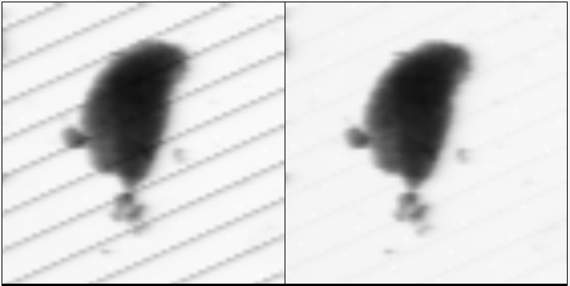
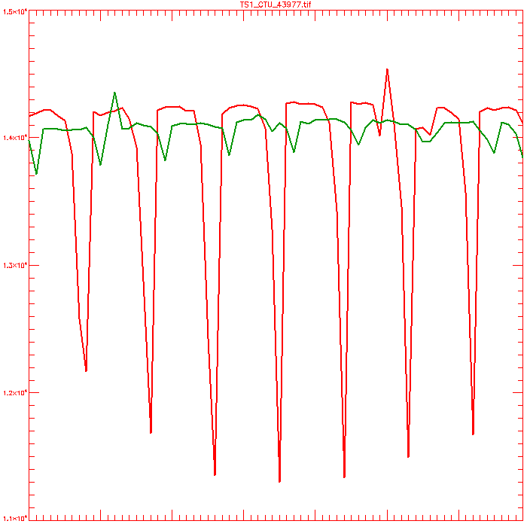
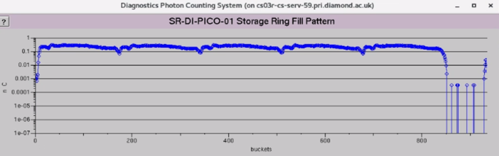
Diamond-I: Top-up Disturbance
Continuous Firing Tests on I08 beamline
Efforts to suppress beam disturbance during top-up ongoing:
H+V pinger magnets enabled during top-up in Runs 1 and 5
Clear benefit for majority of beamlines
Leads to ~10-15 % drop in injection efficiency (trade-off)
Also investigating switching from SB to MB top-up (10 min period):
Charge/shot into SR would increase from ~0.1 nC to ~1 nC
Shots/cycle would reduce from ~100 to ~10
Without pingers
With pingers
Raster scan trans. images (778 eV, 10 ms/pixel)
~2 % drop with pingers
~20 % drop without pingers
Intensity through vertical lines
Courtesy C. Christou, P. Hamadyk

Slide 7
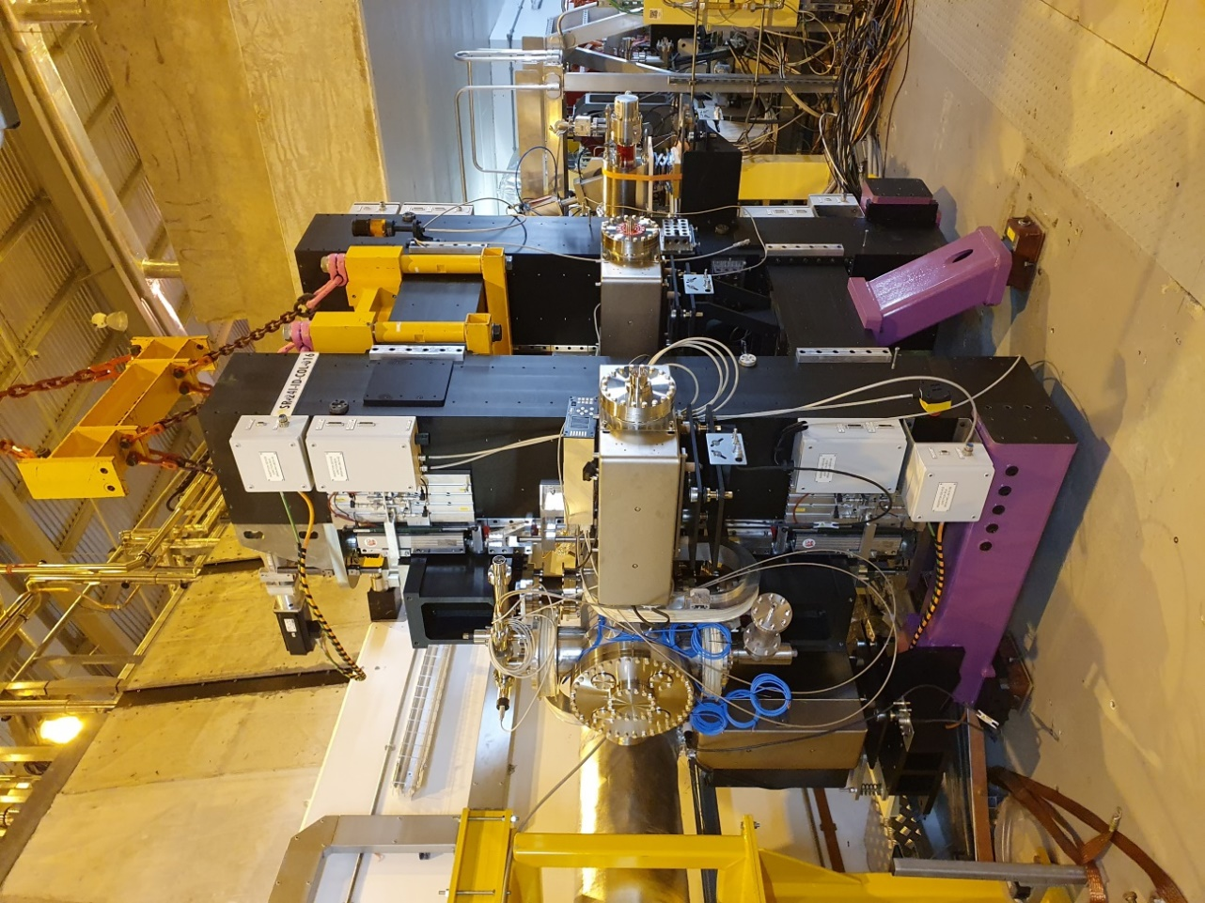
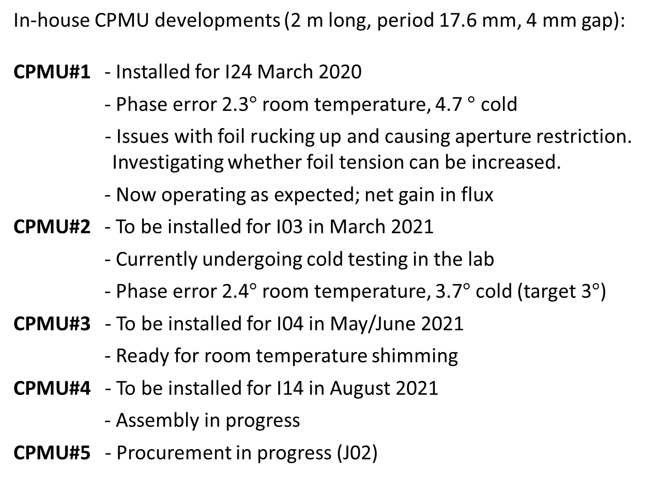
Diamond-I: IDs
In-house CPMU developments (2 m long, period 17.6 mm, 4 mm gap):
CPMU#1 - Installed for I24 March 2020
- Phase error 2.3$°$ room temperature, 4.7 $°$ cold
- Issues with foil rucking up and causing aperture restriction. Investigating whether foil tension can be increased.
- Now operating as expected; net gain in flux
CPMU#2 - To be installed for I03 in March 2021
- Currently undergoing cold testing in the lab
- Phase error 2.4$°$ room temperature, 3.7$°$ cold (target 3$°$)
CPMU#3 - To be installed for I04 in May/June 2021
- Ready for room temperature shimming
CPMU#4 - To be installed for I14 in August 2021
- Assembly in progress
CPMU#5 - Procurement in progress (J02)
Courtesy S. Milward

Slide 8
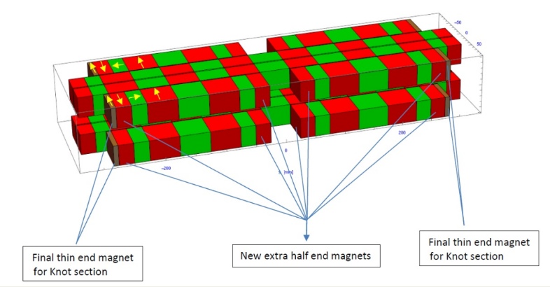
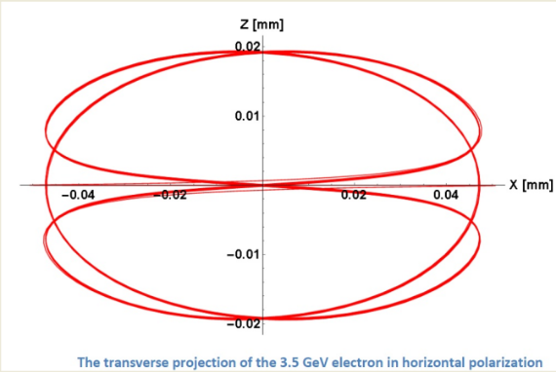
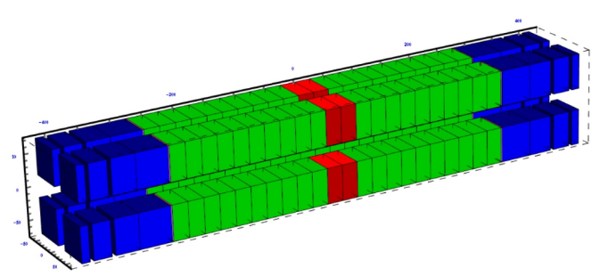
Diamond-I: IDs
Active collaboration with Budker Institute to develop a superconducting undulator (SCU):
2 m long, 15.6 mm period, 6 mm fixed vertical aperture
Delivery expected February 2021 (delayed by Covid)
Hybrid Permanent Magnet Undulator (HPMU) ordered from industry for I04.1
1.5 m long, 19.7 mm period (TBC)
Replaces 0.7 m long, 30.8 mm period out-of-vacuum device
Modifications required to adjacent girders and chicanes to accommodate
Delivery expected Feb 2022
Trajectory in H-plane
Simplified using compound angle magnets
APPLE-II Knot undulator under study for I05
Reduces power on-axis in linear polarization modes
Allows lower photon energies / higher flux compared to standard APPLE
Courtesy S. Milward

Slide 9
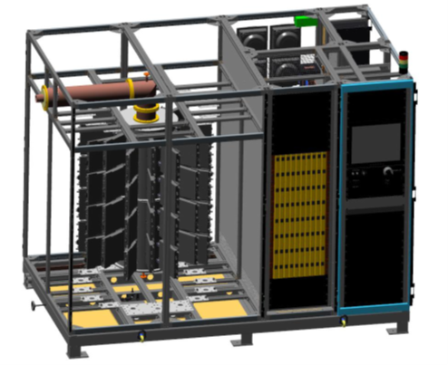
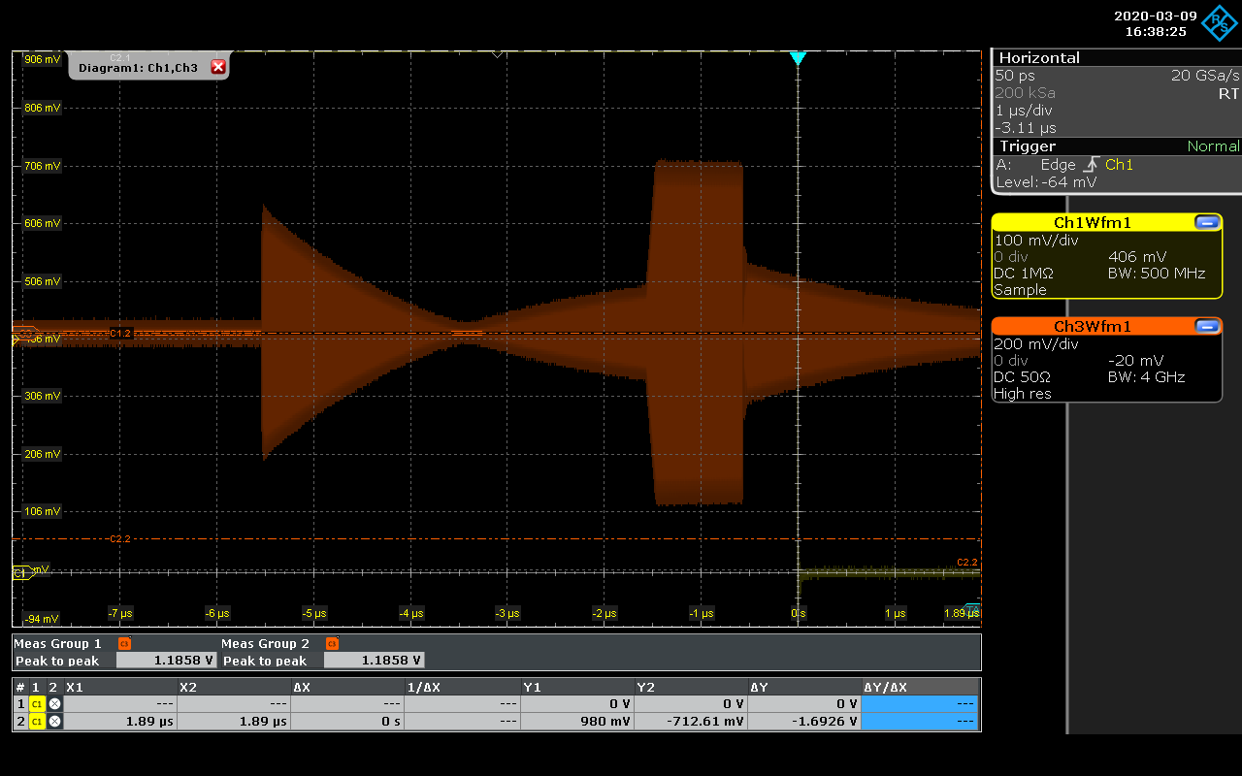
Diamond-I: RF Developments
3rd normal conducting cavity in RF test facility for high power tests/conditioning
  Provides contingency against SC cavity / cryoplant failure (install during 2021)
Installation of two Ampegon solid state amplifiers is progressing
  80 kW for RF test facility: full power operation has been demonstrated
  60 kW for 2nd booster cavity: commissioning and acceptance late 2021
Contract has been placed for one 120 kW Cryoelectra amplifier
  To power third NC cavity in second half of 2021
  Power transistor module assembly and test is progressing to schedule
Digital low-level RF development is continuing
  Front end down- and up-converters replaced by Struck RTM cards
  ALBA code has been ported to Struck system
Linac SLED cavity project is underway
  3 GHz DLLRF system has been developed
  Long-pulse flat top has been demonstrated at low power
  High power test taking place in linac tunnel in machine shutdown
Courtesy C. Christou

Slide 10
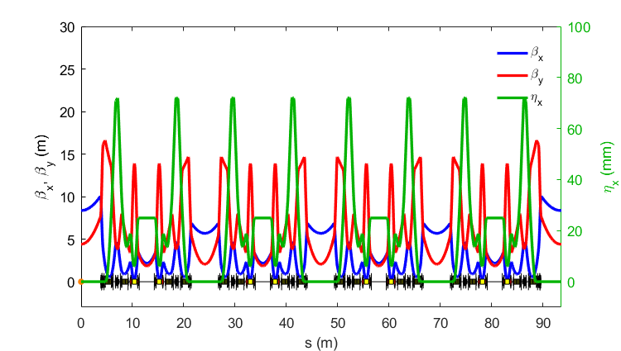
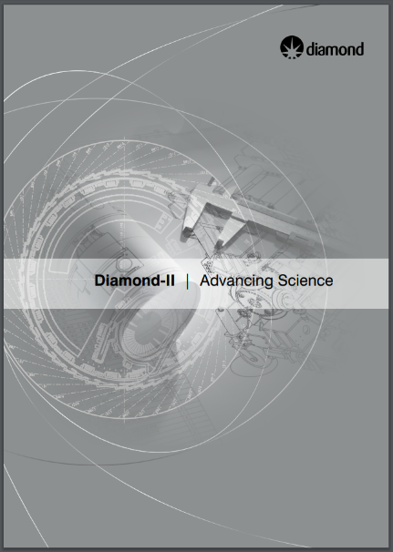
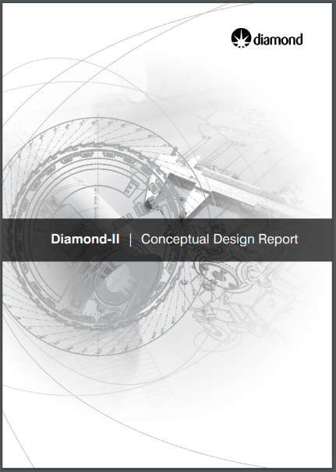
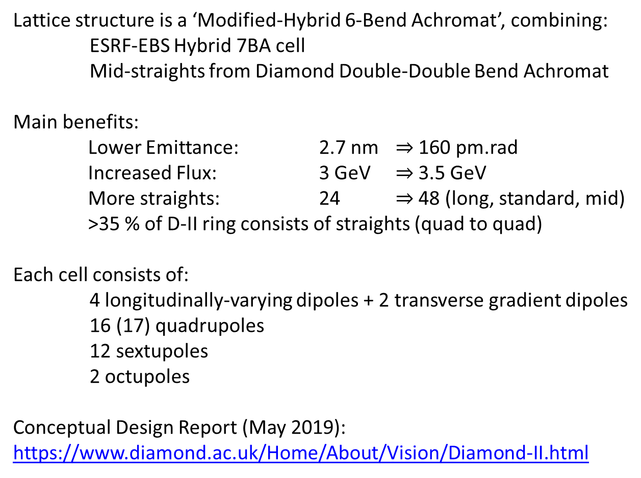
Diamond-II: CDR Lattice
Lattice structure is a ‘Modified-Hybrid 6-Bend Achromat’, combining:
ESRF-EBS Hybrid 7BA cell
Mid-straights from Diamond Double-Double Bend Achromat
Main benefits:
Lower Emittance: 2.7 nm $⇒$ 160 pm.rad
Increased Flux: 3 GeV $⇒$ 3.5 GeV
More straights: 24 $⇒$ 48 (long, standard, mid)
>35 % of D-II ring consists of straights (quad to quad)
Each cell consists of:
4 longitudinally-varying dipoles + 2 transverse gradient dipoles
16 (17) quadrupoles
12 sextupoles
2 octupoles
Conceptual Design Report (May 2019):
https://www.diamond.ac.uk/Home/About/Vision/Diamond-II.html
7.5 m long str.
5.2 m standard str.
2.9 m mid str.

Slide 11
Diamond-II: CDR Lattice
Combination of ‘-I transformer’ and higher-order achromat
Phase advance between focussing chromatic sextupoles:
μ_{x} = ~3π
μ_{y} = ~π
Cell tunes chosen to cancel resonance driving terms over 8 cells:
μ_{x} = ~2π*19/8
μ_{y} = ~2π*7/8
Some detuning necessary:
ring tunes must avoid main resonances
-I transformer drives 2nd order chromaticity (Δμ/2π ~0.025)
tolerance of Δμ/2π ~0.01 for cell tunes
H-function in mid-straight minimised to avoid increase in emittance from IDs
-I transformer
higher-order achromat

Slide 12
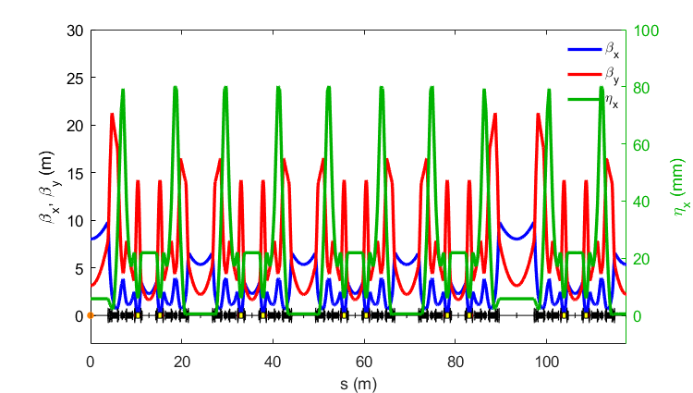
Diamond-II: Post CDR Developments
Addition of reverse bend dipoles to control dispersion found to be beneficial, either to:
increase dispersion at chromatic sextupoles (lifetime gain)
reduce dispersion in dipoles (emittance reduction)
Further lines of investigation (WIP):
Better symmetrisation of the phase advance between chromatic sextupoles (μ_{x,y})
Adding transverse gradient / shaping of longitudinal bend profiles to match the dispersion
Tuning of H-function in mid-straights (improves emittance with IDs)
Allowing some dispersion leakage in long / standard straights
μ_{x,y}
μ_{x,y}
μ_{x,y}
μ_{x,y}
Reverse bend quadrupoles

Slide 13
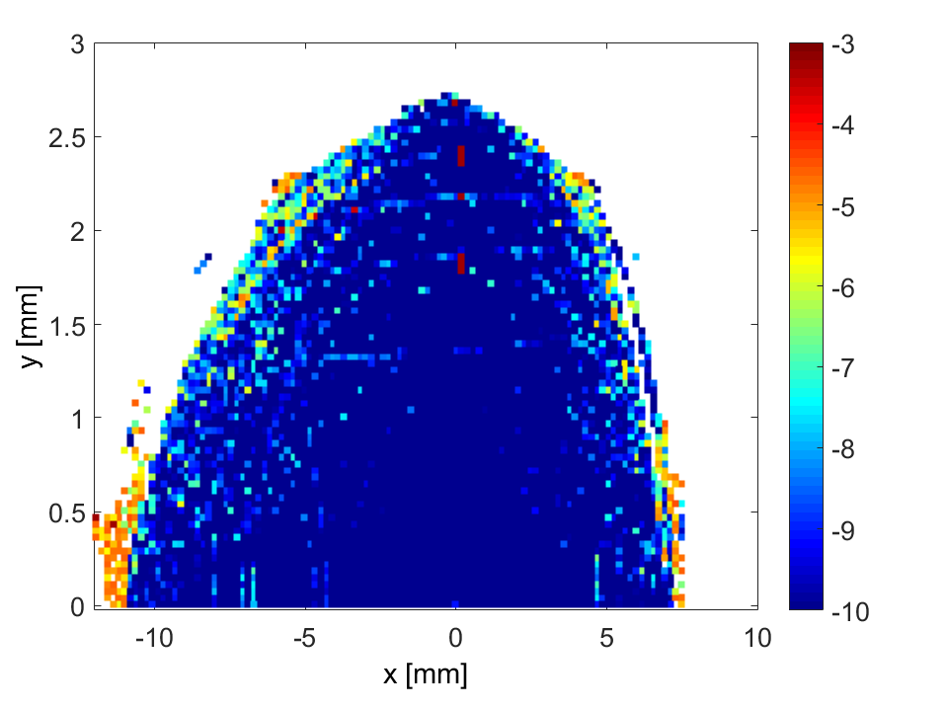
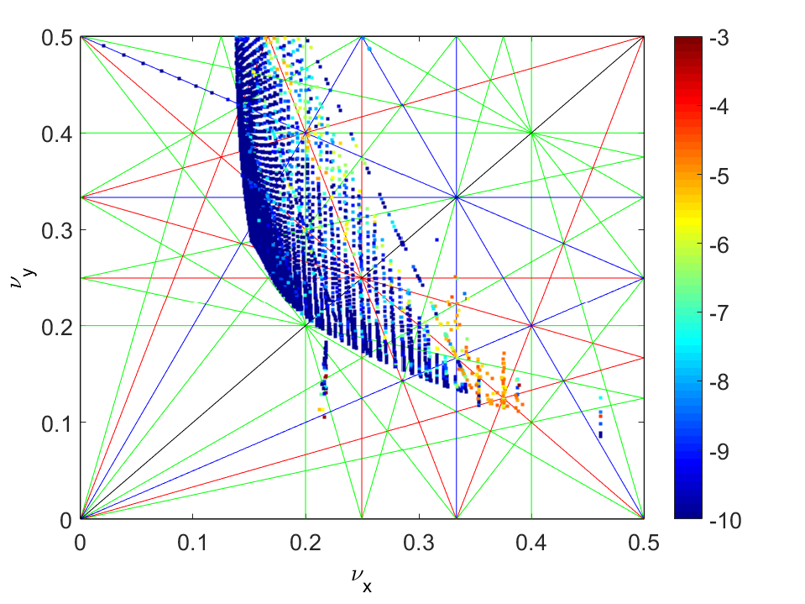
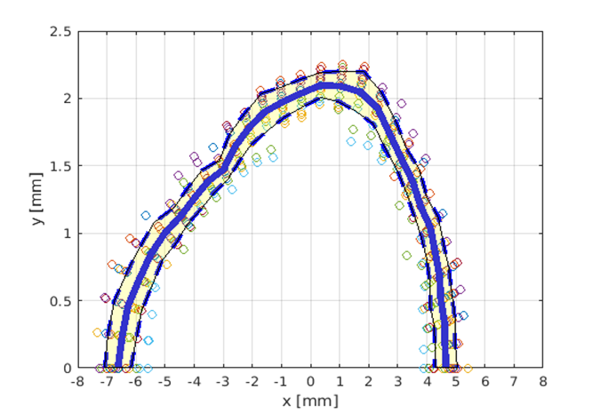
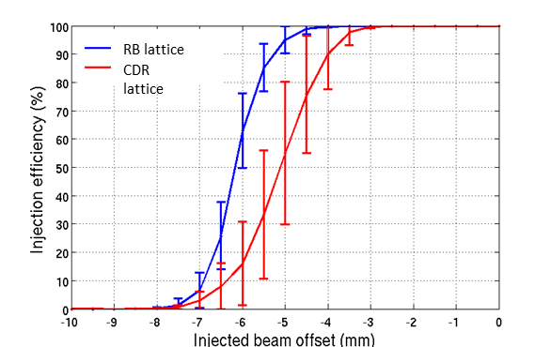
Diamond-II: Dynamic Aperture
Combination of changes improved the performance:
Smaller tune shift with amplitude
Larger on/off momentum DA
Still some impact from strong resonances.
(Working to improve via tune scans and MOGA)
Off-axis accumulation looks feasible, however, maintaining high injection efficiency requires improvements:
Injected beam emittance < 20-30 nm.rad
Injected beam bunch length < 40 ps
New booster forms part of the Diamond-II upgrade plan
(more details in talk on 17/12/2020)
Courtesy H. Ghasem

Slide 14
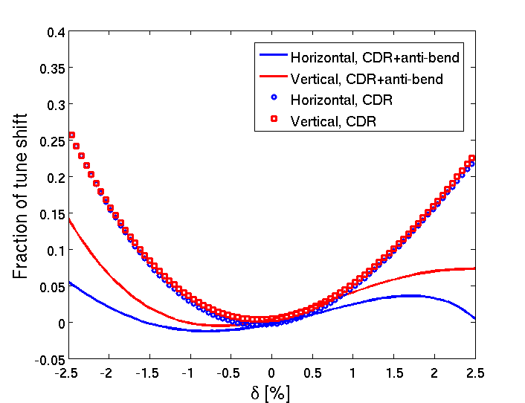
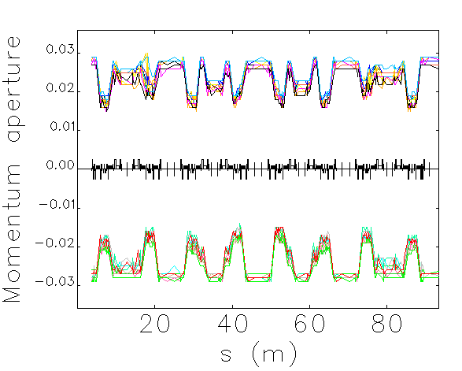
Diamond-II: Lifetime
Reverse bend lattice also has improved lifetime compared to CDR:
Reduced tune-shift with momentum avoids resonances
More robust to errors
(Momentum acceptance reduced in dispersion bumps)
Lifetime calculations assume 300 mA, 900 bunches, ε_{y} = 8 pm.rad
Gas lifetime assumes 100 % CO equivalent pressure of 10⁻⁹ mbar
ΔQ_{x}, RB lattice
ΔQ_{y}, RB lattice
ΔQ_{x}, CDR lattice
ΔQ_{y}, CDR lattice
Component | Lifetime (h)
Coulomb | 37.3
Bremsstrahlung | 72.8
Total gas | 24.7
Touschek (no IDs, no IBS, no 3HC) | 1.6
Touschek (with IDs, with IBS, with 3HC) | 4.8
Overall lifetime | 4.0
Courtesy H. Ghasem

Slide 15
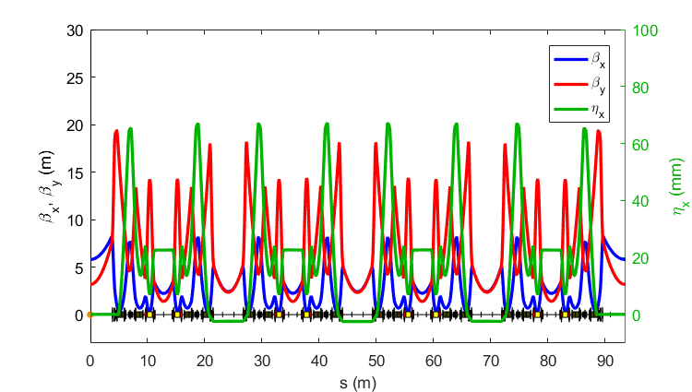
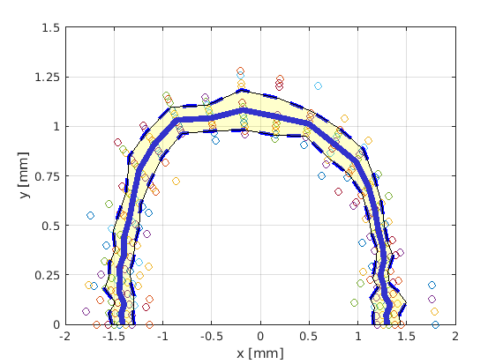
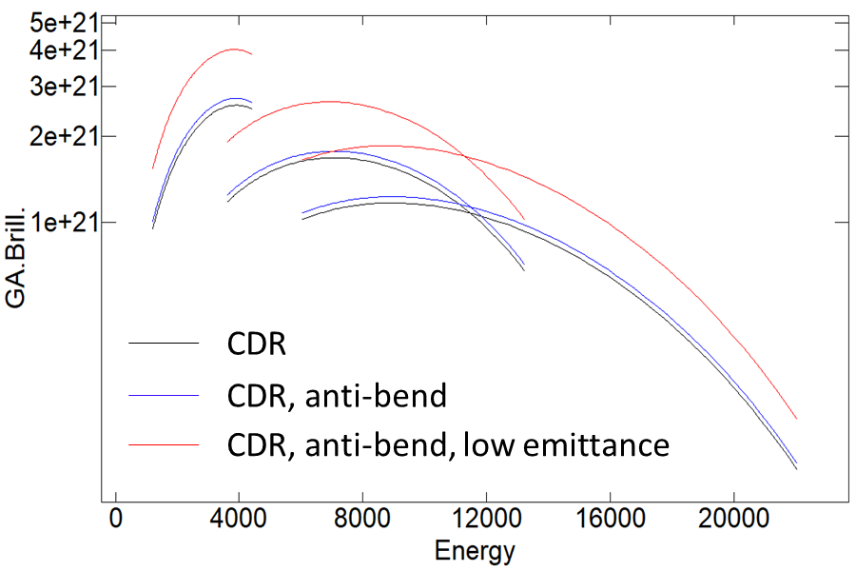
Diamond-II: High-Brightness Mode
Future ‘brightness-upgrade’ under consideration:
Use same basic hardware
Source points fixed
Increase horizontal tune to lower emittance
Better phase-space matching at IDs
Can be phased-in after initial commissioning
Storage ring / injector already commissioned
Challenges:
Would require on-axis injection (SB only)
Reverse bend quads need to be re-aligned
Shorter lifetime / frequent injection
Increased sensitivity to beam motion
1.5 m CPMU in MSS
(λ_{u} = 17.6 mm)
Brilliance [ph/s/mrad²/mm²/0.1%BW]
CDR Lattice
RB Lattice
RB Lattice (low emittance)
Energy [eV]
Courtesy H. Ghasem

Slide 16
Diamond-II: Parameters
Parameter | Units | CDR Lattice | Off-axis RB Lattice | On-axis RB Lattice
Betatron tunes |  | [57.16, 20.25] | [54.16, 20.29] | [62.16, 20.31]
Natural chromaticity |  | [-75.7, -89.7] | [-67.8, -91.2] | [-89.3, -110.3]
Momentum compaction factor |  | 1.2×10⁻⁴ | 1.1×10⁻⁴ | 1.0×10⁻⁴
Energy Loss per turn (with/without IDs) | MeV | 0.67 / 1.71 | 0.72/1.76 | 0.72 / 1.76
τ_{x}, τ_{y}, τ_{E} (without IDs) | ms | 14.2, 19.5, 12.0 | 9.5, 18.1, 16.4 | 9.9, 18.1, 15.5
τ_{x}, τ_{y}, τ_{E} (with IDs) | ms | 6.7, 7.7, 4.1 | 5.4, 7.4, 4.6 | 5.5, 7.4, 4.8
β_{x}, β_{y}, η_{x} (long straights) | m, m, cm | 8.4, 4.4, 0 | 8.0, 3.1, 0.6 | 5.8, 3.2, 0
β_{x}, β_{y}, η_{x} (standard straights) | m, m, cm | 5.7, 2.1, 0 | 5.3,2.2,0.05 | 2.4, 2.4, 0
β_{x}, β_{y}, η_{x} (mid straights) | m, m, cm | 2.2, 1.9, 2.5 | 2.3, 1.6, 2.2 | 2.2, 1.4, 2.3
Emittance (bare lattice) | pm.rad | 157 | 159 | 111
Energy spread (bare lattice) | % | 0.08 | 0.09 | 0.09
Bunch length (bare lattice) | mm | 3.5 | 3.8 | 3.9
Emittance (with IDs, IBS, 3HC) | pm.rad | 147 | 136 | 110
Energy spread (with IDs, IBS, 3HC) | % | 0.10 | 0.11 | 0.11
Bunch length (with IDs, IBS, 3HC) | mm | 10.9 | 10.4 | 10.8
Total lifetime (with IDs, IBS, 3HC) | h | 2.9 | 4.0 | 1.7

Slide 17
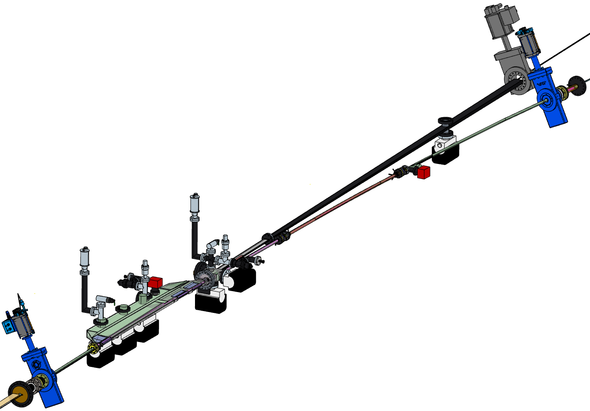

Diamond-II: Vacuum
Requirement: Target average pressure ≤ 10⁻⁹ mbar at 300 mA after 100 A.h beam conditioning
Current solution (WIP)
Vessel cross-section: Mainly circular ($φ$= 20 mm), antechamber in dipole vessels with photon extraction
Pumping: NEG coated apart from antechamber vessels
  Plus discrete ion pumps and NEG cartridge pumps
Heat load management: Mix of discrete and distributed absorbers
Materials/manufacturing: Most vessels copper; antechamber vessels aluminium
  Fully RF-shielded gate valves, flanges and bellows
  NEG coating by industry
Photon beam pipe
RGA ports
Assembly process: Ex-situ bakeout only
  Vacuum strings (~7m) built up, baked out and NEG activated on assembly trolleys
  Under vacuum during installation
RF gate valve
Beam direction →
Dipole
2 and 3 vessels (Cu/NEG)
Crotch 1 absorber (Cu)
Dipole 1 vessel (Al)
Courtesy M. Cox

Slide 18
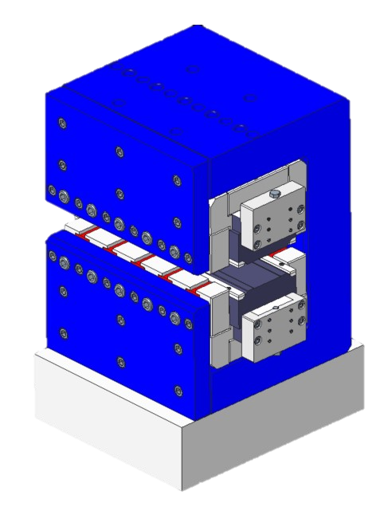
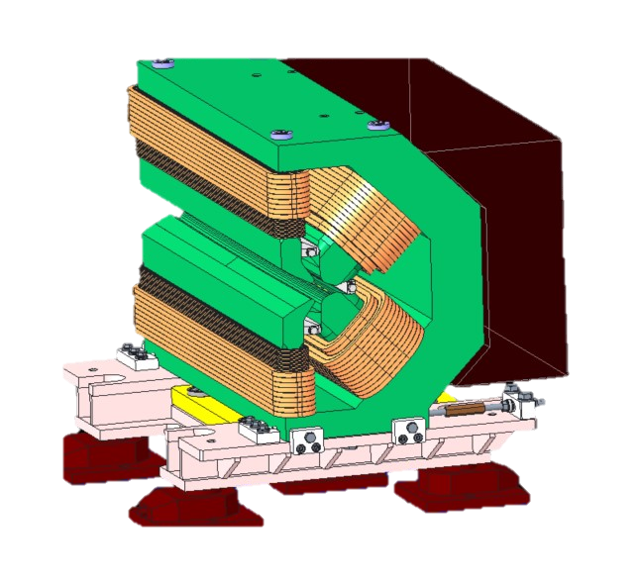
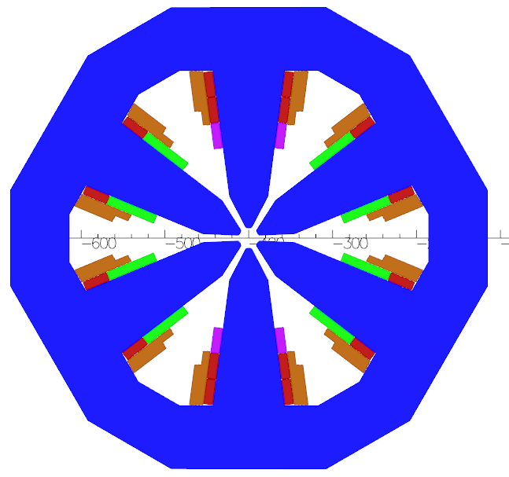
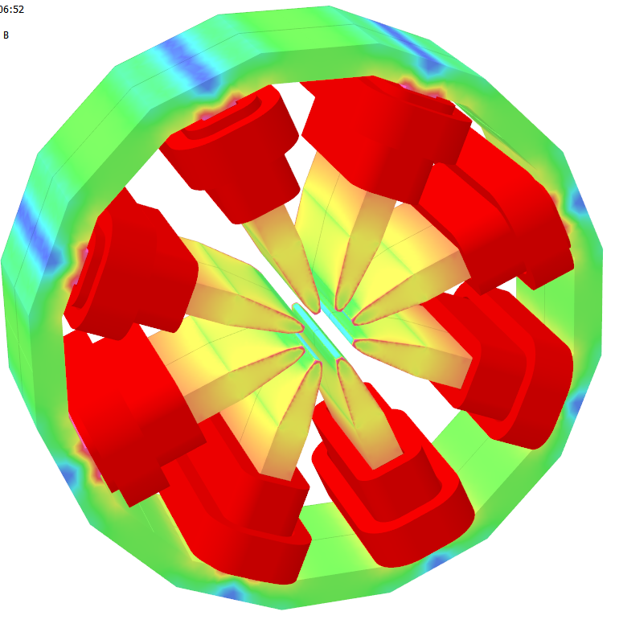
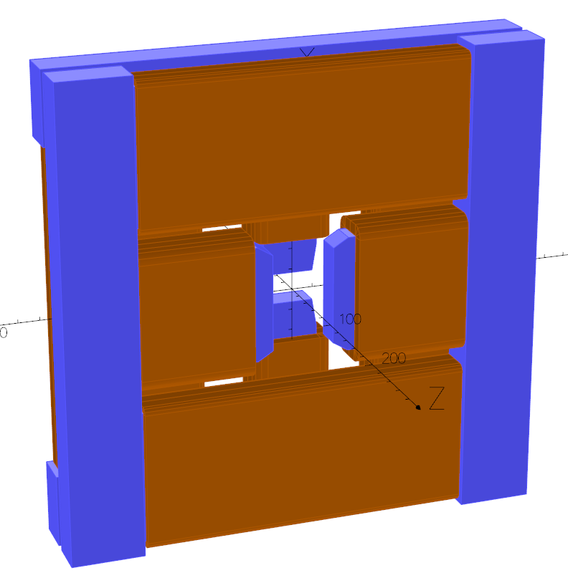
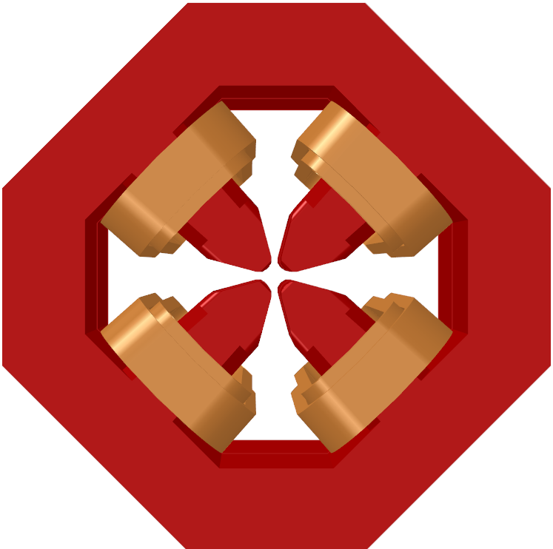
Diamond-II: Magnets
Magnet | Length | Max B₀ | Max G₀ | Max S₀ | Max O₀ | # Magnets | # Families | Type
 | [m] | [T] | [T/m] | [T/m²] | [T/m³]
DL dipole | 1 | 0.29 to 0.76 | - | - | - | 96 | 1 | Permanent Magnet
DQ dipole | 0.87 | 0.695 | -32.32 | - | - | 48 | 1 | Electro-Magnet
Quadrupole | 0.105-0.36 | - | 85 | - | - | 396 | 13 | Electro-Magnet
Sextupole* | 0.1-0.14 | - | - | 3850 | - | 288 | 6 | Electro-Magnet
Octupole | 0.09 | - | - | - | 110300 | 48 | 1 | Electro-Magnet
Slow Corrector | 0.08 | 0.15 | - | - | - | 12 | 1 | Electro-Magnet
Fast Corrector | 0.025 | 0.01 | - | - | - | 144 | 1 | Electro-Magnet
*Sextupoles contain additional horizonal/vertical corrector and skew quadrupole windings
DL Dipole
DQ Dipole
Quadrupole
Sextupole
Octupole
Slow corrector
Courtesy A. Shahveh

Slide 19
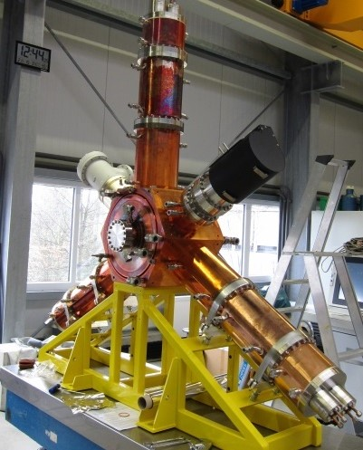
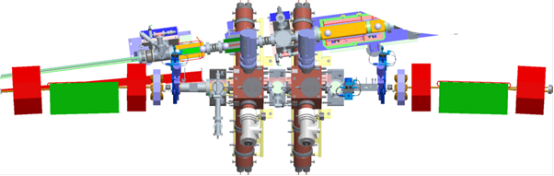
Diamond-II: RF
Use HOM-damped normal-conducting cavities (500 MHz):
  More robust and more easily repaired than superconducting cavities
  Releases current long RF straight for a new flagship beamline ID
  Broader frequency tuning range allows Diamond-I NC cavities to be used in Diamond-II
  Latest iteration of cavities used in BESSY, ALBA and ESRF (scaled for frequency)
  Smaller footprint than superconducting cavities in cryostats
  Effective HOM-damping has been demonstrated in Diamond-I
Eight RF cavities arranged in pairs in mid-section straights:
  Multiple low-voltage cavities gives lower wall losses
  Use of multiple cavities introduces redundancy of operation
Courtesy C. Christou

Slide 20
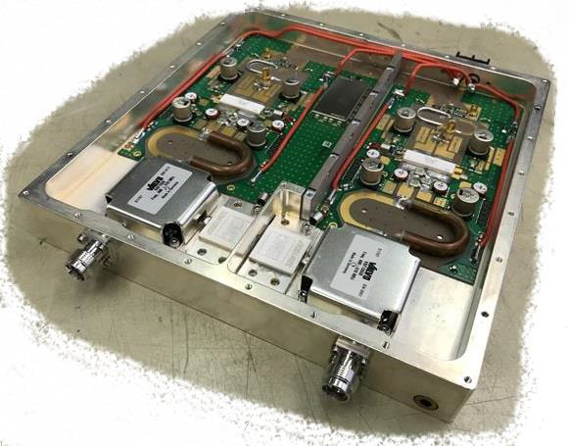
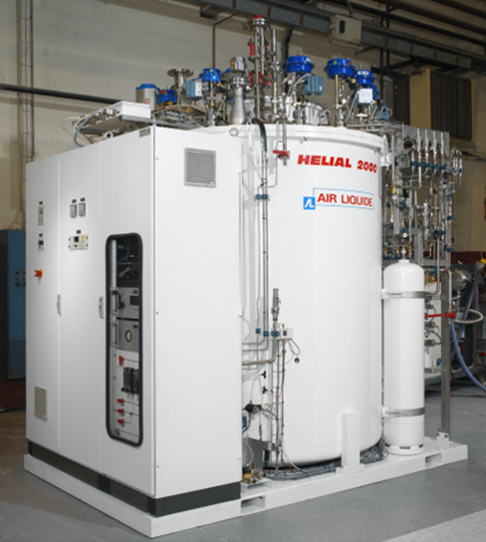
Diamond-II: RF
Amplifiers
Each cavity powered by single solid state amplifier
  100 kW amplifier many 800 W power transistors
  Redundancy ensures continuity of operation
  Several commercial suppliers exist
Amplifier/cavity operation regulated by digital LLRF
  IQ or polar PI loops for cavity ampl./phase
  Based on the MicroTCA standard
  Digital (functionality can be added as required)
  Based on system developed at ALBA
Higher harmonic cavity
  Minimise storage ring heating
  Alleviate collective instabilities
  Maximise beam lifetime
Passive superconducting HHC
  Needs no new amplifier
  Operates across all beam currents
  Can fit in mid-section straight
  Available from industry (CEA design: SLS, Elettra)
Can use the existing Diamond-I cryogenic plant
Courtesy C. Christou

Slide 21
Diamond-II: Nominal Timeline (TBC)
Event | Date
CDR Published | May 2019
1st MAC | Feb. 2020
UKRI International Accelerator Committee project review | Nov. 2020
2nd MAC | Jan. 2021
UKRI decision from Board | Jan. 2021
Decision from Wellcome Trust on grant application | Feb. 2021
Submit Outline Business Case to BEIS | Mar. 2021
Draft TDR reviewed by MAC and SAC | Dec. 2021
Final TDR published | Dec. 2021
CD-2 (UKRI) | Jan. 2022
Submit Final Business Case to BEIS | Feb. 2022
Start of funding and procurement | Apr. 2022
Start of shutdown | Dec. 2025
Resume full User Mode | Jun. 2027

Slide 22
Conclusions
Diamond-I:
Main impact of Covid-19 was in a reduction of user hours and shift to remote working
Majority of staff continue to work from home, with site visits requiring approval in advance
Small number of staff still based on-site where remote working not possible / detrimental
Upgrades and installation has largely continued unaffected by the pandemic
No sign of impact of Covid-19 on operating performance (MTBF, MTTR, etc)
Diamond-II:
Optimisation of the Diamond-II lattice is on-going. Aiming to freeze the hardware in the next 1-2 months to allow finalisation of engineering, vacuum and magnet designs
Still some work to do on the optics; this in turn impacts other studies (commissioning, collective effects, …)
Staged upgrade looks attractive and feasible:
standard off-axis injection to allow injector and storage ring to be commissioned and characterised
injection with nonlinear kicker and single-bunch kickers for transparent injection
shift to high-brightness / on-axis injection lattice once performance established

Slide 23
Extra Slides

Slide 24
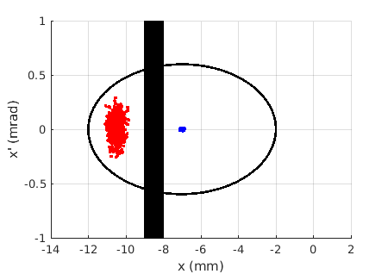
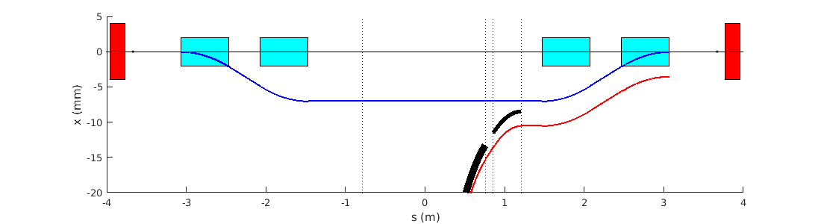
Diamond-II: Injection
Baseline injection scheme:
standard 4 dipole kicker bump (6 μsec, half-sine pulses)
allows single-shot, on-axis injection for initial commissioning
off-axis accumulation possible by reducing amplitude of bump
compatible with both multi-bunch or single bunch injection
combination of thick (3 mm) / thin (1 mm) septum magnets
allows ~3.5 mm beam separation at injection point
3.5 mm beam separation
5 mm dynamic acceptance
Dipole kickers:
L = 0.6 m
θ = 7.0 mrad
B = 0.14 T
Main septum:
L = 0.155 m
θ = 7.5 deg
B = 0.98 T
Thin septum:
L = 0.35 m
θ = 1.0 deg
B = 0.58 T

Slide 25
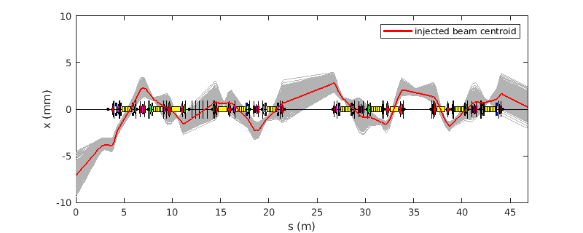
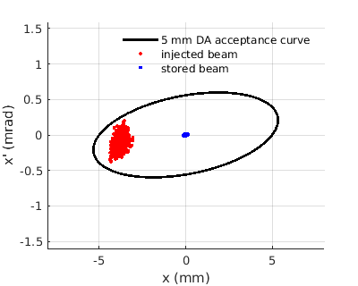
Diamond-II: Injection
Alternative injection scheme under consideration (stage 2: off axis injection with nonlinear kicker):
Thick/thin septum magnets moved to upstream end of straight
Injected beam exits septum magnet at ~ -8.5 mm
One (or more) nonlinear kickers at downstream end (reduces disturbance during top-up)
Injected beam must be matched to slope of NLK field for high injection efficiency
Nonlinear kicker: θ_{NLK} ~ 1.0 to 1.5 mrad
x_{beam} ~ -3.5 to -4 mm

Slide 26
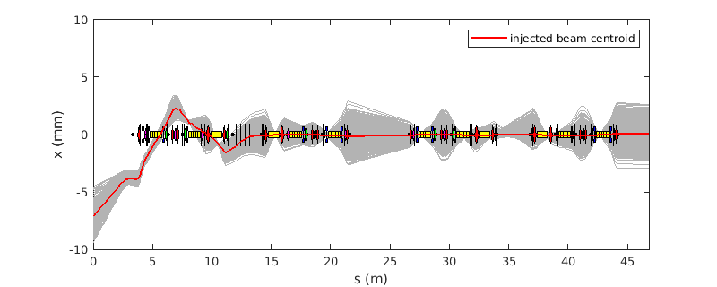
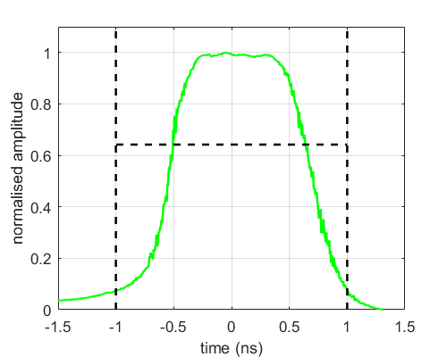
Diamond-II: Injection
Alternative injection scheme under consideration (stage 3: on-axis injection):
Combination of thick/thin septum magnets and nonlinear kicker remain unchanged
Single bunch stripline kickers added in downstream mid-straight section
Could enable single-bunch swap out injection
Oscillations could be shared between stored / injected bunches to avoid losing stored bunch
±20 kV / 2 ns pulsers with 5×0.3 m long striplines (8 mm half-gap) looks sufficient
FID GmbH:
2 ns (0-0)
±20-30 kV
SB kickers: θ_{SBK} ~ 0.2 - 0.25 mrad

Slide 27
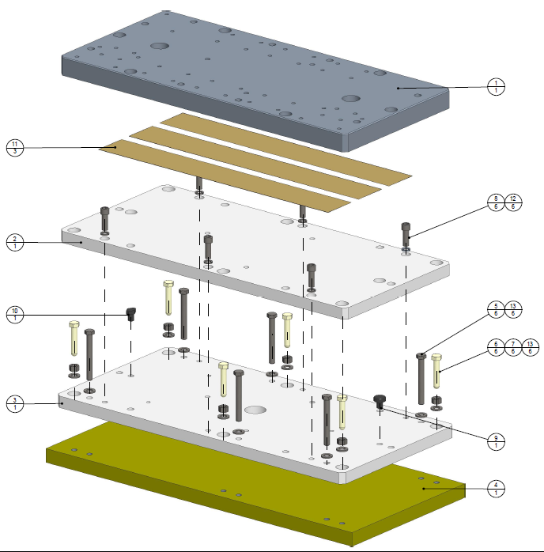
Diamond-II: Girders
Girder design work is on-going.
Present solution:
Magnets to be supported on single girder per half-cell (~8 m long)
Manual adjustment system (screw-thread adjustment in each plane))
Aim to achieve overall transmissibility of ~1 in 1-100 Hz band
Electron beam is most sensitive to vertical girder motion
Use viscoelastic tape in baseplates
  stiff at high frequency to reduce transmissibility
  Soft at low frequencies to allow expansion and contraction
Choice of material from trial girders
  steel fabrication (same as existing girders, good stiffness)
  cast grey iron (better damping properties, easy to produce, cost-effective)
  carbon composite (lightweight, high natural frequency, expensive)
Test girders will inform final choice of material and support system (in progress).
Courtesy J. Dymoke Bradshaw

Slide 28
Diamond-II: IDs
ID |  | Period (mm) | N | L (m) | Gap (mm) | B (T) | K | Emin1 | Emin3 | Diamond-II energy range (keV) | Ptot (kW)
I24 | CPMU-1 | 17.6 | 113 | 2 | 4 | 1.4 | 2.30 | 1.81 | 5.44 | 5-30 | 9.06
I03 | CPMU-2 | 17.6 | 113 | 2 | 4 | 1.4 | 2.30 | 1.81 | 5.44 | 5-30 | 9.06
I11 | SCU-1 | 15.6 | 128 | 2 | 4 | 1.2 | 1.75 | 2.95 | 8.85 | 9-35 | 6.68
I14 | CPMU-3 | 17.6 | 113 | 2 | 4 | 1.36 | 2.24 | 1.89 | 5.67 | 5-25 | 8.55
I04 | CPMU-4 | 17.6 | 113 | 2 | 4 | 1.4 | 2.30 | 1.81 | 5.44 | 6-30 | 9.06
J02 (VMXm) | CPMU-5* | 17.6 | 113 | 2 | 4 | 1.4 | 2.30 | 1.81 | 5.44 | 5-30 | 9.06
K04 (I04.1) | HPMU-1 | 19.7 | 76 | 1.5 | 4 | 1.2 | 2.21 | 1.72 | 5.15 | 10-25 | 5.01
I05 | APPLEIIK-1 | 192 | 26 | 5 | 20 | 0.45 | 8.07 | 0.02 | 0.05 | 0.018-0.24 | 2.35
I13 | CPMU-6 | 20 | 100 | 2 | 6.4 | 1.04 | 1.94 | 2.01 | 6.04 | 5-25 | 5.03
K02 (VMXm) | HPMU-2 | 17.6 | 85 | 1.5 | 4 | 1.1 | 1.81 | 2.51 | 7.53 | 5-30 | 4.21
J13 | HPMU-3 | 22.6 | 119 | 2.7 | 5 | 0.97 | 2.05 | 1.66 | 4.99 | 6-38 | 5.88
I09 | HPMU-4 | 25.3 | 79 | 2 | 6.4 | 1.06 | 2.50 | 1.11 | 3.33 | 2.1-18 | 5.22
K21 | HPMU-5 | 18.7 | 80 | 1.5 | 4 | 1.17 | 2.05 | 2.00 | 6.00 | 6-14.5 | 4.80
K16 | HPMU-6 | 18.7 | 80 | 1.5 | 4 | 1.17 | 2.05 | 2.00 | 6.00 | 6-14.5 | 4.80
I06 | APPLEII-1 Segmented? | 56 | 29 | 3.5 | 12.5 | 0.73 | 3.82 | 0.25 | 0.75 | 0.25-2.1 | 2.01
I08 | APPLEII-2 | 56 | 62 | 3.5 | 12.5 | 0.73 | 3.82 | 0.25 | 0.75 | 0.25-4.2 | 4.30
I10 | APPLEII-3 | 48 | 73 | 3.5 | 13.2 | 0.93 | 4.17 | 0.25 | 0.75 | 0.25-1.6 | 7.04
K07 (B07-2) | APPLEII-4 | 80 | 22.5 | 1.8 | 12.5 | 1.09 | 8.14 | 0.04 | 0.13 | 0.25-5.0 | 4.97
I18 |  | 19.5 | 102 | 2 | 4 | 1.21 | 2.20 | 1.74 | 5.22 | 2-27 | 6.77
I19 |  | 18.7 | 106 | 2 | 4 | 1.17 | 2.04 | 2.01 | 6.04 | 6-35 | 6.31
I02 (VMXi) | CPMU-5* | 17.6 | 113 | 2 | 4 | 1.36 | 2.24 | 1.89 | 5.67 | 5-30 | 8.55
I22 | HPMU-7 | 18.7 | 106 | 2 | 4 | 1.17 | 2.04 | 2.01 | 6.04 | 6-30 | 6.31
D-I upgrade
D-II operations
D-II science
D-II future
Courtesy S. Milward

Slide 29
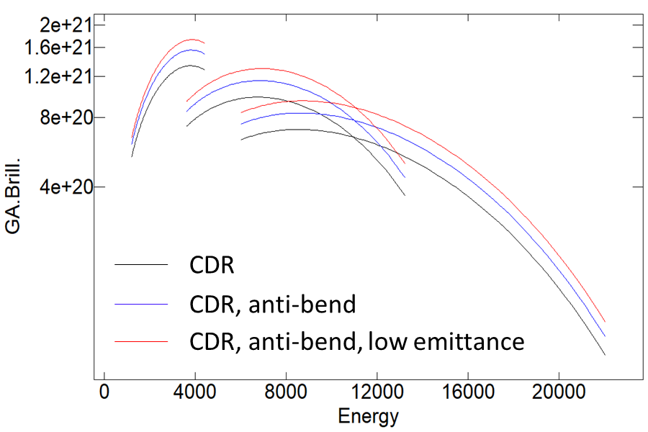
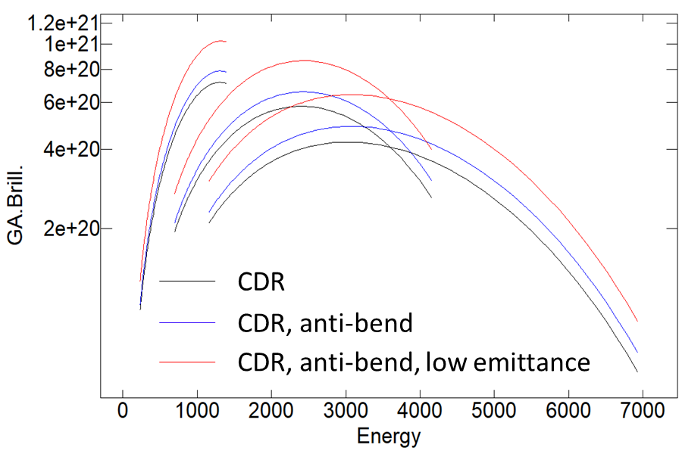
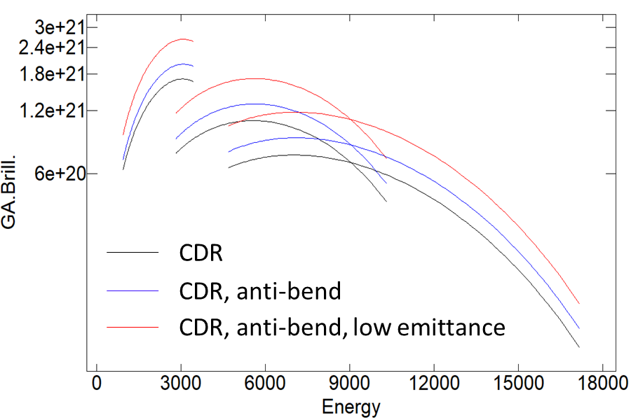
Diamond-II: Brightness
2 m CPMU in SSS
(λ_{u} = 17.6 mm)
1.5 m CPMU in MSS
(λ_{u} = 17.6 mm)
Brilliance [ph/s/mrad²/mm²/0.1%BW]
Brilliance [ph/s/mrad²/mm²/0.1%BW]
CDR Lattice
RB Lattice
RB Lattice (low emittance)
CDR Lattice
RB Lattice
RB Lattice (low emittance)
Energy [eV]
Energy [eV]
5 m APPLE-II in LSS
(λ_{u} = 56 mm)
2.7 m HPMU in LSS
(λ_{u} = 22.6 mm)
Brilliance [ph/s/mrad²/mm²/0.1%BW]
Brilliance [ph/s/mrad²/mm²/0.1%BW]
CDR Lattice
RB Lattice
RB Lattice (low emittance)
CDR Lattice
RB Lattice
RB Lattice (low emittance)
Energy [eV]
Energy [eV]
Courtesy H. Ghasem

