Slide 1
SLS status & upgrade
- On behalf of SLS operations and the SLS 2.0 upgrade team
Jonas Kallestrup :: Paul Scherrer Institute
European Synchrotron Light Source workshop 2020

Slide 2
Content
SLS Operation 2020
PSI / SLS covid-19 response
Injector revamp
SLS 2.0 upgrade highlights

Slide 3
COVID-19 crisis at the SLS
On 16. March the Swiss government closed the borders
External users could not perform experiments at PSI
PROSCAN (proton therapy) and SLS had to continue operation:
  Patient treatment in tumour therapy could not stop
  SLS asked special call for COVID-19 research experiments
  No external users -> no demand for seven-day-operation
SLS switch to five-day-operation (Mid of March to end of May):
  Monday 7am start-up, 9:00 to 15:00 warm-up 400 mA
  Monday 15:00 to Tuesday 15:00 beamline set-up
  Tuesday 15:00 to Saturday 5:00 user operation
Worked very well: stable beam, happy users.

Slide 4
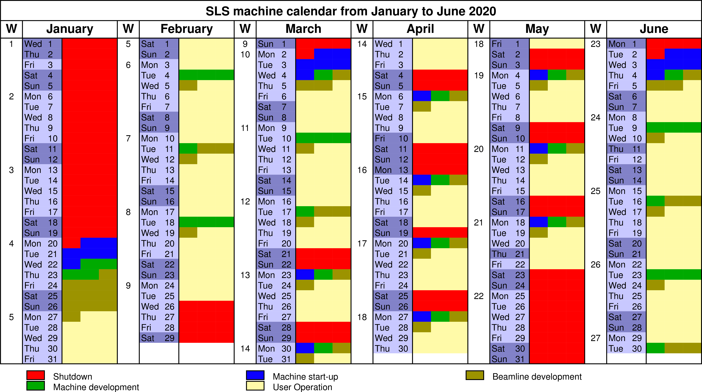
Adapted SLS schedule for COVID-19 crisis
Total user operation in 2020 will be reduced from 5000 h to 4672 h
Covid-19 only caused operational changes for 2.5 month

Slide 5
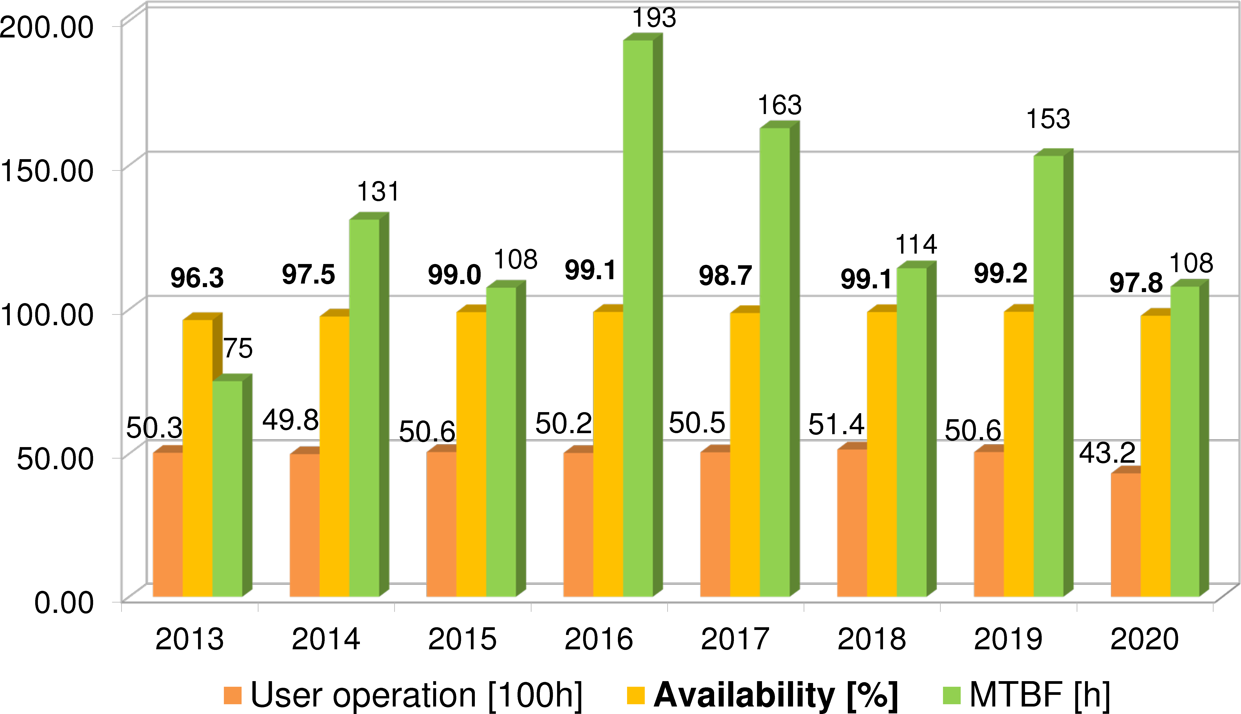
SLS Operation Statistics (up to 7. Dec. 2020)
Overall 2020 was still a good year
Dominating event: 30 h outage (>30%) from Linac RF, consequence of broken window

Slide 6
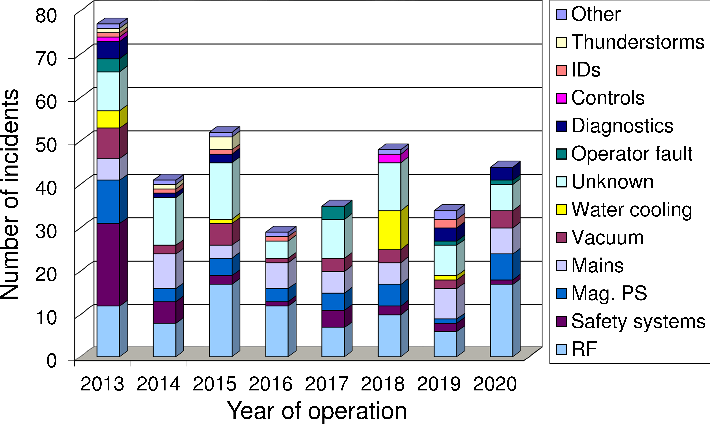
Number of beam outages by causes

Slide 7
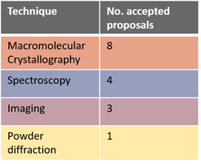

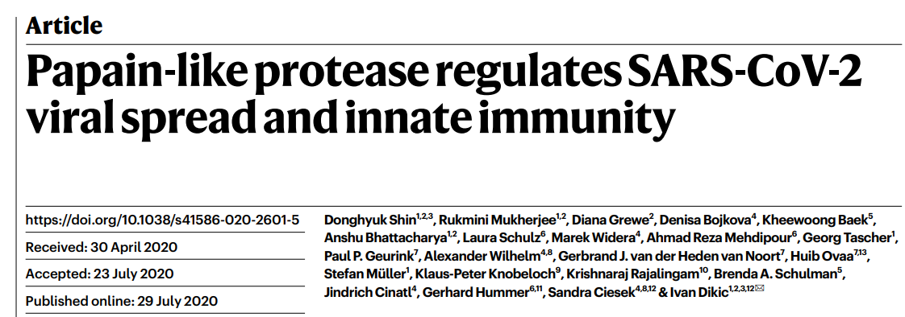
Priority covid-19 call
Modest number of proposals
  16 accepted proposals as of mid November
  50% within protein crystallography
Using the PXI beam line
https://doi.org/10.1038/s41586-020-2601-5
Courtesy of Oliver Bunk

Slide 8
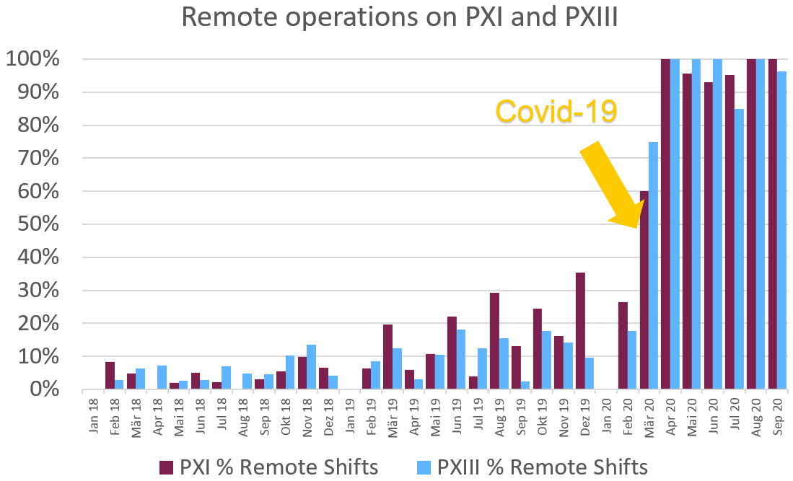
Challenges with remote users
Remote user operation has caused logistic problems
  Overwhelming number of packages received and sent.
  Non-trivial customs procedures, extensive paperwork etc…
  No common logistic handling
  ➔ beamline groups must hold the extra work load
  Large fraction of experiments expected to be remote even post-covid
Solution must be found!
Courtesy of Oliver Bunk

Slide 9
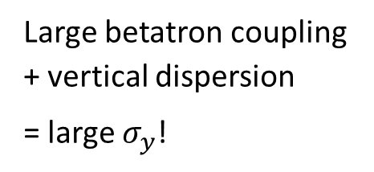
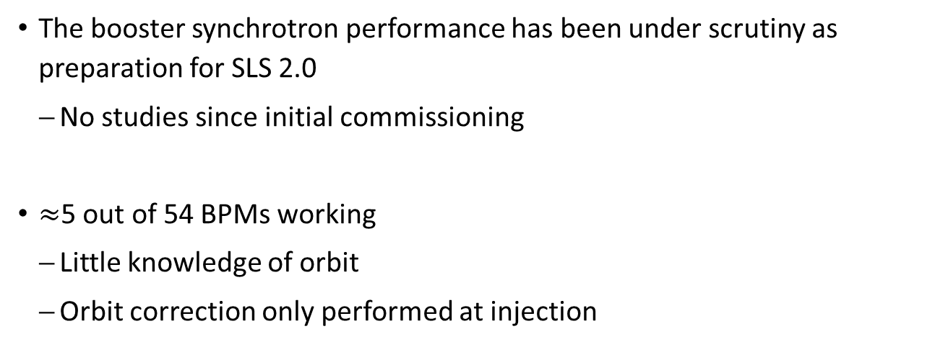
Injector revamp
The booster synchrotron performance has been under scrutiny as preparation for SLS 2.0
  No studies since initial commissioning
$≈$5 out of 54 BPMs working
  Little knowledge of orbit
  Orbit correction only performed at injection
Vertical orbit offsets in sextupoles create skew quadrupole
  18 regular sextupoles
  93 dipoles with sextupole gradients
  Large betatron coupling
  + vertical dispersion
  = large $σ_{y}$!

Slide 10
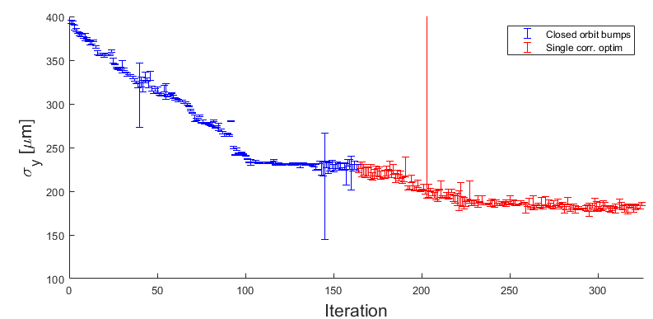
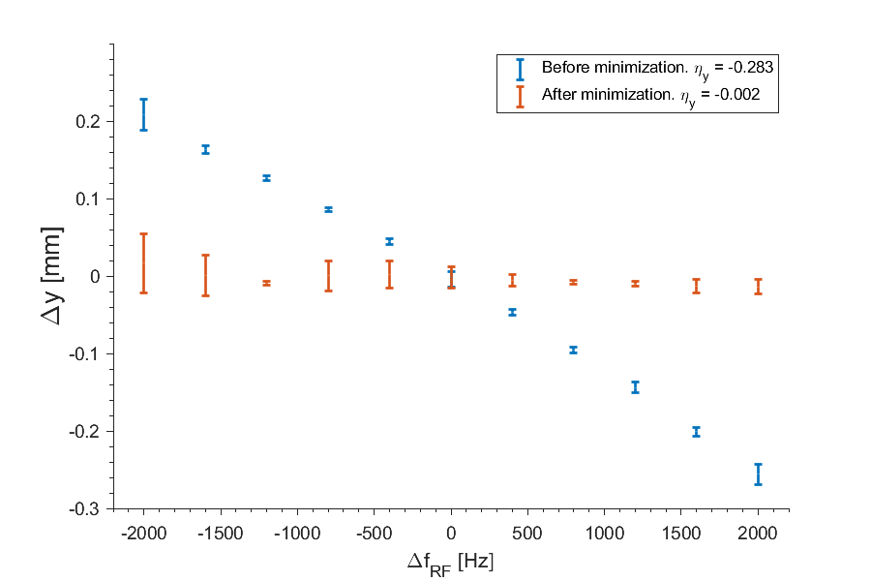


Vertical beam size minimization
      Perform brute-force closed orbit bumps around the booster
      Measure beam size in booster-to-ring transfer line
      If $σ_{y}$ decrease ➔ increase bump amplitude
      Iterate until no improvement
      Follow up by brute-force single corrector adjustments
$$\left|C\right|=0.02→0.002$$
Vertical dispersion measurement
on screen in transfer line
$$≈225 μm$$

Slide 11
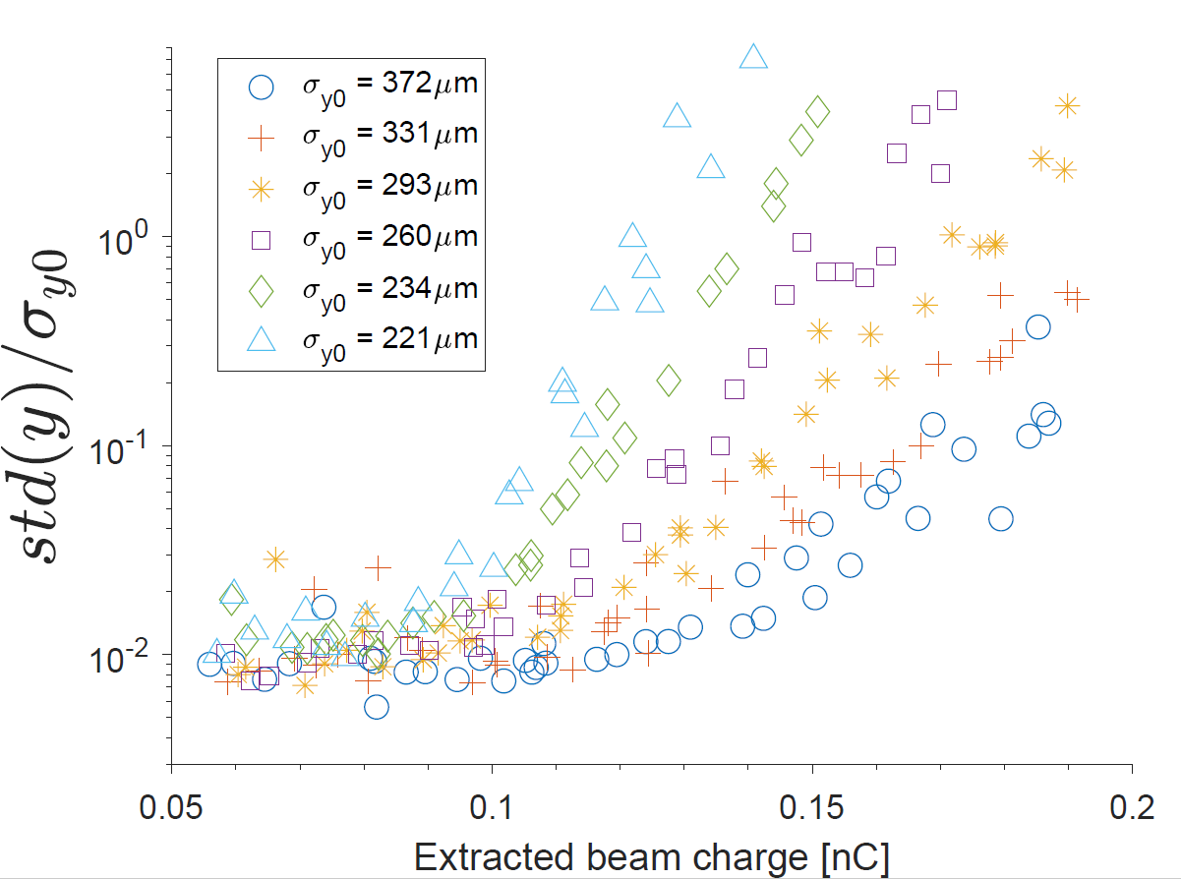
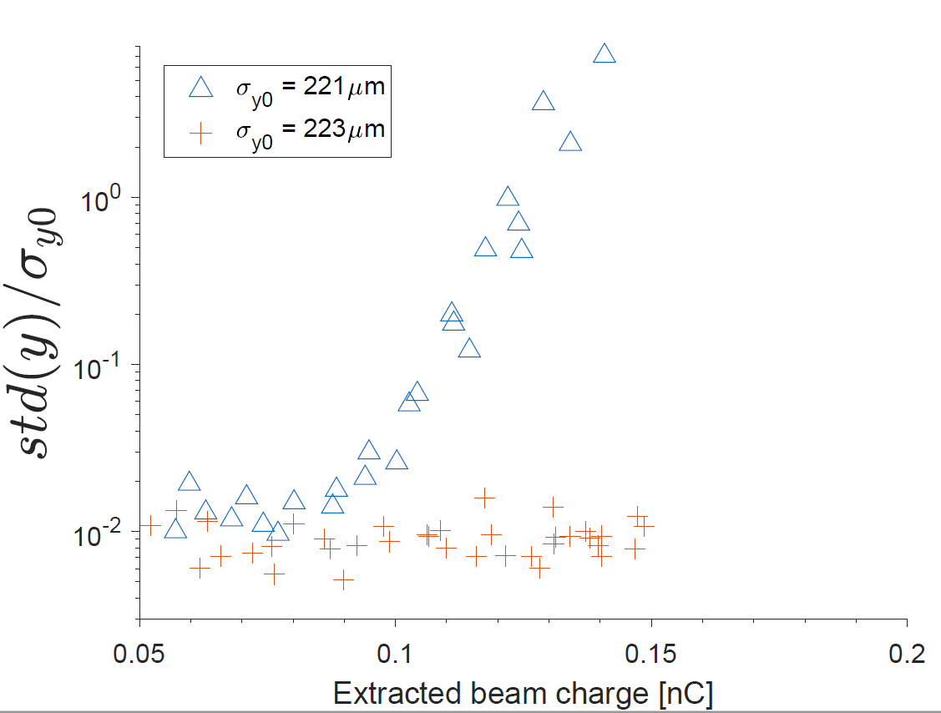
Instability due to negative chromaticity
Decoupling of booster beam provoked on-set of an instability for high charge
  Limits injection rate into storage ring
Chromaticity was measured: (+7.9, -2.1)
expected: (+5, +5)
After adjusting sextupole family: (+5.5, +4.8)
  Instability disappears!
Injection rate increased from
30mA/min ➔ >40 mA/min

Slide 12
SLS 2.0 upgrade highlights
Detailed overview was recently presented by Masamitsu Aiba at
Low Emittance Rings Workshop (26th -30th October 2020)
https://agenda.infn.it/event/20813/overview

Slide 13
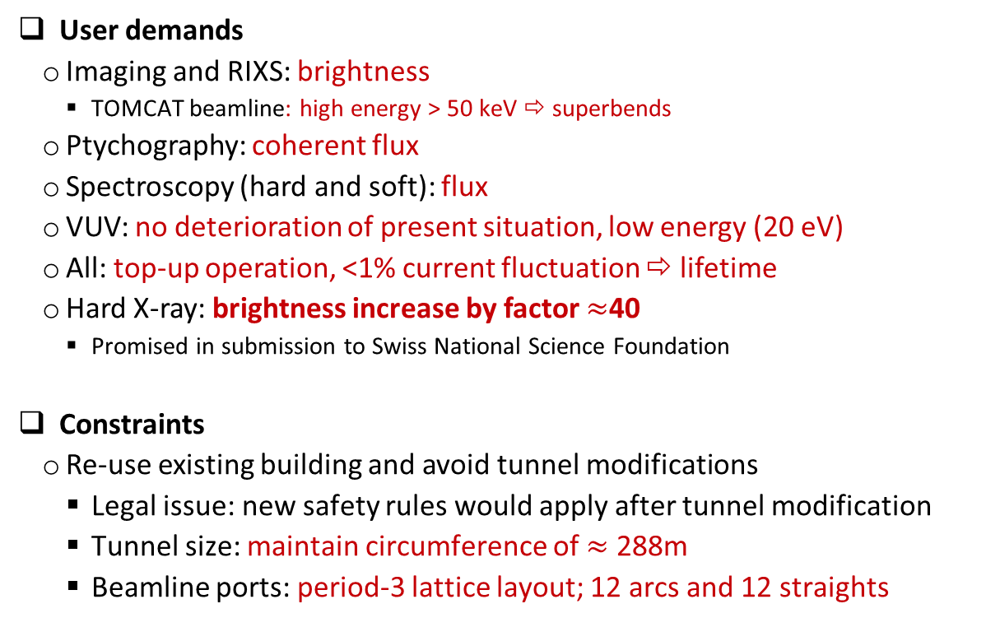
Upgrade: charge
User demands
  Imaging and RIXS: brightness
    TOMCAT beamline: high energy > 50 keV ⇨ superbends
  Ptychography: coherent flux
  Spectroscopy (hard and soft): flux
  VUV: no deterioration of present situation, low energy (20 eV)
  All: top-up operation, <1% current fluctuation ⇨ lifetime
  Hard X-ray: brightness increase by factor $≈$40
    Promised in submission to Swiss National Science Foundation
Constraints
  Re-use existing building and avoid tunnel modifications
    Legal issue: new safety rules would apply after tunnel modification
    Tunnel size: maintain circumference of $≈$ 288m
    Beamline ports: period-3 lattice layout; 12 arcs and 12 straights

Slide 14
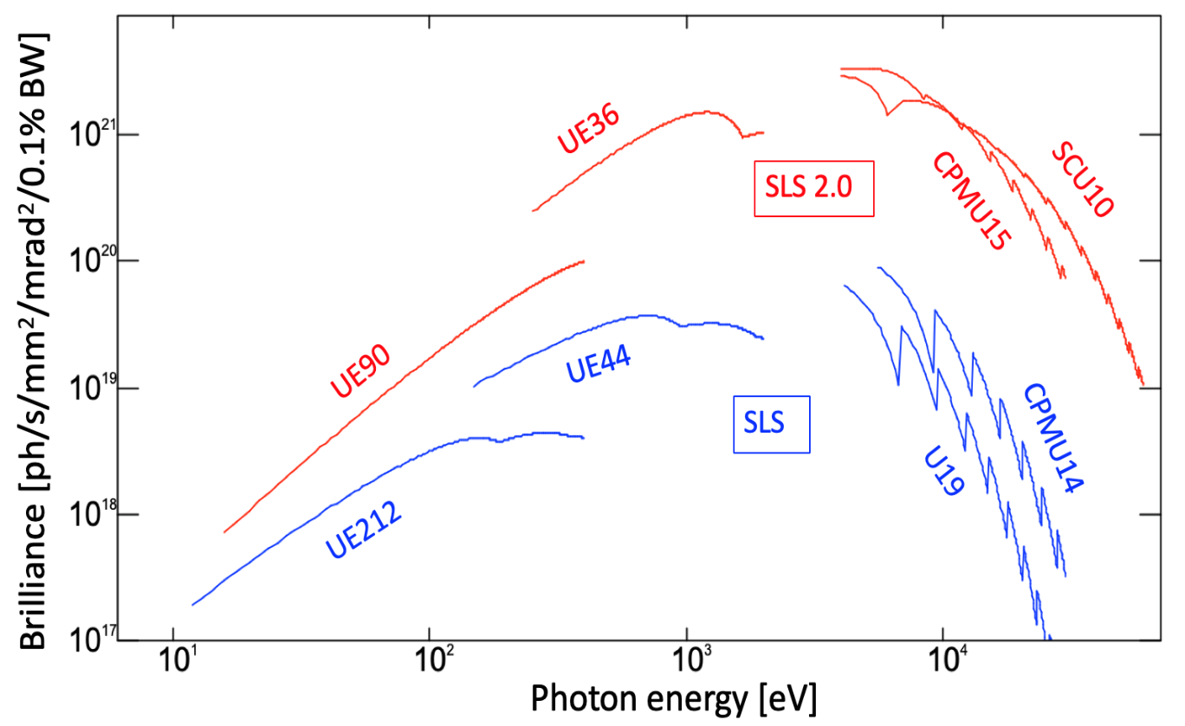
SLS 2.0 brightness:
Factor 40 increase in hard X-ray required
Improvement factor
relative to SLS:
reduced emittance:
× 24 (10...20 keV)
+ higher energy (2.7 GeV):
× 59 (10...20 keV)
+ new undulator
(CPMU15 instead of U19):
× 140 (10 keV) ... 870 (20 keV)
+ upgrade to SCU10:
× >1000 above 20 keV
Superbends for highest photon energies
  SC: 5.0 T and 3.5 T peak
  PM: 2.1 T peak

Slide 15
SLS 2.0 storage ring parameters
Parameters | Values | Remark
Circumference | 288 m | Total absolute bending angle of 430 degree with RB
Beam energy | 2.7 GeV | SLS operation at 2.4 GeV
Nominal beam current | 400 mA | As of SLS
Betatron tunes (H/V) | 39.35/19.22 | Uncorrected chromaticity -99.0 / -33.4
Momentum compaction factor | 1.04x10-4 | Negative alpha lattice abondoned
Natural energy spread | 1146 ppm | 1160 ppm with IBS, 1040 ppm with all IDs
Natural emittance | 157 pm | 161 pm with IBS, 135 pm with all IDs
Damping partition (H/V/L) | 1.82 / 1.0 / 1.18
Damping time | 4.1 / 7.5 / 6.4 ms | 3.6 / 5.8 / 4.3 ms with all IDs
Radiation loss per turn | 689 keV | 900 keV with all IDs
RF frequency | 500 MHz | Passive 3HC in addition to 500 MHz system
Nominal RF voltage | 1.44 MV | RF bucket height -6.2/+4.5%, 1.7 MV with all IDs
Beam lifetime | 11 hours | Ideal lattice with 3HC and 10-9 mbar CO
Number of Superbends | 4 | To be installed after commissioning
Superbend peak field | 5 / 3.5 / 2.1 T | 2.1 T bend with P.M., otherwise superconducting
Total length of straight for IDs | 50 m

Slide 16
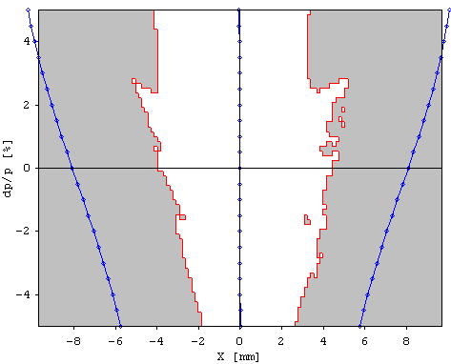
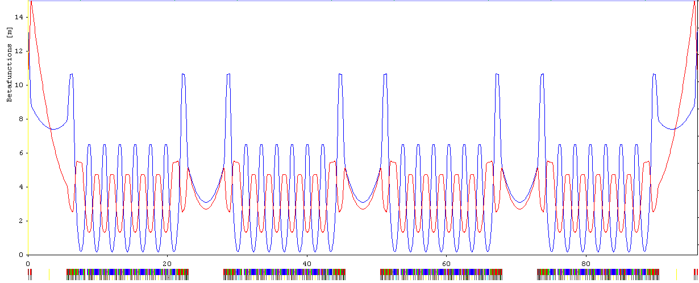
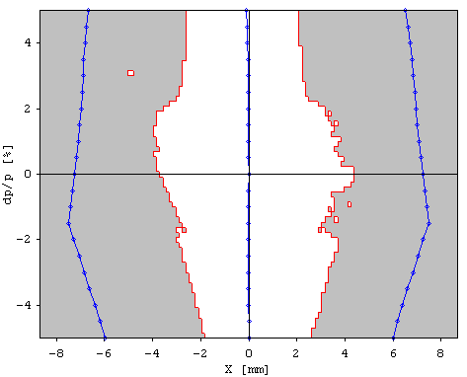
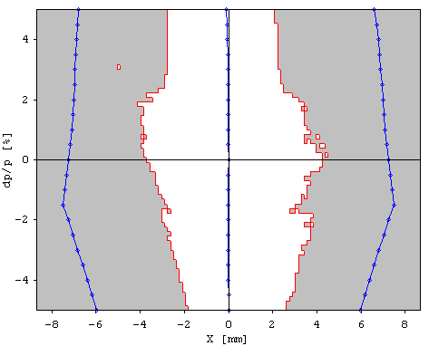
Pseudo symmetry
DA vs dp/p ±5%
@ βx=2.95 m
Beta function, 1/3 of ring
Second half of
matching section
+ half straight section
Second half of
matching section
+ half straight section
S.P.=12
P.S.P.=12
S.P.=3
P.S.P.=12
Achromat +
2 x First half of
matching section
S.P.=1
P.S.P.=12
Identical achromat arc + first half of matching section
Second half of matching section (sextupole free) can be different but with the identical phase advance in H and V for 2x matching section + straight section

Slide 17
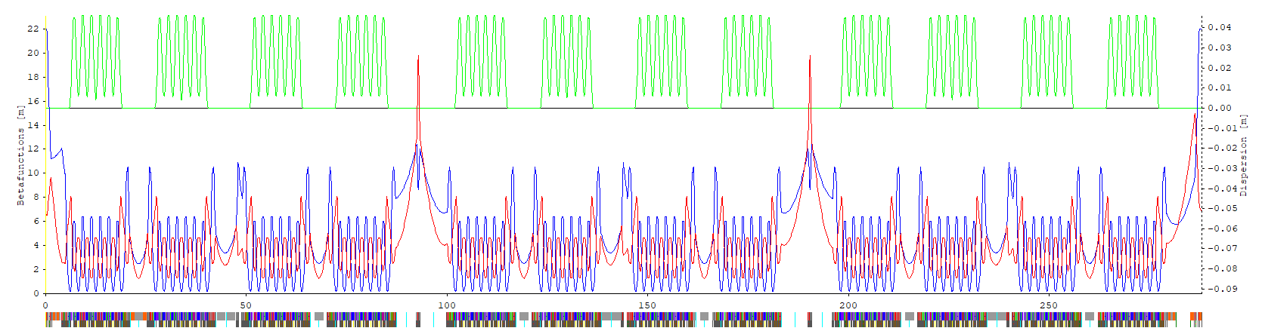
Full ring
LGB+RB unit cell
Three types of straight section: 3x long, 3x medium, 6x short
  All straights with same H/V phase advance
Large number of magnets, 1150
  Flexibility in optics correction and vertical emittance control

Slide 18
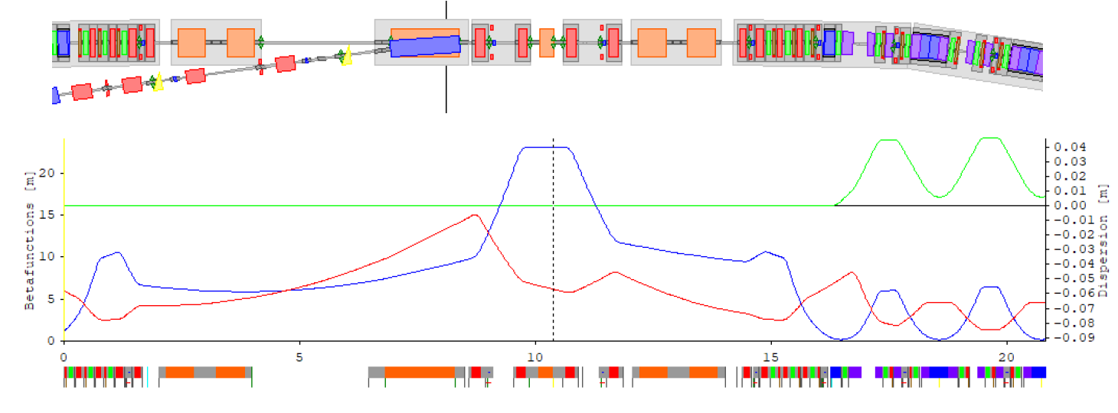
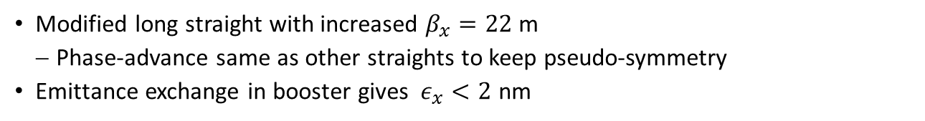
Injection: horizontal kicker-bump => aperture sharing
Modified long straight with increased $β_{x}=22$ m
  Phase-advance same as other straights to keep pseudo-symmetry
Emittance exchange in booster gives $ε_{x}<2$ nm
K1
K2
K3
K4
Thick septum
Thin septum
Injection elements
4 bump kickers (re-use)
Thick septum
Thin septum (1 mm)
4 large aperture quadrupoles (re-use)
Fast kicker for aperture sharing / on-axis injection in 2. straight

Slide 19
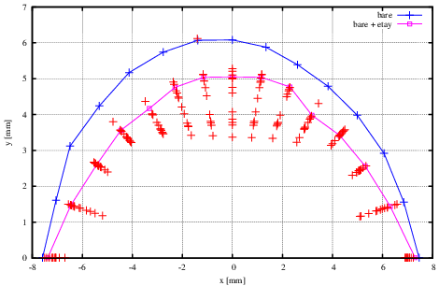
Dynamic aperture
DA of ideal lattice,
i.e. no errors
DA of ideal lattice with skew quads set for 10 pm of vertical emittance
DA with error settings and optics corrections, 12 seeds
Tracy-3 6D-tracking, 4096 turns
Silhouette of ∅ 18 mm beam pipe (approx.)
Silhouette of beam pipe including insertion devices
Injection septum (1 mm)
Injected beam (3σ, approx.)
+ ++
β_{x} = 22 m
β_{y} = 6.7 m
+ ++
+ ++
Error setting and correction scenario
Misalignments: 60/20/30 μm, cut 2σ
girders/inter-girder/element-girder
Beam based alignment, 5 μm
Orbit correction, 18 bit
Optics correction, Δβ/β ∼ 0.5%
Tune correction
2 iterations
Systematic multipoles from magnet design

Slide 20
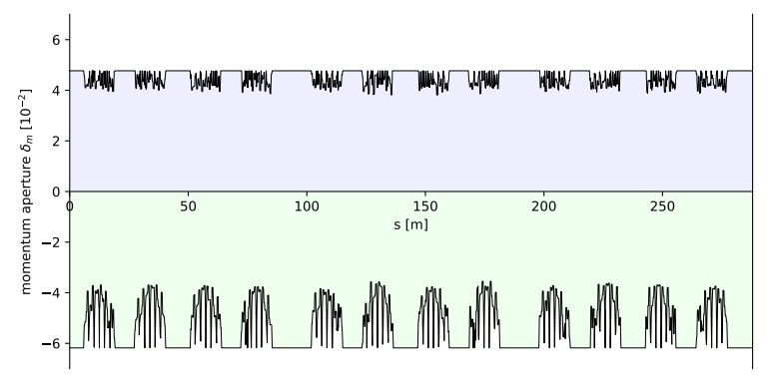
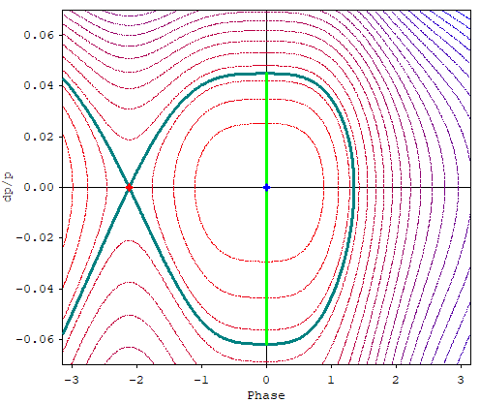
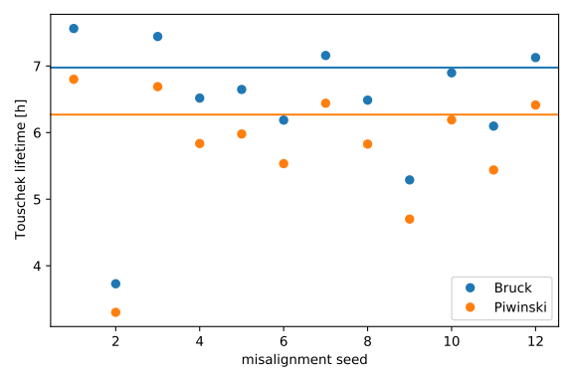
Beam Lifetime
Local momentum acceptance
for Touschek particles
Ideal lattice with 10 pm vert. emit.
Tracy-3 6D-tracking, 1200 turns
without 3rd harmonic cavity
12 errors seeds
lifetime models Bruck/Piwinski
RF-bucket
with 3rdHC
1440 kV
+ 375 kV
Acceptance
−6.2 / +4.5 %
Solid lines = ideal & 10 pm v.e.
6.98 h
6.27 h
3.73 h
3.30 h
Total Lifetime with 3rd harmonic cavity
and 10⁻⁹ mbar residual gas (CO):
11 hrs (ideal & 10 pm) [7 hrs for the bad seed]
9½ hrs with insertion devices
one bad seed → recovery
by tune adjustment

Slide 21
Upgrade status & outlook
Technical design report under preparation
  More details on lattice in technical reports
  https://ados.web.psi.ch/SLS2/Notes/?C=M;O=D
Prototyping going on (magnets, girders etc.)
Minor lattice modifications due to technical issues
  iterations between technical groups and beam dynamics
  but no change of specifications, lattice layout, source point positions etc.
Dec. 18, 2020: possible decision on funding in parliament
Installation planned for Oct. 2023 – Dec. 2024
  Commissioning and start of user operation first half 2025

Slide 22
Thank you for your attention!

Slide 23
Extra slides

Slide 24
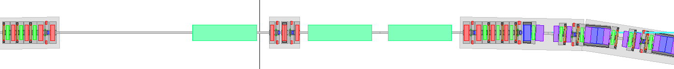
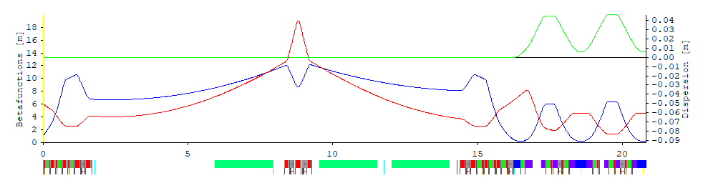
Long straights
center triplet for [asymmetric] split and to “simulate” 12-fold symmetry
Straight 1L: Injection (next slides)
Straight 5L: 4x RF cavities, triplet, 2x ID
Straight 9L: 3rd HC, ID, triplet, 2x ID
Gross / net length:
12.71 m / 5.00 + 6.56 m

Slide 25
Collective effects
Only uniform filling planned
 | Threshold | Remark
Ion instability | 10-bucket gap out of 480 | Nominal filling is 20-backet gap
Longitudinal MWI | 2.2 mA | 6.5 mA with 3HC cavity
Head-tail (TMCI) | 4 mA | With 3HC and chromaticity=1.5
Coupled bunch instability | Under study | HOM damped cavity may be required Betas larger than SLS at cavity location… Chromaticity lower than SLS (+5 both planes)…
Nominal filling: 400 mA for 460 bunches (0.87 mA/bunch)
Arc vacuum chamber diameter 18 mm

Slide 26
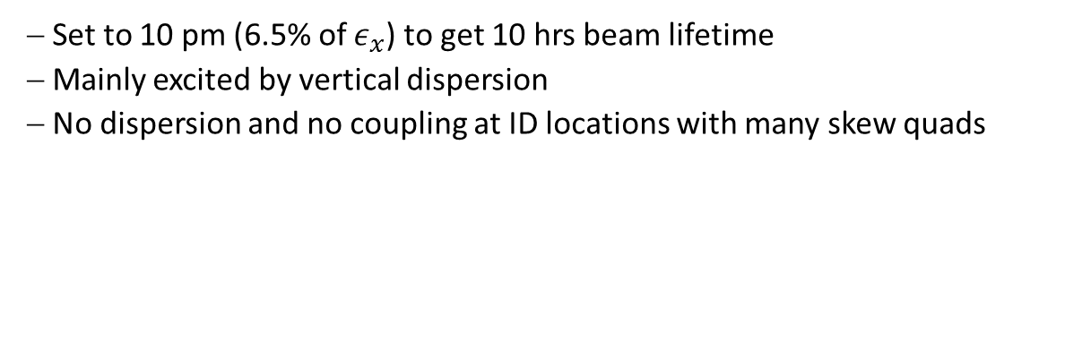
Closed vertical dispersion bumps in arcs
  Set to 10 pm (6.5% of $ε_{x}$) to get 10 hrs beam lifetime
  Mainly excited by vertical dispersion
  No dispersion and no coupling at ID locations with many skew quads
Vertical dispersion (1/3 of ring)
η @ all elements
η @ BPMs

Slide 27
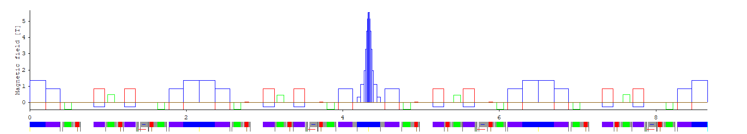
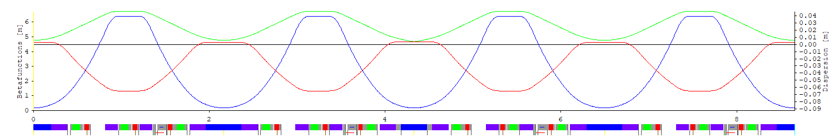

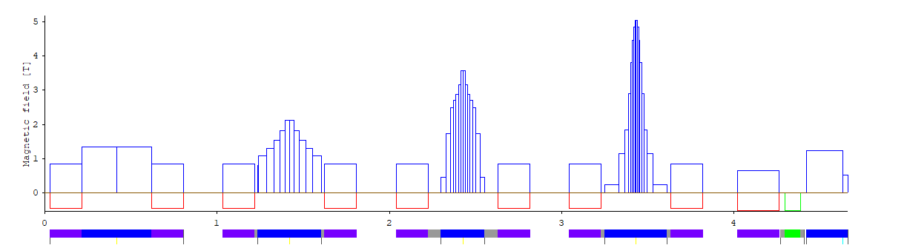
Superbend integration
VB-SB-VB
VB-BN-VB
↑ ↑ ↑ ↑ ↑ ↑ ↑ ↑ ↑ ↑
Field profiles
1.35 T PM, 2.1 T PM, 3.5 T SC, 5.0 T SC
Optics matching
(α_{x} , α_{y} , η′, ΔQ_{x} , ΔQ_{y})
by 2×5 tuning quads (↑)
inside octupoles.
⇨ noticeable perturbation
of cell periodicity.
⇨ careful tuning of [VB-SB-VB]
unit (work in progress)

Slide 28
Plan and status of components (1)
Magnet
  Permanent magnet : Unit cell dipoles, combined function magnets and Superbend (2.1 T peak)
  Electromagnet: Dipole correctors, Quadrupoles, Sextupoles and Octupoles
  Additional windings at Octupoles as Quadrupole correctors and Skew quadrupoles
  Superconducting magnet: Superbends (3.5 and 5 T peak)
  Status
    Magnet design almost completed / under finalization (taking into account cross-talk)
    Proto-typing on-going

Slide 29
Plan and status of components (2)
RF system
  New Main 500 MHz RF system
    4 stations to meet the power requirement, 276 (Lattice) + 85 (IDs) kW
    Various options under consideration from house-made to commercial products
  3HC
    Re-use SLS superconducting cavity with some upgrade
  Amplifiers
    Solid state amplifier – Higher initial cost but lower operation cost
  Low level RF
    New digital system, In-house development

Slide 30
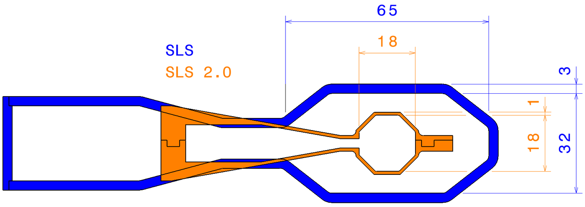
Plan and status of components (3)
Vacuum chamber
  Octagonal cross section, equivalent diameter 18 mm
  Copper + NEG coating (Coating at PSI)
  10⁻⁹ mbar (CO equivalent) after 100 A.h
  Activation of 17 m long sector outside tunnel and transport into the tunnel, keeping vacuum
  Newly designed crotch absorber: 80 W/mm² → 30 W/mm²
SLS
SLS2

Slide 31
Plan and status of components (4)
BPM
  Orbit mode resolution spec: <50 nm rms
  SLS BPM upgrade on-going
    New system will be used in SLS (except for BPM pickups)
    System test at SLS will reduce SLS2 commissioning time
  SLS2 BPM pickup: design completed and under prototyping

Slide 32
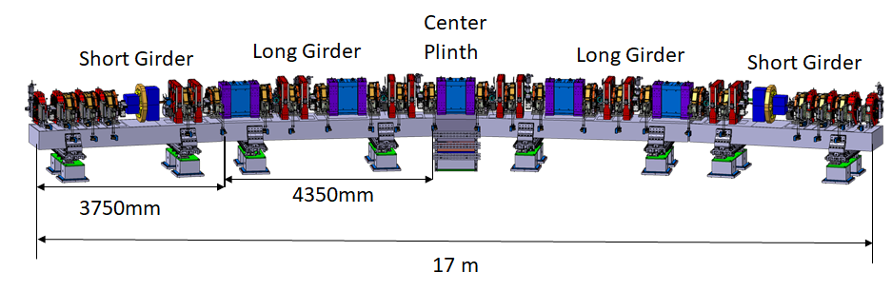
Plan and status of components (5)
Girder
  Lowest eigen-frequency spec: >50 Hz
  4 girder + 1 center plinth per arc
  Remotely movable girder as in SLS
  Design completed and under prototyping

