Slide 1
PAL-XFEL Undulator Tuning and Off-axis Measurement
Sojeong Lee, Jang-Hui Han for Insertion Device Team
Pohang Accelerator Laboratory
IMMW21 24-28 June 2019, Grenoble

Slide 2
Outline
PAL-XFEL hard X-ray undulator field measurement
PAL-XFEL undulator beamline
HXU125 field measurement and tuning
Off-axis field measurement for HXU125
Motivation and requirements
Measurement results

Slide 3
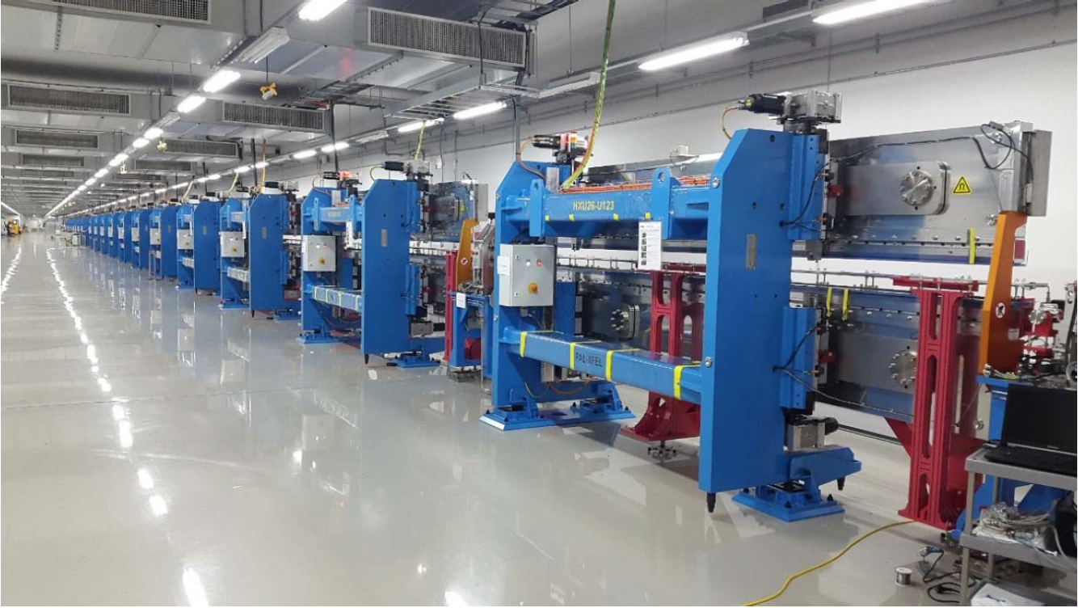
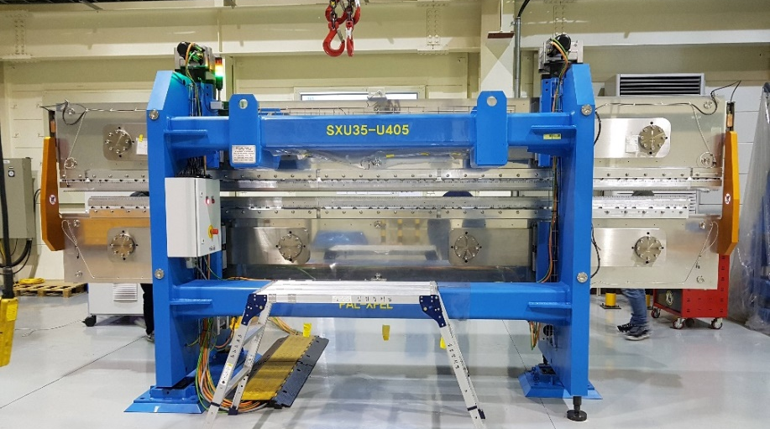
PAL-XFEL Undulator System
PAL-XFEL undulator beamlines and major parameters
New undulator for hard X-ray beamline (HXU125)
During 2020 summer maintenance, one undulator module will be added to the hard X-ray beamline.
In 2018 winter, a new hard X-ray undulator was built by refurbishing the prototype undulator mechanical frame and control system.
Parameter | Hard X-ray | Soft X-ray
Beam energy (GeV) | 10 | 3.15
Undulator length (m) | ~ 5.0 | ~ 5.0
Period (mm) | 26.0 | 35.0
Min. gap (mm) | 8.30 | 9.00
K | 1.973 | 3.321
Number of undulators | 20 | 7

Slide 4
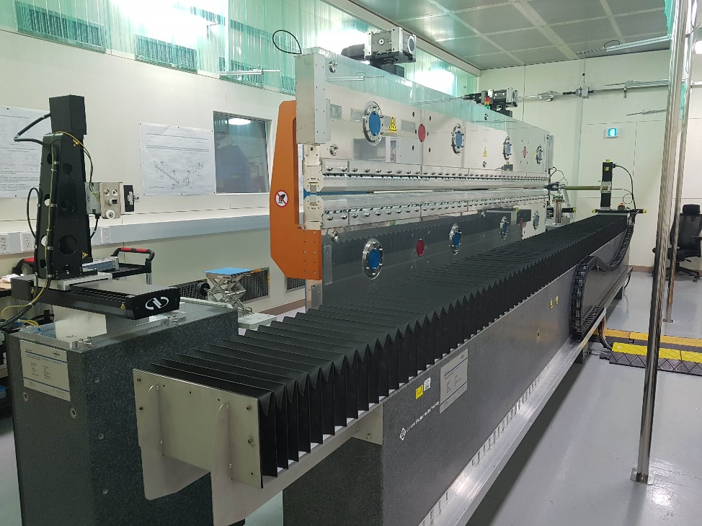
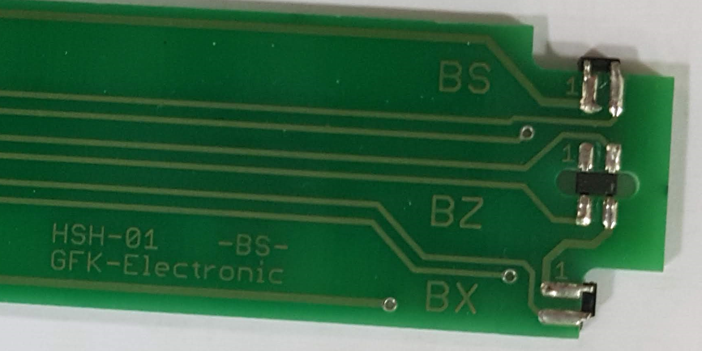
Magnetic Measurement Bench System
Room temperature: 25℃ ± 0.1℃
Two Helmholtz coils (horizontal and vertical)
Hall probe stage
Three FW Bell GH-700 Hall sensors are integrated in one PCB board.
Effective bench length: 6.5 m
Bench straightness: ~ ±6.0 μm
Positioning accuracy: ±2.5 μm
Field accuracy: ~ 1.0 Gauss
Operating range: up to 1.8 Tesla
Single stretched wire stage
0.1 mm diameter varnish-insulated copper wire.
Analog integrator

Slide 5
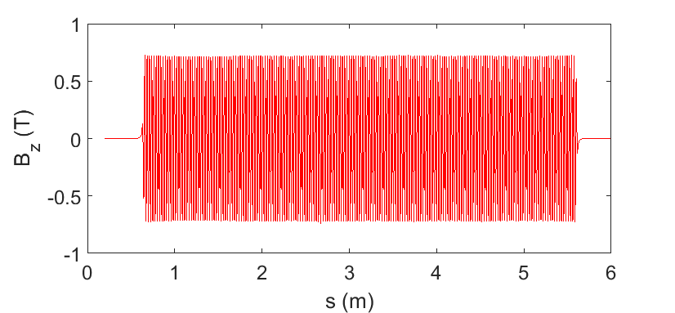
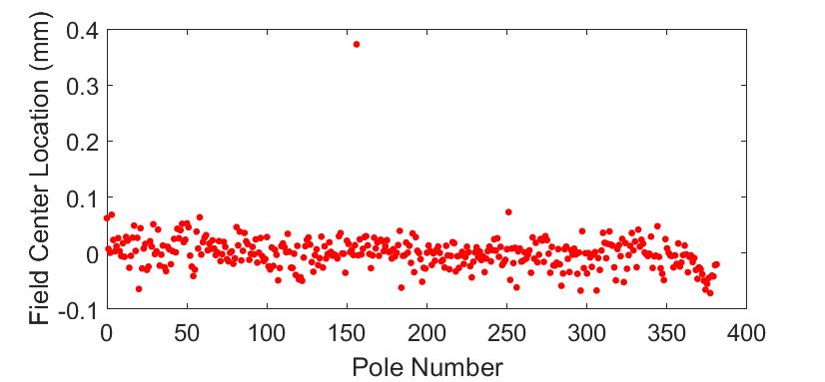
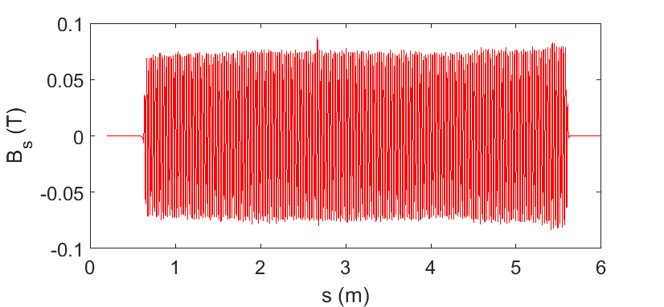
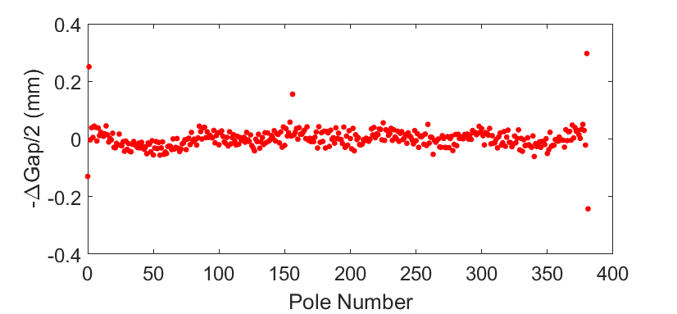
HXU125 First Field Measurement
B-field and mid-plane measurement (gap 10mm)

Slide 6
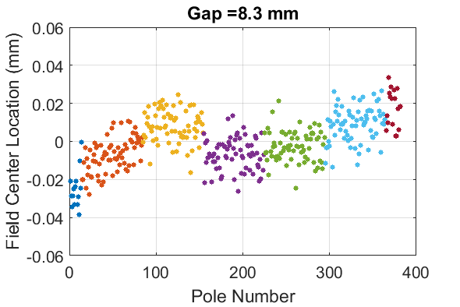
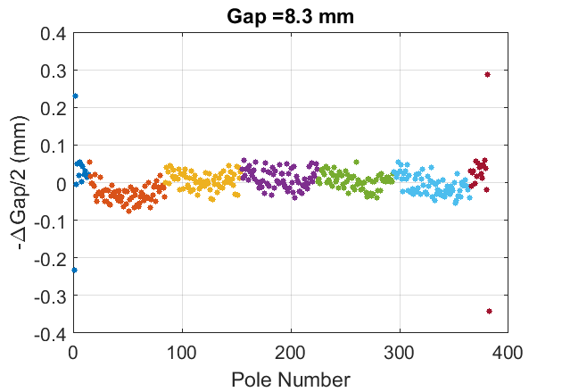
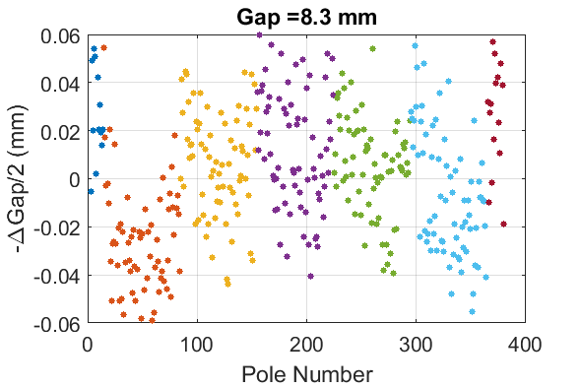
Field Measurement
Field center and pole gap distribution before tuning (minimum gap, 8.3mm)
E2
M5
M4
M3
M2
M1
E1

Slide 7
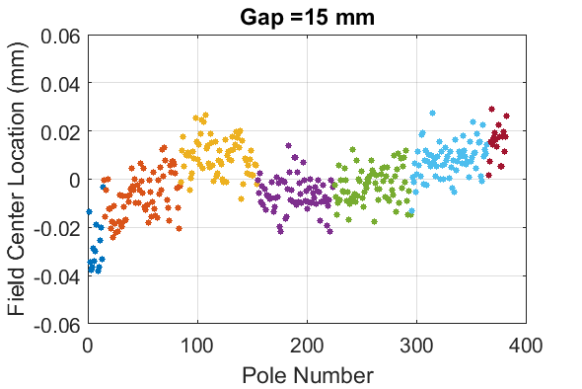
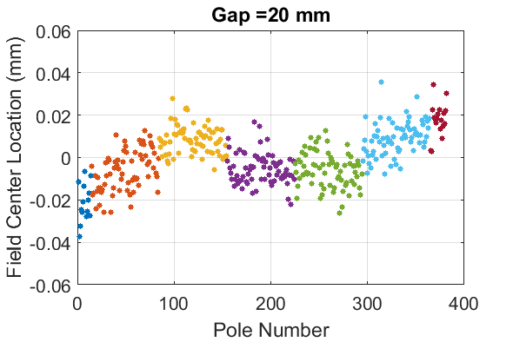
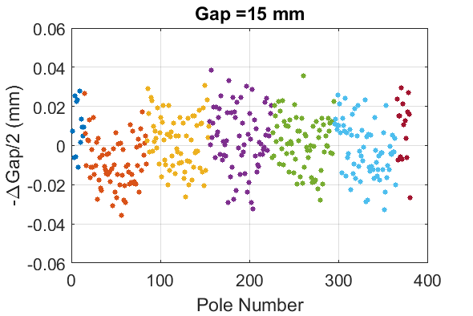
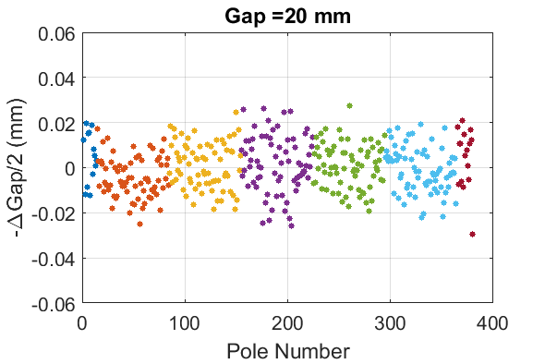
Field Measurement
Pole center and gap change

Slide 8
Magnet Block Deformation
Undulator magnet keeper deformation
E2
M5
M4
M3
M2
M1
E1

Slide 9
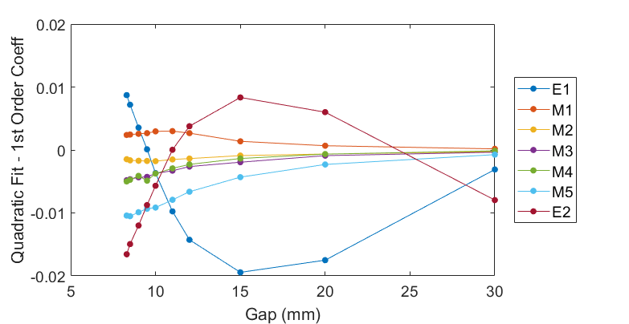
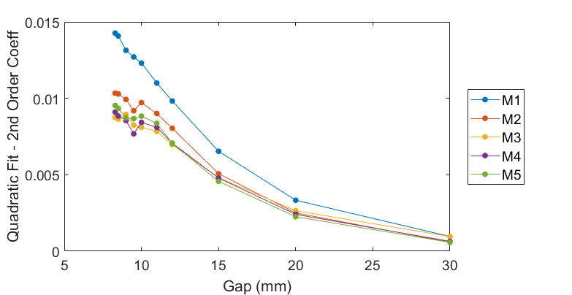
Field Measurement
-ΔGap/2 distribution polynomial fit
E2
M5
M4
M3
M2
M1
E1

Slide 10
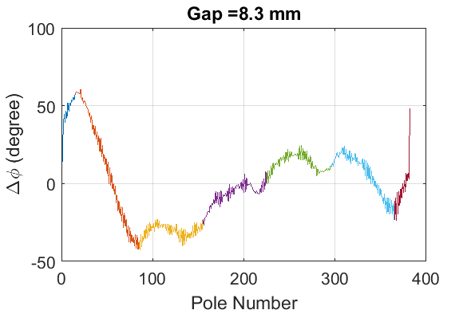
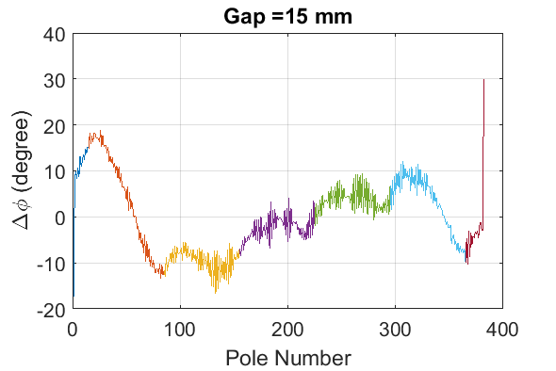
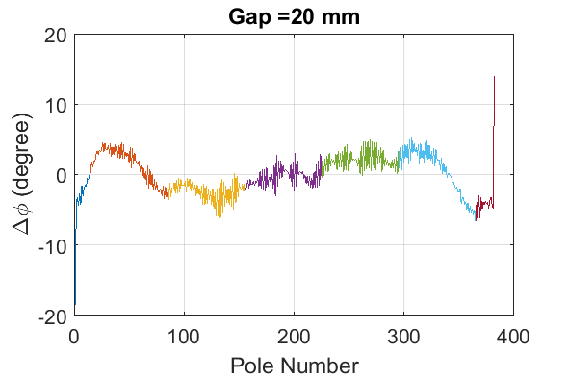
Field Measurement
Magnet keeper and phase jitter
RMS phase jitter: 24.41 deg.
RMS phase jitter: 9.10 deg.
RMS phase jitter: 3.98 deg.

Slide 11
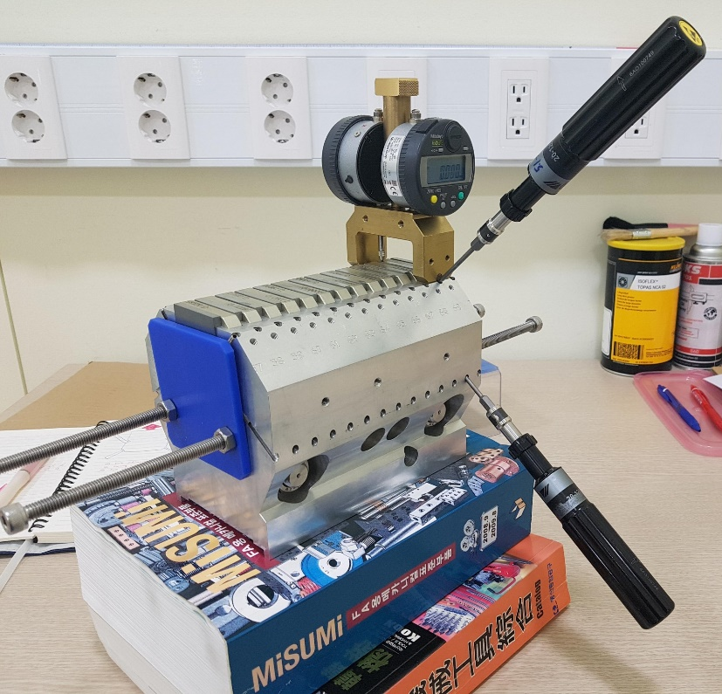
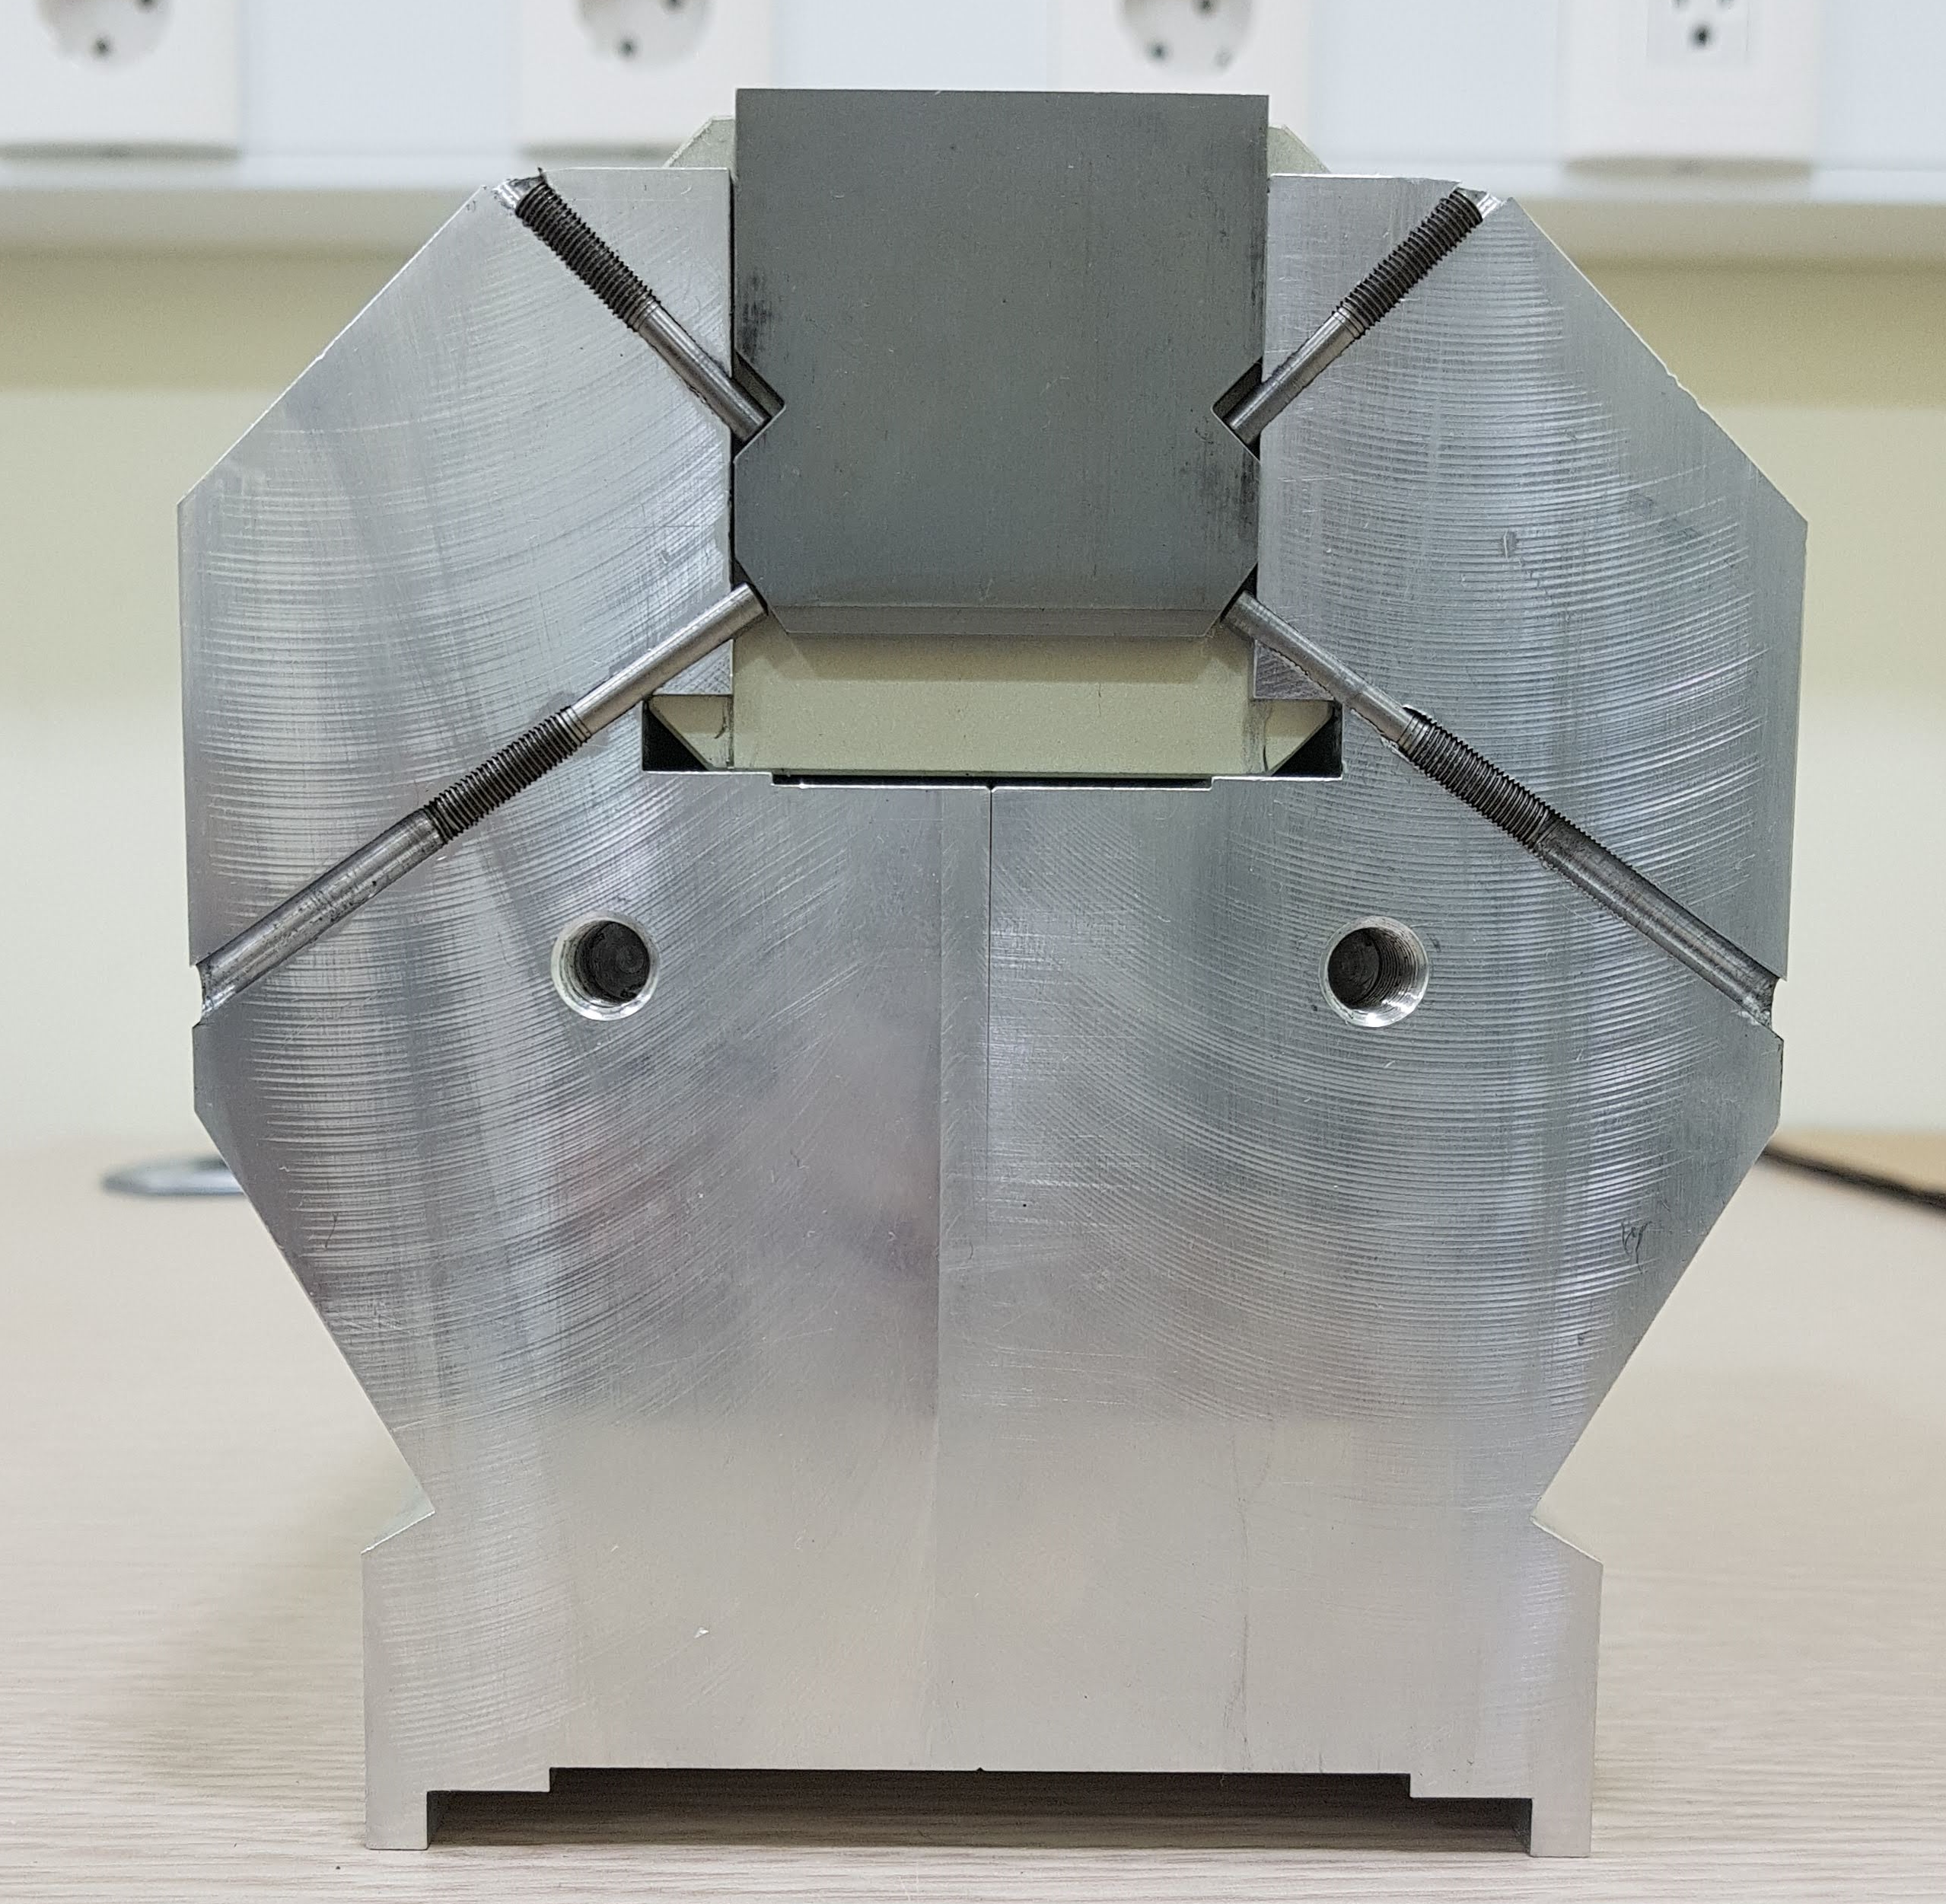
Undulator Tuning
PAL-XFEL undulator RMS phase jitter requirement
For hard and soft X-ray beamline: < 7.0 degree
PAL-XFEL tuning procedure
Adjusting the pole height and tilting based on the signature measurement result (local-K correction scheme).
Tuning procedure is done to meet the phase jitter requirements and minimize the orbit distortion.
The expected mechanical tuning accuracy is ±2 μm.
Tuning gap was set as a 9.5 mm by considering working gap range (8.5 ~ 13 mm).

Slide 12
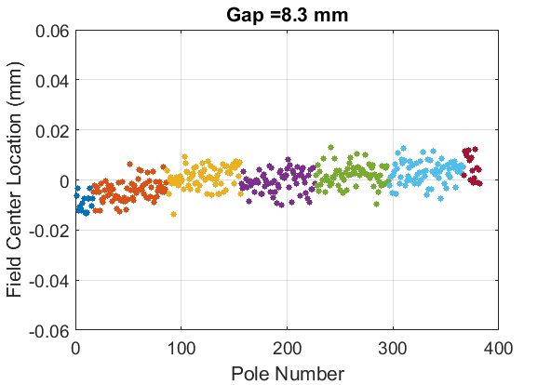
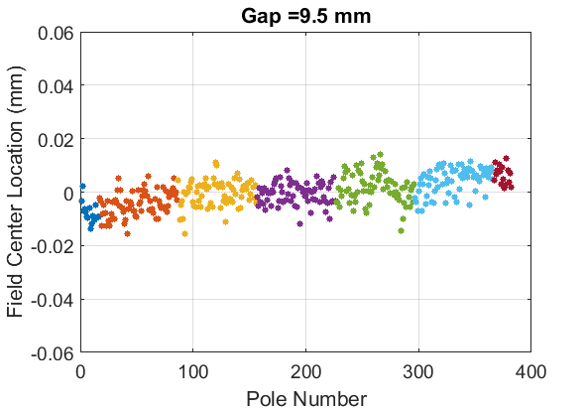
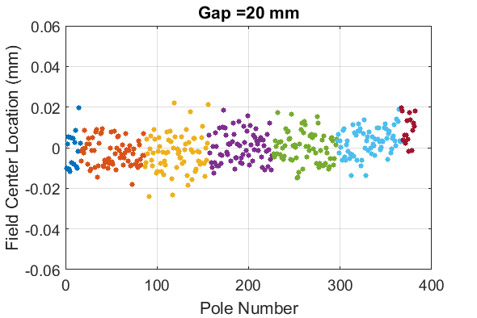
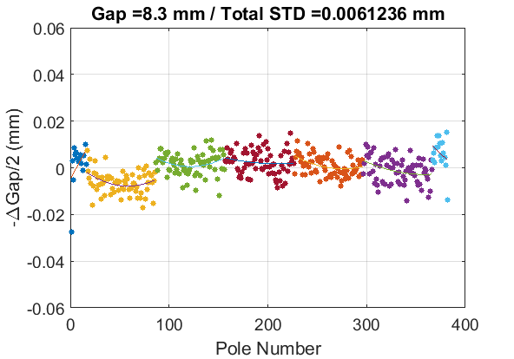
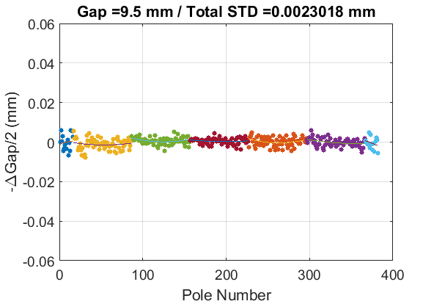
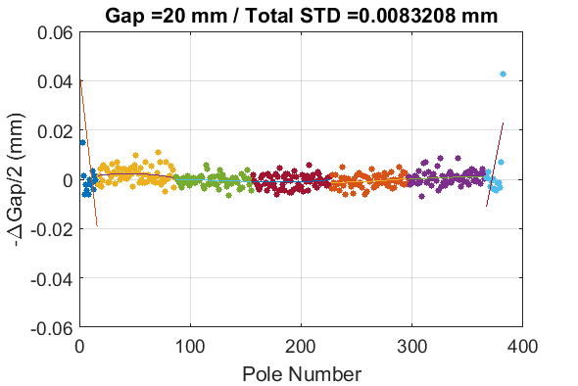
Tuning Result
Field measurements after four times pole tuning

Slide 13
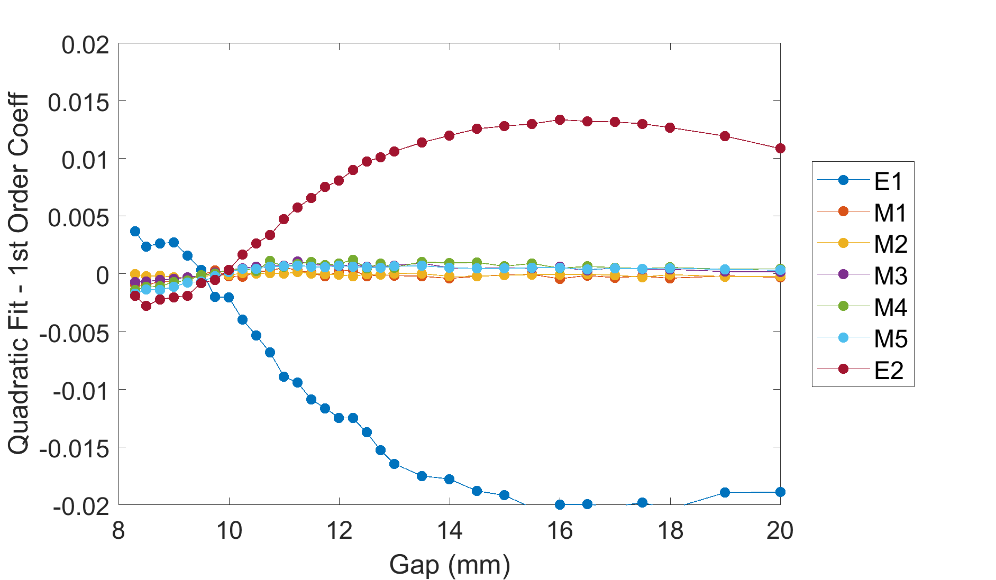
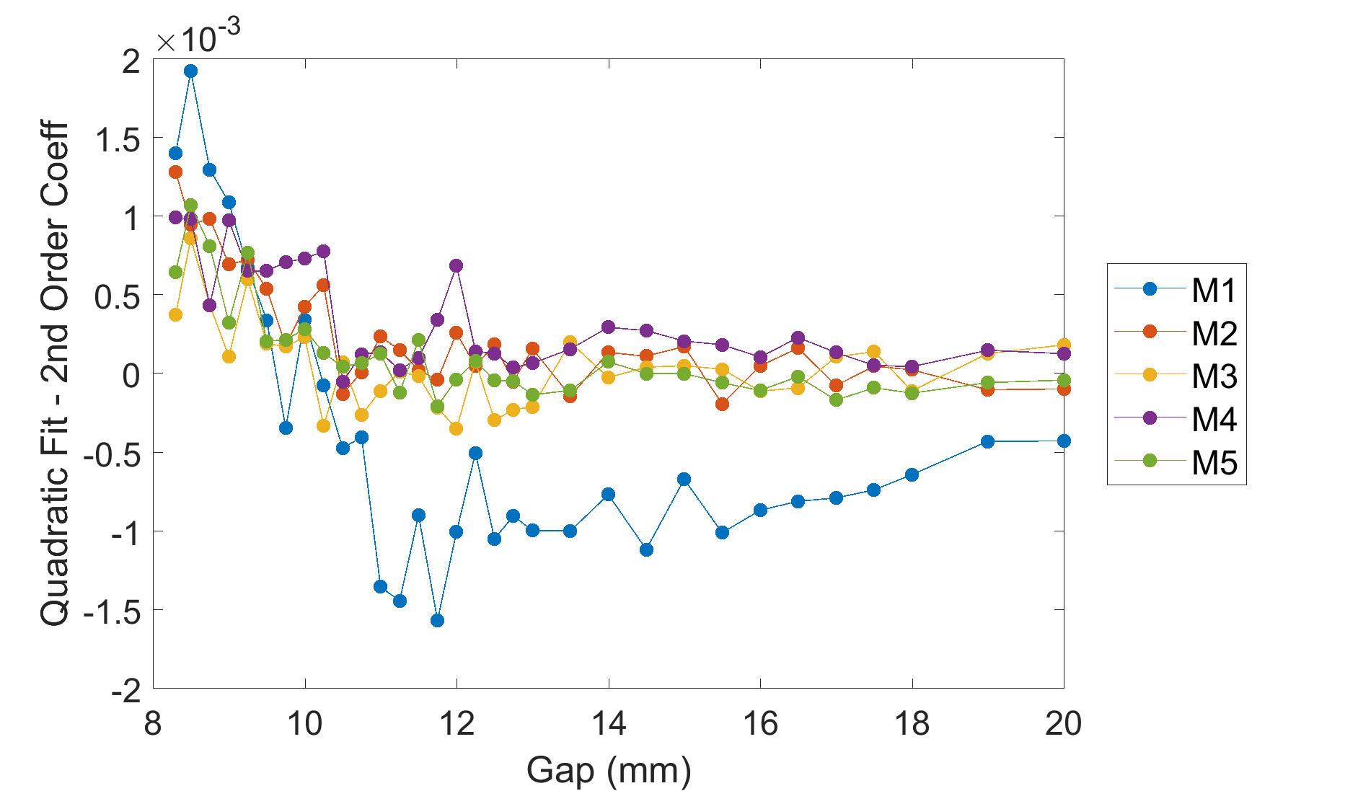
Tuning Result
Undulator magnet keeper bending after pole tuning
Before tuning

Slide 14
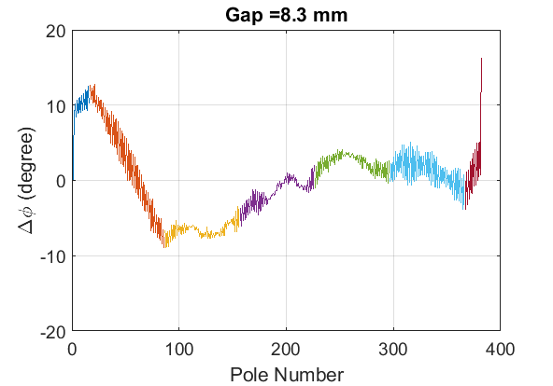
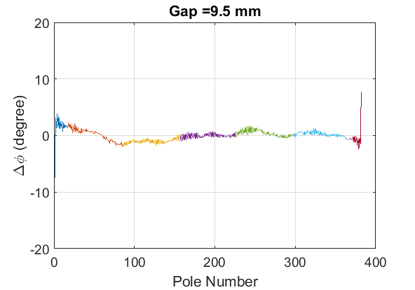
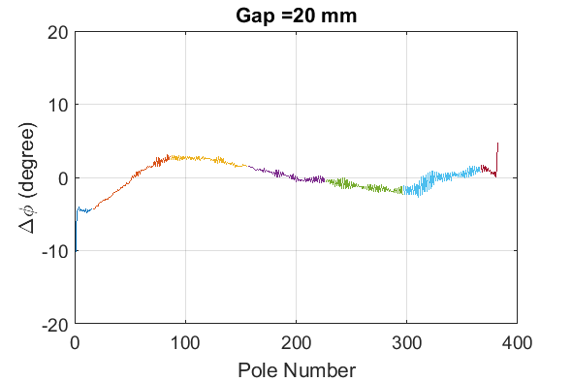
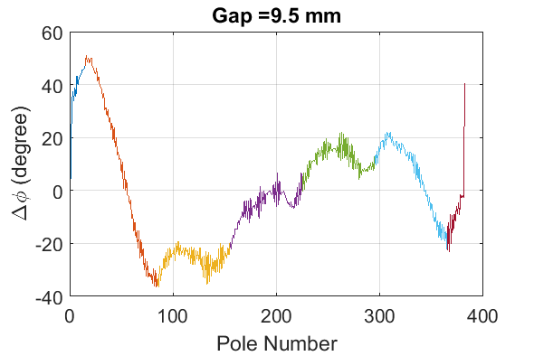
Tuning Result
Phase jitter
Before Tuning

Slide 15
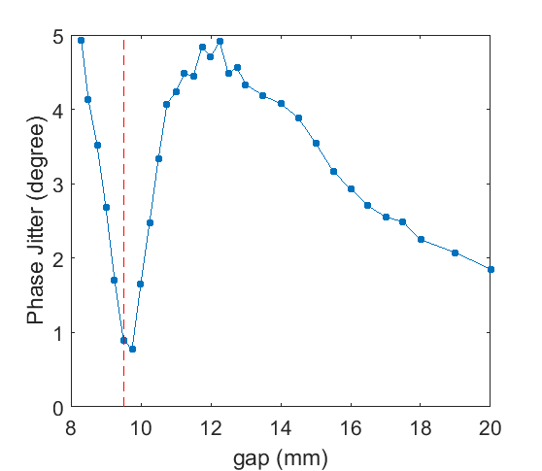
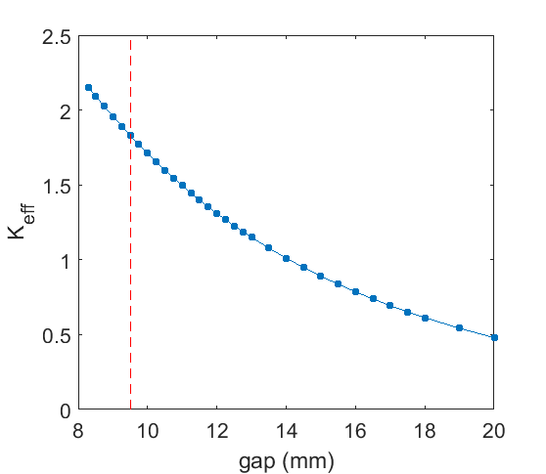
Tuning Result
Measured phase jitter and K_{eff}

Slide 16
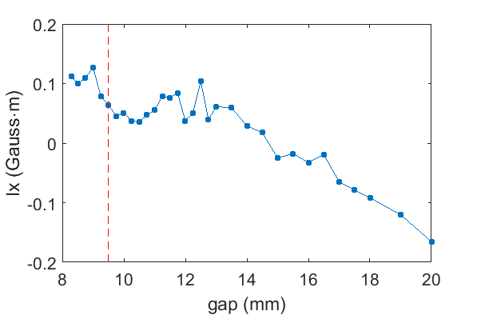
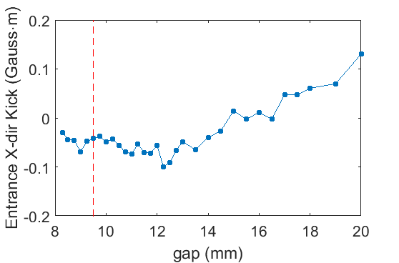
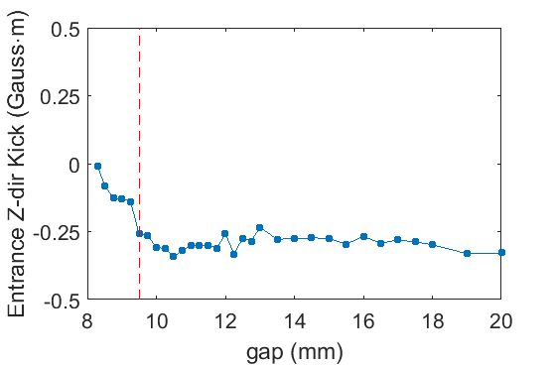
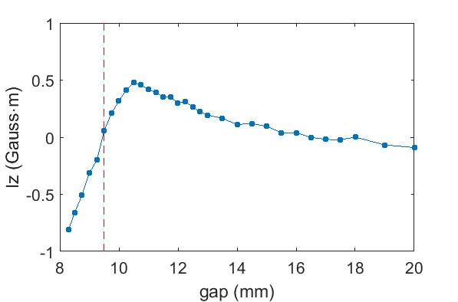
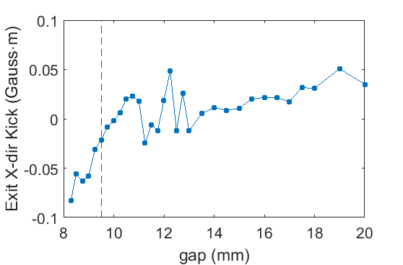
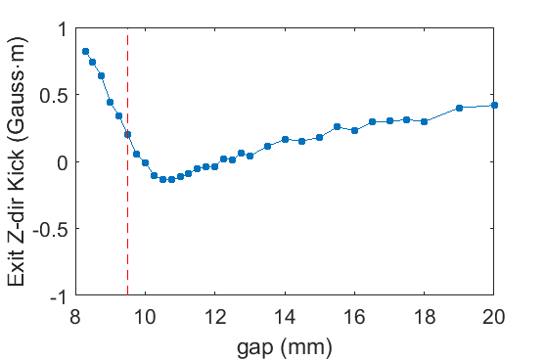
Tuning Result
Field integrals and kicks of HXU125 (based on HX1 1st undulator position)

Slide 17
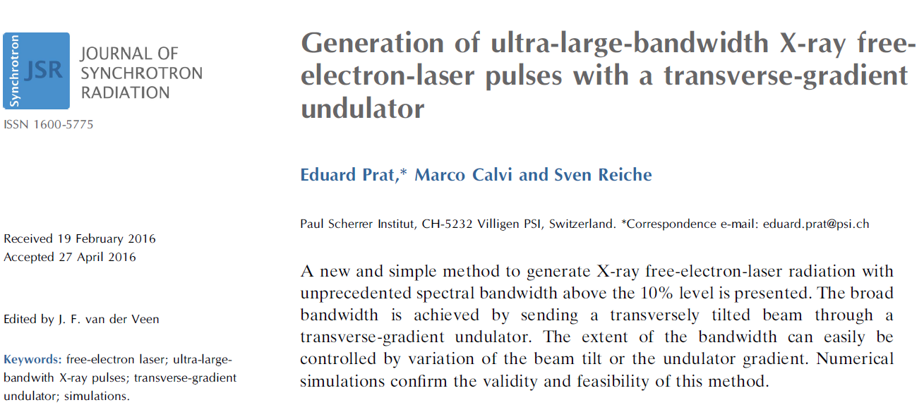
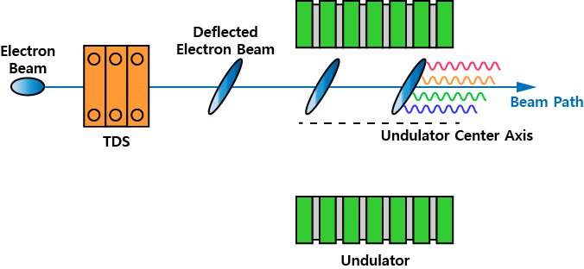
Large Bandwidth Operation
Large bandwidth soft X-ray
Some experiments require large bandwidth (> 1 %) soft X-rays.
Usual FEL operation provides a ~0.1% bandwidth.
SwissFEL suggested a large bandwidth schematics based on transverse deflecting structure and transverse gradient undulator (using APPLE-X type undulator).
Large bandwidth operation mode schematics

Slide 18
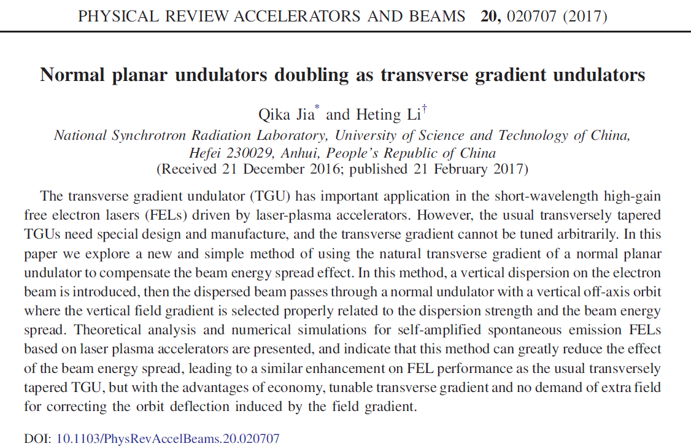
PAL-XFEL for Large Bandwidth Operation
PAL-XFEL soft X-ray beamline
Transverse deflecting structure
: One transverse deflecting cavity and RF station
: One corrugated structure
Transverse gradient undulator (TGU)
: Seven planar undulators → can be used as TGU
PAL-XFEL layout

Slide 19
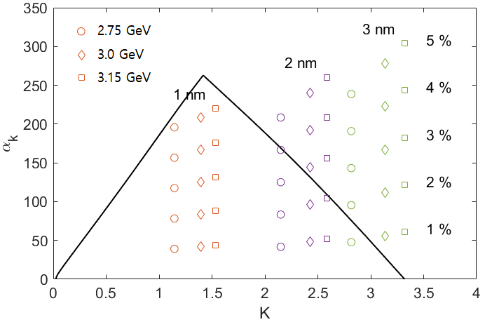
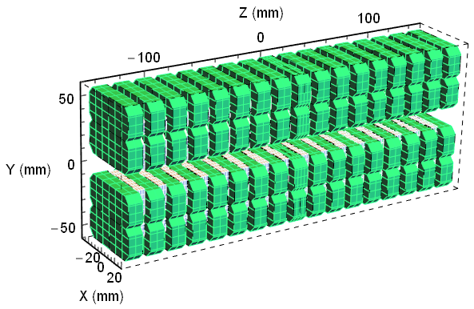
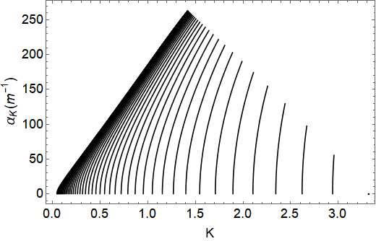
PAL-XFEL Undulator as TGU
Requirements to generate 3% bandwidth soft X-ray FEL in PAL-XFEL
Assuming 20 MeV deflecting voltage, 40 μm electron bunch length and 340 μm beam size
λ_{FEL} (nm) | E_{beam} (GeV) | K | α_{K} (m⁻¹) | Und. gap (mm) | Beam offset (mm)
1 | 3.15 | 1.53 | 130 | 17.2 | 2.6
 | 2.75 | 1.14 | 117 | 21.0 | 3.4
2 | 2.75 | 2.15 | 125 | 13.3 | 1.7

Slide 20
PAL-XFEL Undulator as TGU
Requirements of TGU for large bandwidth operation
Radiation center change
: PAL-XFEL undulator control system supports moving the magnet girder in the same direction.
: This feature can change the mid-plane of undulator without changing the undulator chamber position.
Phase error
: Large bandwidth operation mode is based on the SASE process of each beam slice.
: To support SASE process, the RMS phase jitter of undulator needs to be maintained under 7 degree for PAL-XFEL soft X-ray beamline.
: The tuning process of undulator was done for on-axis field to meet the RMS phase error of undulator.
To check the feasibility to use planar undulator as TGU, the HXU125 off-axis field measurement and phase jitter measurement were done.

Slide 21
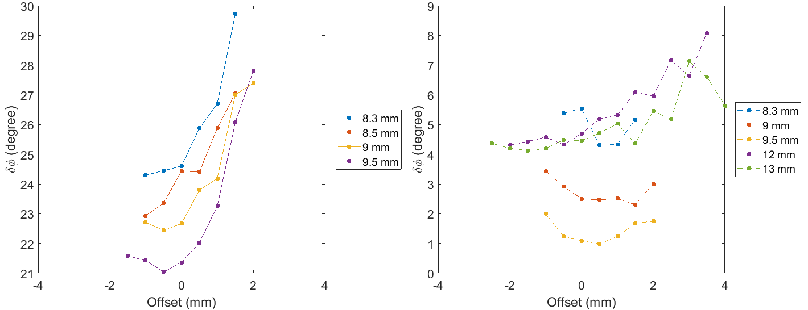
Off-axis Field Measurement Result
RMS phase jitter before and after tuning of HXU125
Before Tuning
After Tuning

Slide 22
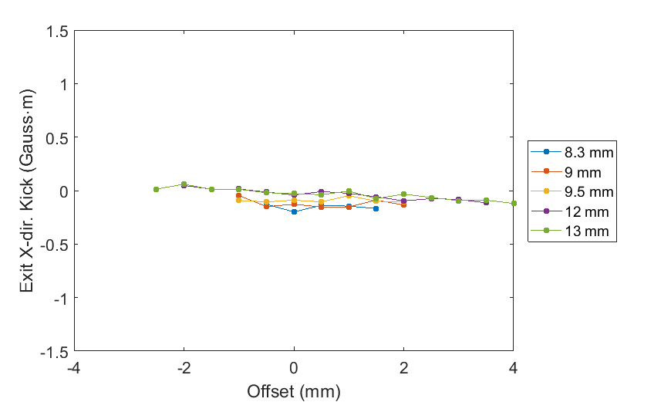
Off-axis Field Measurement Result
Beam trajectory (PAL-XFEL requirement 1.5 Gauss·m)

Slide 23
Summary
HXU125 for PAL-XFEL hard X-ray beamline
One undulator was built for additional installation in the PAL-XFEL hard X-ray beamline.
Field measurement shows magnet keeper deformation caused by the magnet force.
Tuning was done to minimize the magnet keeper deformation within the working range.
Planar undulator as TGU for large bandwidth operation
To support large bandwidth operation in the PAL-XFEL soft X-ray beamline, the required RMS phase jitter at off-axis is less than 7 degree.
After nominal tuning procedure, the phase error increases at off-axes and the error is minimum at the tuning gap.

