Slide 2
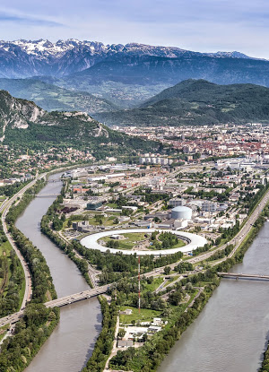
Local structure of laser shocked FeNi probed by XAS
Notes:
So, my name is Olivier Mathon. I am working at the European Synchrotron Facility and I originally proposed a talk entiteled X-ray Absorption under Extremes. Extremes means extreme conditions of Pressure Temperature and magnetic field. But as I am in a session dedicated to “time resolved methods”, I am going to slightly change my proposal and to talk about XAS under extremes…. Using time resolved techniques….

Slide 3
scientific case
Fe rich FeNi alloys are important for geophysics as major components of the earth’s core.
Knowledge about the local structure of the molten phase at ambient and high pressure is still missing.
two fold interest
in the static range comparison to ramp and LH results
much more extreme states
isochoric ramp, F. Occelli
laser heating, S. Boccato

Slide 4
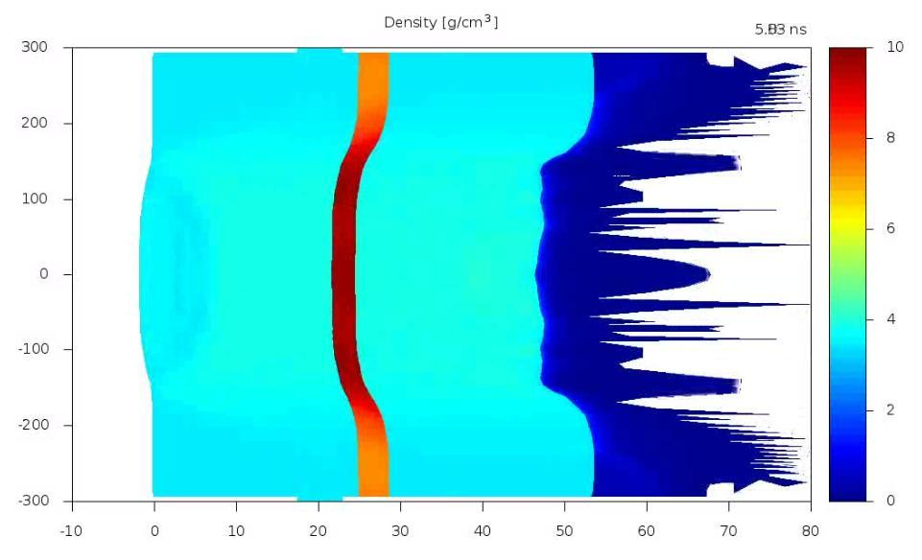
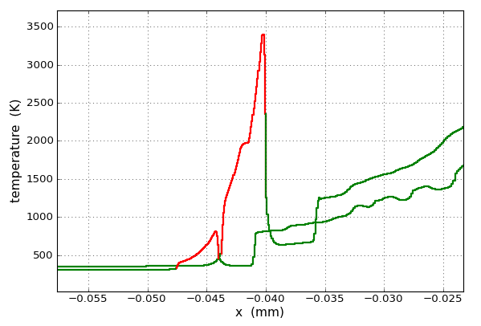
experiment miniaturization: target design
R.Torchio, L. Videau, T. Vinci
diamond Fe diamond CH
40 µm
50 µm
P<100 GPa
laser foc 300µm
The shock in Fe is confined for a measurable time interval (2-4 ns) thanks to the diamond sandwich and the CH ablator limits the pre-heating effect.
ESRF time resolution: 100 ps
AR
P>100 GPa
laser foc 90µm
25 µm
25 µm
Pre-heating effect
2D effects
Fe
3.5 µm
Fe
Al ablator
µm
density (g/cm³)
diamond
CH ablator
diamond
25 µm
diamond
25 µm
diamond
shock front
focal spot
250 µm
µm
150 µm
200 µm
Notes:
Let me now tell you about our experiment. The experiment miniaturization requires an accurate target design. We used a deposited Fe layer of 4 microns in a sandwich of diamonds. The role of the diamonds is to confine the sample shock for a large time interval, which was in our case 2-6 ns, to fit the synchrotron intrinsic time resolution: 100 ps.
When using a very small laser focal spot we have to consider 2D effect, that modify the shock front as the sample is traversed, and the pre-heating effects, since the flux is very high. The 2D effects become particularly important at pressures higher than 100 Gpa, when the diamonds become opaques. In this case if one wants do VISAR measurements the only available surface to look at is the rear one, so it is important that the total thickness is not too much. As to the pre-heating effect, which arises from radiative transfer which anticipates the arrival of the shock front, a small layer of plastic was deposited on the drive side to prevent it. As you can see in the picture, temperatures can get very high before the arrival of the real shock because of this effect.

Slide 5
diamond Fe diamond CH
40 µm
50 µm
25 µm
25 µm
liquid CH
in the best case!
diamond windows: Applied Diamonds 50 of 50 µm + 50 of 25 µm, 8080 euro, 6ws
AR deposit: Fichou company, test and realization, 1639 euro, 3 ws
4 µm FeNi deposit, DEPHIS company, 4680 euro, 9 ws
CH deposit: RAL company, 1700 euro, 3ws
total: 16100 euro for 50 targets (25 thin and 25 thick)

Slide 6
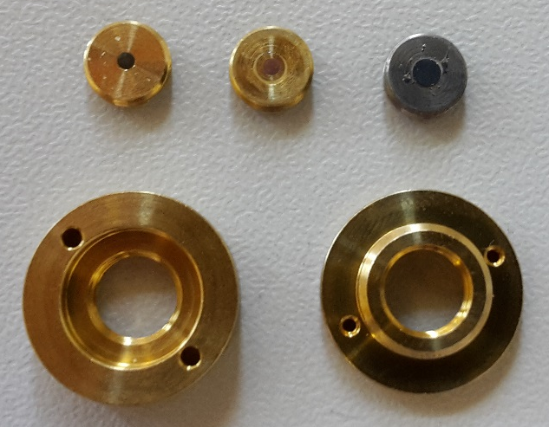

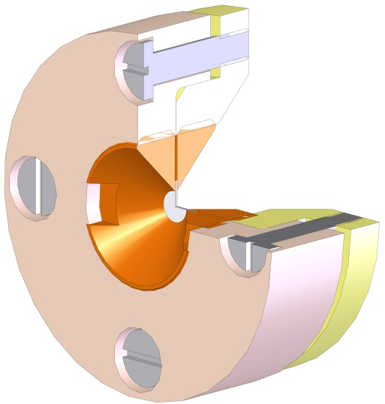
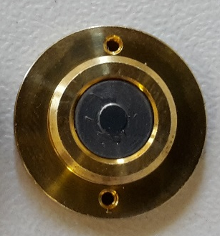
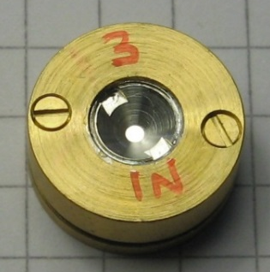
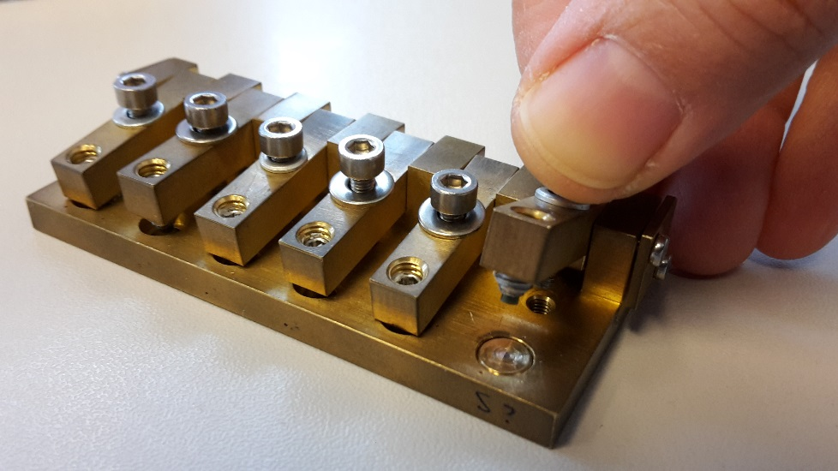
Ø14mm
F. Occelli
EPOTECNY glue
150 supports
FeNi, GeO₂, Mo?

