Slide 1



GCLT laser & diagnostics status
A. Sollier (CEA/DIF/DPTA) | Preparation meeting for shock experiments on ID24
January 19th, 2016

Slide 2
OULTINE
Pour insérer une image :
Menu « Insertion / Image »
ou
Cliquer sur l’icône de la zone image
GCLT Laser status
  GCLT characteristics
  Feedback from 2014 shock experiment on ID24
  Current configuration
  Expected configuration
Diagnostics status
  What we have
  What we would like to do
  Possible experimental configurations
CEA | January 19th, 2016
| PAGE 2

Slide 3
GCLT laser status

Slide 4

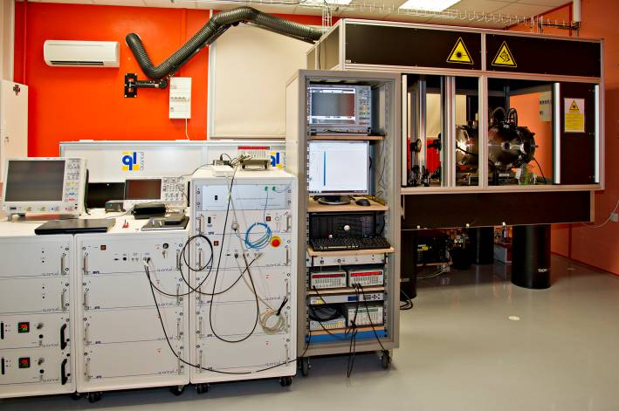
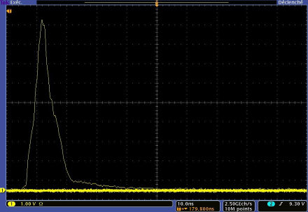
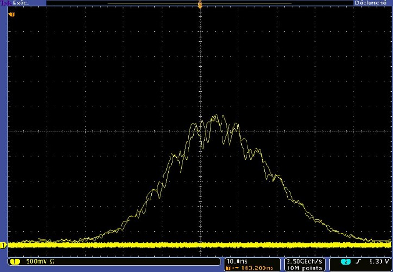
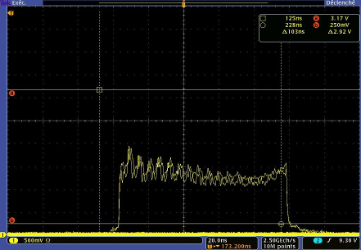
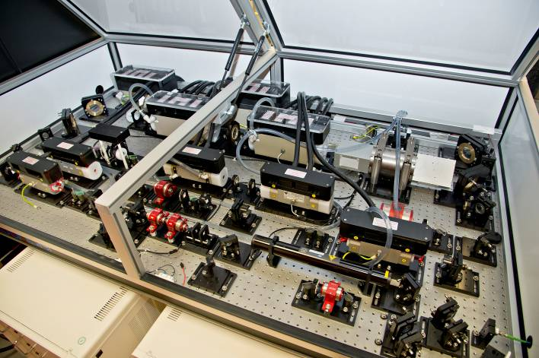
Reminder of GCLT laser system characteristics
Pour insérer une image :
Menu « Insertion / Image »
ou
Cliquer sur l’icône de la zone image
Custom laser system built by Quantel
  Square Pulse oscillator (SPO)
      Fiber laser (200 ns; 5 Hz)
  Pulse shaping capability
      Programmable Optical Pulse Shaper (POPS)
      4-100 ns FWHM (800 steps of 125 ps)
  2 amplification stages
      Nd:YLF @ 5 Hz
      Nd:Phosphate @ 0.02 Hz
  Maximum energy
      ~ 30 J @ 4 ns; ~ 60 J @ 100ns
  Repetition rate @ full energy
      0.0222 Hz (1 shot every 45 s)
Triangular
10 ns
Gaussian 30 ns
Square 100 ns
CEA | January 19th, 2016
| PAGE 4

Slide 5
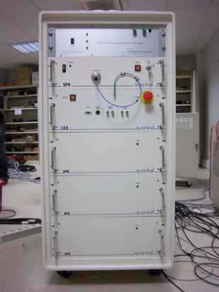
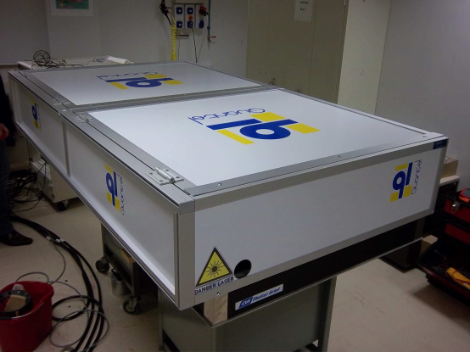
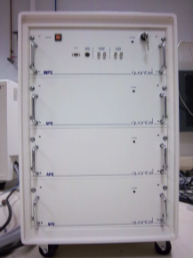
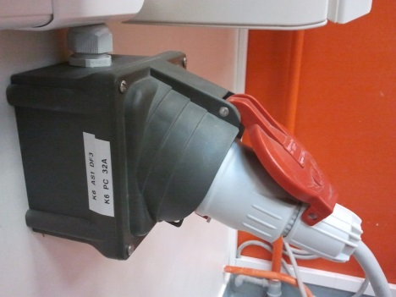
Reminder of GCLT laser system characteristics
Pour insérer une image :
Menu « Insertion / Image »
ou
Cliquer sur l’icône de la zone image
  6 electronic units
      1×24U rack (1150×550×800 mm)
      5×16U rack (890×550×800 mm)
  1 optical table (2×1 m)
  1 external chiller
  A single electrical plug
      Legrand Hypra (3P+N+E) IP44 32 A socket
CEA | January 19th, 2016
| PAGE 5

Slide 6
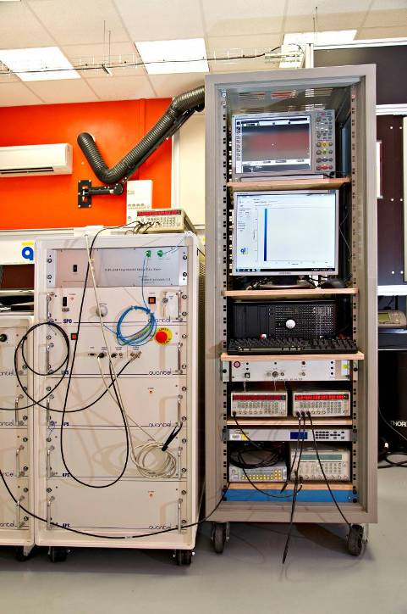
Control-Command
All the laser system is operated from a personal computer
  Choice of high energy/low energy modes, or only the 5 Hz Nd:YLF stage for alignment
  Choice of the pulse shape and FWHM duration
      Imported from a validated database through an Excel macro,
      Another Excel macro allow to build any desired shape and convert it to the required signal for the electronics.
  Choice of the internal/external synchronization mode
CEA | 3 February 2013
| PAGE 6

Slide 7
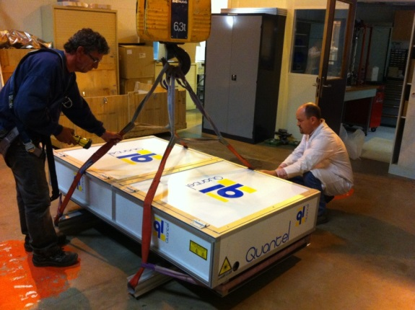
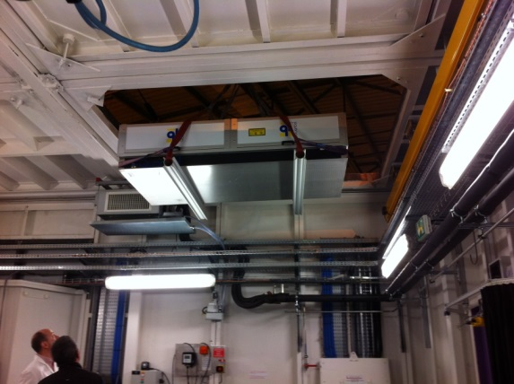
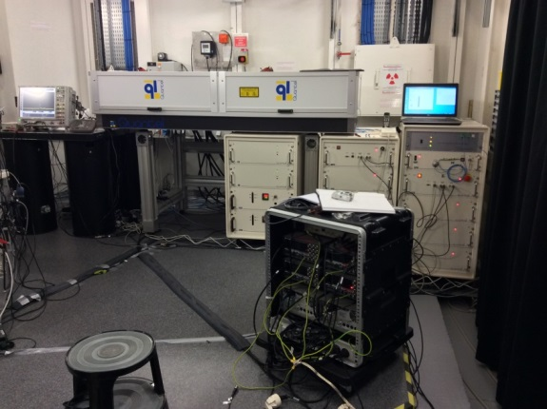
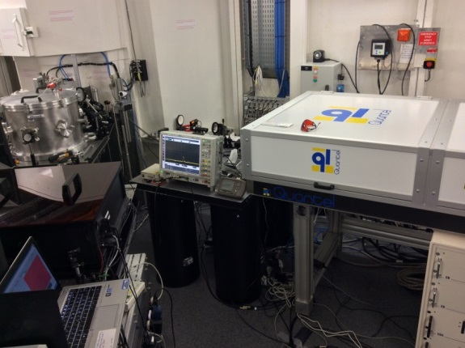
Feedback from previous shock experiment
1. Transport
  Transport operated by Bovis society on April 24th, 2014
  The laser system was moved inside the hutch on April 29th
      The laser table was moved using ESRF main travelling crane (operated by ESRF handling team).
      We moved the electronic cabinets using the hutch travelling crane.
  No major problem
  Possible improvements:
      Faster (4 days to plug & unplug) and cheaper (47 k€) installation with an all integrated system containing most of the electronic cabinets and the optical table …
CEA | January 19th, 2016

Slide 8
Feedback from previous shock experiment
1. Installation and running
  Quantel installed the system on W19 and W20
  Several electrical problems
      2 days intervention of a Quantel electronician
      New hardenned electronics cards + higher tolerances.
  Synchonization much easier than expected
  Several laser problems
      Less energy compared to normal performances
      Some return on several shots
  We noticed alignment problems during the XR shots
      Solved using a gasket with the right thickness.
      Could explain the problems with the VISAR data.
  About 120 shots
      ~20 shots for settings.
      ~20 VISAR shots.
      ~75 XR shots.
CEA | January 19th, 2016

Slide 9
Synchronization far easier then expected !
355,202 MHz ± 500 Hz
355,042 kHz
4,99996 Hz
RF clock
BCDU8
OPIOM
Quantum 9538
A B C D E
RF/992
/71012
Trig in
τ=1,4 μs, delay=564 ns
LASER
Check
5 Hz
5 Hz or 1/45 Hz
DG645 (5)
Ext
Trig
5 Hz
0,022 Hz
τ=1,4 μs, delay=851,139 μs
LCS
Flash out
MPSG
Flash out
Laser diag. + pockels
DG645 (2)
A_{ba} B_{ba} C_{ba} D_{ba}
Ext
Trig
Inh
DG535 (4)
T₀ AB- CD-
Switch
Ext
Trig
τ=1,4 μs, delay=700 μs
→acquisition launched ~170μs before shot
HighZ
TTL
XH
C=T₀+0; D=T₀+2 ms
Inh
DG645 (1)
A_{ba}
Ext
Trig
10 dB
DG535 (ID24)
CD+
Ext
Trig
Trig HX 0.022 Hz
CEA | January 19th, 2016
| PAGE 9
HighZ
VH Laser

Slide 10
Synchronization far easier then expected !
Delay 0 set wit two fast photodiodes
  1 photodiode recording both Xrays and laser located 30 cm at the back of the target
  1 Hamamatsu phototube recording the laser ~20 cm before the target
      Delay of ~10 ns expected because of cable length difference (9,19 ns measured).
XH acquisition locked on the right Xray bunch
  Laser + diagnostics delayed of 564 ns (next bunch)
      Quantum delay A=564 ns
      Quantum delay B=851139 ns
CEA | January 19th, 2016
| PAGE 10

Slide 11
Current configuration
A few improvements compared to 2014
  Laser/optic developments :
      All the optics have been carefully checked :
        New flashlamps on all the YLF rods.
        New anti-reflective coating on two rods.
      Reinforcement of the anti-return system :
        We changed the polarizers of the main Faraday rotator.
        We added two new polarizers on the Faraday rotator located after the Pockels cell.
      Modification of the Pockels cell:
        Double cell with 100 ns electronic shutter opening to limit the return in the laser system.
      Spatial filtering and relay imaging at the output of the laser
      New diffractive optics :
        Ø=100 μm for f=350 mm
        Ø=250 μm for f=300 mm
        Ø=500 μm for f=350 mm
        Ø=1 mm for f=300 mm (2)
        Ø=2.5 mm for f=350 mm
      New spare parts to avoid any delay :
        We have at least one spare part for each of the major optical components of the laser.
CEA | January 19th, 2016

Slide 12
Expected configuration for 2016 shock experiment
Major mechanical refurbishment
  New all integrated configuration :
      Most of the electronic and the optical table are all in a sigle mechanical
      Only 3 external electonic units (2×24U + 1×16 U) containing all the CB
      1 external chiller
  Easier to handle and to transport:
      Faster installation (no need to unplug/replug everything)
      Cheaper transport
  On order, delivery expected on April 15th.
CEA | January 19th, 2016

Slide 13
GCLT laser status conclusion
The laser is 100 % operational
  Pick up at CEA on April 25th
  Delivery at ESRF on April 26th
  Installation inside the hutch and plugging on April 27th
      ESRF main travelling crane required !
  Checking & alignment by Quantel from April 27th to April 29th
      Also from May 2nd to May 4th if required
  Operational on May 11th for tests in 16B mode
  STOP = June16th
  Preparation for transport back home on June 17th
      ESRF main travelling crane required !
  Pick up at ESRF on June 20th
STOP
ARRIVAL
NOTHING
CEA | January 19th, 2016

Slide 14
Diagnostics status

Slide 15
What we have currently
Few investments over 2014/2015 period …
  VALYN DOUBLE-DUTY ORB VISAR:
      Dual PM + streak output
      Coupled with a Hamamatsu C7700 streak + PLP10 diode
      6 W Continuum Verdi laser or
  4 channels PDV system:
      8 channels with time multiplexing
  Specialised Imaging SIMD ICCD camera:
      8 channels, 16 frames (3 ns minimum gate)
  Andor Shamrock 303iB, 303 mm focal length, motorized, Czerny-Turner Spectrograph:
      Triple grating turret with 300, 1200 and 2400(Holo) l/mm gratings
      Istar ICCD camera
      C7700 Hamamatsu + PLP10 diode
CEA | January 19th, 2016

Slide 16
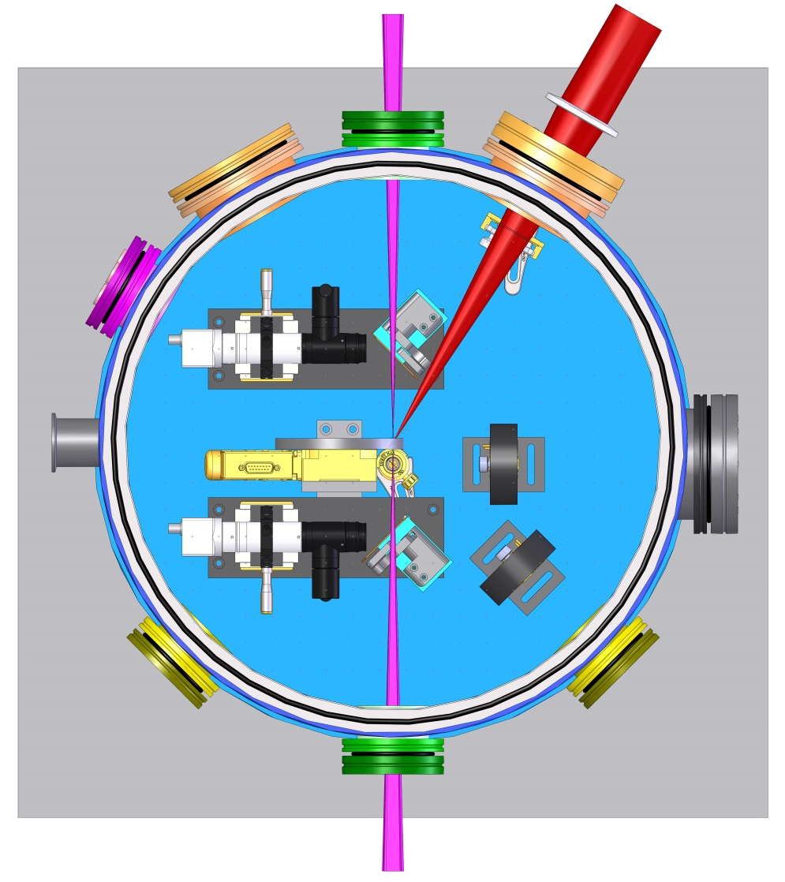
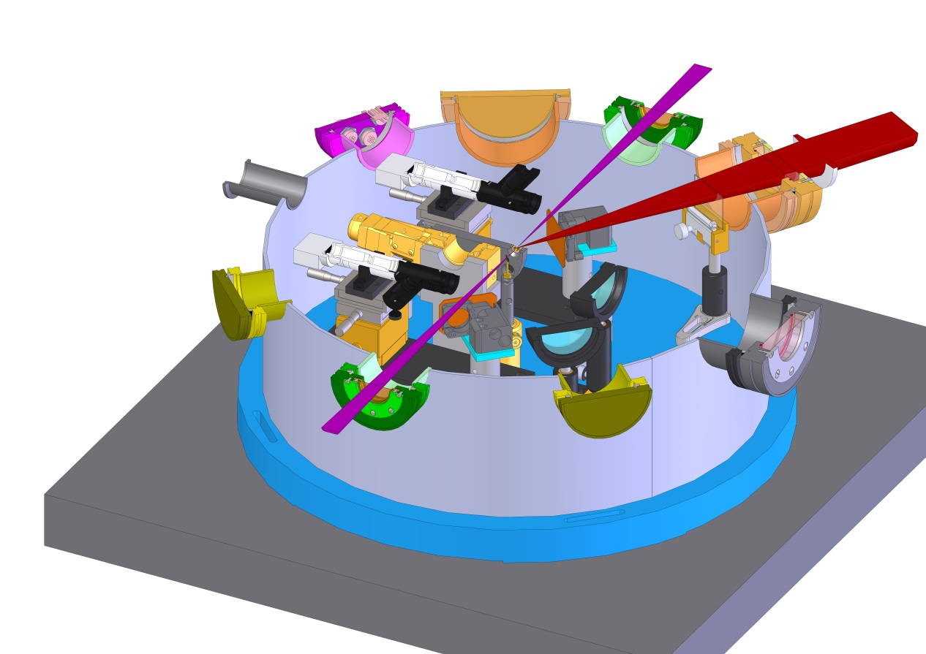
What we would like to do
Online VISAR + temperature measurement + … ?
  Modifications of the vacuum chamber:
      2 microscopes (front/back)
      New target holder
      New optical feedthrough on one side (VISAR)
      Thin 45° reflector in the XR beam (VISAR)
      Multiple SMA or optical feedthrough (T°)
CEA | January 19th, 2016

Slide 17

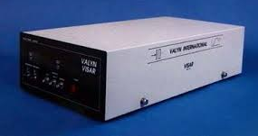
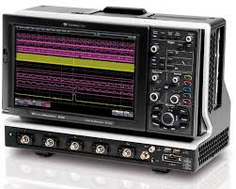

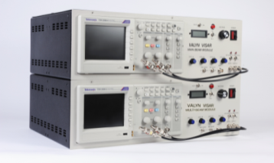
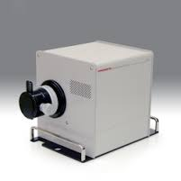
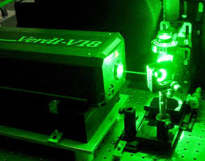

Point VISAR measurement
  The point VISAR is fully operational but:
      Do we use PM only (~1 ns) or PM+streak (< 1ns) ?
      Do we use a VERDI or a pulsed laser ?
      Strongly depends on the 45° reflector properties
  Preliminary tests required before the experiment:
      Check the properties of the reflector
      Enough signal with VERDI ?
      Quality of the target assembly
      Diamond opacification
CEA | January 19th, 2016

Slide 18
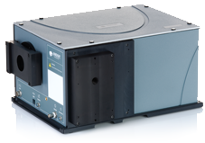
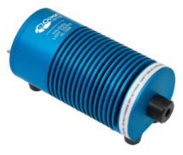
Temperature measurement: option 1
SOP (Streaked Optical Pyrometer)
  Advantages:
      Good time resolution (< 1ns)
      Good precision if large spectral range and well calibrated
      On shelf except calibration source
  Drawbacks:
      Difficult to perform online on multiple shots
      Enough signal ?
Lines/mm | Blaze (nm) | Nominal dispersion (nm/mm) | Bandpass (nm) | Resolution (nm) | Peak efficiency (%) | Maximum recommended wavelength (nm)
150 | 500 | 21.70 | 600 | 0.88 | 73 | 6910
300 | 500 | 10.73 | 297 | 0.43 | 81 | 3455
1200 | 500 | 2.41 | 67 | 0.10 | 81 | 865
2400 | 400 | 1.04 | 29 | 0.04 | 73 | 430
Source of known spectral radiance for calibration or shot on Quartz standard
Andor Shamrock 303iB Czerny-Turner Spectrograph
Hamamatsu
C7700 streak
CEA | January 19th, 2016

Slide 19
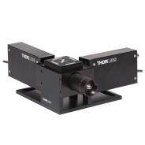
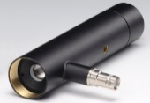
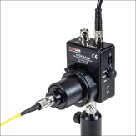
Temperature measurement: option 2
n colors Pyrometer
  Advantages:
      “Easy” to perform online on multiple shots
  Drawbacks:
      Limited time resolution (~ 1 ns)
      Limited precision
      Enough signal ?
      Almost nothing on shelf
PMT
Which detector ?
How many channels ?
BPT
n × (IF + detector)
APD
PPD
2.5 GHz digital oscilloscope
Source of known spectral radiance for calibration
CEA | January 19th, 2016

Slide 20
What kind of detector do we need ?
WIEN DISPLACEMENT LAW
Type | Model | Material | Rise time (ps) | Spectral range (nm) | Quantum efficiency @ peak (%) | Sensitive Area (Dia. μm / mm²) | Dark Current (nA)
PMT | Hamamatsu H3695-10 | ? | 700 | 160-650 |  | 10000 / 78 | 2-50
 | Thorlabs PMTSS2 | Multi-alkali | 1400 | 185-900 | ~35 | 3.7*13 mm/ 48.1 | 2-10
BPT | Hamamatsu R12290U-52 | Sb-Cs | 270 | 185-650 | 80 | 20000 / 314 | Large
 | Hamamatsu R1328U-52 | Sb-Cs | 60 | 185-650 | 80 | 10000 / 78 | Large
APD | Hamamatsu C5658 | Si | 1000 | 400-1000 | 70 | 500 / 0.196 | 16 nW rms
 | Thorlabs APD210 |  | 500 | 400-1000 |  | 500 / 0.196
PD | Alphalas UPD-200-UP | Si | <175 | 170-1100 | 85 | 400 / 0.126 | 0.001
 | Alphalas UPD-300-UP | Si | <300 | 170-1100 | 90 | 600 / 0.283 | 0.01
 | Alphalas UPD-500-UP | Si | <500 | 170-1100 | 90 | 800 / 0.5 | 0.01
 | Thorlabs Det10A | Si | 1000 | 200-1100 |  | 1000 / 0.8 | 0.3-2.5
 | Newport 818-BB-21A | Pin Si | <500 | 300-1100 |  | 400 / 0.126
VIS
5000 K → 579,6 nm
10000 K → 289,8 nm
20000 K → 144,9 nm
UV
We need fast detectors (≤1 ns) with a large active area and a VIS-UV spectral range
CEA | January 19th, 2016

Slide 21
What kind of calibration source do we need ?
WIEN DISPLACEMENT LAW
Model | Material | Spectral range (nm) | Power | Type | Output
Ocean Optics DH-2000-CAL | Deuterium & Tungsten Halogen | 220-1050 (2400) | 25 W (D) 20 W (W) | Absolute irradiance | SMA 905 fiber or CC3 cosine corrector
Ocean Optics DH-3plus-CAL | Deuterium & Tungsten Halogen | 210-1050 (2400) | 25 W (D) 20 W (W) | Absolute irradiance | SMA 905 fiber or CC3 or 6.35 mm barrel for cosine corrector
VIS
5000 K → 579,6 nm
10000 K → 289,8 nm
20000 K → 144,9 nm
UV
Both NIST traceable with SMA fiber output
We need a source covering the VIS-UV spectral range
400 μm core multimode fiber to mimic the sample during calibration
CEA | January 19th, 2016

Slide 22
Diagnostics status conclusion
Still many things to decide …
  The point VISAR is fully operational but:
      Do we use PM only or PM+streak ?
      Do we use our VERDI or a pulsed laser ?
      Strongly depends on the 45° reflector properties
      Test required with the final targets (diamond opacification, gluing quality)
  Do we set a temperature measurement ?
      Which one ?
      Who runs it ?
      Calibration required before the XR experiment with the final setup
      Many things to order (€€€€)
  Post shock observations on some shots?
      Hex-ω phase in Ta around 70 GPa ?
      Can be performed later at CEA on remaining samples…
CEA | January 19th, 2016

