Slide 1
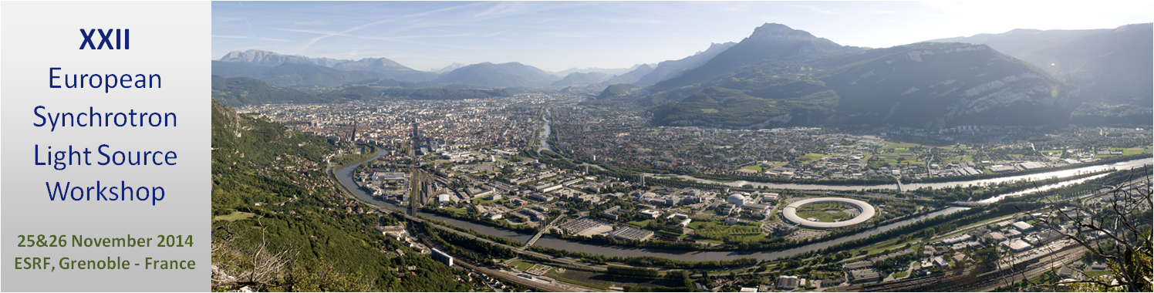

BINP superconducting insertion devices and their applications
A.V. Bragin, S.V. Khruschev, N.A. Mezentsev,
I.V. Poletaev, V.A. Shkaruba, V.M. Syrovatin, V.M. Tsukanov,
A.A. Volkov, E.B. Levichev, S.V. Sinyatkin,
K.V. Zolotarev
Budker Institute of Nuclear Physics, Novosibirsk, Russia

Slide 2
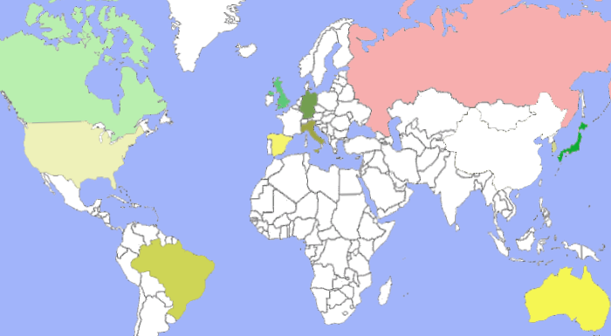
The history of superconductive ID fabrication in the Budker INP
1979 – first in the world 3.5 Tesla superconducting 20 pole wiggler (SCW) for VEPP-3
1984 – 5 pole 8 Tesla superconducting wiggler for VEPP-2
1985 – 4.5 Tesla Superconducting Wave Length Shifter (WLS) for Siberia-1, Moscow
1992 – 6 Tesla Superbend (SB) prototype for compact storage rings
1996 - 7.5 Tesla superconducting WLS for PLS, South Korea⁼
1997 - 7.5 T superconducting WLS with fixed point of radiation for CAMD-LSU (USA)
2000 – 7 Tesla WLS with fixed radiation point for BESSY-2, Germany
2000 – 10 Tesla WLS for Spring-8, Japan
2001 – 7 Tesla WLS with fixed radiation point for BESSY-2, Germany
2002 – 3.5 Tesla 49 pole SCW for ELETTRA, Italy
2002 – 7 Tesla 17 pole SCW for BESSY-2, Germany
2004 – 9 Tesla Superbend for BESSY-2, Germany
2005 – 13 Tesla superconducting solenoids for VEPP-2000
2005 – 2 Tesla 63 pole SCW for CLS, Canada
2006 – 3.5 Tesla 49 pole for DLS, England
2006 – 7.5 Tesla 21 pole SCW for Siberia-2, Moscow
2007 – 4.2 Tesla 27 pole SCW for CLS, Canada
2009 – 4.2 Tesla 49 pole SCW for DLS, England
2009 – 4.1 Tesla 35 pole SCW for LNLS, Brasil
2010 - 2.1 Tesla 119 pole SCW for ALBA, Spain
2012 - 4.2 Tesla SCW for Australian Light Source
2012 – 7.5 Tesla SCW for CAMD-LSU (USA)
2013 - SCW for ANKA
2013 - SCW for ANKA & CLIC with indirect cooling
2013 – 2 SCW for Siberia-2,
BINP

Slide 3
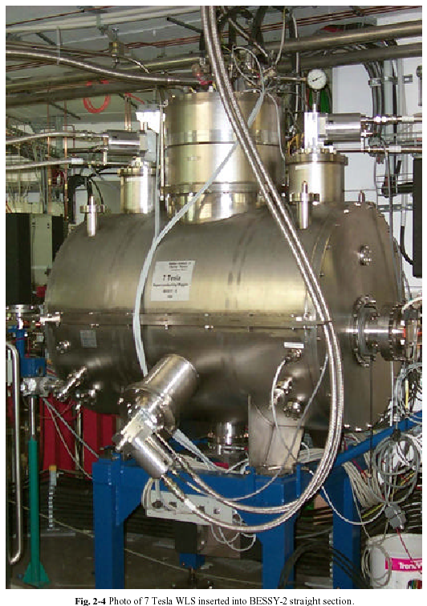
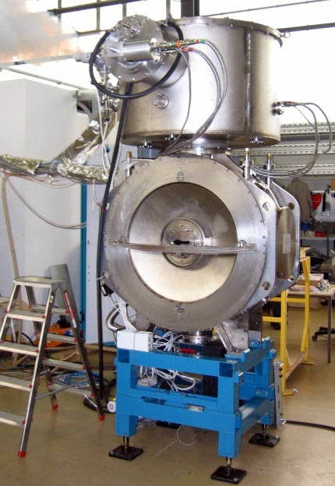
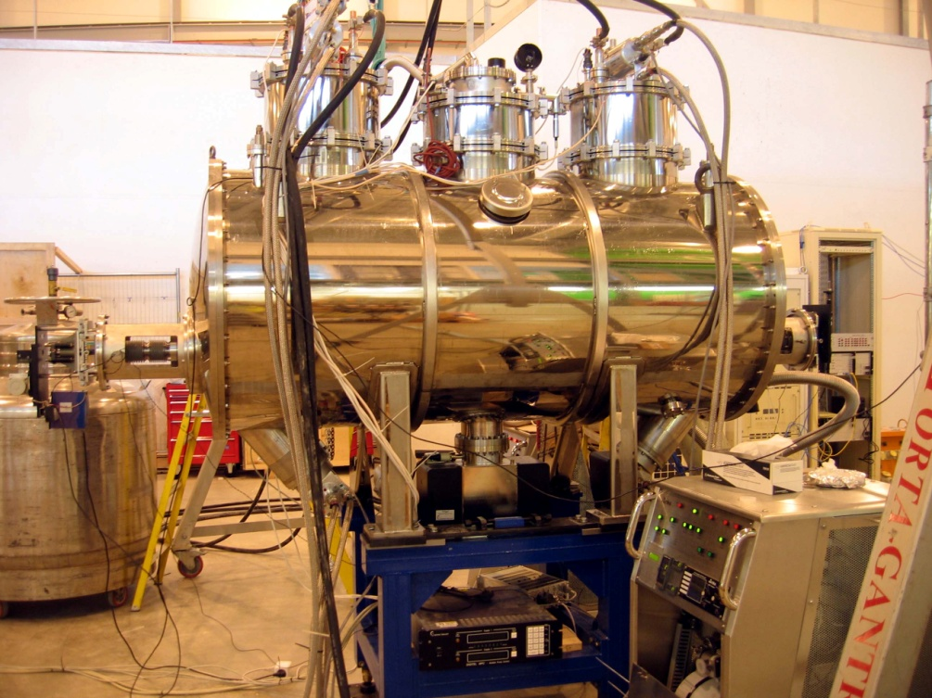
The history of superconductive ID fabrication in the Budker INP
1979 – first in the world 3.5 Tesla superconducting 20 pole wiggler (SCW) for VEPP-3
1984 – 5 pole 8 Tesla superconducting wiggler for VEPP-2
1985 – 4.5 Tesla Superconducting Wave Length Shifter (WLS) for Siberia-1, Moscow
1992 – 6 Tesla Superbend (SB) prototype for compact storage rings
1996 - 7.5 Tesla superconducting WLS for PLS, South Korea
1997 - 7.5 T superconducting WLS with fixed point of radiation for CAMD-LSU (USA)
2000 – 7 Tesla WLS with fixed radiation point for BESSY-2, Germany
2000 – 10 Tesla WLS for Spring-8, Japan
2001 – 7 Tesla WLS with fixed radiation point for BESSY-2, Germany
2002 – 3.5 Tesla 49 pole SCW for ELETTRA, Italy
2002 – 7 Tesla 17 pole SCW for BESSY-2, Germany
2004 – 9 Tesla Superbend for BESSY-2, Germany
2005 – 13 Tesla superconducting solenoids for VEPP-2000
2005 – 2 Tesla 63 pole SCW for CLS, Canada
2006 – 3.5 Tesla 49 pole for DLS, England
2006 – 7.5 Tesla 21 pole SCW for Siberia-2, Moscow
2007 – 4.2 Tesla 27 pole SCW for CLS, Canada
2009 – 4.2 Tesla 49 pole SCW for DLS, England
2009 – 4.1 Tesla 35 pole SCW for LNLS, Brasil
2010 - 2.1 Tesla 119 pole SCW for ALBA, Spain
2012 - 4.2 Tesla SCW for Australian Light Source
2012 – 7.5 Tesla SCW for CAMD-LSU (USA)
2013 - SCW for ANKA
2015 - SCW for ANKA & CLIC with indirect cooling

Slide 4
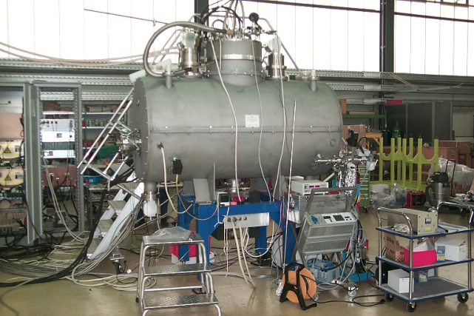
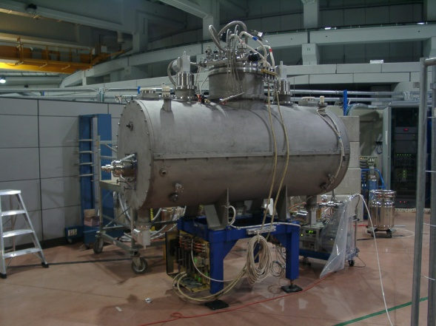
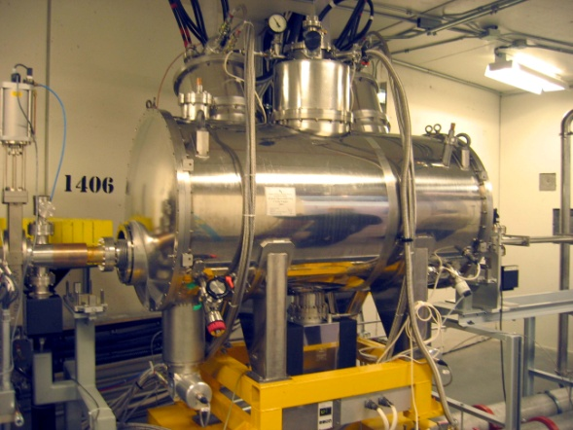

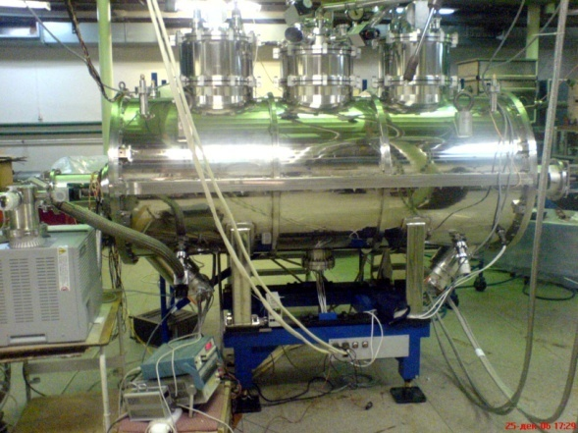
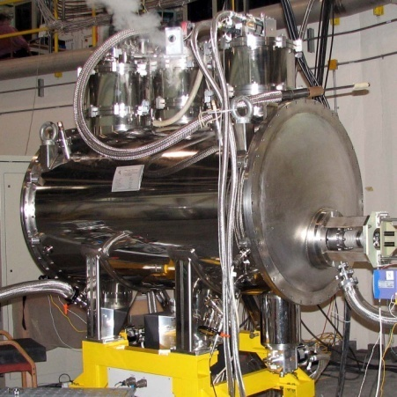
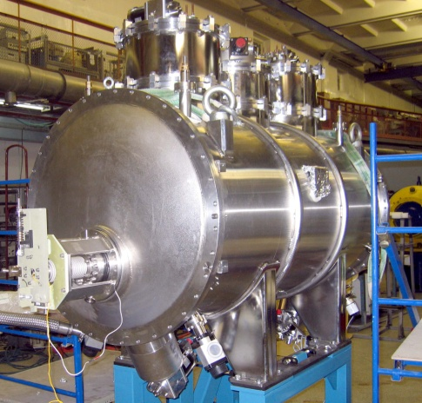
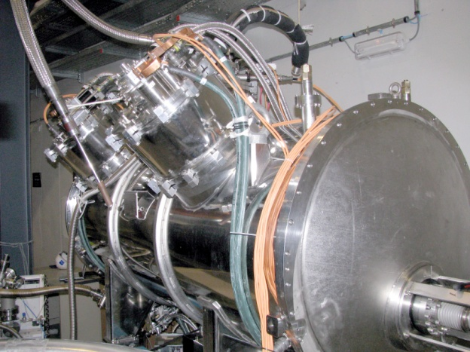
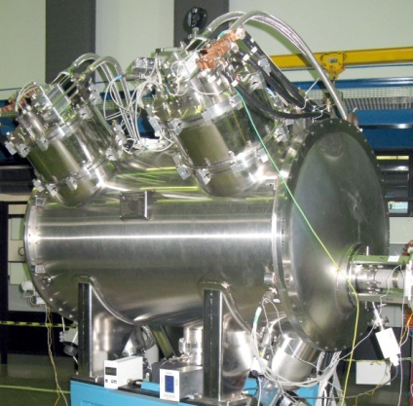
Superconducting multipole wigglers
BESSY, Germany, 2002
17-poles, 7 Tesla superconducting
wiggler
ELETTRA, Italy, 2002
49-pole 3.5 Tesla superconducting wiggler
CLS, Canada,
2004
63-pole 2 Tesla superconducting wiggler
CLS, Canada, 2007
27- poles 4 Tesla Superconducting wiggler
DLS, England, 2006
49-pole 3.5 Tesla superconducting wiggler
Moscow, Siberia-2, 2007
21-pole 7.5 Tesla superconducting wiggler
DLS, England, 2008
49-pole 4.2 Tesla superconducting wiggler
LNLS, Brazil, 2009
35-pole 4.2 Tesla superconducting wiggler
ALBA, Spain, 2010
119-pole 2.1 Tesla superconducting wiggler

Slide 5
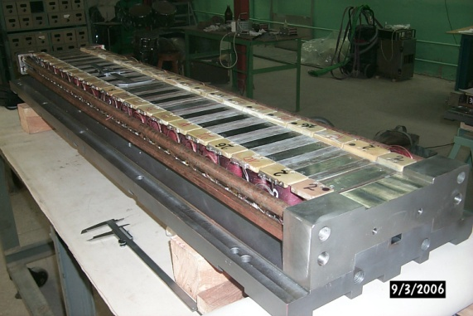
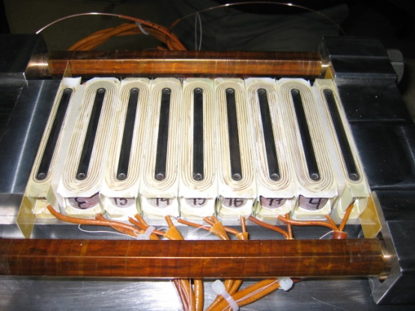
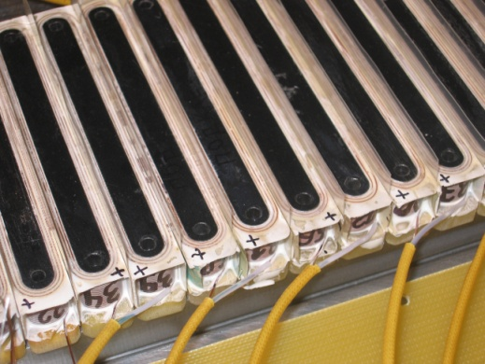
The history of superconductive ID fabrication in the Budker INP
1979 – first in the world 3.5 Tesla superconducting 20 pole wiggler (SCW) for VEPP-3
1984 – 5 pole 8 Tesla superconducting wiggler for VEPP-2
1985 – 4.5 Tesla Superconducting Wave Length Shifter (WLS) for Siberia-1, Moscow
1992 – 6 Tesla Superbend (SB) prototype for compact storage rings
1996 - 7.5 Tesla superconducting WLS for PLS, South Korea
1997 - 7.5 T superconducting WLS with fixed point of radiation for CAMD-LSU (USA)
2000 – 7 Tesla WLS with fixed radiation point for BESSY-2, Germany
2000 – 10 Tesla WLS for Spring-8, Japan
2001 – 7 Tesla WLS with fixed radiation point for BESSY-2, Germany
2002 – 3.5 Tesla 49 pole SCW for ELETTRA, Italy
2002 – 7 Tesla 17 pole SCW for BESSY-2, Germany
2004 – 9 Tesla Superbend for BESSY-2, Germany
2005 – 13 Tesla superconducting solenoids for VEPP-2000
2005 – 2 Tesla 63 pole SCW for CLS, Canada
2006 – 3.5 Tesla 49 pole for DLS, England
2006 – 7.5 Tesla 21 pole SCW for Siberia-2, Moscow
2007 – 4.2 Tesla 27 pole SCW for CLS, Canada
2009 – 4.2 Tesla 49 pole SCW for DLS, England
2009 – 4.1 Tesla 35 pole SCW for LNLS, Brasil
2010 - 2.1 Tesla 119 pole SCW for ALBA, Spain
2012 - 4.2 Tesla SCW for Australian Light Source
2012 – 7.5 Tesla SCW for CAMD-LSU (USA)
2013 - SCW for ANKA
2015 - SCW for ANKA & CLIC with indirect cooling
Long period SC multipole wigglers
(B₀ =7-7.5 Tesla,
λ₀~150-200 mm)
Medium period SC wigglers
(B₀ =3.5-4.2 Tesla,
λ₀~48-60 mm)
Short period SC wigglers
(B₀ =2-2.2 Tesla,
λ₀~30-34 mm)

Slide 6
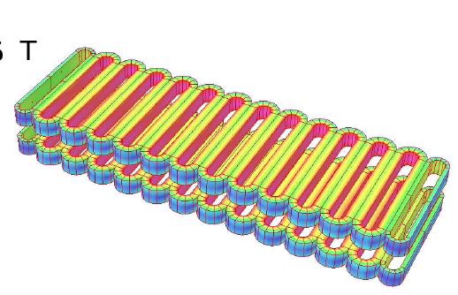
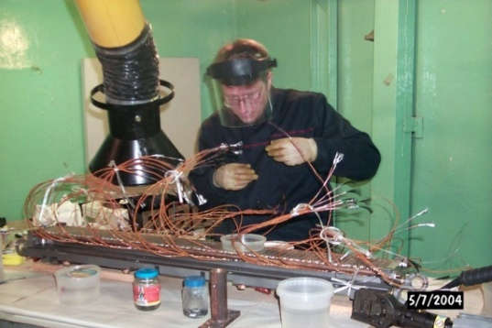
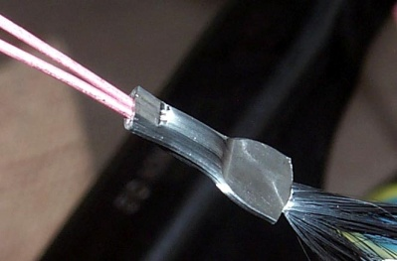
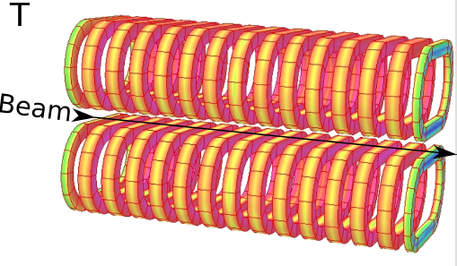
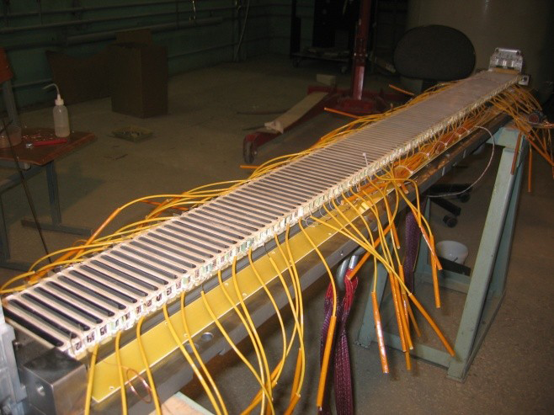
Vertical racetrack coils
Resistance of the connection 10⁻¹⁰- 10⁻¹³ Ohm
Advantages of horizontal racetrack coil technology
Simplicity of the design
Simplicity manufacturing and testing of single coil
Lowest inductivity and stored energy
Possibility to good thermo stabilization of the coil with using Gd₂O₂S powder add mixture to the epoxy compound (in wet winding technology)
Disadvantage
Technology not suitable for mass production of the big number of wigglers (for ex. for CLIC DR)

Slide 7
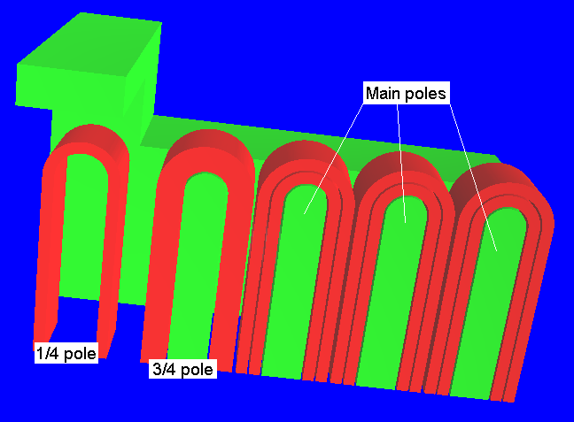
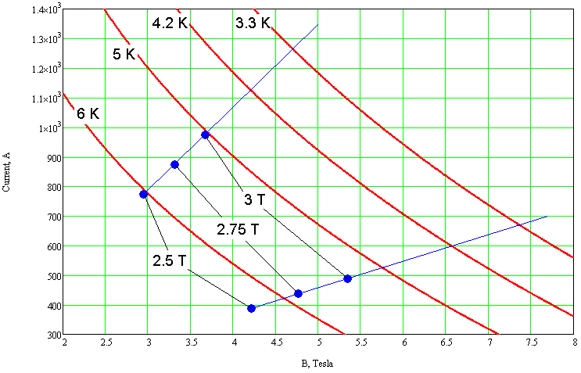
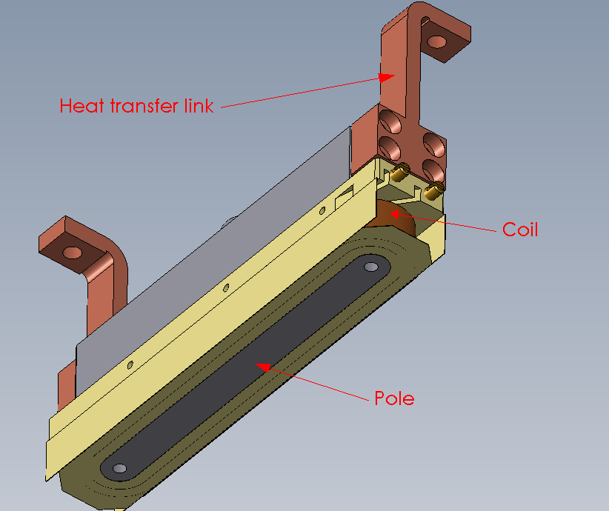
Nested coils

Slide 9
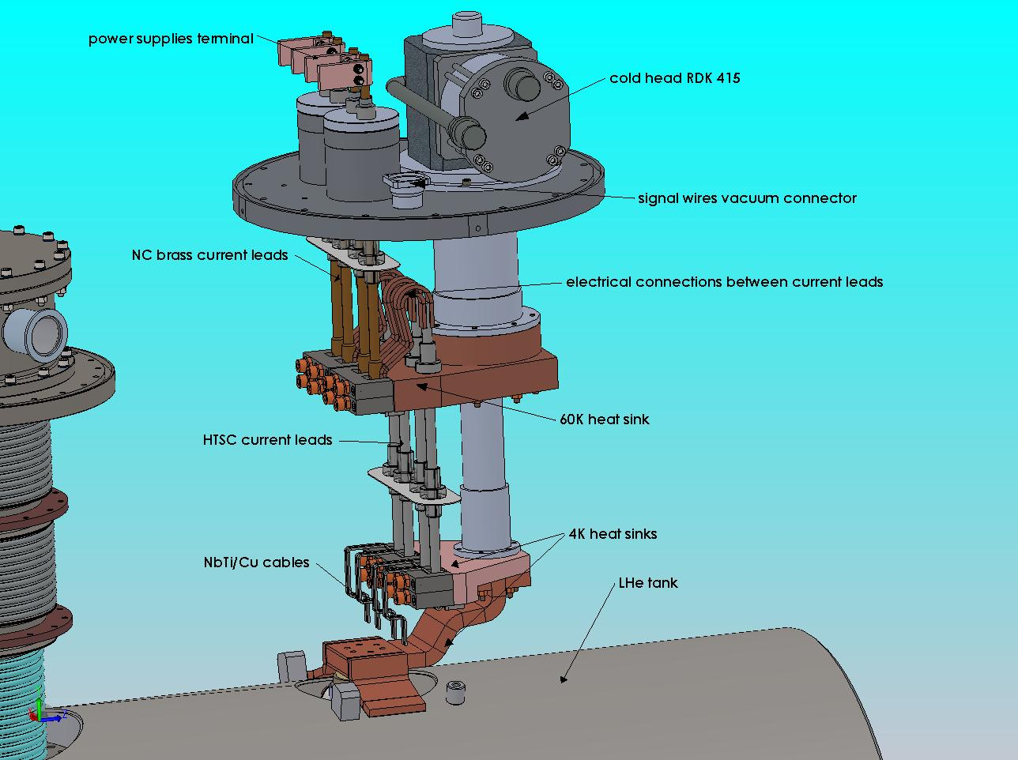
Current lead design

Slide 10
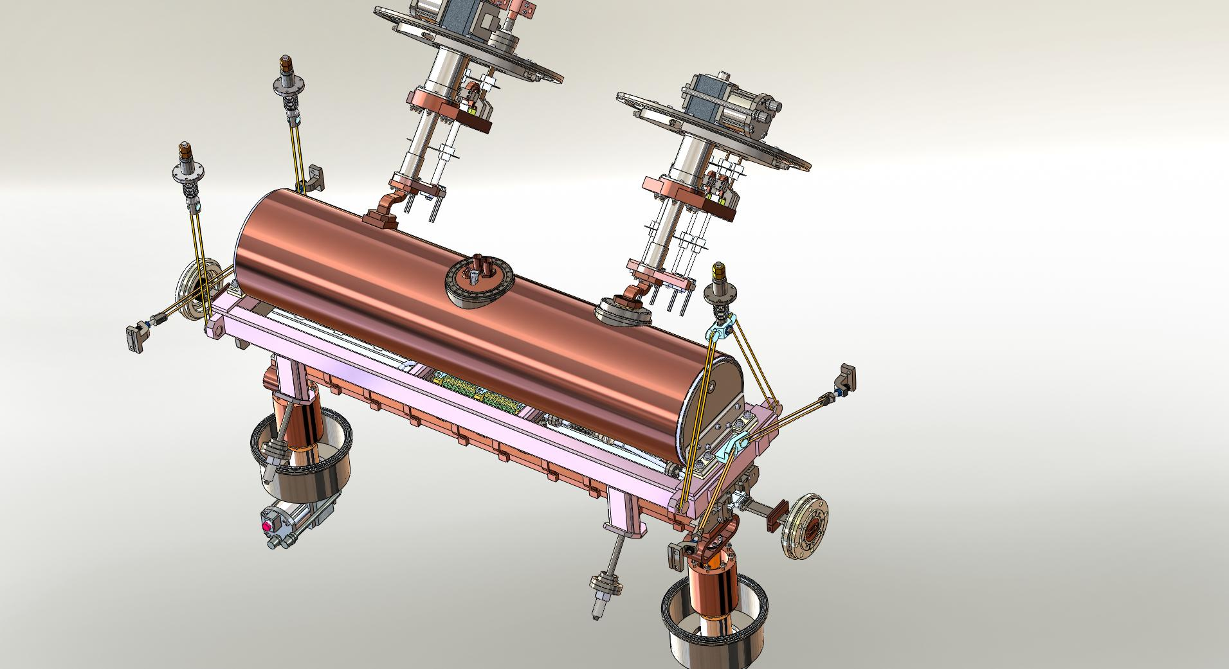
Cold mass support structure
Cold mass is hung on Kevlar strings attached to the cold mass support base on one side and to the vacuum vessel on the other.
Vertical support points
Support system:
3 vertical support points;
4 horizontal support points;
4 transport position stoppers
Horizontal position fixing points
Vertical support point
Kevlar strings
Horizontal position fixing points
Cold mass base frame
Transport position keepers

Slide 11
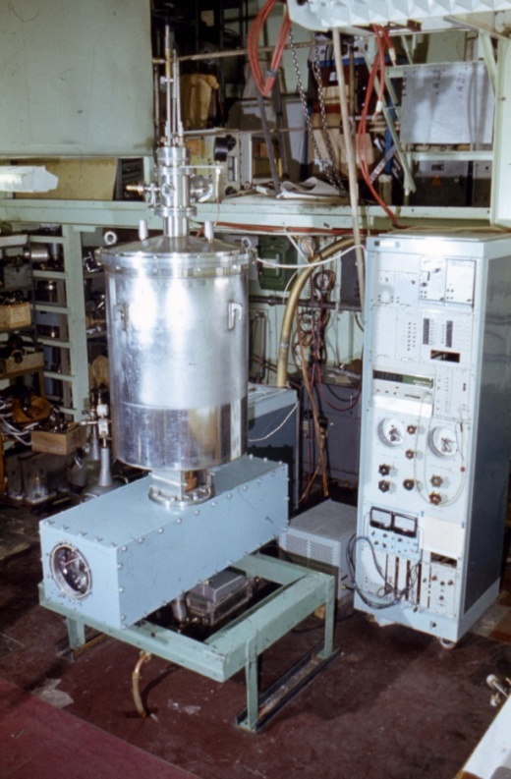
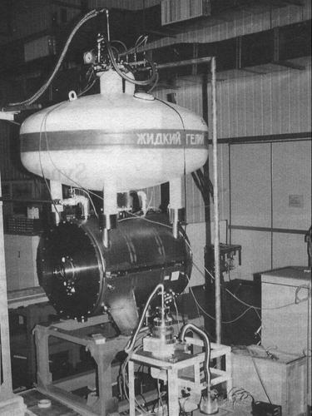
The history of superconductive ID fabrication in the Budker INP
1979 – first in the world 3.5 Tesla superconducting 20 pole wiggler (SCW) for VEPP-3
1984 – 5 pole 8 Tesla superconducting wiggler for VEPP-2
1985 – 4.5 Tesla Superconducting Wave Length Shifter (WLS) for Siberia-1, Moscow
1992 – 6 Tesla Superbend (SB) prototype for compact storage rings
1996 - 7.5 Tesla superconducting WLS for PLS, South Korea
1997 - 7.5 T superconducting WLS with fixed point of radiation for CAMD-LSU (USA)
2000 – 7 Tesla WLS with fixed radiation point for BESSY-2, Germany
2000 – 10 Tesla WLS for Spring-8, Japan
2001 – 7 Tesla WLS with fixed radiation point for BESSY-2, Germany
2002 – 3.5 Tesla 49 pole SCW for ELETTRA, Italy
2002 – 7 Tesla 17 pole SCW for BESSY-2, Germany
2004 – 9 Tesla Superbend for BESSY-2, Germany
2005 – 13 Tesla superconducting solenoids for VEPP-2000
2005 – 2 Tesla 63 pole SCW for CLS, Canada
2006 – 3.5 Tesla 49 pole for DLS, England
2006 – 7.5 Tesla 21 pole SCW for Siberia-2, Moscow
2007 – 4.2 Tesla 27 pole SCW for CLS, Canada
2009 – 4.2 Tesla 49 pole SCW for DLS, England
2009 – 4.1 Tesla 35 pole SCW for LNLS, Brasil
2010 - 2.1 Tesla 119 pole SCW for ALBA, Spain
2012 - 4.2 Tesla SCW for Australian Light Source
2012 – 7.5 Tesla SCW for CAMD-LSU (USA)
2013 - SCW for ANKA
2015 - SCW for ANKA & CLIC with indirect cooling

Slide 12
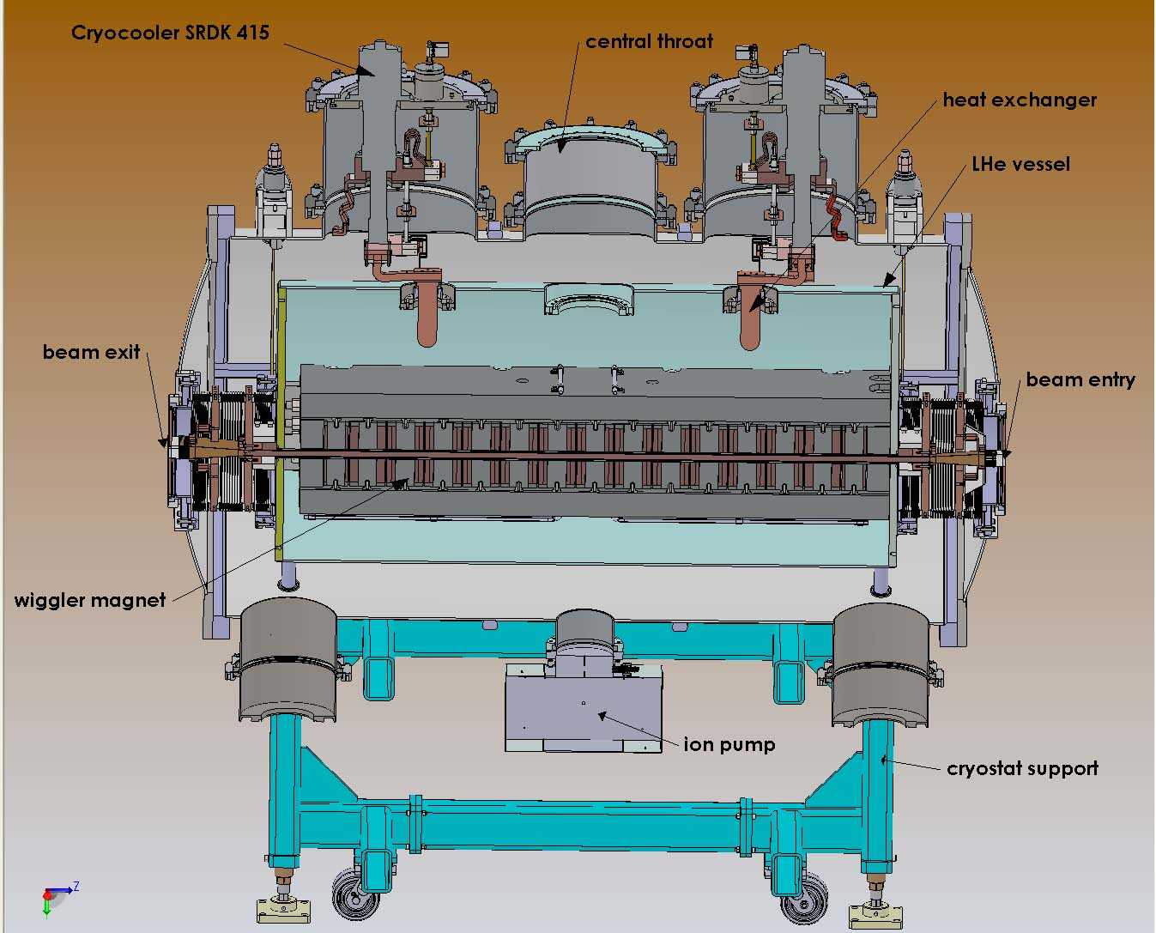
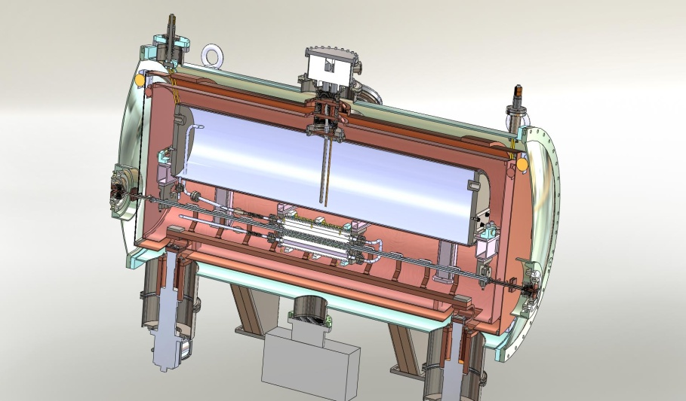
Indirect cooling conception
SC magnet
He fill/vent turret
LHe vessel
LHe piping
20 K radiation shield
60 K radiation shield
Beam chamber
Beam chamber
thermal link to cryocooler
Direct cooled magnet (magnet in bath cryostat)
Indirect cooled magnet (magnet in isolation vacuum)
Advantages of indirect cooling
Easy access to the magnetic system and to the beam vacuum chamber
Possibility for exchanging of the elements of magnetic system (and whole system) without complex operation
Possibility for exchanging the beam vacuum chamber
Possibility for installing of the wigglers in the halls with lower ceilings
Effective using of the magnetic gap

Slide 13
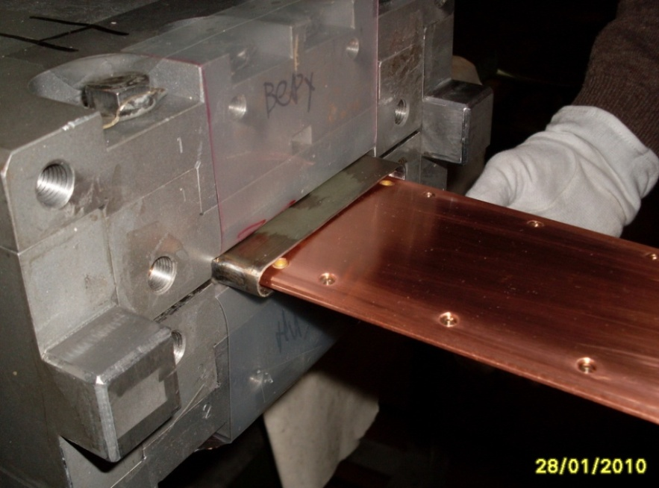
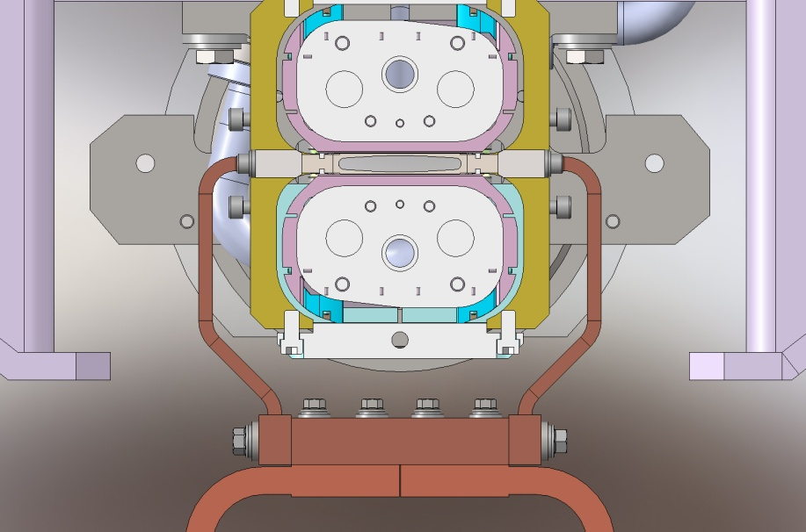
Pole gap and electron beam vertical aperture
Indirect cooling magnet
Magnet in insulating vacuum
Direct cooling magnet with liquid
helium (magnet in bath cryostat)
Pole gap= V aperture + 4 mm
Pole gap = V aperture + 1.5 mm

Slide 14
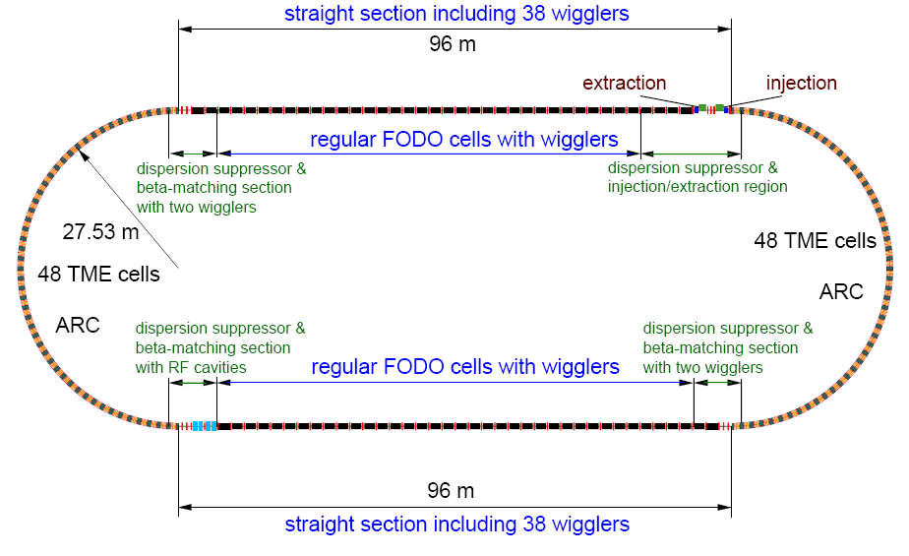
CLIC Damping ring

Slide 15
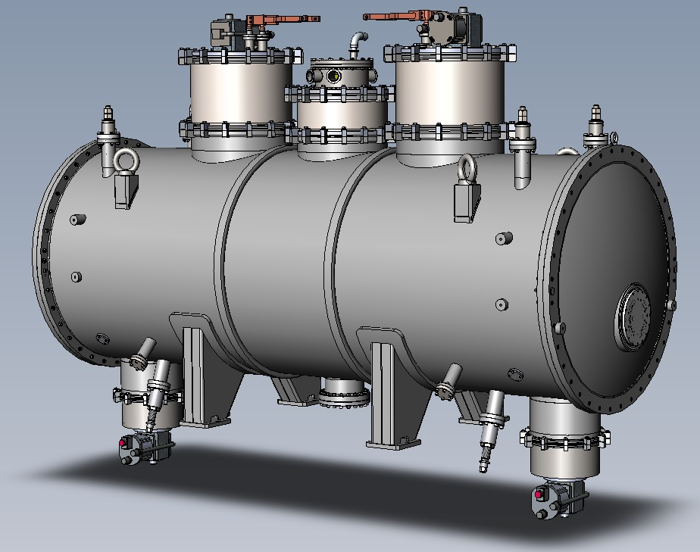
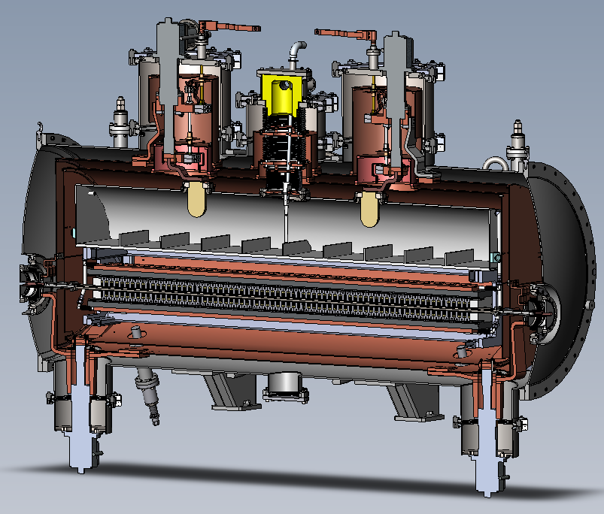
General view ANKA/CLIC wiggler
Total number of poles | 72
Number of main poles | 68
Number of additional poles | 4
Period | 51 mm
Magnetic gap | 18 mm
Peak magnetic field on the main poles | 3 T
Currents | 243 A x4
Stored energy | 60 kJ
Aperture | 13 mm x
Additional requirements
Possibility for exchanging of the magnetic system in future
Possibility for exchanging of the beam vacuum pipe
Heating vacuum pipe till 90 K
Heating vacuum pipe with power load up to 50 W (with keeping temperature about 40 K)
Possibility of activation of the NEG-coating (up to 200º C)

Slide 16

Heat pipe cooling concept
T = 4 K
cooler
T = 300 K
P = 100 bar
LHe
Gold coated
hemisphere
Magnet
LHe drops
cooler
GHe vapor
Micro pore
material
GHe vapor
Heat pipes can provide reliable cooling of magnetic system
The effective thermo conductivity of He filled pipe (100 bar, room temperature) is about 400 fold higher than for equivalent cupper link
LHe
Magnet

Slide 17
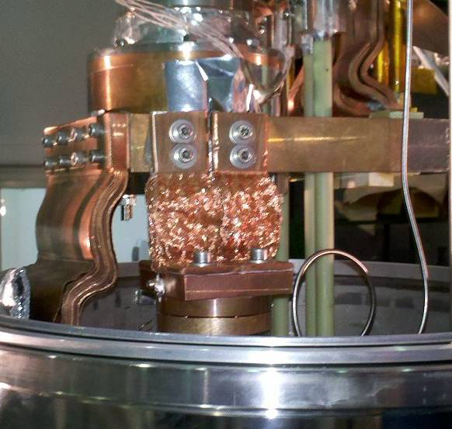
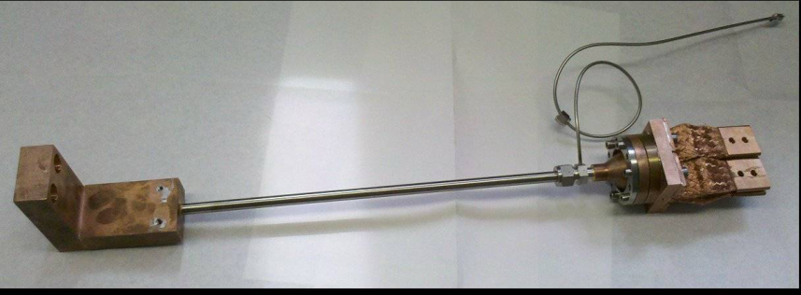
Nitrogen filled heat pipe
Cryogenic cooler
He heat pipe
Working range 3-300 K
Evacuation rate 2 W
N heat pipe
Working range 70-300 K
Evacuation rate 20 W
N filed pipe can be operate like a thermal key and can be used for initial fast cooling with using first stage of cryocooler
Magnet

Slide 18
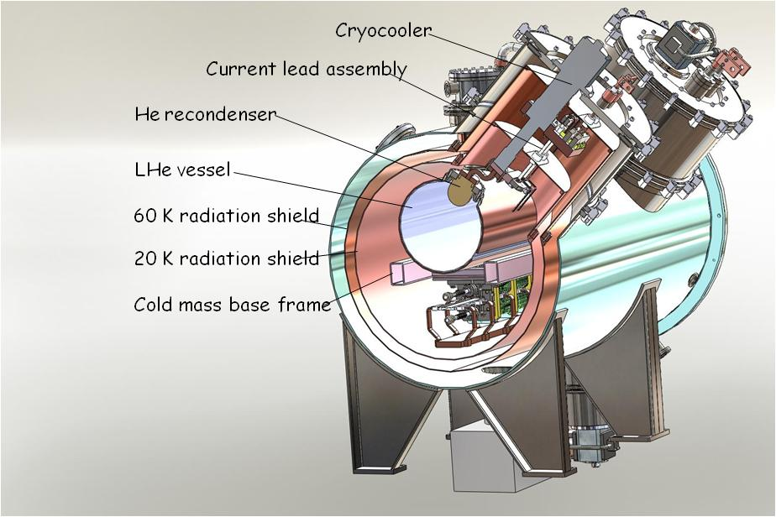
Plans and perspectives
Superconducting undulators
  Horizontal racetrack configuration
  Period ~ 15 – 18 mm
  Indirect cooling cryostat
Longitudinal gradient dipole magnets
  A.Wrulich & R.Nagaoka (1992) EMITTANCE MINIMIZATION WITH LONGITUDINAL DIPOLE FIELD VARIATION

Slide 19
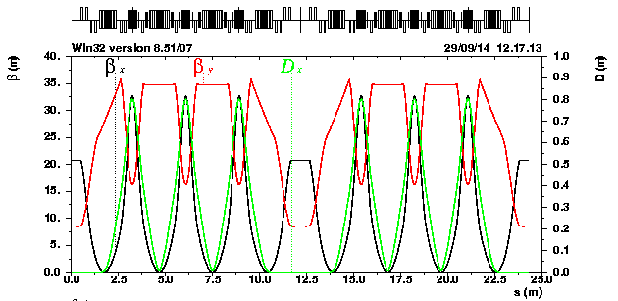
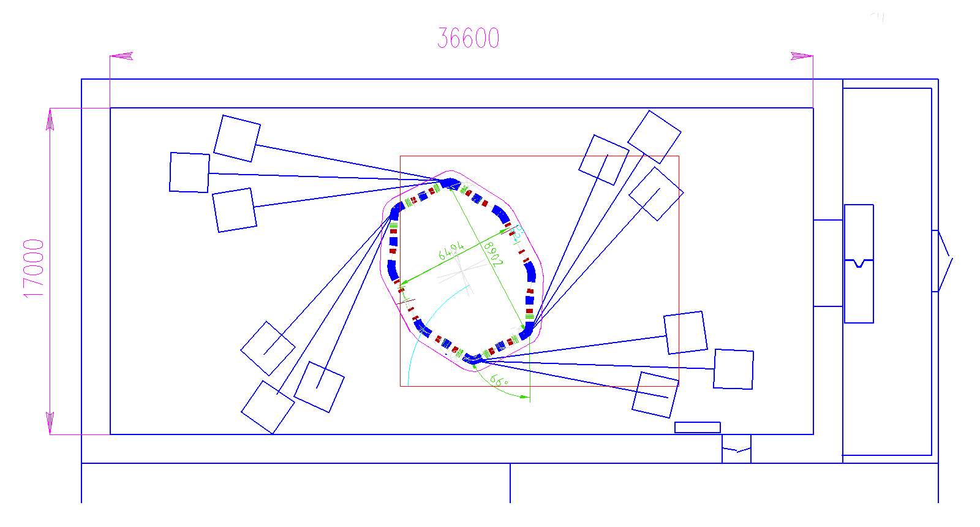
Supercompact high bright hard X-ray light source
Energy E, GeV | 1 | Damping time
Circumference, m | 24.3 | tx, sec | 0.0007
Revolution period, sec | 8.11E-08 | ty, sec | 0.0011
Betatron tunes |  | te, sec | 0.0007
qx | 3.96 | Sigma_s, mm | 9.0
qy | 0.18 | RF voltage | 4.59E-01
Emittance, nm*rad | 12.1 | RF harmonic number | 43
Betatron coupling | 0.5 % | RF frequency, MHz | 500
Energy spread | 1.40E-03 | RF acceptance | 2.E-02
Momentum compaction | -8.16E-03 | Synchrotron tune | 4.9E-03
Energy loss, MeV | 1.49E-01 | Radiation integral
Damping partition number |  | I1, m | -1.98E-01
Jx | 1.53 | I2, m^-1 | 1.06E+01
Jy | 1 | I3, m^-2 | 2.07E+01
Je | 1.47 | I4, m^-1 | -5.57E+00
 |  | I5, m^-1 | 1.33E-01

Slide 20
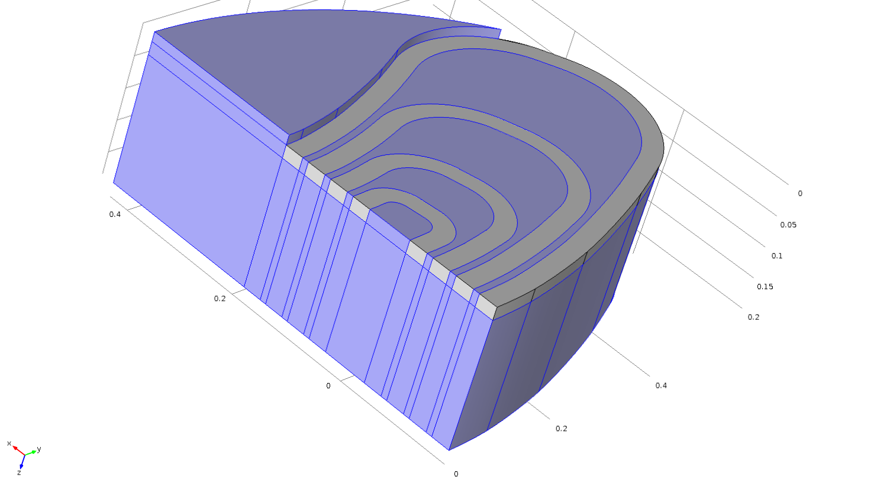
Superconducting dipole with longitudinal variation of the field

Slide 21
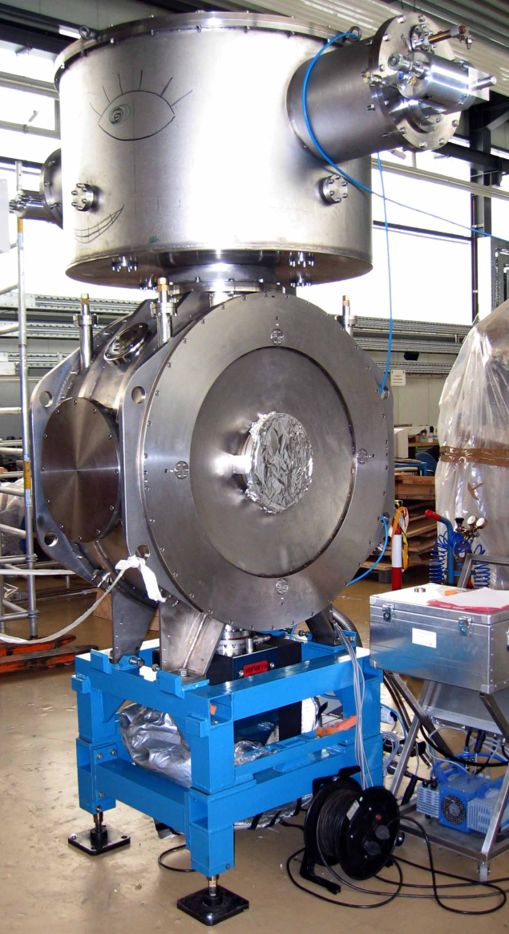
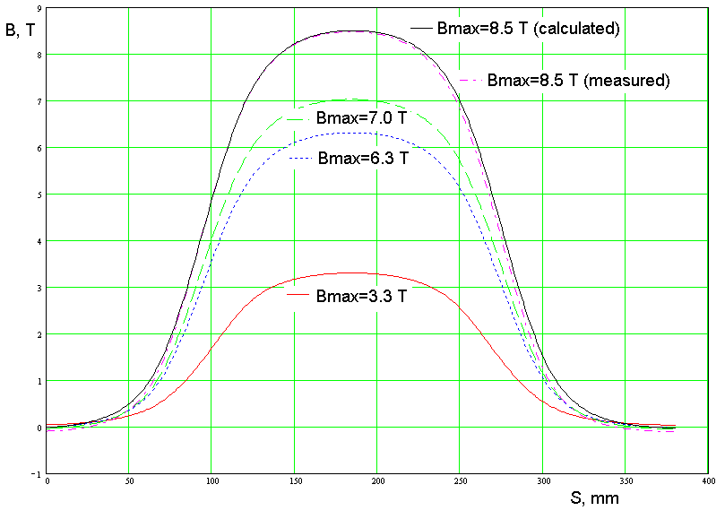
Superconducting dipole for BESSY-II
Vertical aperture, mm Horizontal aperture, mm | 30 75
Pole gap, mm | 46
Operating magnetic field, T Maximum magnetic field, Т | 3.3 - 8.5 9.6
Coil material | Nb₃Sn, NbTi
Edge angle, degree | 1.3
Current in coil for 8.5 T, A | 264
Ramping time 0-7 Tesla, min Ramping time 0-9 Tesla, min | <5 <15
Eff. magnetic length along beam, m | 0.1777
Bending angle, degree | 11.25
Bending radius, m | 0.905
Stored energy for 8.5 T, kJ | 180
Cold mass, kg | 1300
Liquid He consumption | ~0.5 l/h

Slide 22
Acknowledgment
A.V. Bragin, S.V. Khruschev, N.A. Mezentsev, E.G. Miginskya, I.V. Poletaev,
V.A. Shkaruba, V.M. Syrovatin, V.M. Tsukanov, A.A. Volkov, E.B. Levichev, S.V. Sinyatkin,
BINP, Novosibirsk
Axel Bernhard, Erhard Huttel, Sara Casalbuoni, Peter Peiffer, Steffen Hillenbrand
KIT, Karlsruhe,
Daniel Schörling, Paolo Ferracin, Laura Garcia Fajardo
CERN
Thanks for you attention

