Slide 1
Femto-Slicing project at SOLEIL
M.-A. Tordeux
on behalf of the Femto-Slicing project team

Slide 2
Outline
Motivation for a Femto-Slicing project
SOLEIL specificities
Setup
Commissioning
Outlook

Slide 3
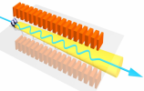
SOLEIL specificities
1) One single laser Ti:Sa 800 nm, 5 W, 1 kHz, 30 fs-fwhm for the machine and for the CRISTAL beamline
Laser
Beam
SDM6
SDC6
SDM7
dipole
SDC7
cor
SDM8

Slide 4
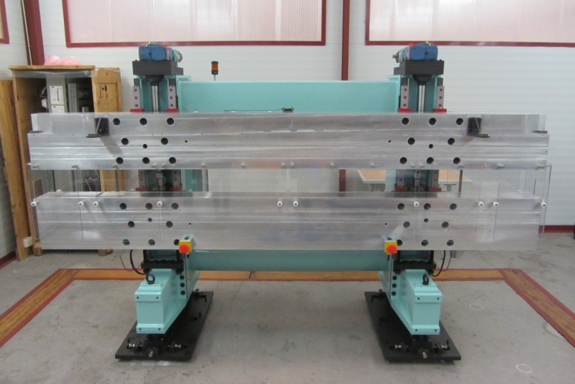
SOLEIL specificities
2) Modulator = a wiggler used for femto-slicing and as a source for PUMA beamline
Laser
Beam
Wiggler Type | Hybrid out-vacuum
Magnetic period | 164.4 mm
Period number | 20
Magnetic gap | 14.5 mm – 240 mm
Magnetic components | Poles: VACOFLUX50 (Saturat. field: 2.35 T) Magnets: VACODYM 764 TP (magn.: 1.37 T)
Max. magnetic field | 1.81 T
Modulator
Wiggler
PUMA BL
SDM6
SDC6
SDM7
SDC7
cor
SDM8

Slide 5
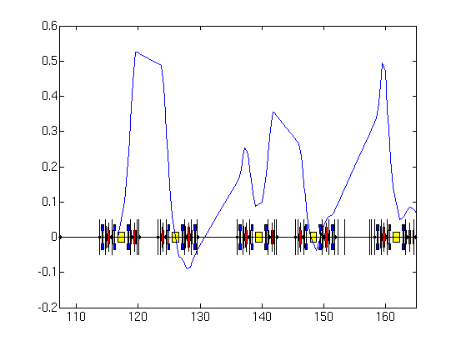
SOLEIL specificities
3) Slice separation using
the machine’s horizontal dispersion function
Effective Dispersion
D_{eff} (m)
3 mm
Shifted diaphragm in BL frontend
Laser
Beam
Modulator
Wiggler
S (m)
SDM6
SDC6
SDM7
SDC7
Slice
SDM8
cor
Additional chicane to reduce the photon emission angle
Core

Slide 6
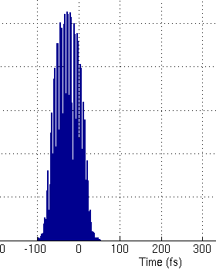
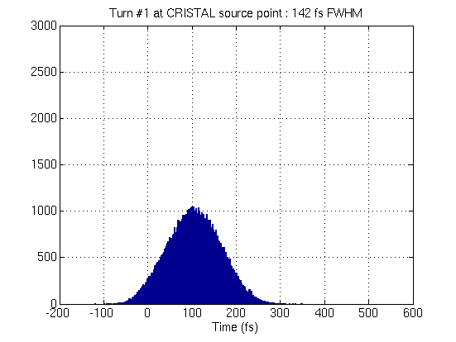
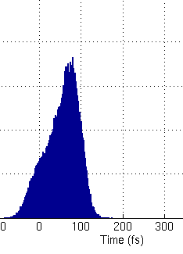
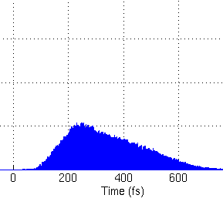
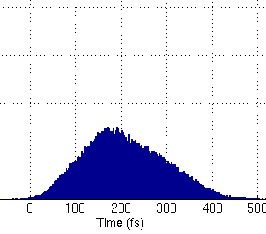
SOLEIL specificities
4) Delivery to several beamlines:
2 ″ Phase 1 ″ beamlines (CRISTAL, TEMPO)
2 beamlines under study (DEIMOS, GALAXIES)
1 extra possible beamline ? (SEXTANTS)
75 fs
75 fs
Laser
Beam
140 fs
Modulator
Wiggler
80 fs
300 fs
CRISTAL
(U20)
DEIMOS
(HU52 + HU65)
GALAXIES
(U20)
210 fs
cor
TEMPO
(HU44 + HU80)

Slide 7
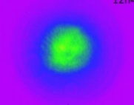
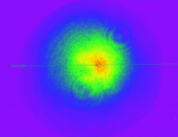
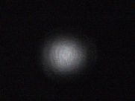
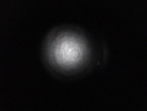
Setup
DIAG_103
Laser: 80 m transport line from CRISTAL Laser hutch to interaction point under primary vacuum
ENC103
5 mirrors under x-y remote control
ENC102
5 centering diagnostics
1 pointing diagnostic
Foreseen position feedback
ENC104
LENS 9 m
55 m
MgF₂
ENC101
MgF₂
STORAGE RING ROOF
Wiggler
DIAG_101
0 : Wiggler
DIAG_001
ENC105
STORAGE RING TUNNEL
LASER ROOM
LASER
Output
DIAG_02
DIAG_IR
CRISTAL BL
DIAG_00
DIAG_01
DIAG_20
PUMA BL
EXPERIMENTAL HALL

Slide 8
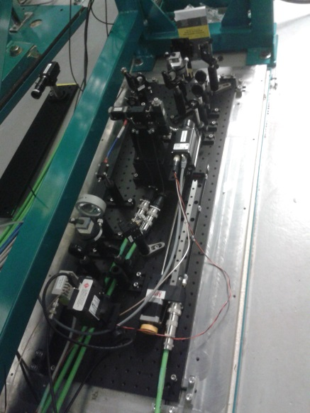
Setup
Infra-Red Diagnostics: measure the overlaps between Laser and SR radiations
→ inside the Storage Ring tunnel,
under the PUMA beamline frontend.
Wiggler
0 : Wiggler
Spatial overlap:
Optics + CCD for imaging in the wiggler
Basler
Spectral overlap:
    Spectrometer
    Ocean Optics USB2000
    Temporal overlap:
    Fast photodiode
    FPD 310-FV from Menlo
In Vacuum Cu Mirror
Saphhire Window
Filters
2.5 m Lens
R_{max} Mirror
MIR 001
WIN 001
FGL 610
LEN 100
MIR 002
DIAG_IR
Optical fiber
STORAGE RING TUNNEL
900 mm
Translation stage for CCD
300 mm

Slide 9
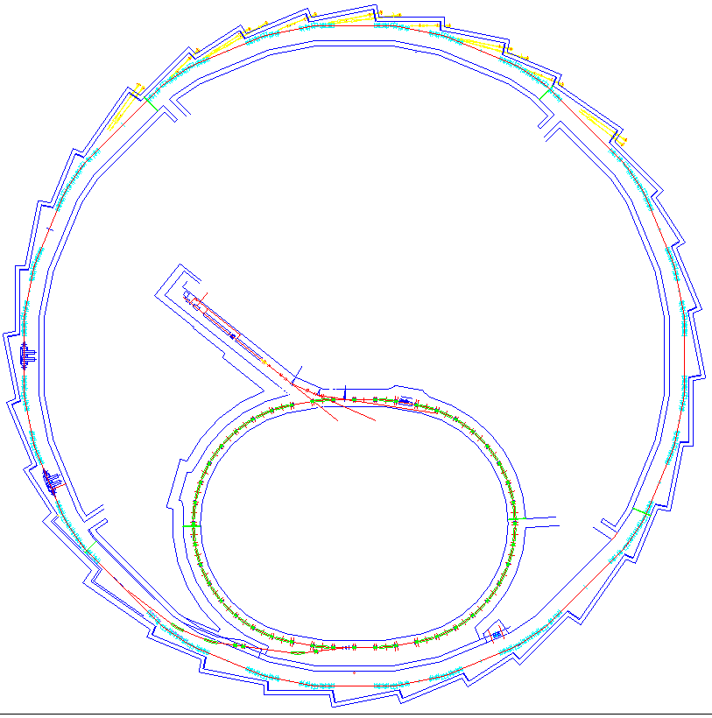

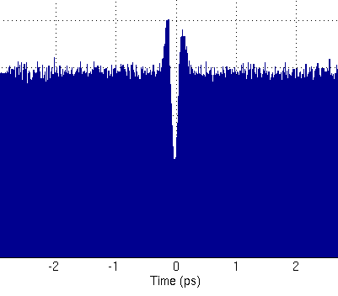
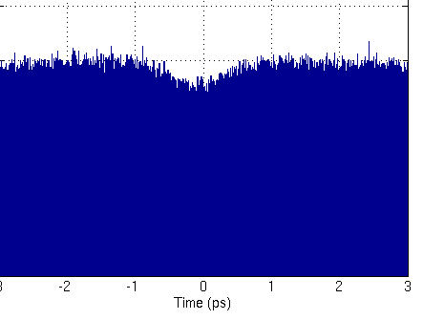
Setup
PUMA BeamLine
fs pulses → CRISTAL BeamLine
THz Diagnostics: evaluates the dip in the beam core using the THz beamline AILES
Laser
Wiggler
fs pulses →
TEMPO BeamLine
laser
1
0
    High sensitivity measurements:
    Bolometer
    QMC 1 ms, SAI card
    IR Labs 1.7 µs, oscillo Lecroy 1GHz
Fast measurements (turn by turn):
    THz diode
    Virginia Diode Virginia 1 nsdiodes)
-1 0 1
Time (ps)
10 m
1
0
THz pulses extracted @ AILES beamline
-1 0 1
Time (ps)

Slide 10
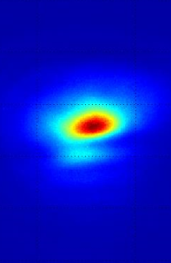
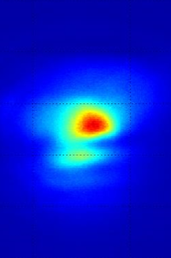
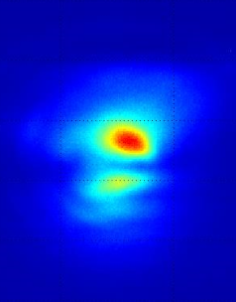
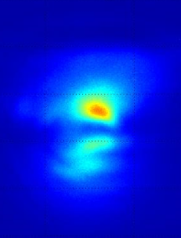
Commissioning
Difficult issues
Transport of laser:
Two steps of alignment: use of a focused mode for first alignment with electrons (minimizes diffraction / reflections in narrow chambers), then use of the collimated mode.
IR Diagnostics:
  Inside the Storage Ring tunnel → lack of access !
  Strong difference in intensity between laser and SR
  Imaging system suffering from distortion at I_{e-} > 1 mA.
  still under investigation
wiggler
wiggler
1
2
1 2 3 4 mA

Slide 11
Commissioning
Chronology
Start of commissioning: late Dec 2013
Dedicated time during shutdowns for some laser mirror re-alignment, laser diagnostic optimization.
20 dedicated machine sessions (often too short..) for :
  Alignment of IR diagnostics on the Synch. Radiation and setup optimization
  Alignment of laser up to IR diagnostics board
  Optimization of the whole protocol for interaction
  Three 12h sessions for systematic interaction test (e- bumps, synchronisation)
  On the 3rd one (September 29), we changed bolometer, from the 1 ms to the 1.7 µs response time one. Interaction is seen..

Slide 12
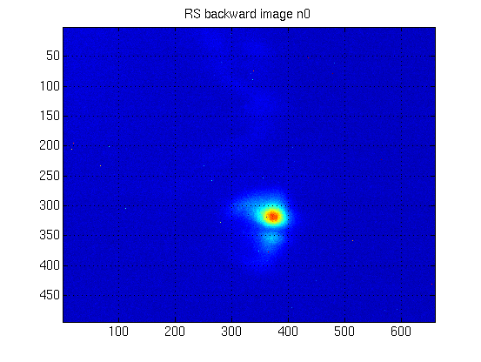
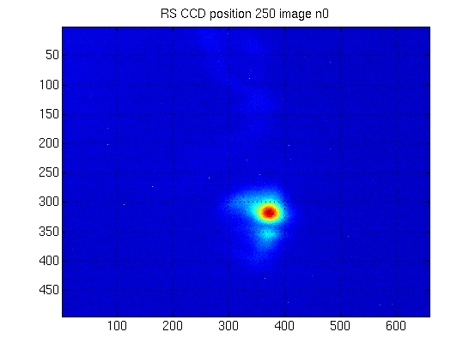
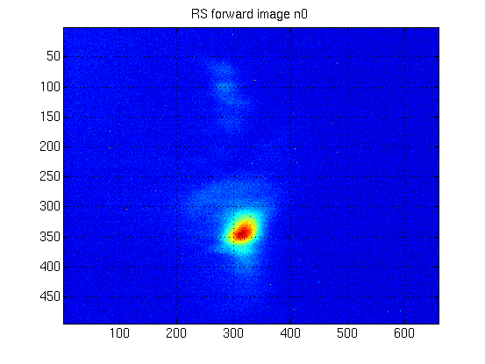
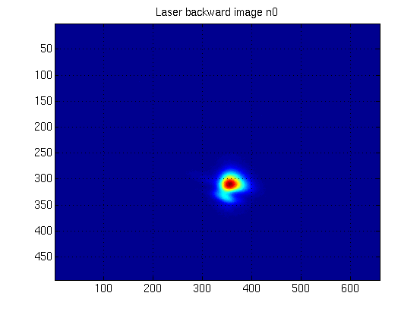
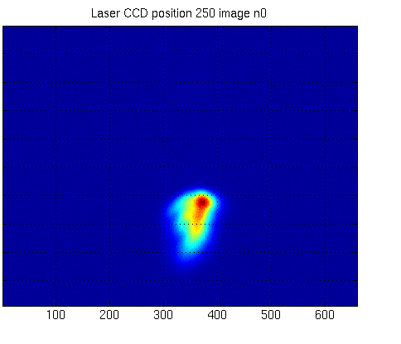
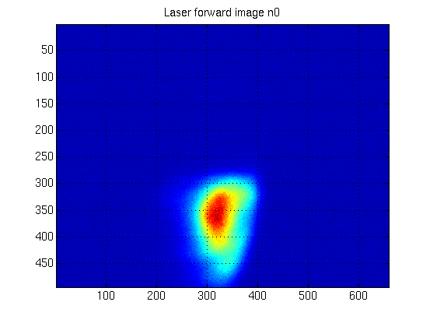
Commissioning
(1) Alignment in the Wiggler of SR and laser (in focused mode and low power)
SR
Wiggler entry
Wiggler middle
Wiggler exit
Laser
1 pixel on the CCD ≡ 20 µm in the transverse plane of the wiggler

Slide 13
Commissioning
(2) Change of the laser mode (collimated, 4 W)
(3) Adjustment of the spectral overlap
No straight forward measurement of the spectral overlap (presence of filters on the IR diagnostics board)
  Measure the laser spectrum in the laser hutch
  Define the central wavelength
  Adjust the wiggler gap to the resonant wavelength
Wiggler gap [mm] | Lambda Res [nm] from magnetic measurements
14.5 | 941.7
15 | 902.07
15.5 | 864.61
16 | 829.86
16.3 | 810.01
16.4 | 803.60
16.5 | 797.17
16.6 | 790.9
16.7 | 784.68
16.8 | 778.51
17 | 766.53
20 | 618.73
Laser

Slide 14
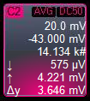

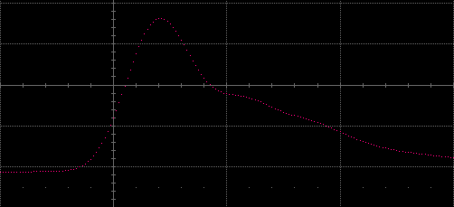
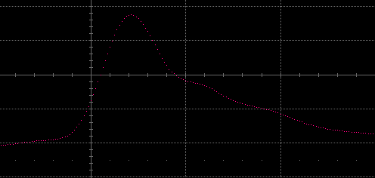
Commissioning
(4) Synchronisation
  Measure arrival time of the SR on the photodiode, without laser.
  Add filters, open the laser shutter, adapt the optical fiber to equal SR and laser intensity level.
  Measure arrival time of the laser, adjust the laser delay to equal the SR’s.
  Final resolution: 10 ps
SR
Laser
1 ns

Slide 15
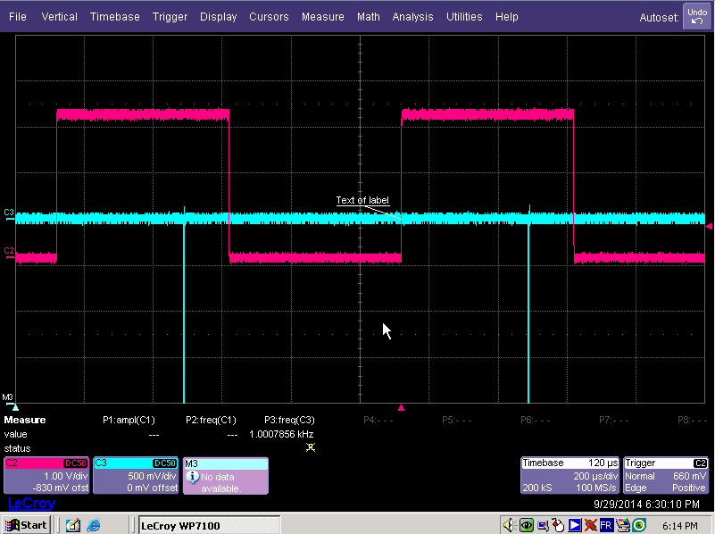
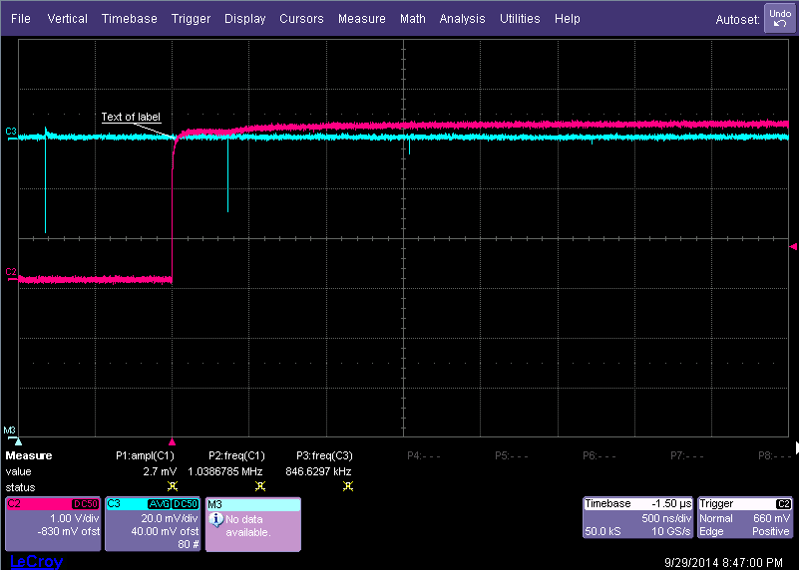
Commissioning
First results : THz intensity measurement
1 kHz trigger
Bolometer signal = Interaction !!
1st turn
2nd turn
3rd turn
4th turn
  With the bolometer (0.1 – 3 THz BW), we saw signals of a few V at laser repetition rate.
  After a rough optimisation, we saw signals for up to 4 turns with the fast diode (0.3 – 0.5 THz BW).

Slide 16
Commissioning
Very first optimizations versus THz signal
U bolometer (V)
U bolometer (V)
e- vertical bump (µm)
Laser focusing (afocal in mm)
U bolometer (V)
U bolometer (V)
e- horizontal bump (µm)
Laser delay (ps)

Slide 17
Outlook
2014
2015
2016
2017
INSTRUMENT
BASIS OK
THz
Optimisation
fs-X^{ph} on CRISTAL
Detect - Optimisation
CRISTAL
fs-TR EXPERIMENT @ 1 kHz
BT Implementation
1 kHz – 5 W LASER SYSTEM Management
5 kHz LASER SYSTEM
OTCX Implementation
BT
OK
THz
Caract.
THz
Optimisation
CRISTAL
fs-TR EXP. @ 5 kHz
X^{Ph} Detect/Optim
on CRISTAL
5 kHz – 25 W LASER SYSTEM Management
BT Implementation
TEMPO
fs-TR EXPERIMENT @ 1 kHz
Chicane impl.
DEIMOS, GALAXIES, SEXTANTS slicing feasibility study
BT = Laser Beam Transport

Slide 18
Femto-slicing project team
Sources and Accelerators Division
Head of the project (Accelerator part): A. Nadji
Deputy : M.-E. Couprie
Commissioning coordinators: M. Labat and M.-A. Tordeux
Accelerator physics: M.-A. Tordeux, P. Brunelle, L. S. Nadolski, A. Loulergue
Diagnostics: M. Labat, L. Cassinari, F. Dohou, D. Pedeau, J.-P. Ricaud
Insertion Devices & Chicane: O. Marcouillé, T. El Ajjouri,
H. Abualrobf, F. Marteau, J. Vétéran, M.-E. Couprie.
Experiences Division
Head of the project (Experience part): J. Luning
Deputy: P. Prigent
Commissioning coordinators: P. Hollander, CRISTAL, TEMPO
Instrumentation & Coordination: P. Hollander, P. Prigent
Detectors : S. Hustache
Optics: F. Polack, T. Moreno
CRISTAL Beamline: C. Laulhé, S. Ravy
TEMPO Beamline: M. Silly, F. Sirotti
Computer Division
(ECA) S. Zhang, J. Bisou, Y.M. Abiven
(ISI) E. Moge, P. Gattoni
(ISG) J. Guyot
(ICA) O. Roux, S. Le
Technical Division
Vacuum: C. Herbeaux, N. Béchu
Mechanical Engineering: J.-L. Marlats, D. Zerbib, S. Génix, K. Tavakoli, A. Mary
C. De Oliveira, C. Créoff , S. Bonnin
Survey and Alignement: A. Lestrade, M. Ros
Infrastructure: P. Eymard, P. Goy
General Division
Radiation safety: J.-B. Pruvost, M. Hafsi, F. Ribaud
Laser Safety: L. Germain, J.P. Laurent
Methods: H. Rozelot
Steering committee: M.-E. Couprie, J. Luning, P. Morin, A. Nadji, P. Prigent

