Slide 1
New magnetic test bench for measuring closed magnet structures
J. Campmany,
L. Ribó, C. Colldelram, L. Nikitina, F. Becheri, G. Cuní, J. Marcos, V. Massana,
J. V. Gigante, X. Serra, A. Camps, J. Nicolàs, F. Rey, M. Llonch, J. Ladrera,
J. Ferrer, K. Maimouni, D. Calderón
www.cells.es

Slide 2
The challenge of «closed» structures
Small gap magnets for low emitance rings
H magnets
In-vacuum undulators
Cryoundulators
Any structure that cannot be accessed lateraly

Slide 3
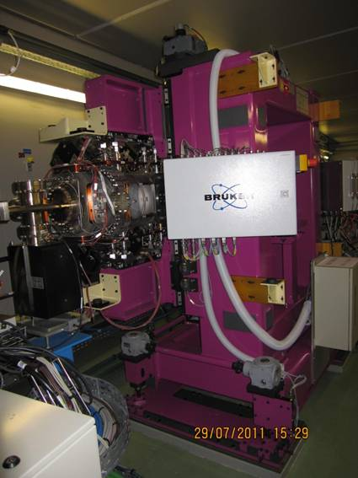
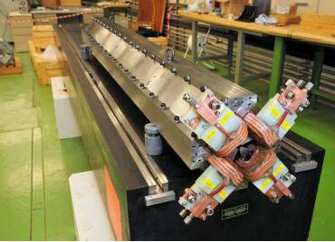
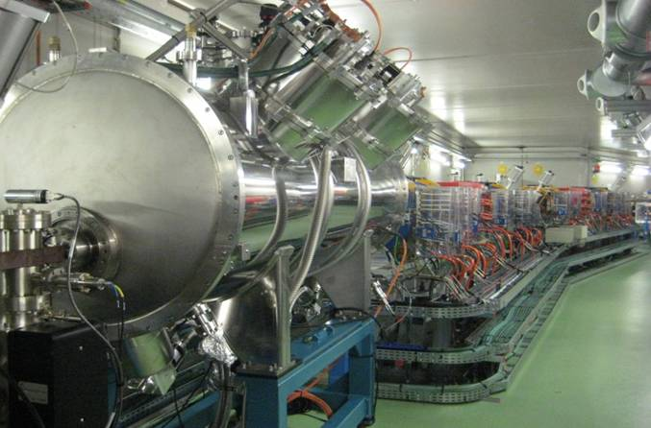
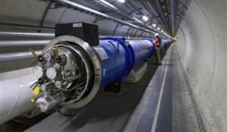
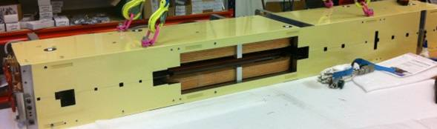
closed magnetic structures
Superconducting undulators
CLIC magnets
(10 mm aperture)
In-vacuum undulators
Low emmittance rings: MAX IV magnets
(15 mm aperture)
Superconducting magnets

Slide 4
our proposal
Small and compact 3D Hall probe
  13.9 mm Wide, 4 mm High, 100 mm long
  Temperature measured with accuracy ±0.01º C
  3 Bell sensors assembled ortogonally
Fixed on a carbon fiber tape. The tape can be attached and deattached and be introduced inside any closed structure with entrance and exit openings
Alignment is achieved using a reference magnet (horizontality) and a cone reference system (positioning)
Whole sistem running into a squared tube acting as anti-chamber or anti-cryostat that can be introduced into a vacuum chamber through the final flanges, allowing Hall probe measurements of cold structures at warm temperature

Slide 5
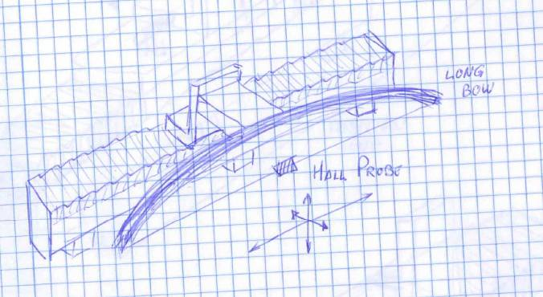
concept

Slide 6
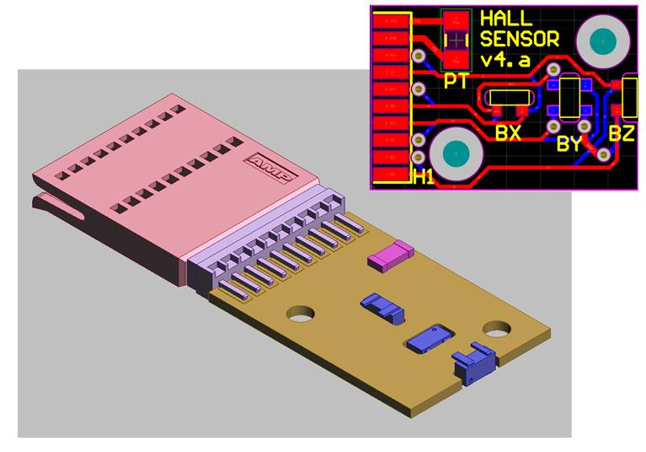
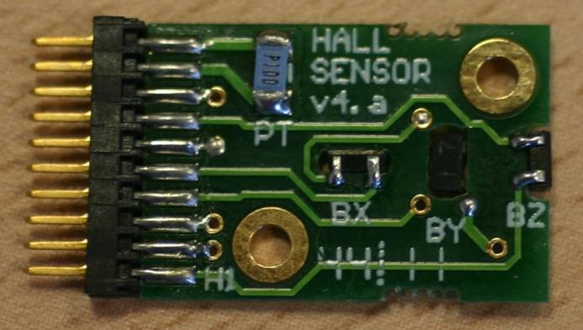

The probe
Dimensions: 13 x 25 x 2 mm
Weigth: 0.75 g
Flexible flat cable fixed on stretched tape
F.W. Bell Hall sensors, Model GH-700

Slide 7
The bench
4
Hall sensor attached on a tape tensioned on a C shaped arc structure
The tape is passing through the closed magnetic structure
The arc is moved by a high accuracy motion stage
X
Y
L
T
Hall
sensor
T
L/
2
L/
2
L/
2
L/
2
Arc length 2l
Length needed for the measurement is 3L
Key points
Can this arc be moved with an accuracy similar to that of a machining tool? -> stiffness of «C» structure
How much space will we need it? -> measurement range x 3
Is the tape stable after being tensioned? -> vibration studies

Slide 8
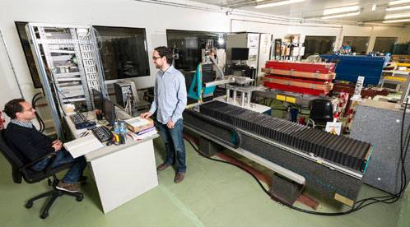
Requirements
Field sentitivity ~10⁻⁴ T
Spatial repetitivity ~10⁻⁶ m
Measurement range: 3 m longitudinal (for prototype, 1.2 m), 0.25 m horizontal, and 0.1 m vertical
Longitudinal scans allowing vertical and horizontal positioning (3D movement)
Small guidance error on positioning the Hall probe (~ 50·10⁻⁶ m)
Very small angular deviations when moving (~50·10⁻⁶ rad)

Slide 9
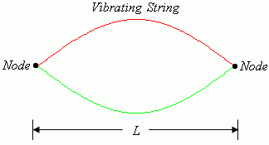
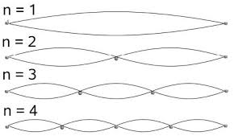
5
Analytical validation
A string under tension has a mode of vibration on the 1st harmonic depending on the vibrating length, the tension and the linear mass
This vibration, if excited, has a clear impact on the accuracy of the Hall probe position
Calculation
L ~ 4 m
Tape cross-section: 24 x 1.4 mm²
Material: pultruded carbon fiber, with density d=1600 kg/m³
Elastic limit: 2800 MPa
T = 7.5 kN -> f = 55 Hz -> stress = 224 MPa
At ALBA, environmental low frequencies are considered < 30 Hz
So, this value is taken as reference when designing

Slide 10
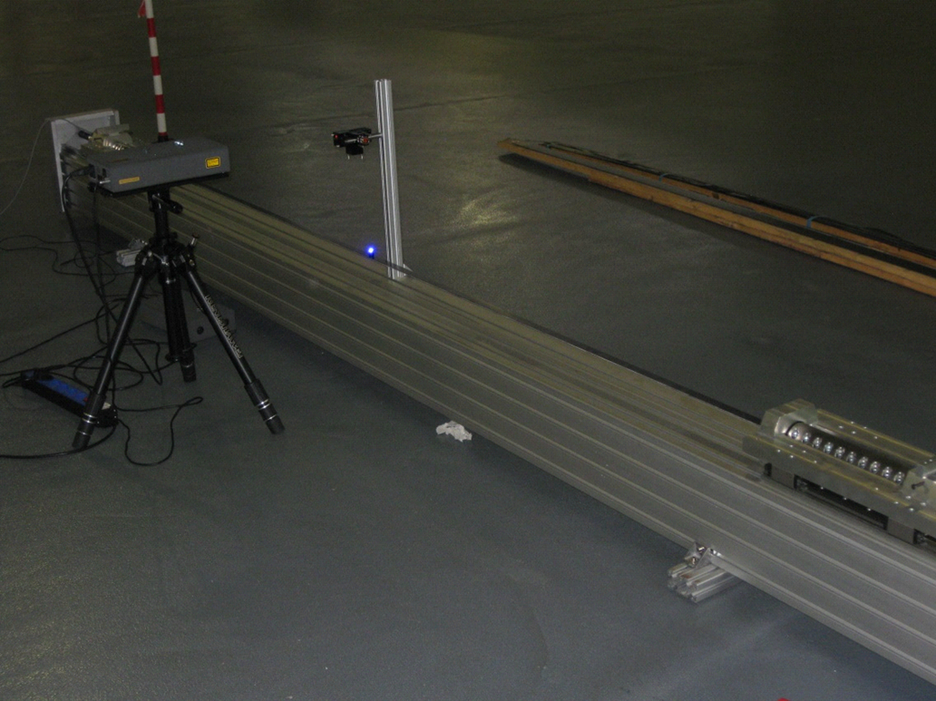
Empirical validation
6
Evaluate fundamental frequency modes of a tensioned tape with the same cross-section as calculated
Experimental set-up: tensioned belt with interferometer
External excitation has been externally induced
The set-up can measure the oscillation amplitude as well as the vibrating frequencies
Iris
Carbon
fiber
tape
Inerferometer

Slide 11
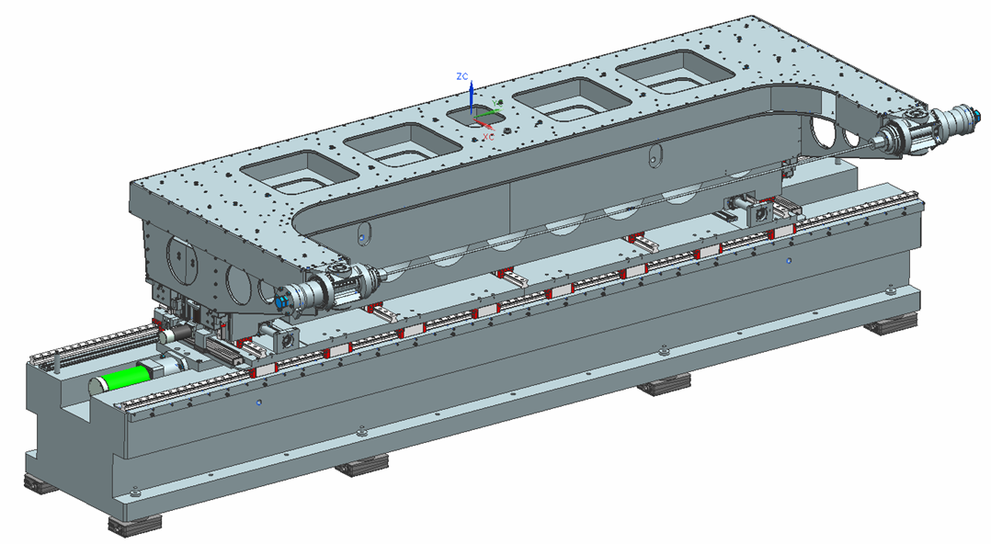
Detailed design
PROTOTYPING
Ranges
X : ± 0.25 m
Z : ± 0.10 m
Y : ± 1.20 m
Chamber allowance (beam stay clear area) = 0.6 m
Longitudinal POSITIONING
ERROR
δX, δY, δZ < 0.05 mm
Angular POSITIONING ERROR
Roll δα, Pitch δβ < 50·10⁻⁶ rad
XY
stage
Yaw δγ < 100·10⁻⁶ rad
Z
stage
Repeatability
X, Y, Z = 30·10⁻⁶ m
Arc
structure
Speed
with
carbon
fiber
Y’ = 15 mm/s
tape

Slide 12
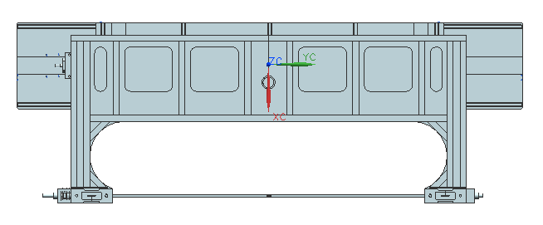
Dimensions
Side View
2600
650
650
1400
4300
Top View
1445 (+125)
600

Slide 13
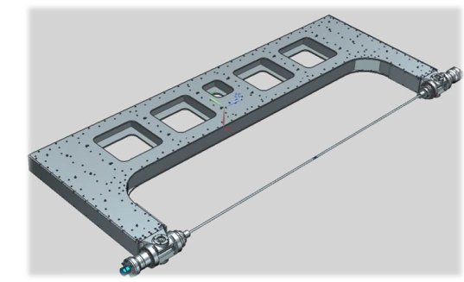

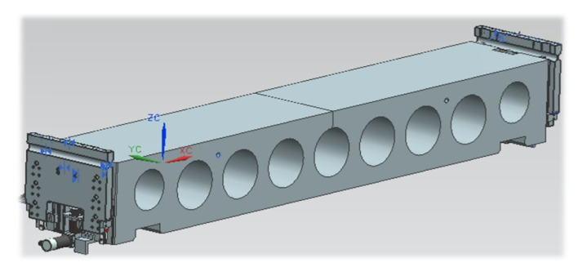

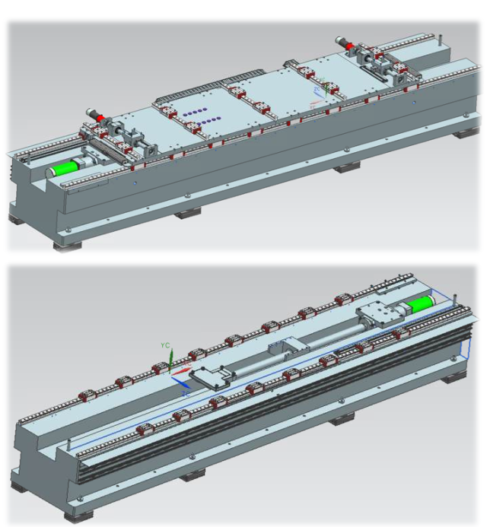

Belt dimensioning
Tape cross-section 16 x 1,4 mm²
Vibrating length: 2.6 m
Density d = 1600 Kg / m³
Pulling force: 0.5 N
Arc structure
Structure: Al profile
Stretching blocks, one with load cell gauge
Mass: ~ 400 kg
Results
Stress = 223 MPa
Security factor = 13
f₀ = 71 Hz
Elongation: 0.004 m
Z stage
Double flexure system on a granite block
Compact design: with a single step Z & pitch
Allowing 100 mm Z range and tilt about 0.2º
Flexures on high Young modulus material
Preloaded guiding system and grinded spindles
Movement for each flexure is encoded
Mass of assembly ~1200 kg
X,Y stage
X stage has 2 actuators to avoid rotation on vertical axis
Y stage measurement axis: placed on a granite block
Preloaded roller and matched guides, which separation determine vertical accuracy
Mass of the XY stage ~5000 kg

Slide 14
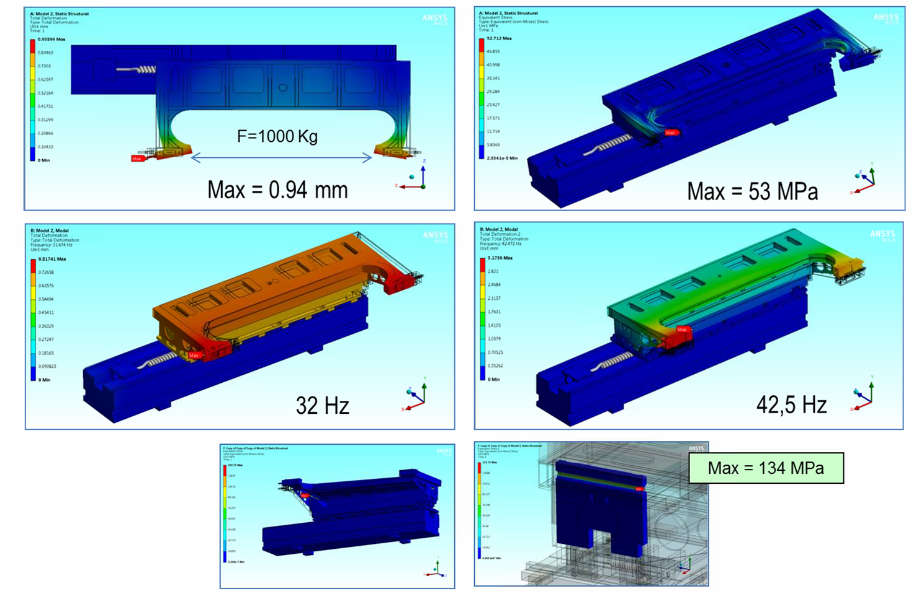
FEA calculation

Slide 15
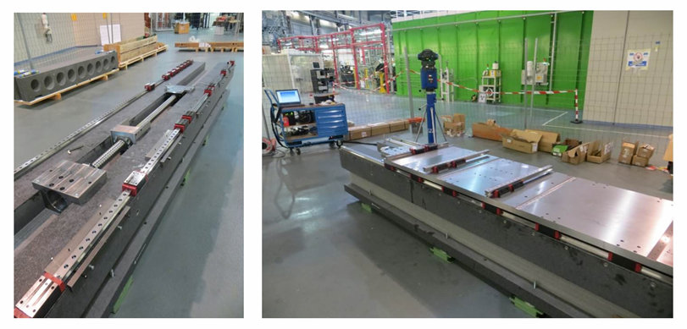
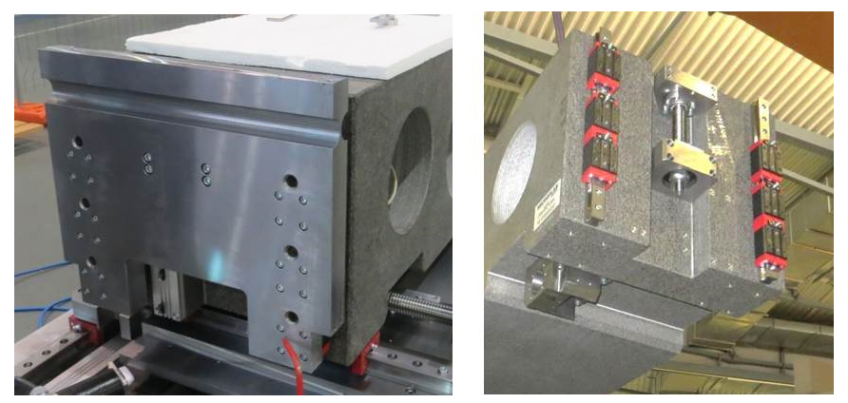

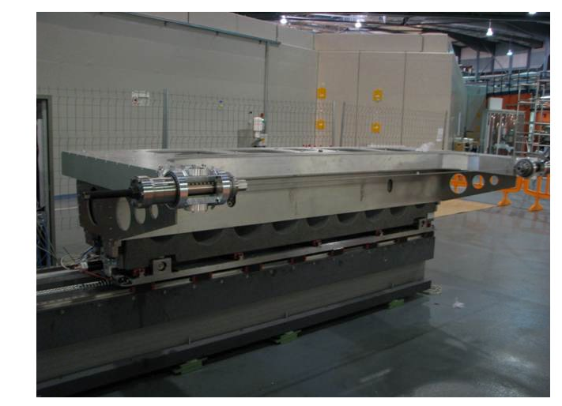


Assembly
XY stage
Verification of parts with alignment and metrology group
Big granite block is aligned flat with respect to the floor
Interface plate fitted in top. Slots for guides have been checked
Plate grinding has been corrected several times
Very accurate alignment of linear guide sets
Z stage
Hollowed granite placed on top of XY stage
Motors have been tested
Arc structure
Stretching system
Carbon fiber is cutted by water
All motors of the assembly have been tested
«C» structure and stretching system have been assembled in parallel
Carbon fiber is stretched up to 10 kN

Slide 16
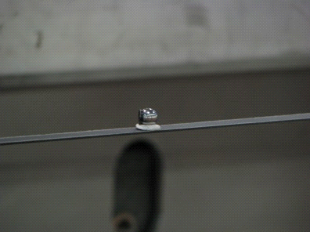
Prototype characterization
Straightness of Y displacement
Straightness errors
Peak to peak < 20·10⁻⁶ m
Straightness of Z displacement
Guidance errors
Yaw errors < 10·10⁻⁶ rad

Slide 17
Roll rugosity error < 5·10⁻⁶ rad
Roll drift error < 50·10⁻⁶ rad

Slide 18
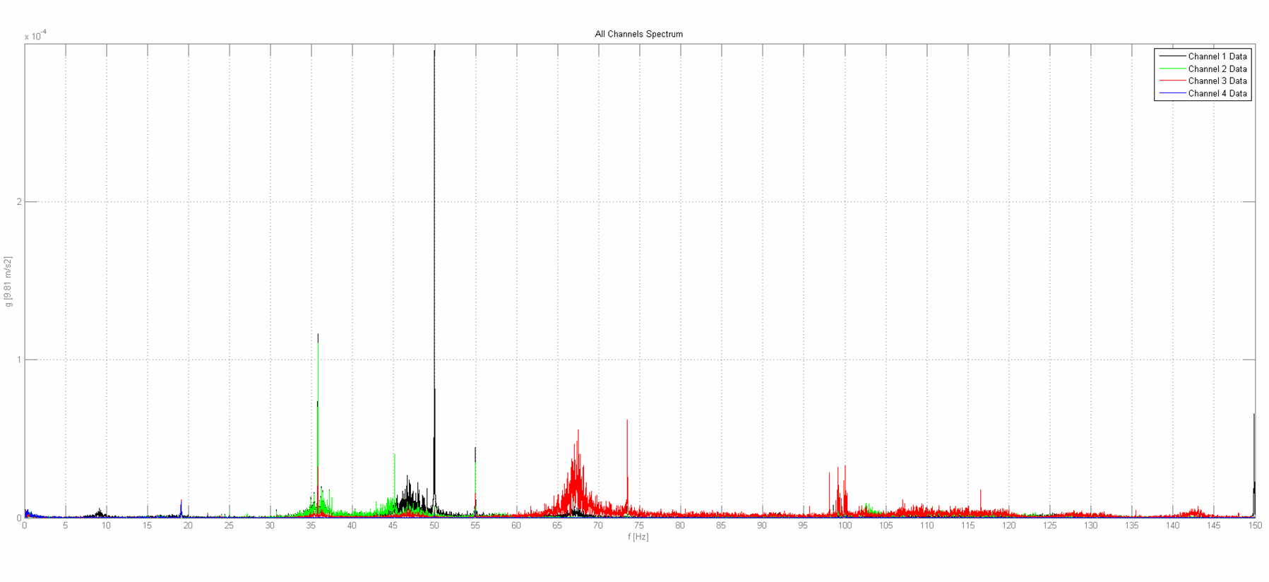
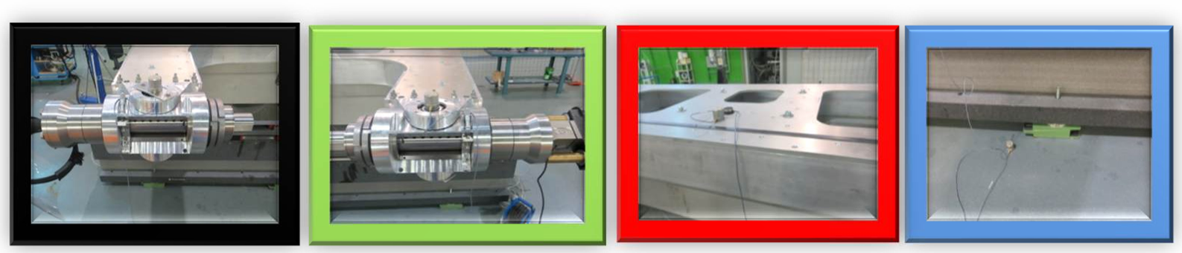
Vibration static
> 50 Hz

Slide 19
Next steps
Integration of Hall sensor in the bench
Positioning error on Hall probe in X, Y, Z in all range
Repetitivity positioning error on Hall probe in X, Y, Z
Guidance error: straightness, flatness, pitch, yaw and roll errors measured on Hall probe
Roll angle: measurements of repetitivity, hysteresis and evolution
Vibration frequencies for the final assembly
Main granite deformations with Z stage movements
Conclusions
After measurements done, specifications fulfillment is almost guaranteed
Bench can work for very narrow gap closed structures as well as conventional
Main drawback is the long longitudinal space needed as operational range
If the prototype suceeds, a 3 m range bench (9 m total lenght) can be foreseen

Slide 20
Thanks for your attention!

