Slide 1
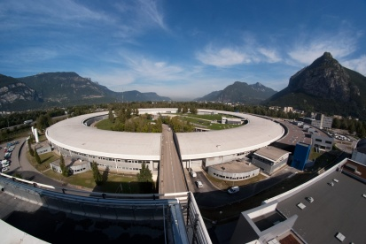
Stability studies at SOLEIL
DEELS
12-13 May 2014
ESRF, Grenoble
Beamline dedicated beam stability criterion
…..
Nicolas HUBERT#
on behalf of the stability group:
N. Hubert, L. Cassinari, J-C. Denard, L. Nadolski, M-A. Tordeux
# nicolas.hubert@synchrotron-soleil.fr

Slide 2
Beam stability criterion
Machine side:
Usual beam orbit stability criterion:
ΔX/σ_{x} ≤ 10% , ΔZ/σ_{Z} ≤ 10%
ΔX’/σ’_{x} ≤ 10%, ΔZ’/σ’_{Z} ≤ 10%
For users:
Photon flux stability matters:
ΔI/I ≤ 0.5%
Photon flux depends on beam size and angle stability at the source point, but also on the beam size stability
No « official » criteria on the beam size stability

Slide 3
Beam stability criterion
Correspondence between photon flux on the beamline and machine parameters is not easy to predict:
Depends on the beamline optics
Can not be generalize
Survey has been done in 2012 to identify the most sensitive beamlines
Experiments are carried on with those beamlines to evaluate their sensitivity and establish dedicated stability criterion on:
Beam position
Beam angle
Beam size
Beam divergence
The time span on which those criterion apply is also extremely important and differs considerably from one beamline to another.

Slide 4
Beam stability criterion
Parameter ↓ | PX1 | PX2
Time span | 5 mn | 1h
Position H | 35 µm rms | 30 µm rms
Angle H | 3 µrad rms | 4 µrad rms
Position V | 1 µm rms | 1.3 µm rms
Angle V | 2.5 µrad rms | 1 µrad rms
Size | / | /
Divergence | / | ± 10%

Slide 5
Beam stability criterion
Parameter ↓ | PX1 | PX2 | Anatomix | Nano scopium
Time span | 5 mn | 1h | 10mn to 6h | 8 hours
Position H | 35 µm rms | 30 µm rms | ± 12 µm | ± 5 µm
Angle H | 3 µrad rms | 4 µrad rms | ± 4 µrad | ± 5 µrad
Position V | 1 µm rms | 1.3 µm rms | ± 1 µm | ± 1.5 µm
Angle V | 2.5 µrad rms | 1 µrad rms | ±1 µrad | ± 1.5 µrad
Size | / | / | ± 5% in 6h ± 10% in 1 wk | ± 2%
Divergence | / | ± 10% | / | ± 2%

Slide 6
Beam stability criterion
Parameter ↓ | PX1 | PX2 | Anatomix | Nano scopium | Tightest wrt Beam size
Time span | 5 mn | 1h | 10mn to 6h | 8 hours
Position H | 35 µm rms | 30 µm rms | ± 12 µm | ± 5 µm | ∼σ_{x}/125 *
Angle H | 3 µrad rms | 4 µrad rms | ± 4 µrad | ± 5 µrad | ∼σ’_{x}/15 *
Position V | 1 µm rms | 1.3 µm rms | ± 1 µm | ± 1.5 µm | ∼σ_{z}/25 *
Angle V | 2.5 µrad rms | 1 µrad rms | ±1 µrad | ± 1.5 µrad | σ’_{z}/14 *
Size | / | / | ± 5% in 6h ± 10% in 1 wk | ± 2%
Divergence | / | ± 10% | / | ± 2%
*σ Is the beam size and σ’ the divergence of the PHOTON Beam at its source point and the highest user energy. Equivalence: 2,5 µm (or µrad) 1 µm rms (or µrad rms)

Slide 7
Beam stability criterion
Offline analysis based on archived data sampled at 1 Hz (position, angle and emittance) :
Done at posteriori for all beamlines
Limited by the size of the data to be treated…
Vertical position (blue) and angle (pink)
H (red) & V (blue) emittances

Slide 8
Beam stability criterion
Then a percentage of useful beam for each beamline can be calculated:
Example of useful beam for the PX2 beamline in 2013:
Calculation to be done online in the future:
Real time warning for operators and reduce the perturbation time
Increase of the sampling rate used to make the calculations

Slide 9
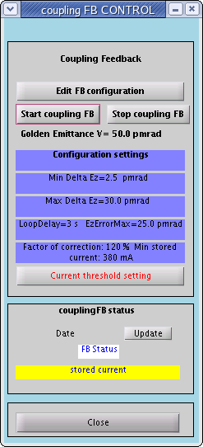
Beam emittance feedback
Useful beam time is low for new long beamlines Anatomix and Nanoscopium (in construction) due to their tight specifications on the beam size and divergence.
Emittance variations are caused by unwanted skew gradient error of some undulators
A feedback on the vertical emittance is in operation since sept 2012:
Matlab application
Based on the vertical beam size measured on the pinhole camera
Calculates a setting on the 32 Skew Quad to keep the vertical electron beam emittance constant (modification of the pure vertical dispersion amplitude)

Slide 10
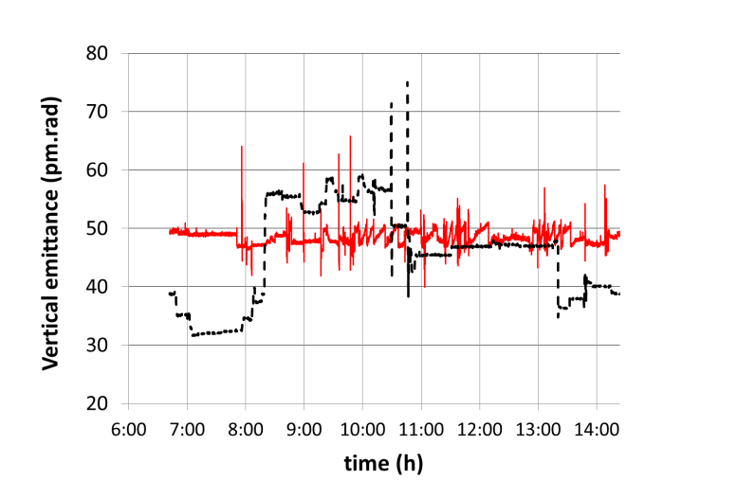
Beam emittance feedback
Keep constant the vertical emittance at 50 pm.rad +/- 2,5 pm.rad
Correction rate: every 3secondes
Evolution of the coupling versus time with (red) and w/o (black dotted) global feedback correction on the coupling, observed during the typical restart of the user session on Tuesdays
DC value is well corrected but still some transients due to the low correction rate (limited by beam size aquisition, SQ power-supply control)
Feedback will not correct fast transient on the vertical beam size foreseen with 200 ms fast switching of HU640 and the 8 mm/s gap variation of one APPLE II type undulator.
Next improvement: Development of coupling feedforward scheme to cancel ID skew gradient error locally with higher correction rate (50 Hz)

Slide 11
Conclusion (1)
Usual beam orbit stability requirements (Δ/σ<10%) do not fit the users needs anymore
Position/angle requirements might be tighest
Beam size stability requirement must be defined as well
The duration on which the requirements apply must be specified
Beamlines needs differs so much that establishing commun stability requirements is not possible
Soleil decided to:
Inventory its most sensitive beamlines
Establish dedicated requirements for them
Publish statistics on beam quality (in a first time)
Make runtime checking to warn the operator as soon as possible (in the future)

Slide 12
Conclusion (2)
Vertical beam emittance feedback is in operation since 2012
Keep the V emittance constant at 50 pm.rad
Mandatory to compensate for ID skew gradient error
To be upgraded by a faster feedforward for the most perturbating IDs
Horizontal emittance variations have been correlated to ID configurations
Investigations are going-on
At the moment no possibility for correction
Thank you for your attention…

