Slide 2
for event participant
Expense Report
(from web application)
Notes:
Présentation standard de l’ESRF.
Elle est composée de 11 diapositives présentant :
- L’ESRF en bref avec des chiffres clés
- L’ESRF : Une coopération de 21 pays
- Le campus EPN (European photon & neutron science campus)
- Au cœur du campus mondial d’innovation
- L’ESRF joue un rôle crucial dans l'Europe de la recherche
- Il y a environ 50 synchrotrons dans le monde
- 4 prix Nobel parmi les utilisateurs
- Une meilleure technique pour une meilleure science
- ESRF : PLUS de 20 ans de succès et d’excellence
- Un programme ambitieux de modernisation
- Esrf upgrade programme PHASE II

Slide 3
Objectives and pre-requisites:
The following slides explain:
How to create and submit your expense report, from the SAP Concur web application
Pre-requisites:

Slide 4
INTRODUCTION
Receipts are required for the submission of your expense report
Two alternatives:
Certified receipts, if scanned from SAP Concur mobile
Paper receipts are no longer required
Attached images, if NOT scanned from SAP Concur mobile
Original receipts must be sent to ESRF Travel agency (by postal mail)
Complements:
Expense report must be submitted from the approved travel requests (as several
fields will be automatically populated)
Unexpected expenses and higher amounts are subject to ESRF approval

Slide 5
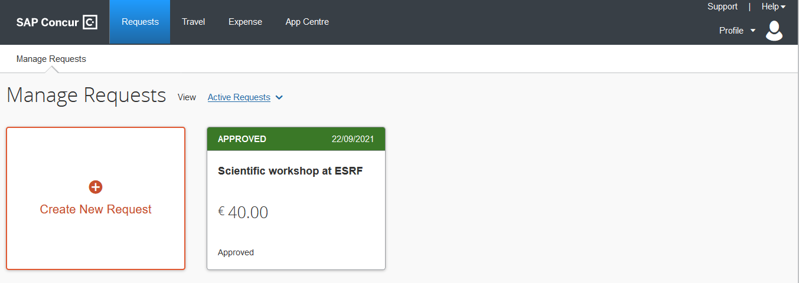
Creation of the expense report
From SAP Concur home page,
click on « Request »
Then, click on the approved request for which
you want to create the expense report

Slide 6
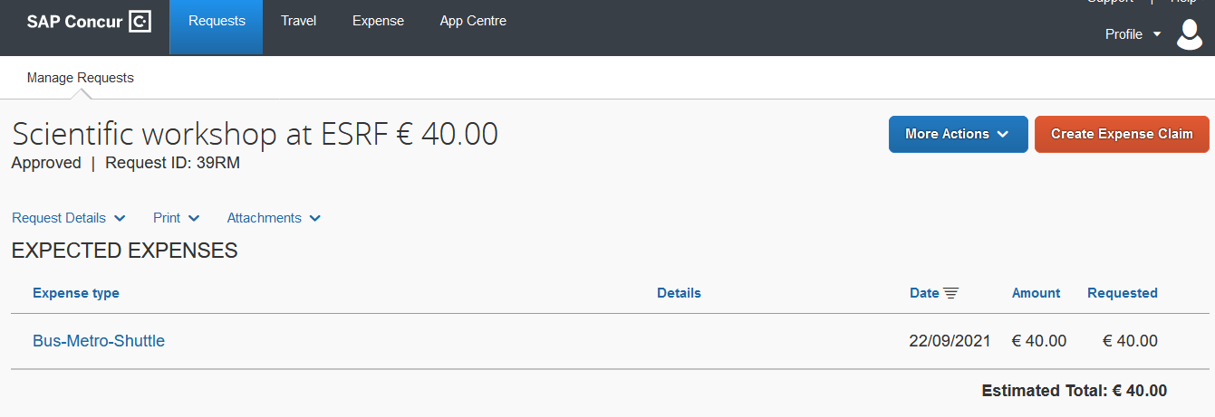
Creation of the expense report
SAP Concur opens the previously approved request
Click to create the Expense Report

Slide 7
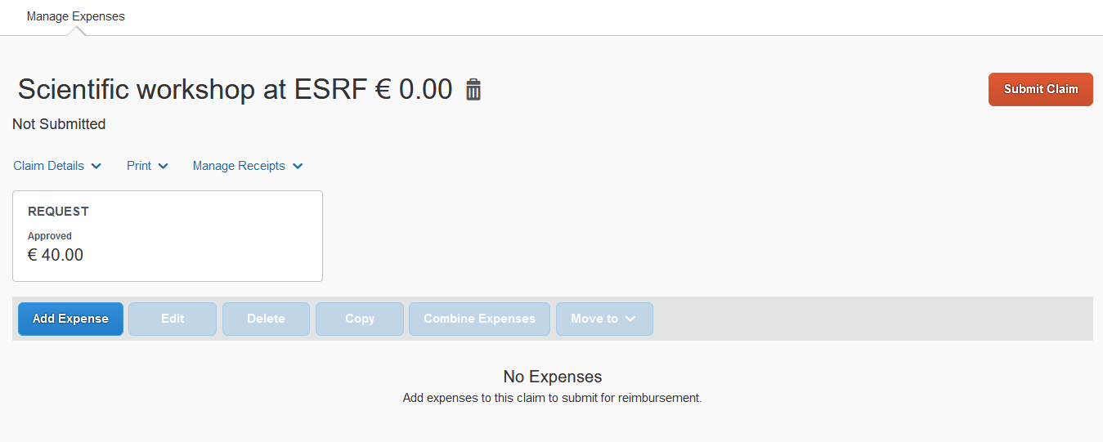
Creation of the expense report
Well done! the expense report is created
The expense report is automatically filled-in (see « Claim Details »)
Click here to add your travel expenses (see next slides)

Slide 8
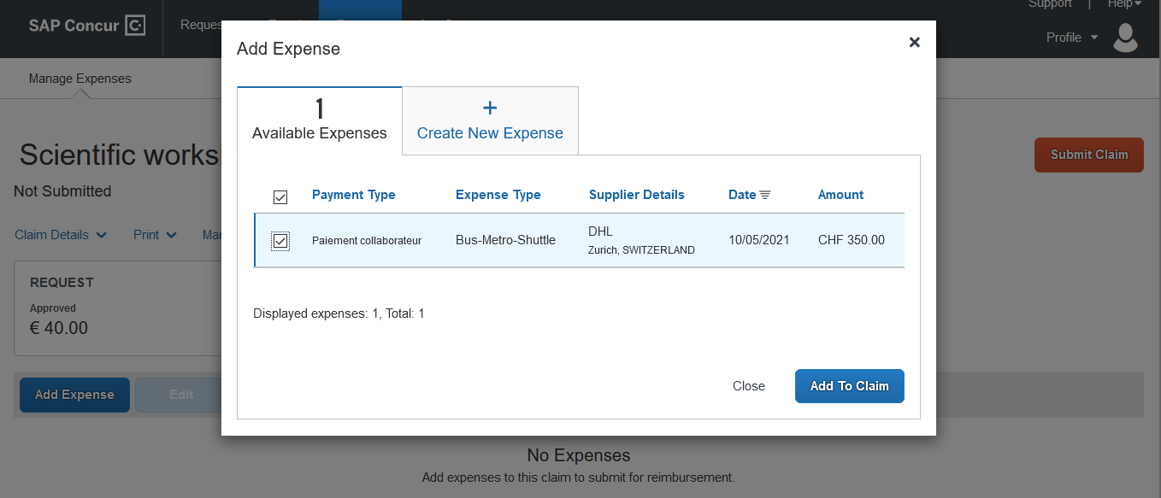
Input of travel expenses
Alternative 1: you already have available expenses:
In « Available Expenses », select the expense you want to claim for
Then « Add To Claim »

Slide 9
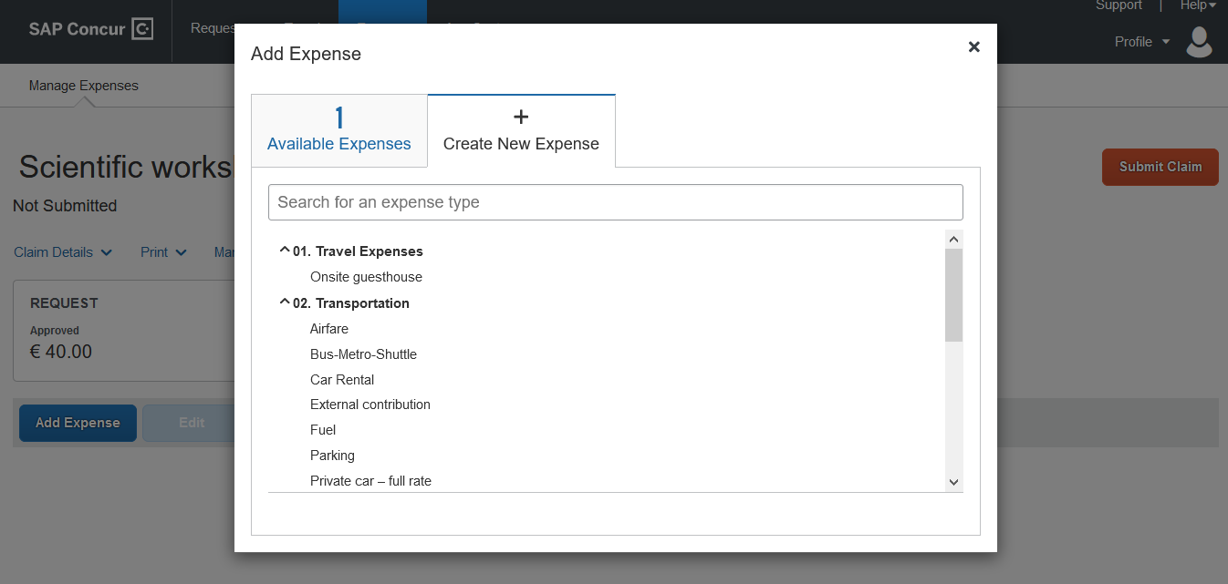
INPUT OF TRAVEL EXPENSES
Alternative 2: you don’t have available expenses:
In « Create new Expense », choose an expense from the list

Slide 10
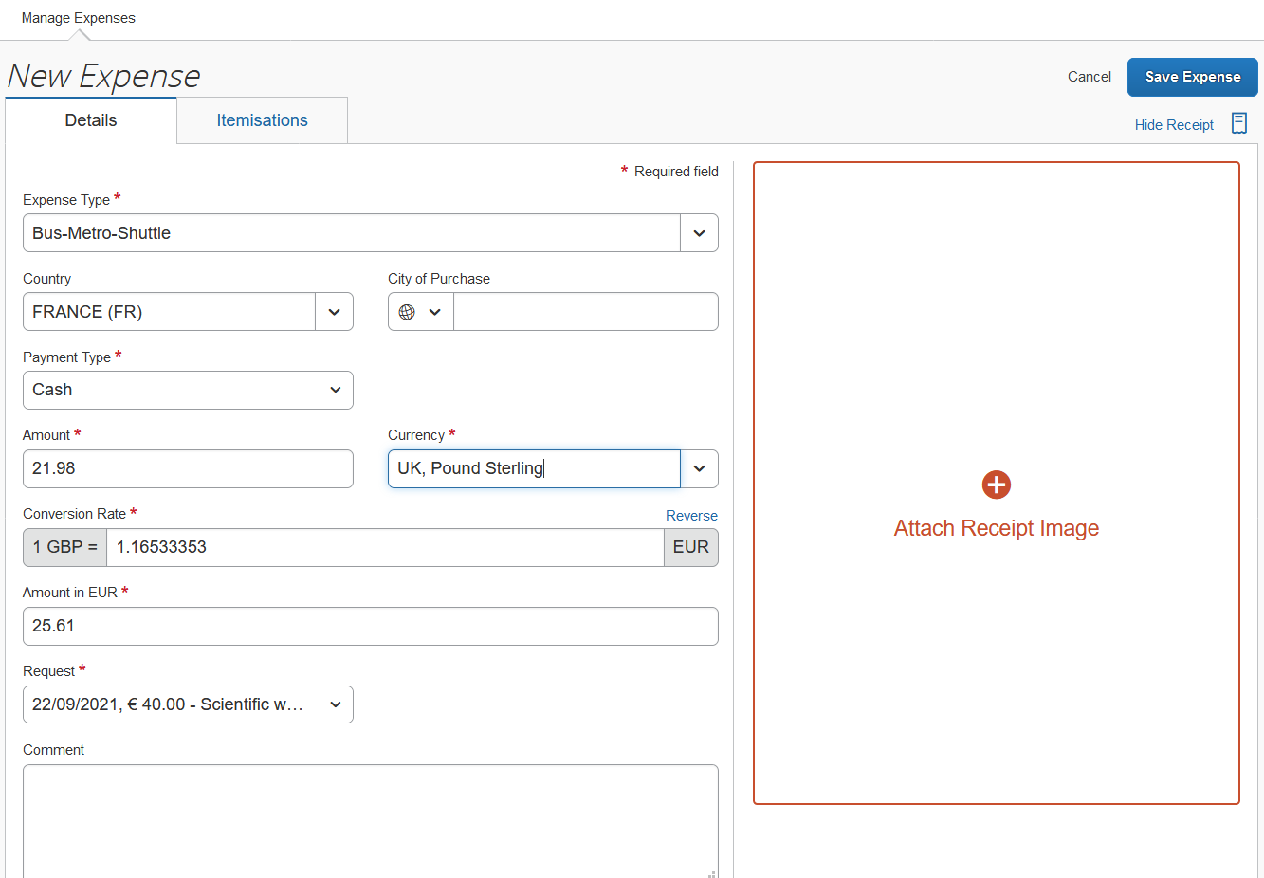
INPUT OF TRAVEL EXPENSES
Alternative 2: you don’t have available expenses:
Fill-in all the mandatory fields
(i.e those with « * »)
You must also attached an image (click here)

Slide 11
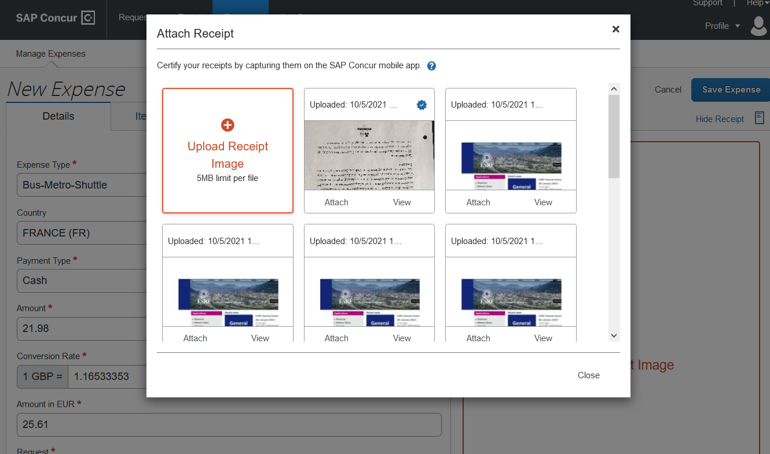
INPUT OF TRAVEL EXPENSES
Alternative 2: you don’t have available expenses:
Select an available image…
Or, upload one from your PC

Slide 12
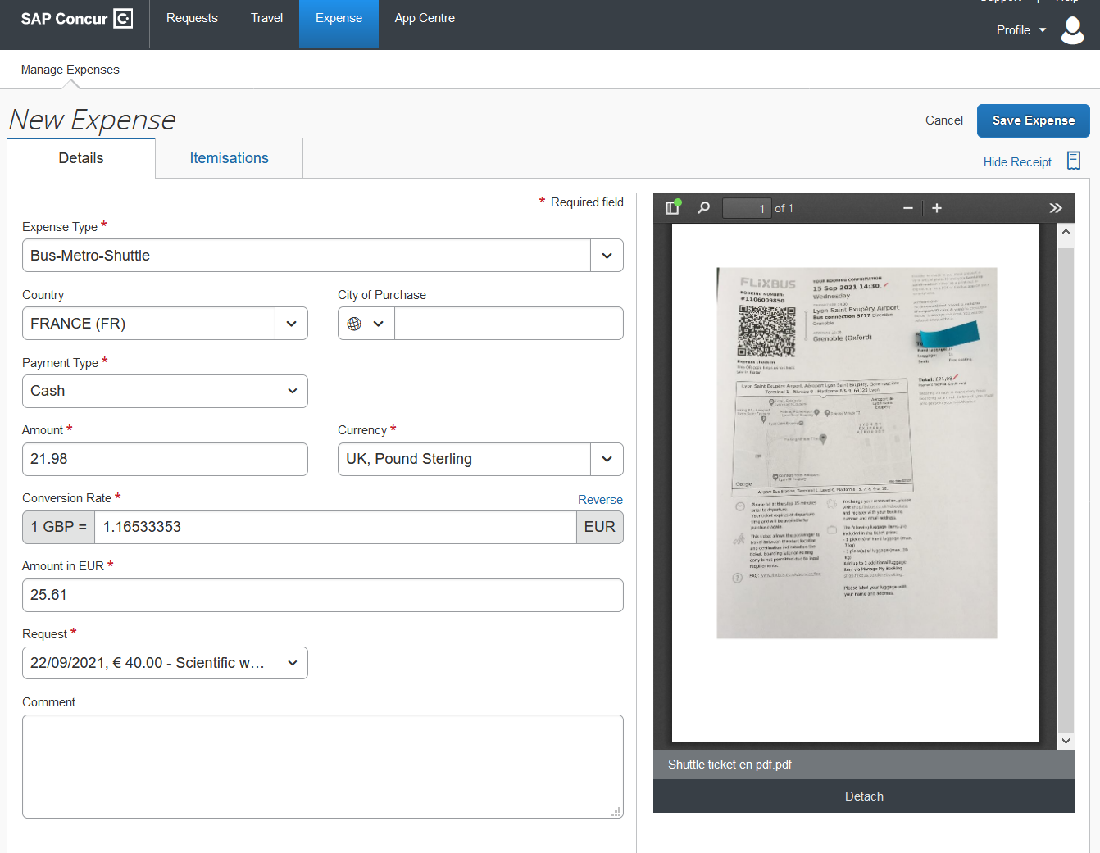
INPUT OF TRAVEL EXPENSES
The selected expense is correctly attached
Click « Save Expense »

Slide 13
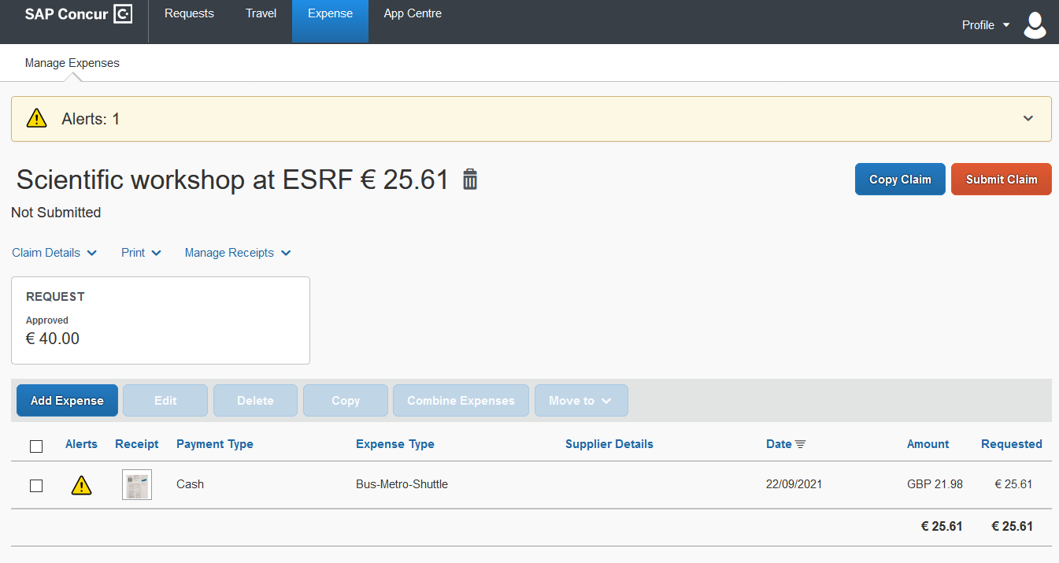
INPUT OF TRAVEL EXPENSES
The selected expense is correctly registered
As this expense is not « certified », you must send this receipt
by Postal mail to ESRF travel office
Click again on « Add Expense » for extra travel expenses

Slide 14
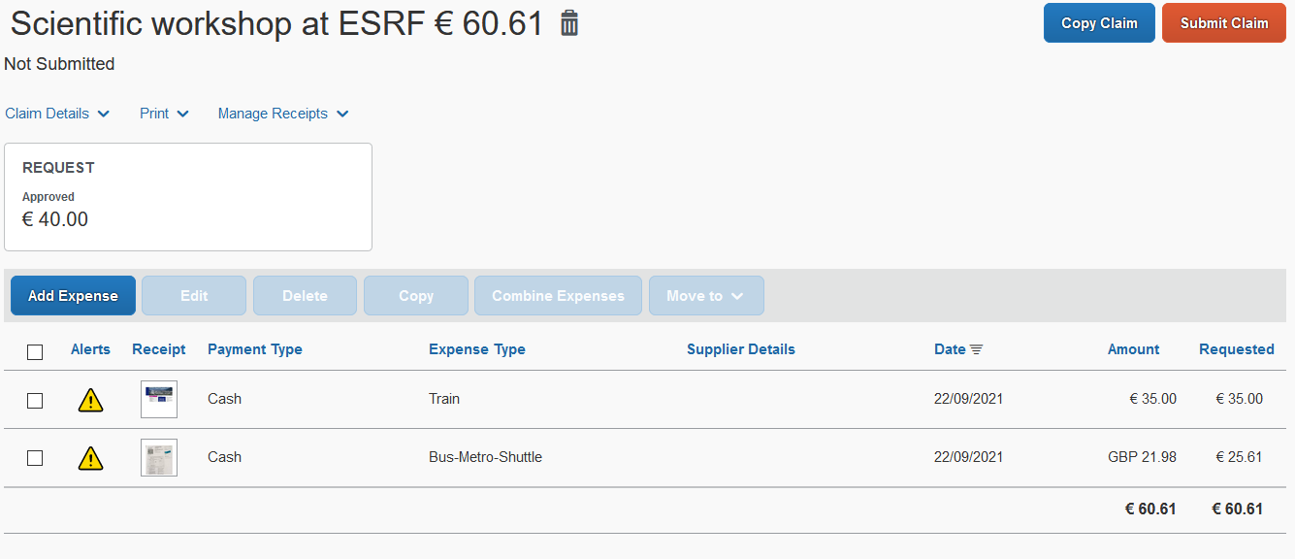
SUBMISSION of the expense report
Once all your expenses are added, click on « Submit Claim »

Slide 15
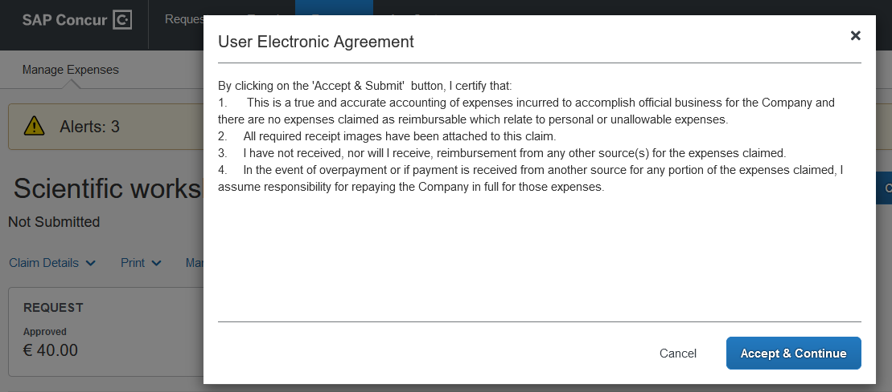
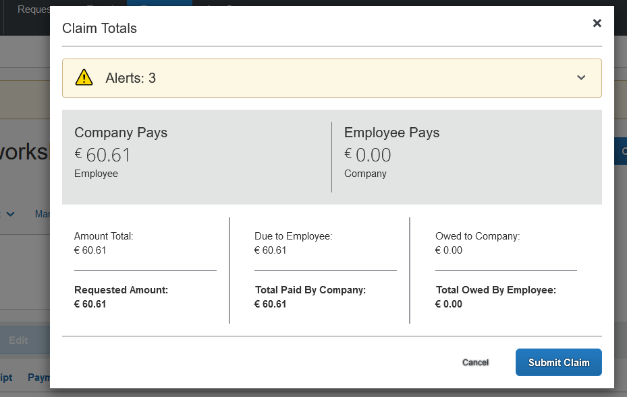
SUBMISSION of the expense report
Read the agreement
Final review:
Once ok, click « Accept & Continue »
Then, « Submit Claim »

Slide 16
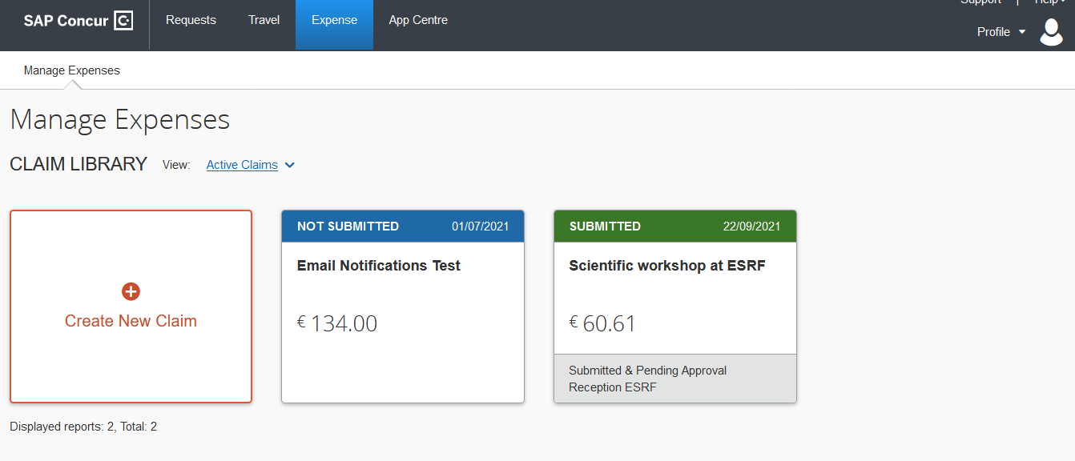
SUBMISSION of the expense report
Your Expense report has been successfully submitted:
If you have non-certified receipts, please send them by postal mail, to ESRF Travel Office
not later than 30 days after the end of your trip.

