Slide 2
for event participants
First connection
Notes:
Présentation standard de l’ESRF.
Elle est composée de 11 diapositives présentant :
- L’ESRF en bref avec des chiffres clés
- L’ESRF : Une coopération de 21 pays
- Le campus EPN (European photon & neutron science campus)
- Au cœur du campus mondial d’innovation
- L’ESRF joue un rôle crucial dans l'Europe de la recherche
- Il y a environ 50 synchrotrons dans le monde
- 4 prix Nobel parmi les utilisateurs
- Une meilleure technique pour une meilleure science
- ESRF : PLUS de 20 ans de succès et d’excellence
- Un programme ambitieux de modernisation
- Esrf upgrade programme PHASE II

Slide 3
Objectives and pre-requisites:
The following slides give information on:
First connexion to SAP Concur application
Home page of SAP Concur application
Pre-requisites:
The ESRF recommends that beforehand, you looked at:
Introduction to SAP Concur for ESRF event

Slide 4
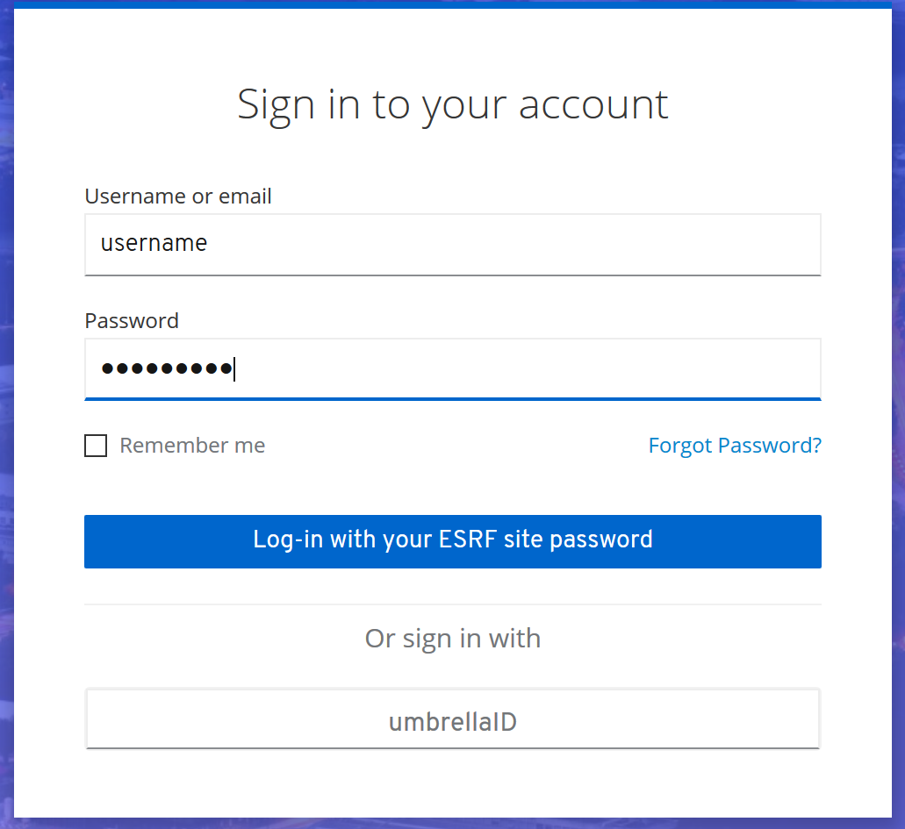
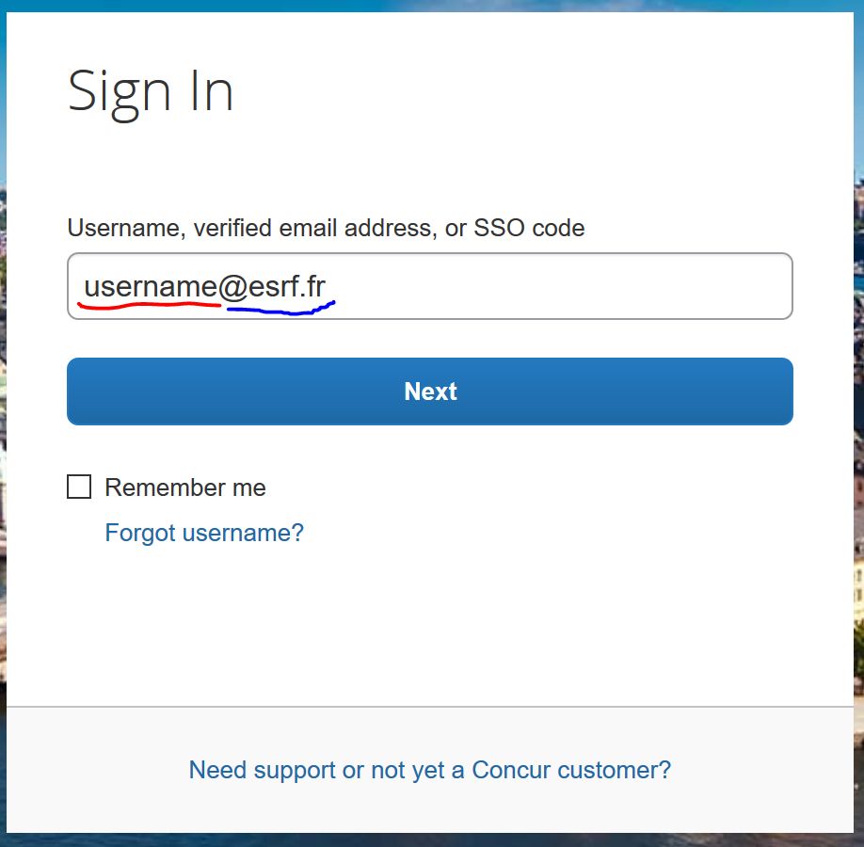
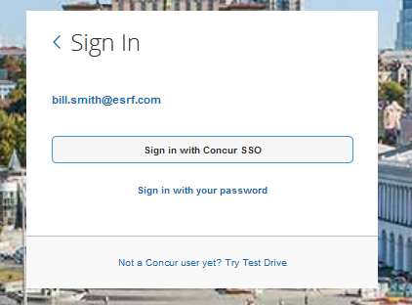
First connection to sap concur
Link to SAP Concur application:
Sent in the email for the confirmation of your registration to the event
« Username »,
followed by «@esrf.fr »
(3) Password
(4) Click here
(2) Choose « Sign in
with Concur SSO »
Welcome to SAP Concur
home page! (see next slides)

Slide 5
First connection to sap concur
2 preliminary actions are required in your personal profile:
- Data treatment confidentiality acknowledgment by GBT American Express (i.e ESRF Travel agency)
- Validation of your email address
Select « Profile » from the Home Page, on the top right,
Then, click on « Profile Settings »
And finally, on « Personal Information »

Slide 6
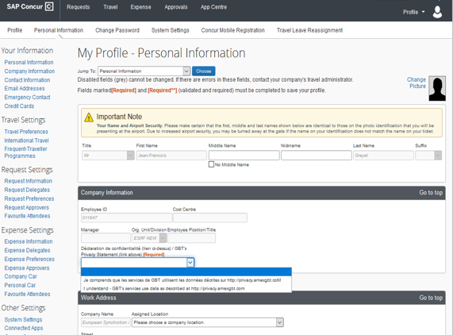
First connection to sap concur
Data treatment confidentiality acknowledgment by GBT American Express (i.e ESRF Travel agency)
Click to open the rolling list and select one choice

Slide 7
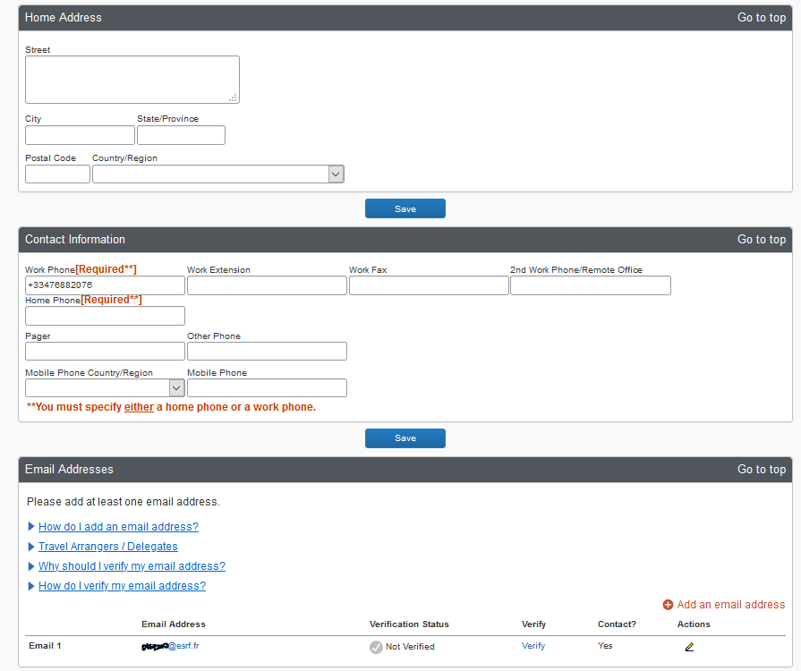
First connection to sap concur
Validation of your email address (1/2):
Scroll down the menu, until « Email Addresses »:
Click « Verify »:

Slide 8
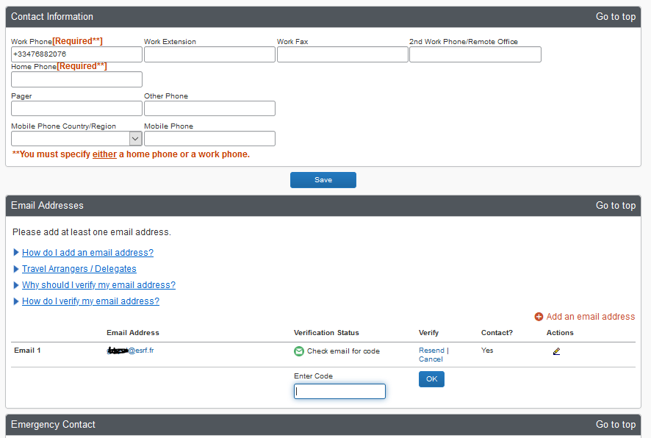
First connection to sap concur
Validation of your email address (2/2):
SAP Concur just sent you an email, with instructions and a verification code
Enter the verification code, here
Click « OK »

Slide 9
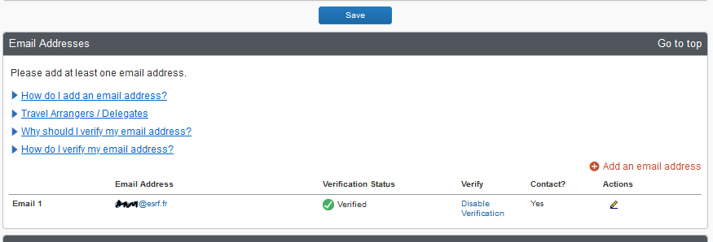
First connection to sap concur
Click “SAVE” to validate
your changes
Click “SAP Concur” and return to Home Page
Your personal profile is correctly updated!

Slide 10
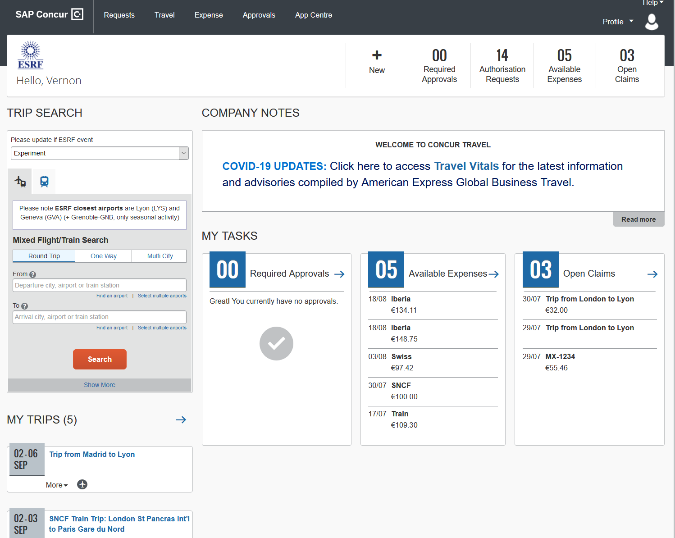
Presentation of the HOME PAGE
1
2
4
3
5
See next slide for information

Slide 11
Presentation of the Home Page
1
HEADER:
“Request”: Travel plan
“Travel”: Online booking
“Expense”: Expense report
“Profile”: traveler’s data
“Help”: guidelines + videos
“White line”: Shortcuts to traveler’s files
2
COMPANY NOTES:
Information given by the ESRF (to all travelers)
3
MY TASKS:
“Required Approvals” =
Requests pending for approvals
“Available expenses” =
Receipts pending for reimbursement claims
“Open claims” =
Outstanding reimbursement claims
4
TRIP SEARCH (or travel wizard):
Used to request online bookings
5
MY TRIPS:
Approved and scheduled trips

