Slide 1
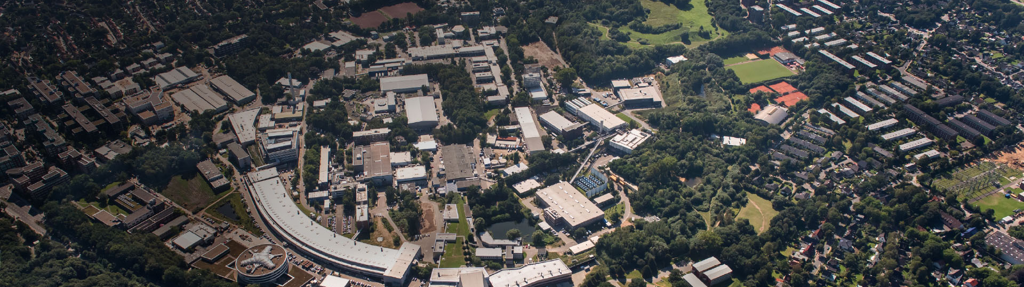
PETRA III
Status report and
plans: PETRA IV
Rainer Wanzenberg
28th ESLS workshop, Grenoble, Dec 16/17, 2020

Slide 2
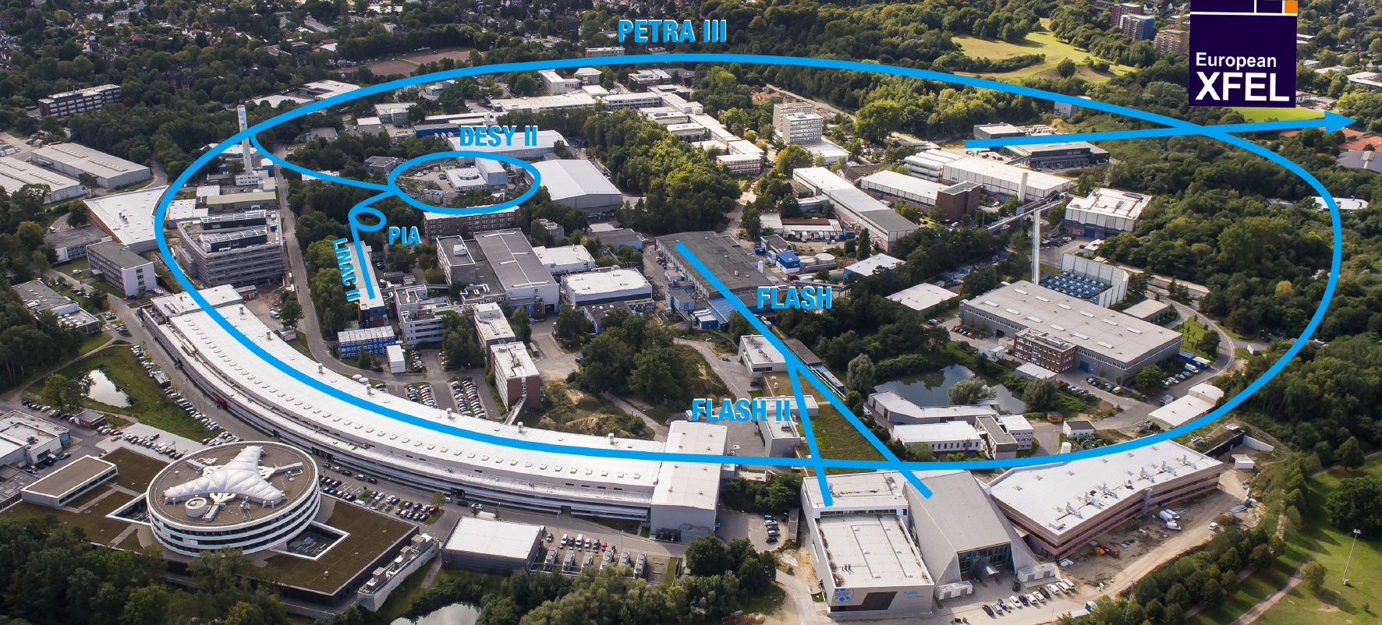
PETRA III is one of the core facilities at DESY
Each year, more than 2000 users are performing measurements at the PETRA III beamlines
Ada Yonath Hall
Extension Hall East
Parameter | PETRA III
Energy / GeV | 6
Circumference /m | 2304
Emittance (horz. / vert.) /nm | 1.3 / 0.013
Total current / mA | 100
Max von Laue Hall
Paul P. Ewald Hall
Extension Hall North

Slide 3
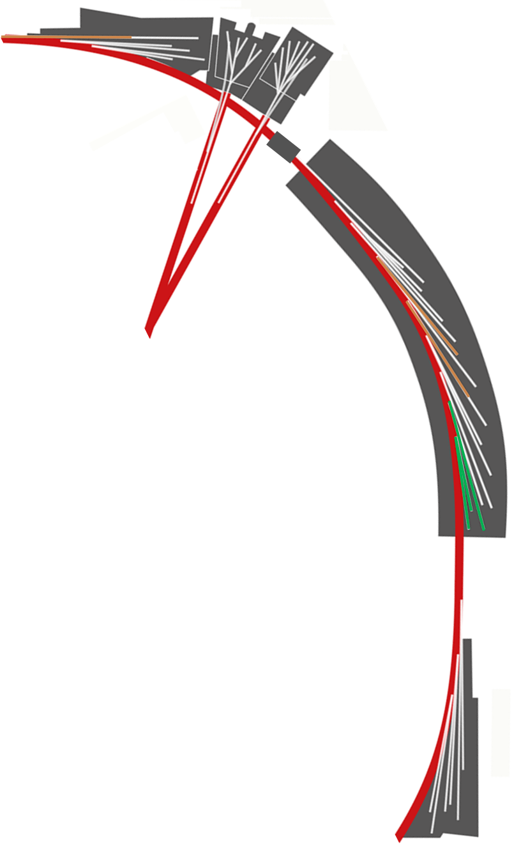
PETRA III : 23 Beamlines are in operation
Hall „Paul Peter Ewald“
BLs P61 … P65
P66
More than 50 experiments covering most relevant methods
Diffraction & Scattering
P02.1, P02.2, P07, P21.1, P21.2, P61 High energy X-ray, white beam diffraction & imaging
P03, P12, P62 Small angle scattering, GISAXS, ASAXS (➔ 2020)
P08, P23, P24 Crystallography & Surfaces scattering
P11, P13, P14 Macromolecular crystallography
P04, P06, P10 Coherent diffraction & scattering
P09 Resonant magnetic scattering
Spectroscopy
P01 Inelastic and nuclear scattering
P22 Hard X-ray photoelectron spectroscopy
P04 Soft X-ray photoelectron spectroscopy
P64, P65 X-ray absorption & fluorescence spectroscopy
P09 XMCD
P66 VUV spectroscopy (➔ 2021)
Imaging
P04, P06, P10 Micro & Nano imaging (coherence)
P05, P06, P07, P14, P61 Micro & Nano imaging (absorption & phase contrast)
P03, P06, P21.1, P21.2, P62 Micro & Nano imaging (fluorescence, dark field )
ASAXS Anomalous Small Angle X-ray Scattering HZG Helmholtz-Zentrum Geesthacht https://www.hzg.de/
FLASH 1&2
Hall „Max von Laue“
Beamlines P01-P14
HZG
EMBL
Sweden
Hall „Ada Yonath“
BLs P21…P25

Slide 4
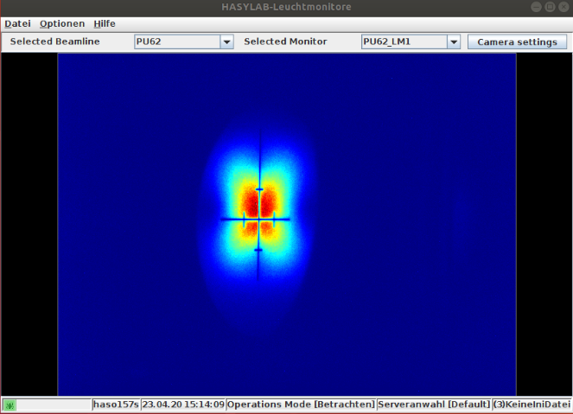
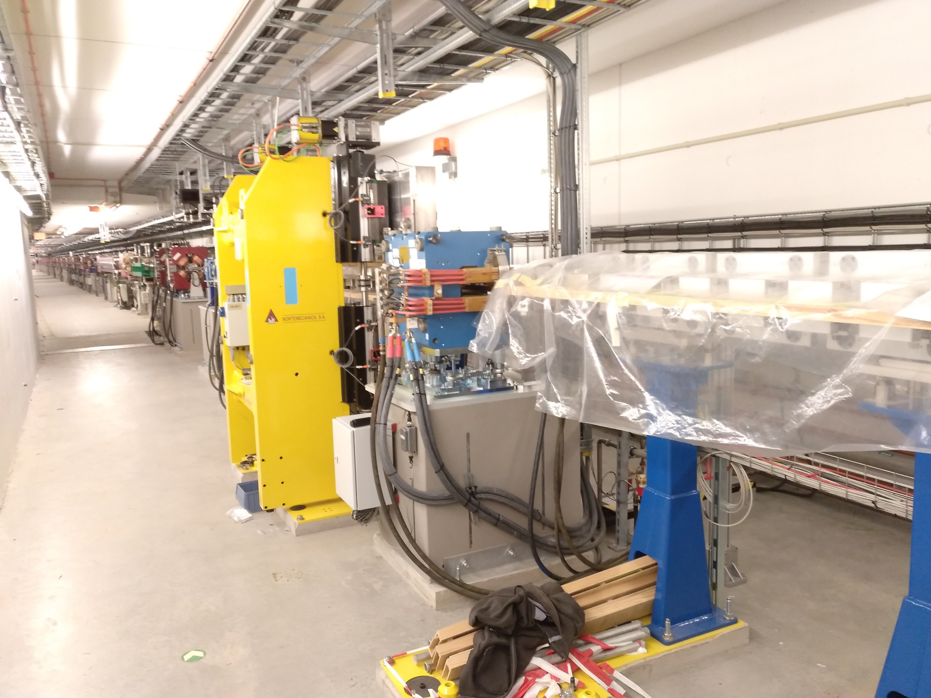
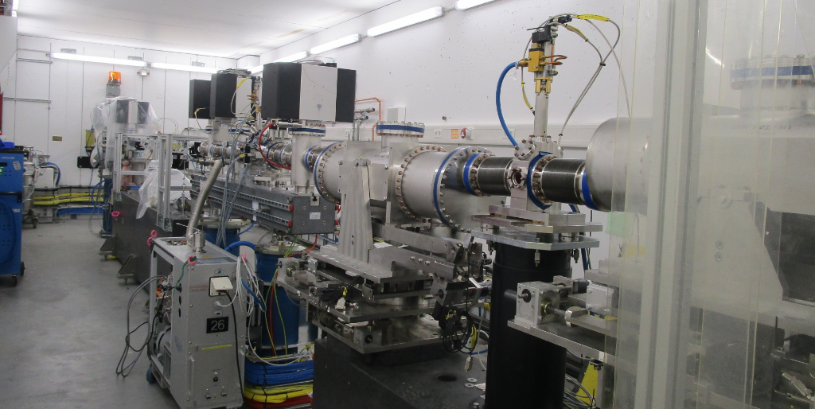
Commissioning of a new undulator beamline P62 at PETRA III
First light in the front end (Apr 23rd) and in the in experimental hutch (Dec 2020)
ASAXS Beamline P62
Enhance SAXS contrast by using absorption edges
First undulator light in frontend:
Apr 23rd 2020
P62 Undulator
Free slot P63
X-ray
optics

Slide 5
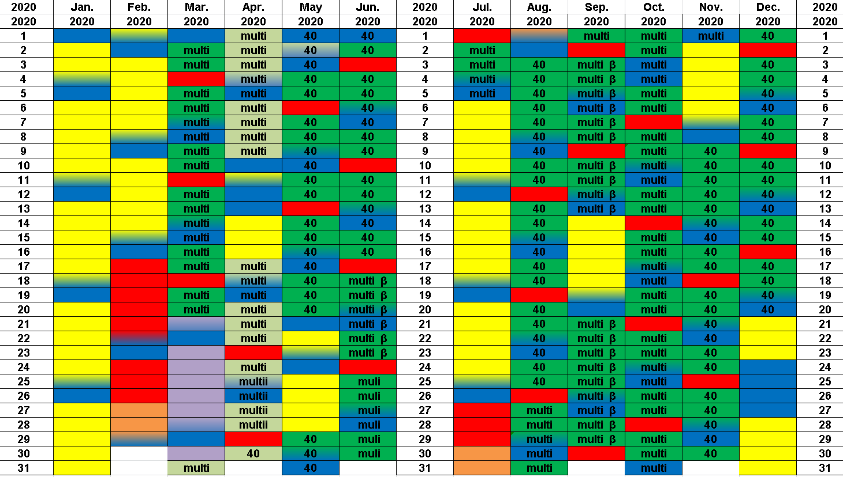
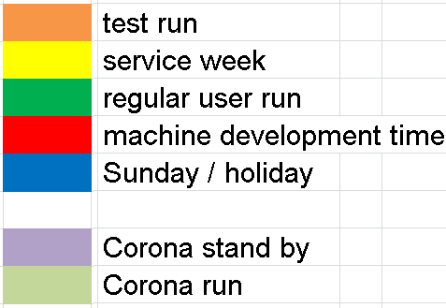
PETRA III schedule 2020
Original planned hours: 4944h, after Covid-19 stand by: 4200h + 600h Corona run
stand by due to Corona:
Mar 21st
restart for Corona related experiments: Mar 31st
Corona related experiments get priority by directorate
During the regular user run it was necessary to reschedule user due to Covid19 travel restrictions

Slide 6
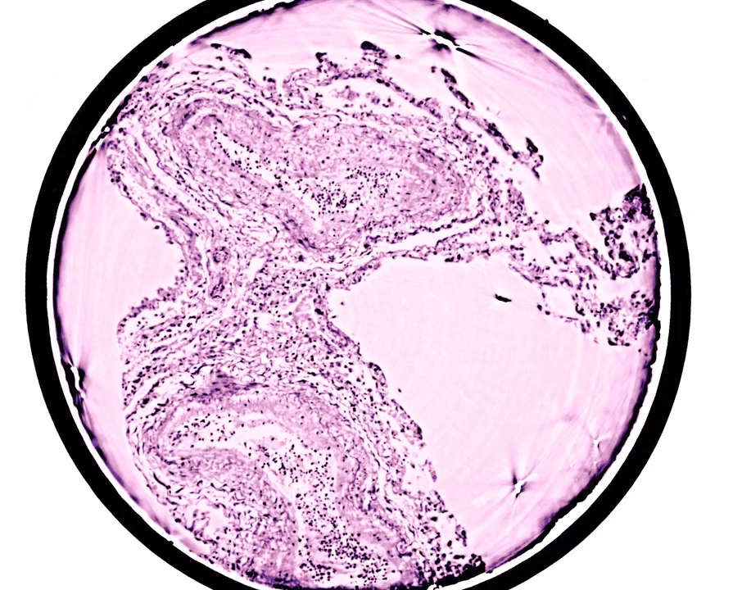
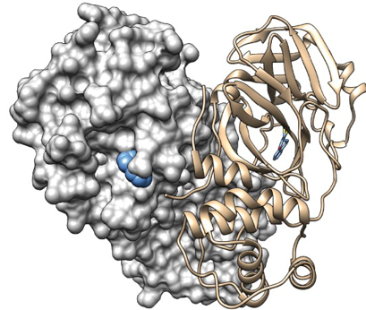
COVID-19 related research at PETRA III
X-ray tomography of lung tissue and drug screening
3D virtual pathohistology of lung tissue from Covid-19 patients based on phase contrast X-ray tomography
M. Eckermann et al., eLife (2020)
doi:10.7554/eLife.60408
Beamline P10
Catalytic cleavage of HEAT and subsequent covalent binding of the tetralone moiety by the SARS-CoV-2 main protease
S. Günther et al., bioRχiv (2020)
doi:10.1101/2020.05.02.043554
Beamline P11
screening a large number of possible drugs for deactivating SARS-CoV-2 virus
Number of crystals: 7697
Number of unique compounds (drugs): 4035
Number of success diffraction data: 6506
Number of hits: 38

Slide 7
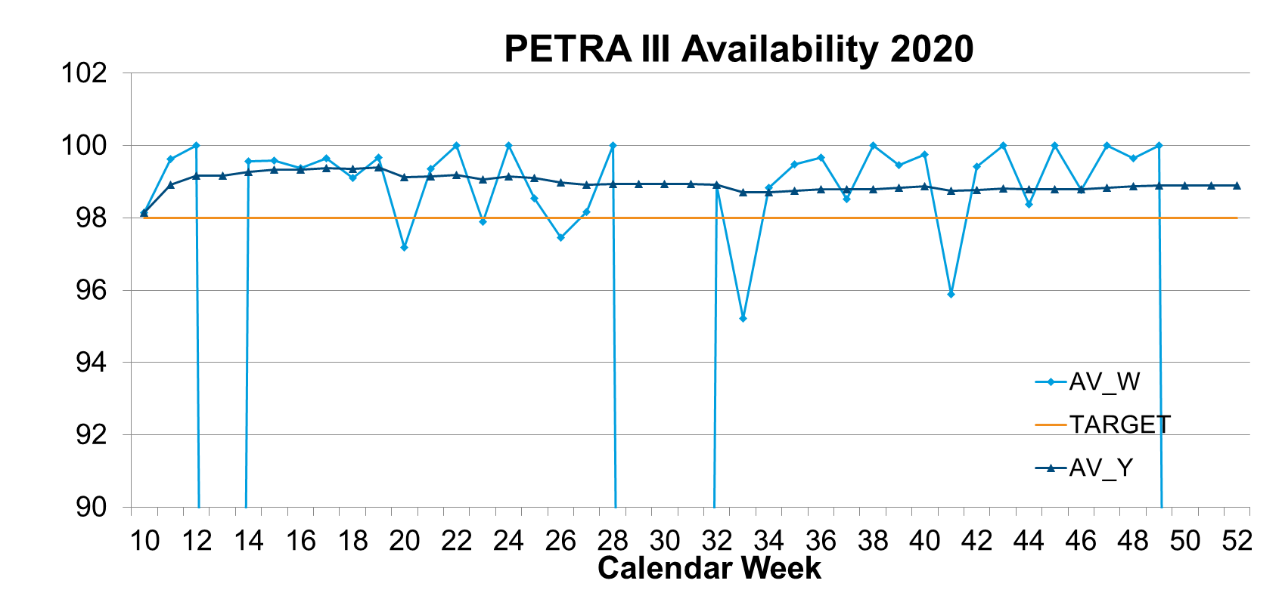
PETRA III availability in 2020
The availability is exceeding 98 %
98,89 %
MTBF
78 h

Slide 8
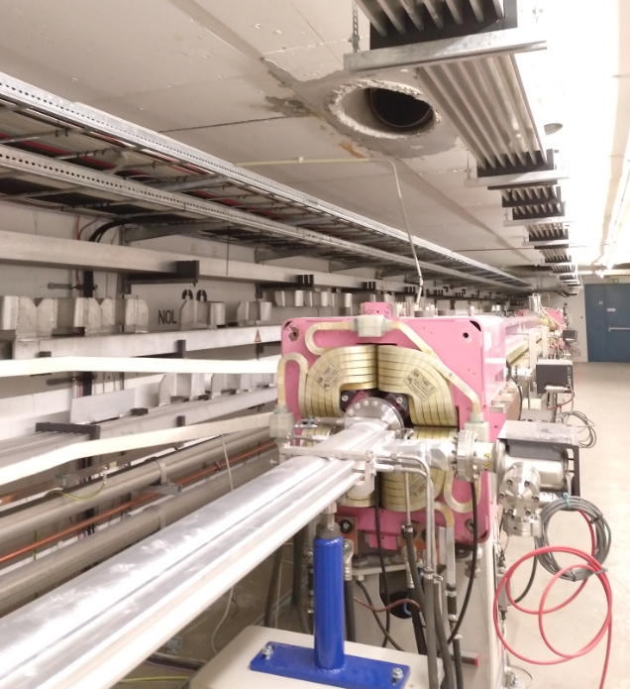
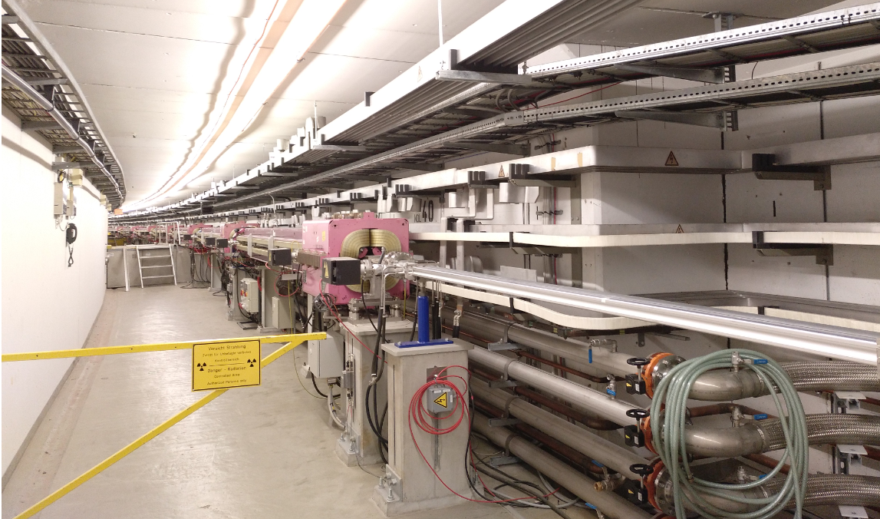
Preparation for a new dipole beamline at PETRA III
The Installation of a new chamber will start in the winter shutdown 2020/21
Dipol
Quadrupol NOL 39
P66
P66
Hall „Paul
Peter Ewald“
FLASH 1&2
Hall „Max von Laue“
Hall
„Ada Yonath“

Slide 9







PETRA IV is the planned upgrade of PETRA III
The Conceptual Design Report of the ultimate 3D X-ray Microscope PETRA IV has been completed
CDR has been completed
available from:
http://doi.org/10.3204/PUBDB-2019-03613
The high brightness synchrotron light facility will directly contribute to almost all of the 17 Sustainable Development Goals of the UN

Slide 10
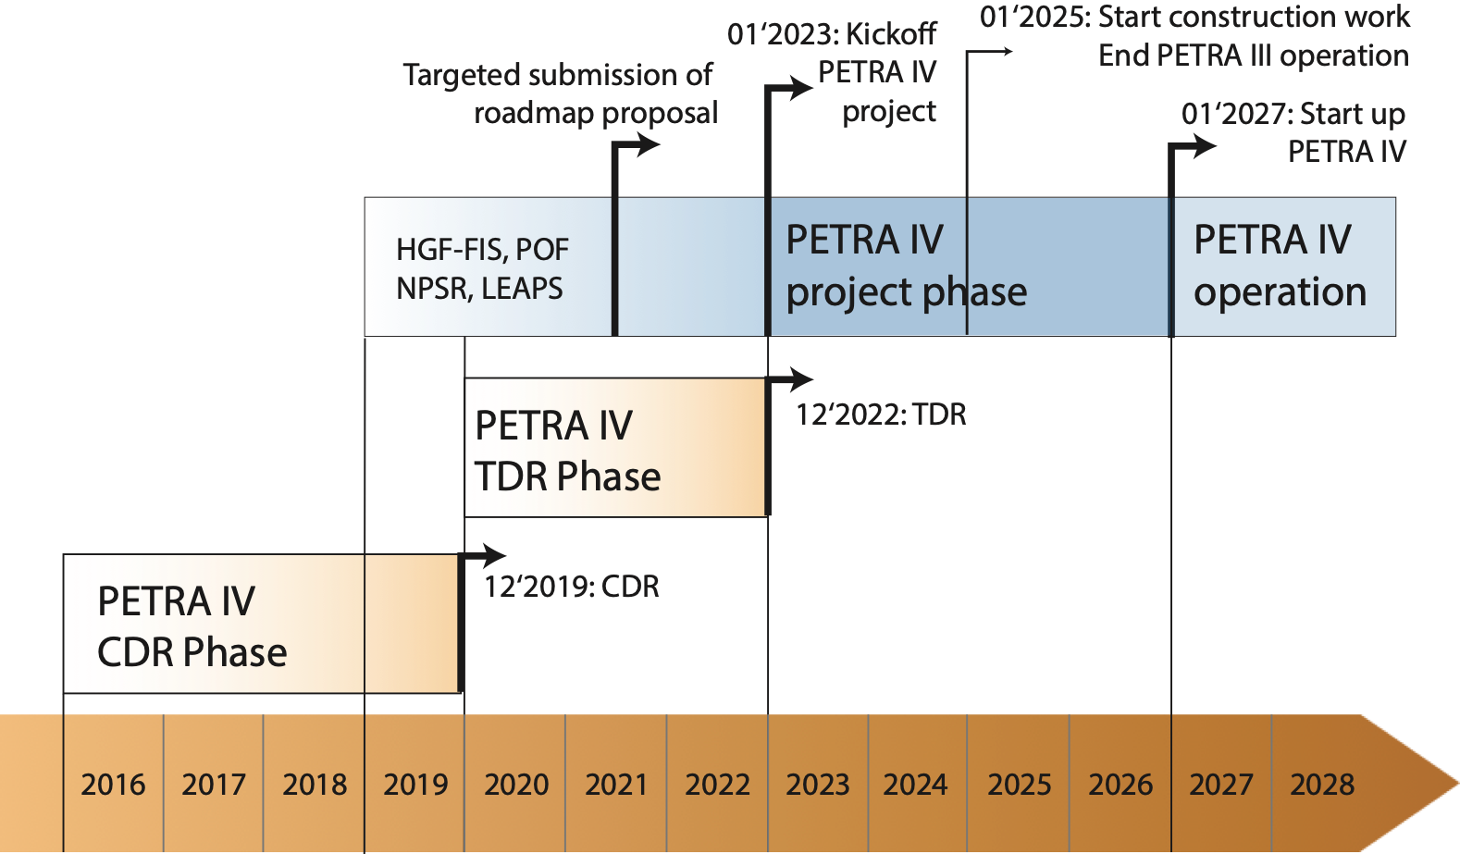
The PETRA IV programme schedule is demanding
A Technical Design Report will be completed in 2022
TDR
Project leader: Riccardo Bartolini
Draft breakdown below hinges on
Project approval in 2022
CFTs start in end 2022
Dark period ~20 months
Users’ operation resumes in Jan 2027

Slide 11
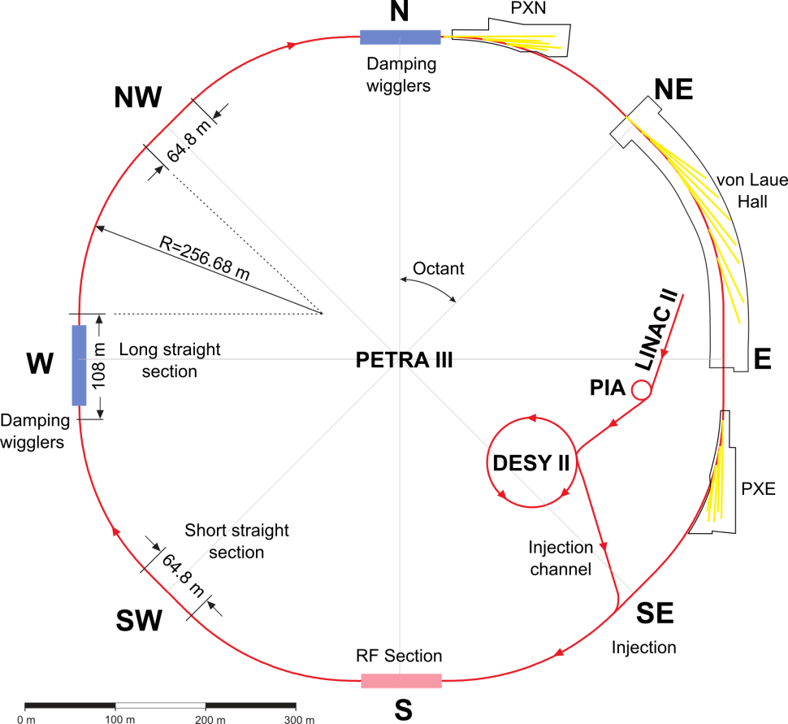
PETRA III to PETRA IV
The PETRA IV CDR lattice is based on the ESRF-EBS cell (H7BA)
Eight Arcs (45°), 201.6 m long
  One arc build from 9 DBA cells L_{cell} = 23 m, 5 m ID straight sections
  5 pure FODO-arcs + 2 modified FODO arcs with 2 DBA-like cells
Beamlines
  Max von-Laue Hall:14; PXN:5; PXE: 7
Eight Arcs (45°), 201.6 m long
  64 cells ESRF-EBS cells (H7BA)
  8 cells per arc L_{cell} = 26.2 m, 5.3 m ID straight sections
Beamlines
  Max von-Laue Hall: 9; PXN: 5; PXE: 7 + New Hall: 9 + 9

Slide 12
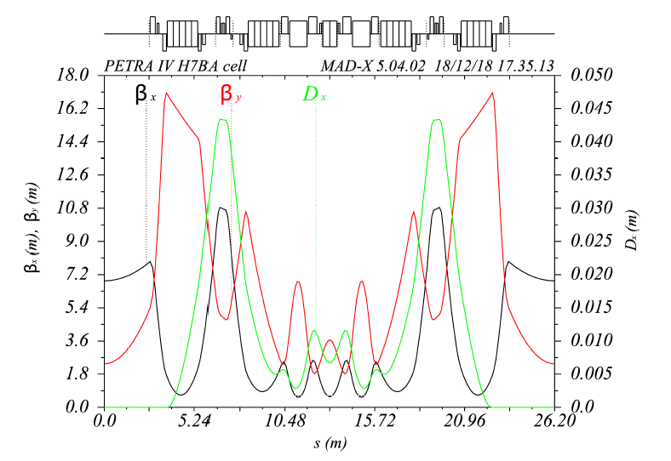
CDR lattice meets all performance requirements for an ultra-low emittance storage ring (DIFL @ 1 Å)
Based on ESRF-EBS H7BA cell – 8 octants with 8 cells each

Slide 13
Important design decisions have been taken
All beamlines will be moved
Extensive beam physics studies showed that
best performance (DA/MA) is achieved with a scaled version of the ESRF cell (26.2 m cell length)
the 9 cells structure in Max von Laue octant (23 m cell) cannot be retained
  neither extended to the full ring (9*8 cell) nor locally in the Max von Laue octant
  high gradients (120 T/m) and poor dynamics
  existing canting angles in P. Ewald and A. Yonath extensions are 20 mrad and increase the emittance to ~40 pm range. Also the 5 mrad canted in the MvL hall could be tolerated for just a few cases
  Emittance and beam physics performance have overridden all logistics considerations of keeping the existing beamlines as they are!

Slide 14
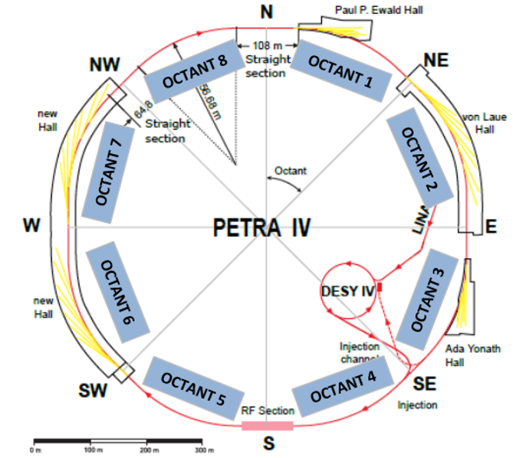
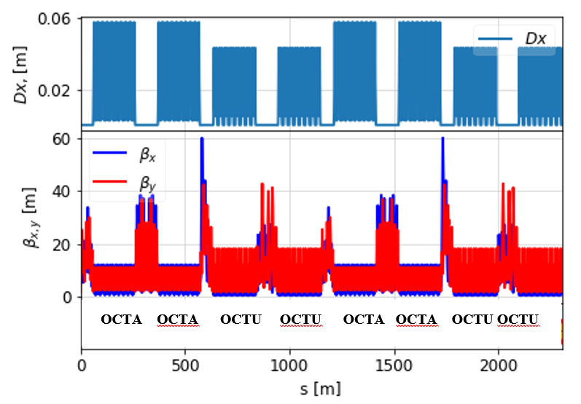
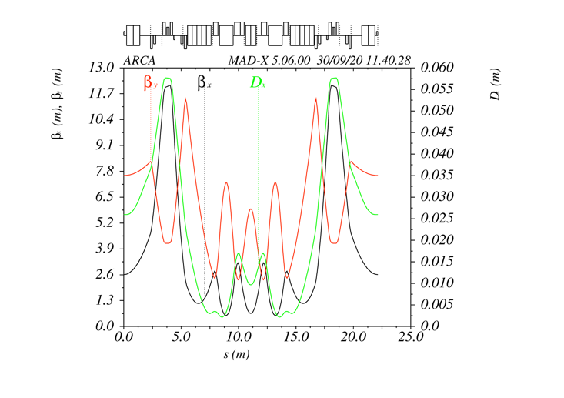
Further lattice work to optimize the lattice design
Alternative design is in progress on the “combi lattice” based on relaxed H7BA cells in octants where no beamlines are possible
OCT U
OCT U
OCT U
OCT U
Rekaxed (“A”) cell
without undulator
Advantages “Combi Lattice”
• DA and lifetime
• Possibility to go to lower beta in the 5m ID
(and hence brightness)
• Lower power consumption (~10%)
Charge stability (via lifetime) and injection frequency
• Better prospects for accumulation option
• Potentially less stress on injection chain (via lifetime)
• Better fits geometry

Slide 15
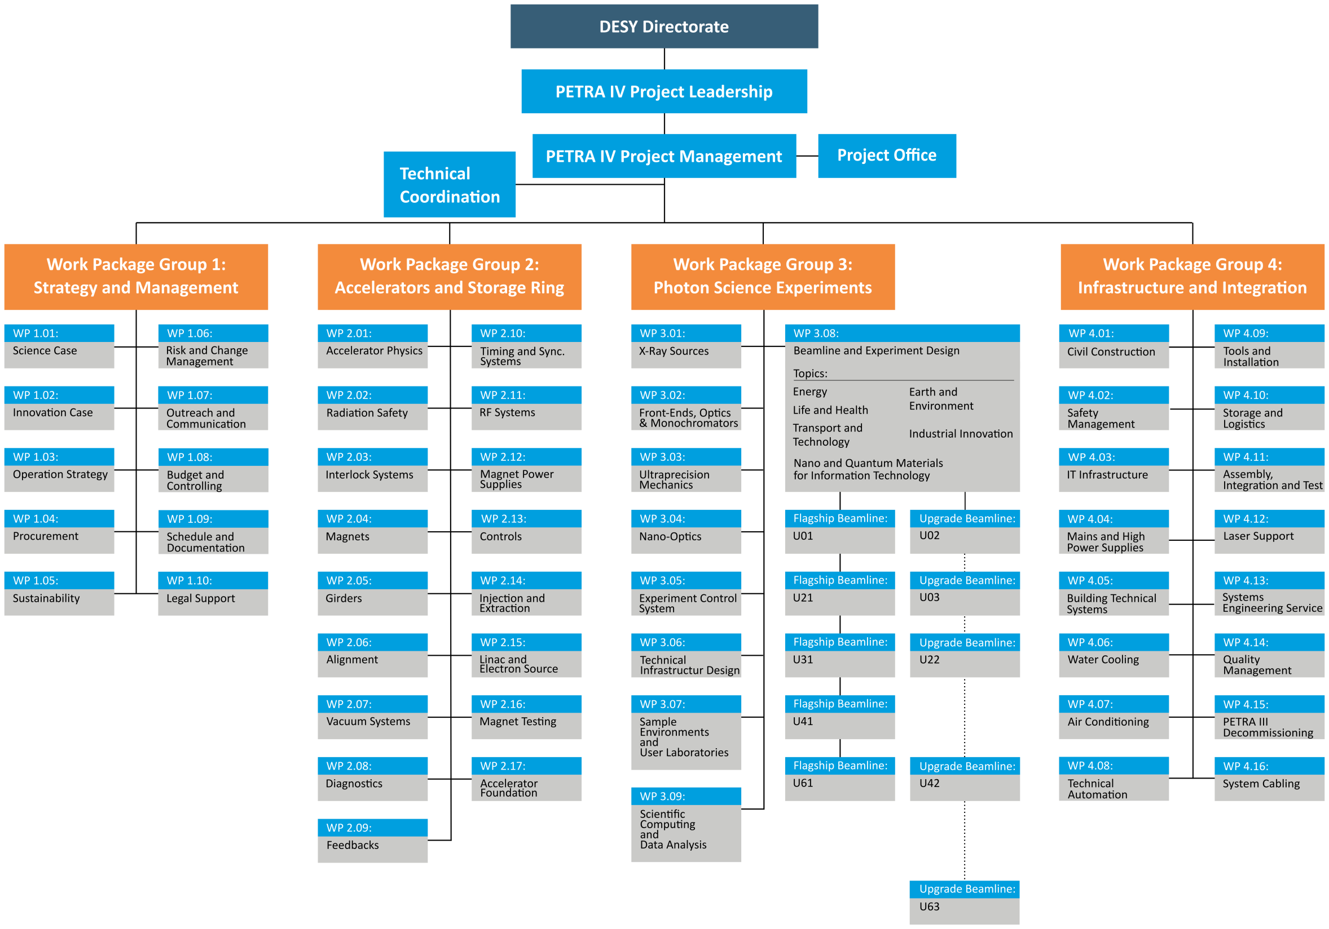
PETRA IV project structure
Work Packages definition
Aggressive recruitment
ongoing ~30 positions
Visit DESY vacancies web
https://www.desy.de/career/job_offers/index_eng.html

Slide 16
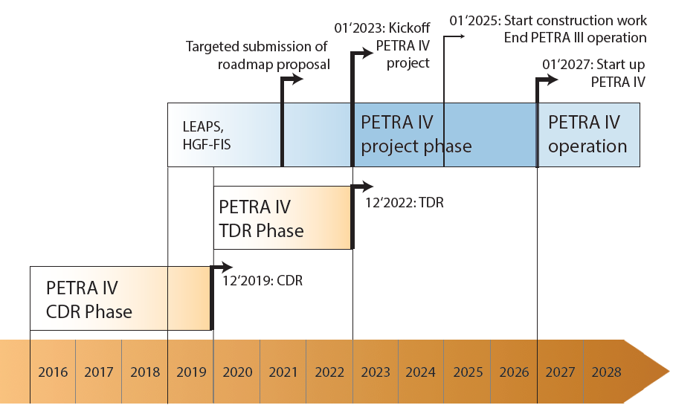
Studies for PETRA IV at PETRA III are important for the TDR
A workshop (online Sep 16) was organized to discuss topics and opportunities for studies at PETRA III
Opportunities for studies at PETRA III
Beam stability concepts
Accelerator physics / beam dynamics
  Test of commissioning strategies
  Test of impedance models
Technical subsystems
    Accelerator Controls
  Vacuum system
  RF system
  Diagnostics
Studies at PETRA III
relevant for the TDR
2020
2021
2022
…

Slide 17
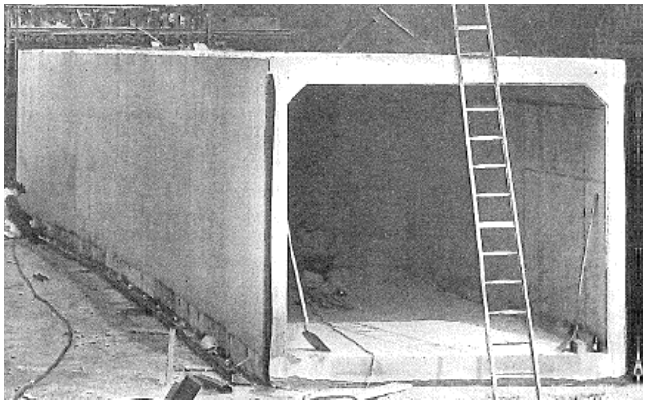
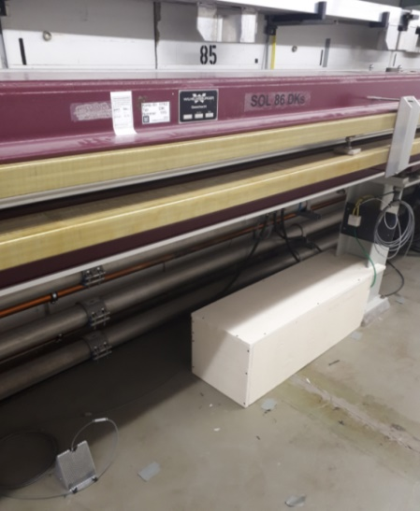
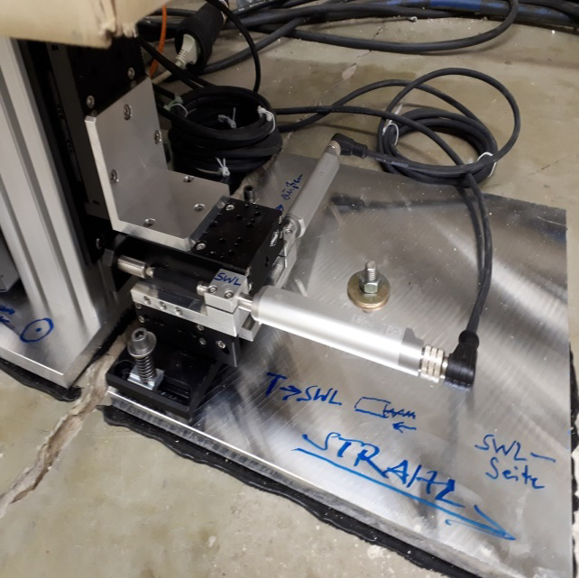
Stability will be crucial for PETRA IV
Opportunities for studies / tests at PETRA III
A large portion of the PETRA IV ring will still be sitting in the old 1976 concrete slab (23 m long, 30 cm thick)
No option for a complete rebuild of the tunnel
Further measurements planned at PETRA III
Mechanical Measurements,
Temperature Measurements,
Stretched Wire Measurements
- Correlation of movements with temperature.
Comparison between temperature stabilized
areas and floating areas.
Comparison between mechanical measurement
and stretched wire measurement
Comparison of measured movements with
tolerances of PETRA IV

Slide 18
Accelerator physics / beam dynamics
First studies have already started, further are planned
Test of commissioning strategies
  Commissioning simulation tests
  Advanced methods of optics measurement and correction
  Software Implementation and Testing
Test of impedance models
  Benchmarking of simulations against data from PETRA III
First results have been published:
Andrei Ivanov, Ilya Agapov
Physics-based deep neural networks for beam dynamics in charged particle accelerators
PRAB 23, 074601 (2020)
Using neural networks to measure the optics

Slide 19
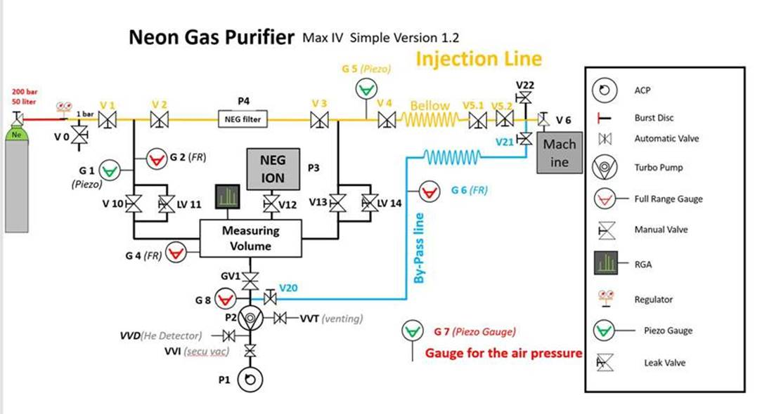
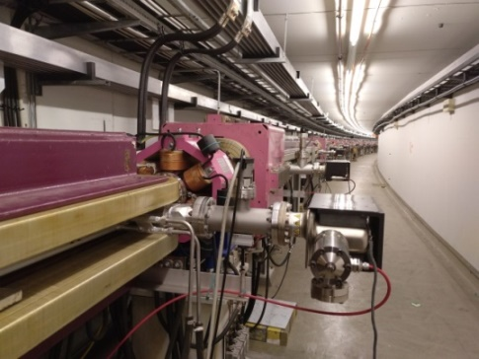
Studies related to the vacuum system started in 2019
Preliminary results from the NEG coated chambers
Plans for new experiments:
Test of an neon purifier venting system in 2021/2022
Venting with pure neon has the advantage, that activated NEG-Pumps will stay activated
Noble-Diode Ion getter pumps are required
Test vacuum diagnostics like Mass-spectrometer, Ion-Gauges, new cabling, new thermo sensors, …
Test in the thermal and radiation environment of the
PETRA III tunnel
Experiment at PETRA III with NEG-coated chambers
10 chambers in the standard arc-section of PETRA III (West, about 60 m)
NEG activation due to
synchrotron radiation ?
Preliminary result:
The design of vacuum system
will include external heaters
Studies will be continued
Test would follow the scheme as implemented by
Eshraq al Dmour et al.
at MAX IV
Design of new type of RF-shielded bellows
test one unit in PETRA III ring

Slide 20
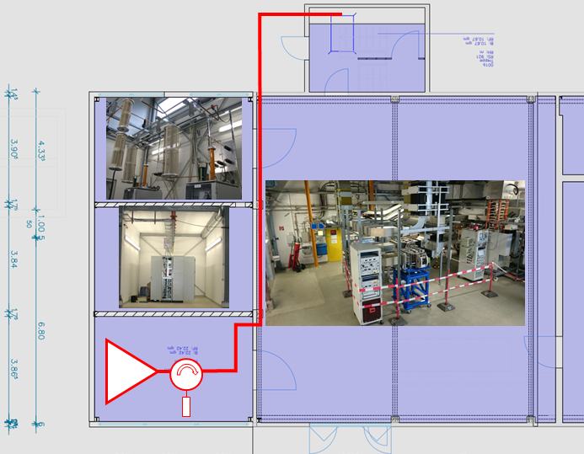
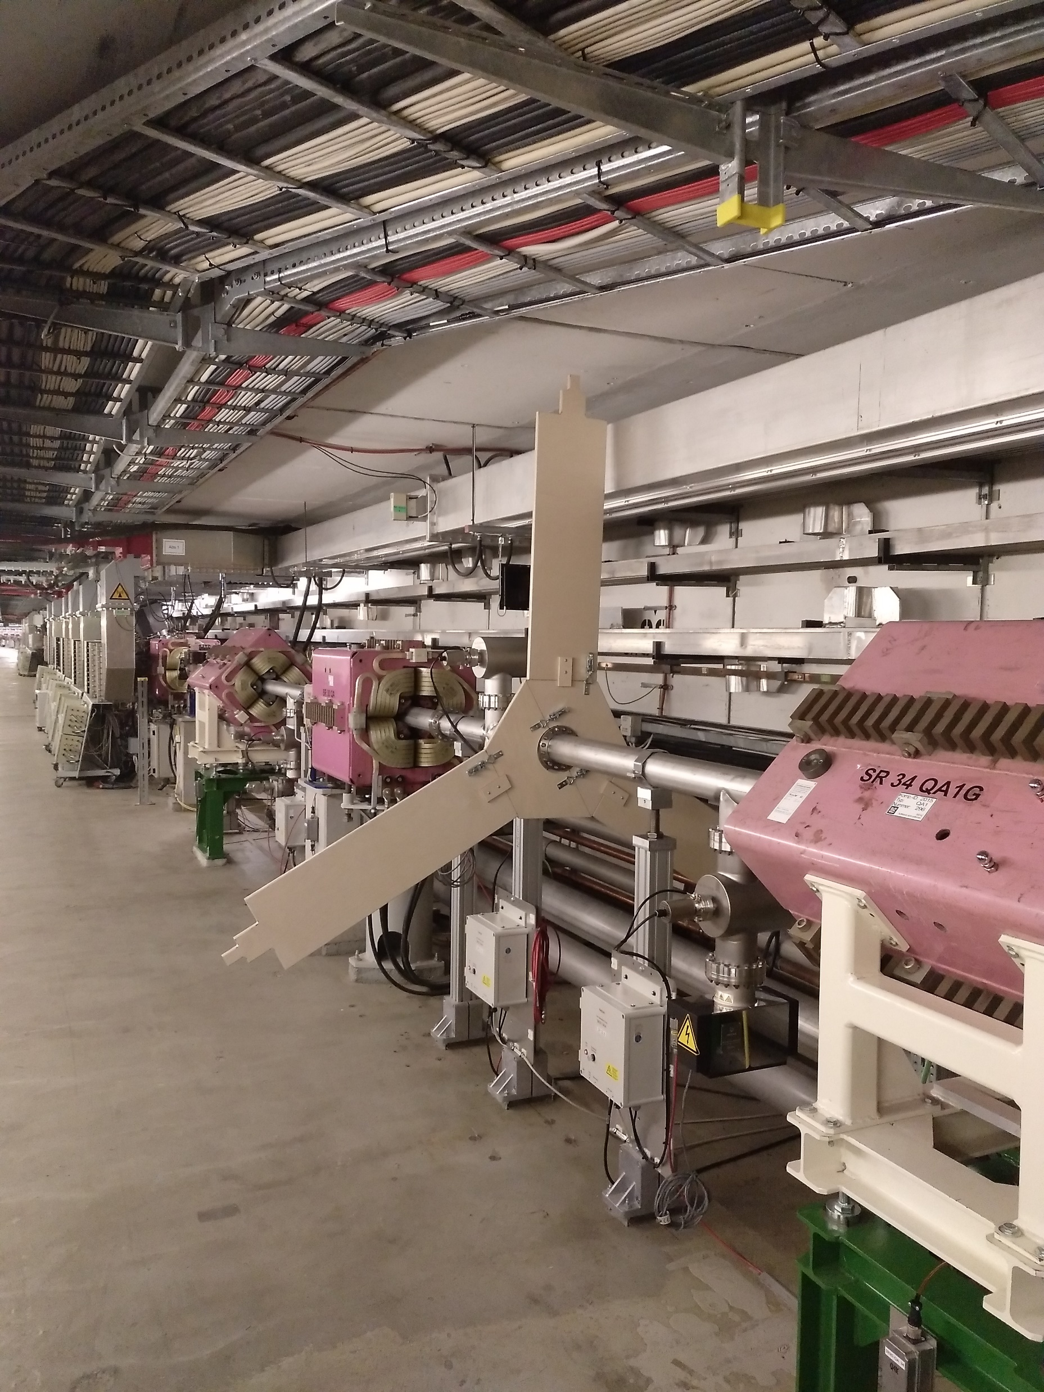
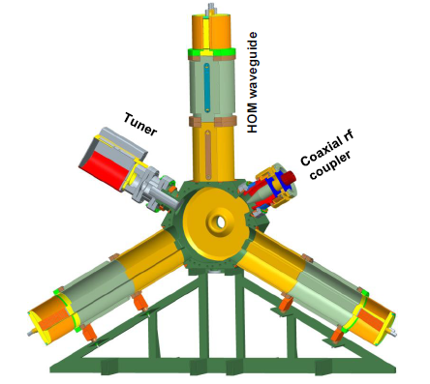
Key components of the new RF system will be tested at PETRA III
Tenders have been placed to order prototypes
A 500 MHz PETRA IV RF subsystem will be installed in PETRA III to run it in parallel to the existing RF system for study purposes.
Solid State Amplifier (SSA) 110 kW
initially operated on a dummy load
connected to one of the
PETRA III 7-cell cavities
drive a 500 MHz HOM-damped Cavity
500 MHz HOM-damped Cavity
Develop and test µTCA-based process control hardware and software
3rd harmonic cavity
collaboration between ALBA(CELLS),
BESSY(HZB) and DESY
test a prototype cavity at BESSY
A 500 MHz HOM-damped Cavity
fits into the PETRA III tunnel

Slide 21
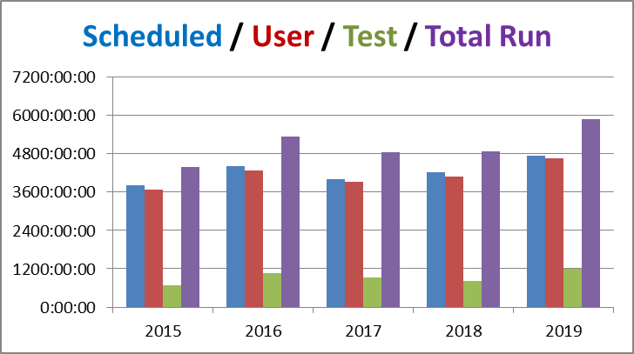
Implementing Studies in the PETRA III 2021 schedule
Additional time slots have been identified without cutting into the time for user runs
Test run time can be reduced at the end of service weeks to free time for studies,
Test run time has been
650 h … 1200 h / year
The time for user runs
has not to be be reduced
in 2021 for additional studies
201 days or 4824 h of user run of user run / goal ~ 5000 h
Maintenance day, runs ends at 7 h start-up at 15 h
19 h Test run, user run 7 h next day
Study day, runs ends at 7 h, studies
19 h Test run, user run 7 h next day
Shut down or
Service week
#

Slide 22
Thank you

Slide 23
Rainer Wanzenberg
MPE
rainer.wanzenberg@desy.de

