Slide 1

Permanent Magnet Developments at STFC
Ben Shepherd
Magnetics and Radiation Sources group, ASTeC, STFC Daresbury Laboratory
28th ESLS workshop
16-17 December 2020

Slide 2


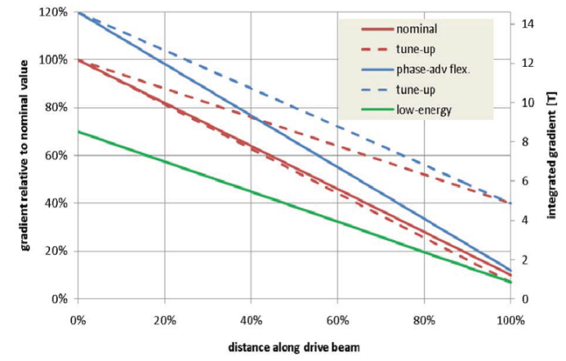
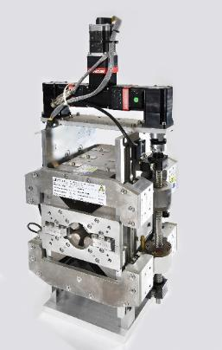
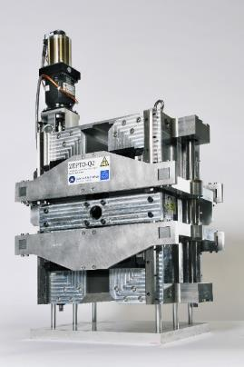
The ZEPTO project
Zero-Power Tunable Optics
Initially, collaboration between ASTeC and CERN to develop tunable PM quadrupoles for CLIC’s drive beam
Nominal 0.24-2.4 GeV, with some tuning range at each point
Two prototypes built at STFC Daresbury Laboratory
  27 mm aperture
  230 mm length
  15-60 T/m, 4-35 T/m ranges
  Fixed poles, movable PMs
  Simple control system with one motor
12.2 T
1.22 T

Slide 3
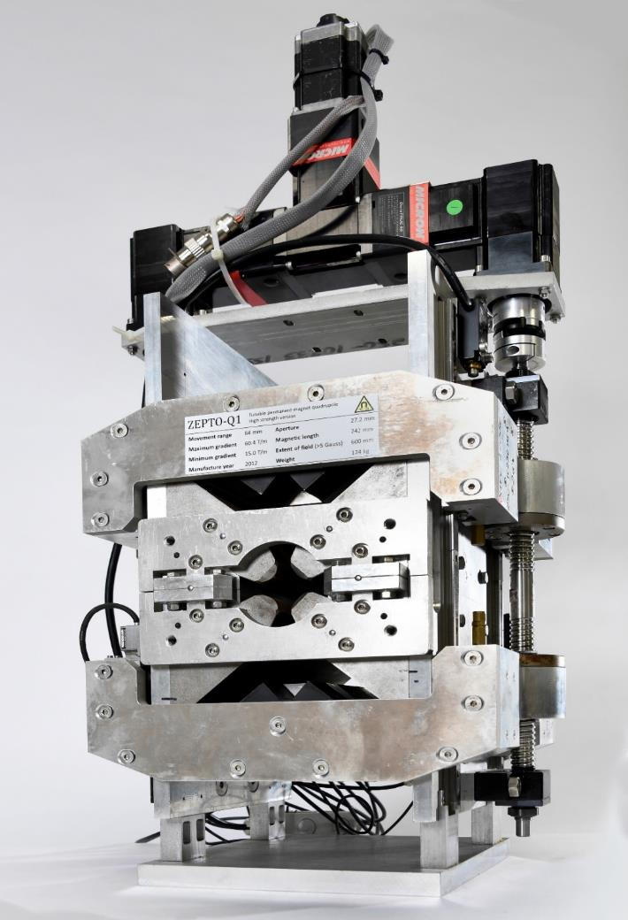
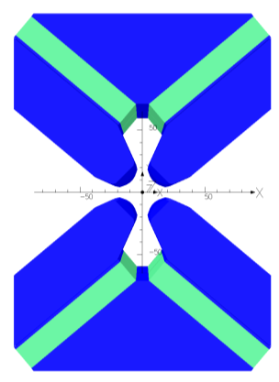
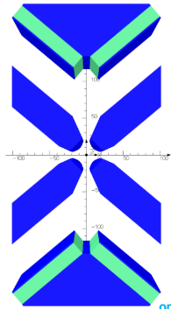
ZEPTO Q1: High Strength
Shepherd et al, IEEE Trans Appl SC, vol. 22, no. 3, p4004204 (2012)
Shepherd et al, IPAC2013 THPME043
High gradient: 60 T/m
  Can reduce to 15 T/m by moving PMs up to 64 mm
  Tuning using variable gap in magnetic circuit
Magnetic force: 16.4 kN per side
  Pulling PMs parallel to magnetic axis → large forces
Some unwanted magnetic centre movement
(100 µm) due to ferromagnetic rails
4 NdFeB blocks, each 18 x 100 x 230 mm
Gradient 15-60 T/m
Pole gap 27.2 mm
Field quality ±0.1%
over 23 mm
Length 230 mm
Max gradient
Min gradient
Fixed poles =
fixed field quality

Slide 4
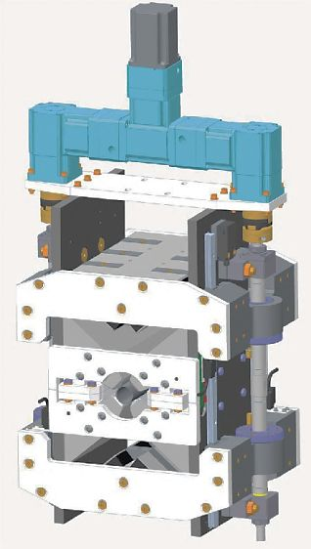
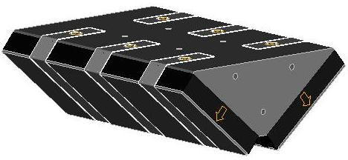
Engineering of High Strength Quad
Single axis motion with one motor and two ballscrews
Rotary encoder on motor (linear encoders used during setup to check repeatability)
Maximum force is 16.4 kN per side, reduces by x10 when stroke = 64 mm
PM blocks bonded to steel bridge piece and protective steel plate also bonded
Steel straps added as extra security

Slide 5
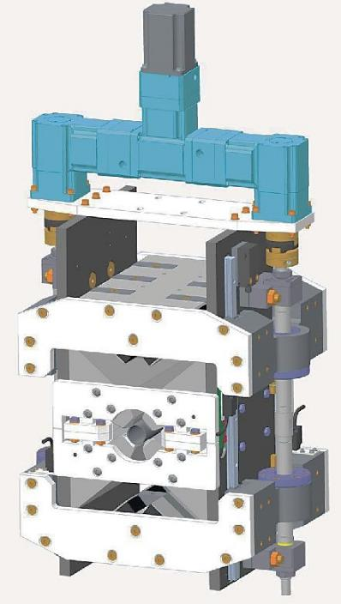
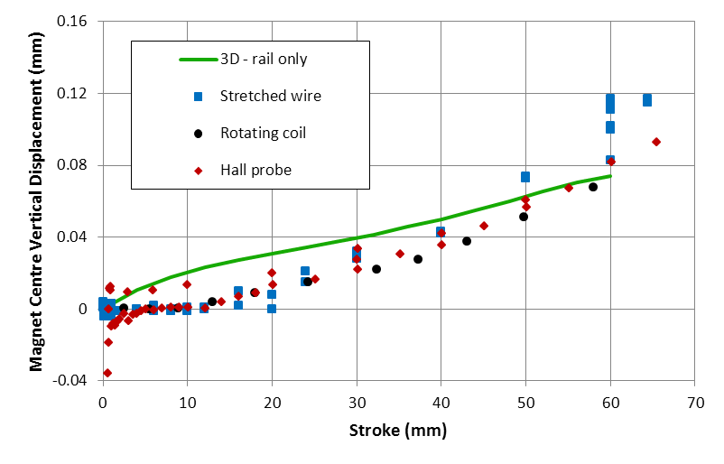
Magnet Centre Movement
The magnet centre moves upwards by ~100 µm as the permanent magnets are moved away
3D modelling suggests this is due to the rails being ferromagnetic (µ_{r} ~ 100, measured) and not mounted symmetrically about the midplane – should be easy to fix
Motor/gearbox assembly may also be a contributing factor

Slide 6
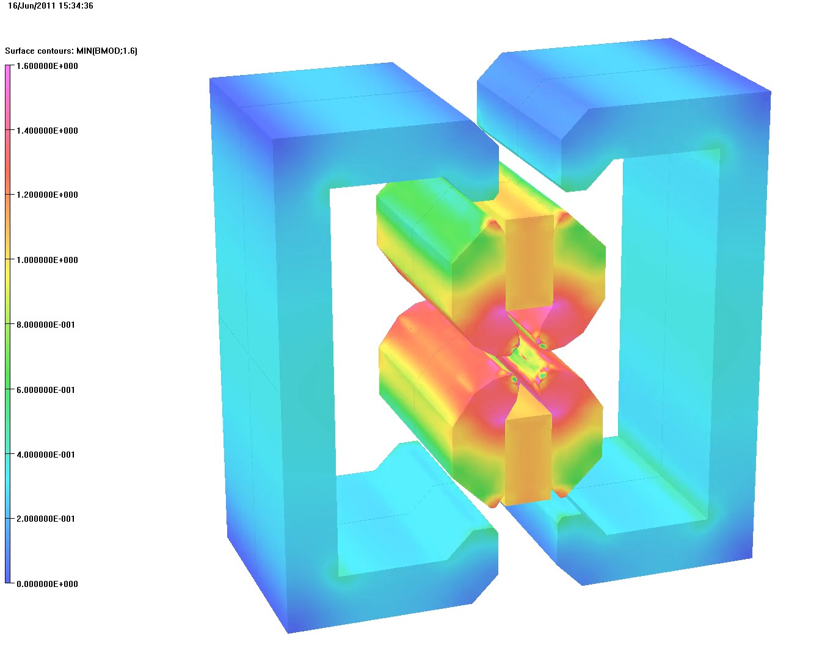
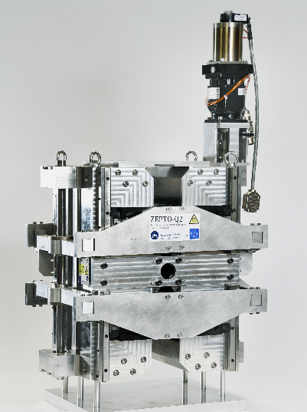
ZEPTO Q2: High Dynamic Range
Shepherd et al, IPAC2014 TUPRO113
Factor of 12 tuning range: 3.5-43 T/m
  Tuning using outer shell as secondary flux circuit
  to reduce quad strength rapidly
  PMs move perpendicular to magnetic axis → smaller forces
Smaller magnetic centre shift of 80 µm
2 NdFeB blocks, each 37.2 x 70 x 190 mm
Pole gap 27.6 mm
Field quality ±0.1% over 23 mm
Length: 190 mm

Slide 7
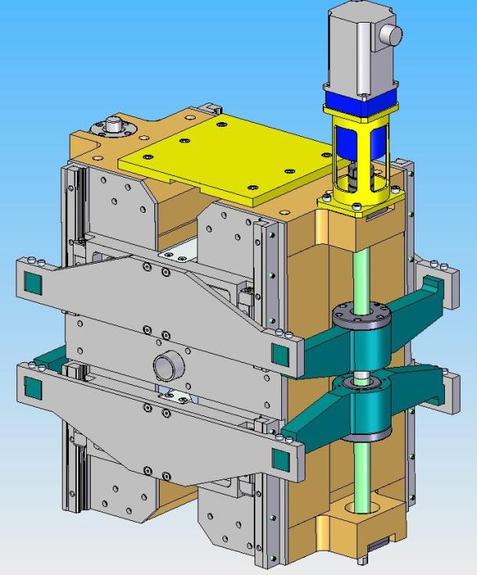
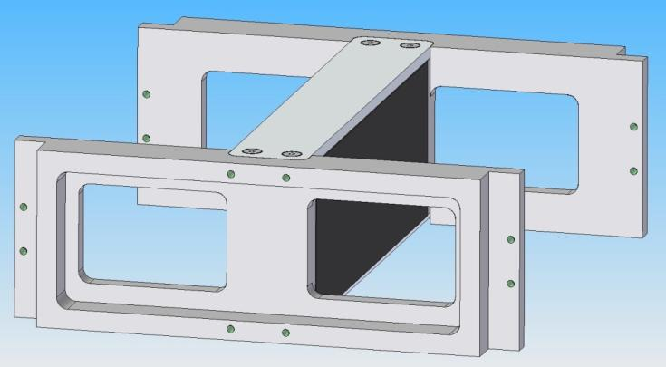
Engineering of ZEPTO Q2
Simplified single axis motion with one motor and one ballscrew
Rotary encoder on motor – linear encoders used during setup to check repeatability
Maximum force is only 0.7 kN per side
PM blocks bonded within aluminium support frame

Slide 8
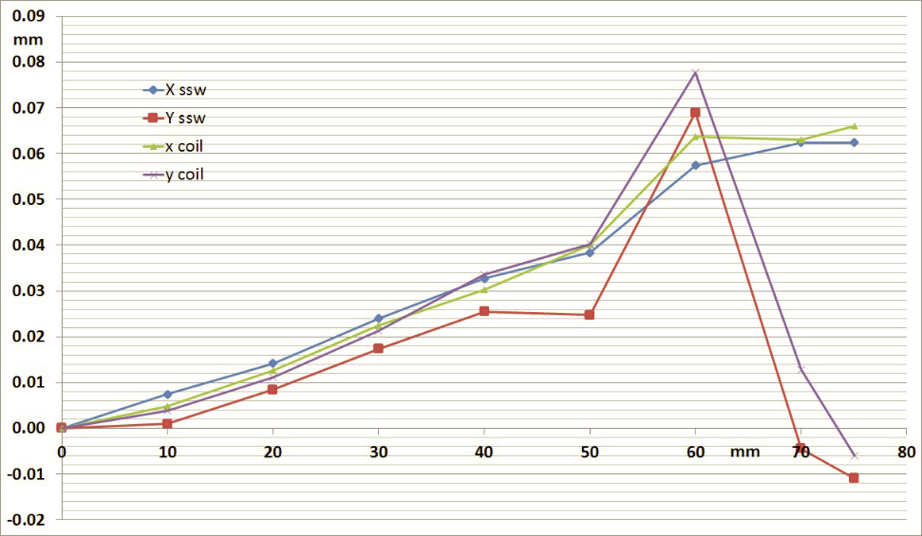
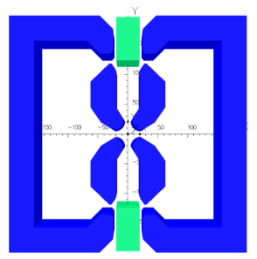
Measured Axis Movement
Good agreement between measurement methods
  stretched wire
  rotating coil
X axis moves in one direction
  Possible misalignment of outer shell?
Y axis moves up and then back down
  Harder to explain this…
X (horiz)
Y (vert)

Slide 9
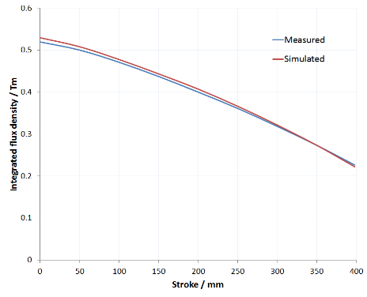
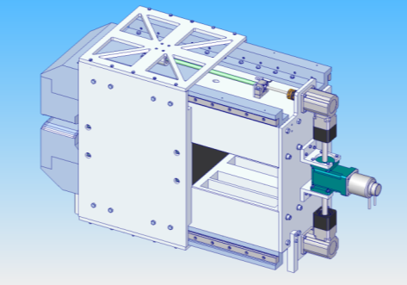
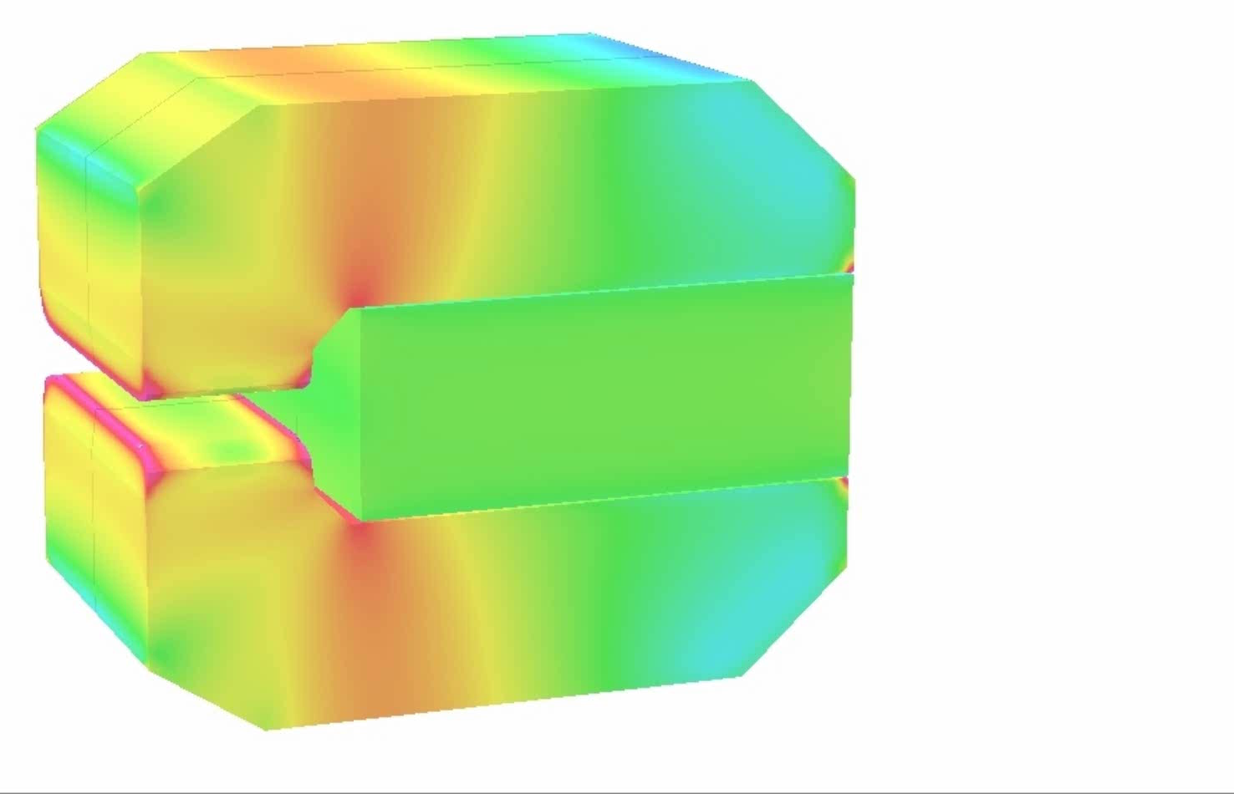
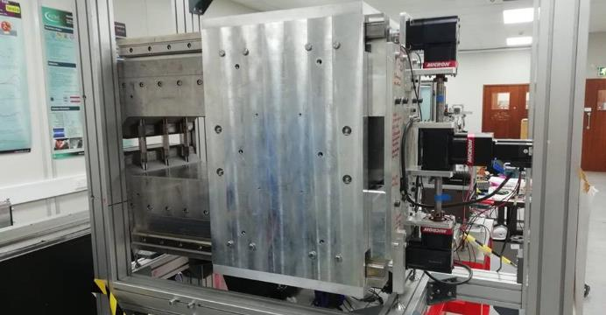
ZEPTO Dipole
Bainbridge et al, IPAC2017 THPIK105
Bainbridge, IMMW21 workshop
Prototype based on specifications for CLIC DB turnaround loops
0.46-1.1 T tuning range (355 mm stroke)
NdFeB block: 500x400x200 mm, B_{r} 1.38 T
Horizontal field quality: ±1x10⁻³ over 40 mm
Built and tested in 2019 at Daresbury Laboratory

Slide 10
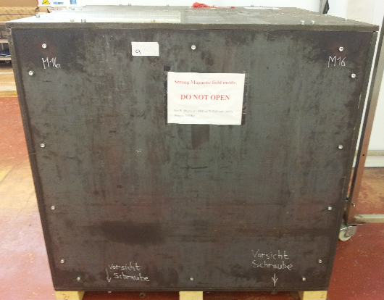
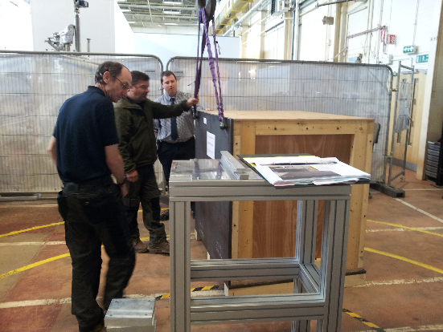
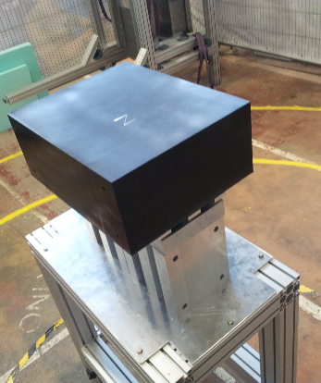
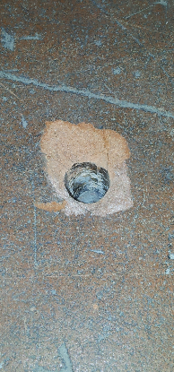
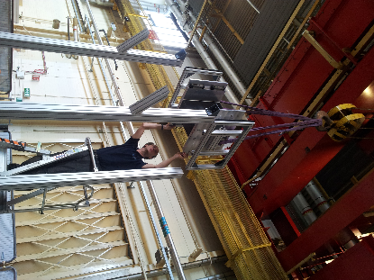
ZEPTO Dipole Construction
Extremely large PM
Lowered vertically into steel pole assembly
Mass 350kg + magnetic force 27 kN = 30.5 kN
PM became ‘wedged’ due to slight misalignment (2mm)
Frame not anchored to floor correctly
Not enough fine control on crane ➔ frame pulled out of floor

Slide 11
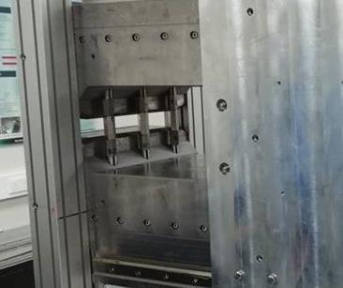
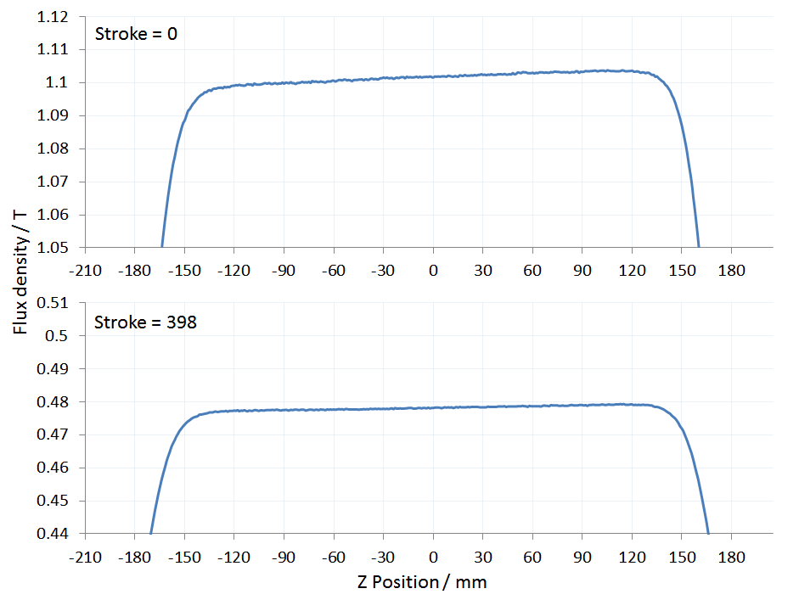
ZEPTO Dipole Measurements
Full suite of measurements performed on ZEPTO dipole, performed well but showed mechanical modifications needed:
Measurements showed 2 problems:
A longitudinal gradient in the field
The gradient changes as the block moves
Error in construction was to blame, needed adjusting and re-measuring
Cannot do any machining to pole faces once magnet is assembled.
However 3 support pillars have screw threads allowing independent adjustment with a very big (and non-magnetic!) spanner.

Slide 12
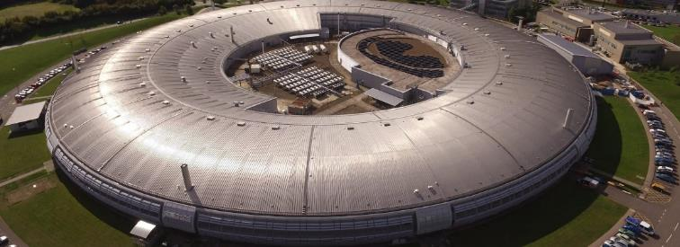
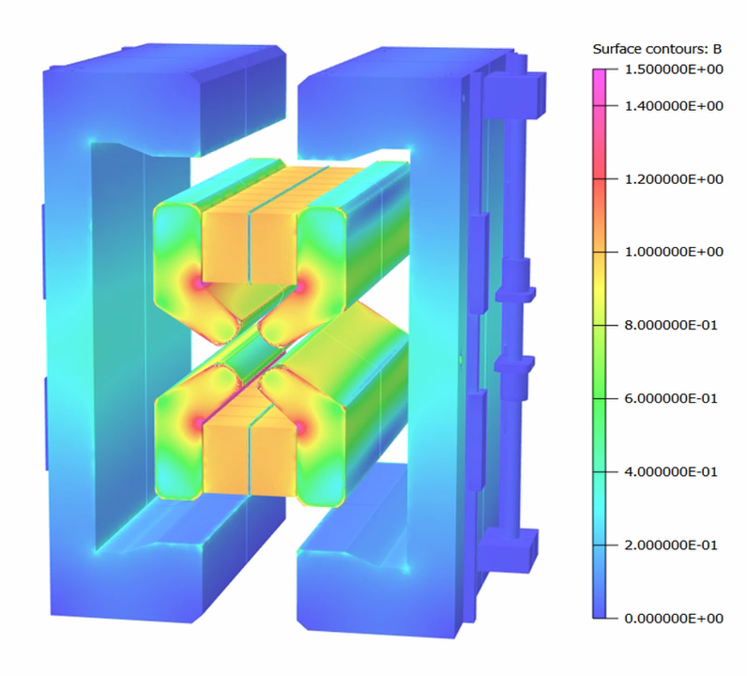

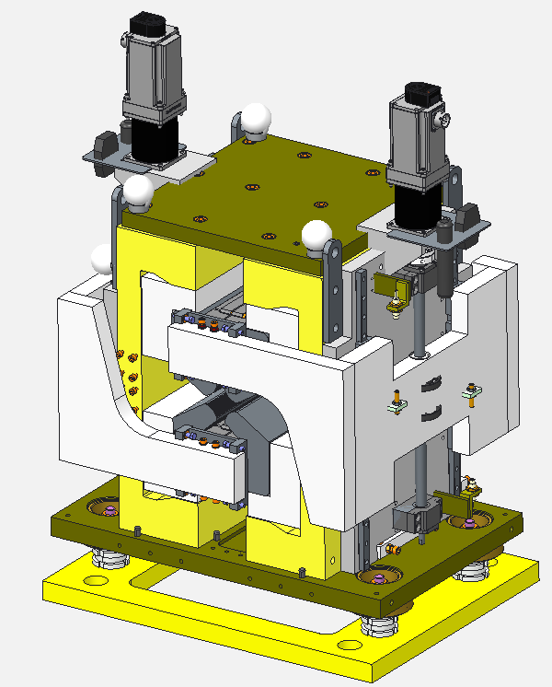
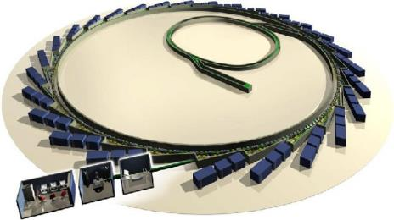
ZEPTO Diamond Quadrupole
Aim: demonstrate operation of a ZEPTO quadrupole on a working accelerator
Install a tunable PM quadrupole as a drop-in replacement for an EM quadrupole
To be installed at Diamond Light Source, on the BTS transfer line
Enabled by STFC’s Proof of Concept Fund
  Step towards commercialisation of ZEPTO technology
Design complete
  Assembly and testing at Daresbury in late 2020
  Similar design to ZEPTO-Q2
    Outer shell for large tuning range
  SmCo blocks
    improved temperature stability
    radiation resistance
  Max gradient 19 T/m
  Min gradient 0.5 T/m
  Movement range 90 mm
  Aperture diameter 32 mm
  Splittable to allow installation around vacuum chamber
  Two independent motors for magnetic centre correction
  Ice cube tray design for PM block holder: modular, easy assembly

Slide 13
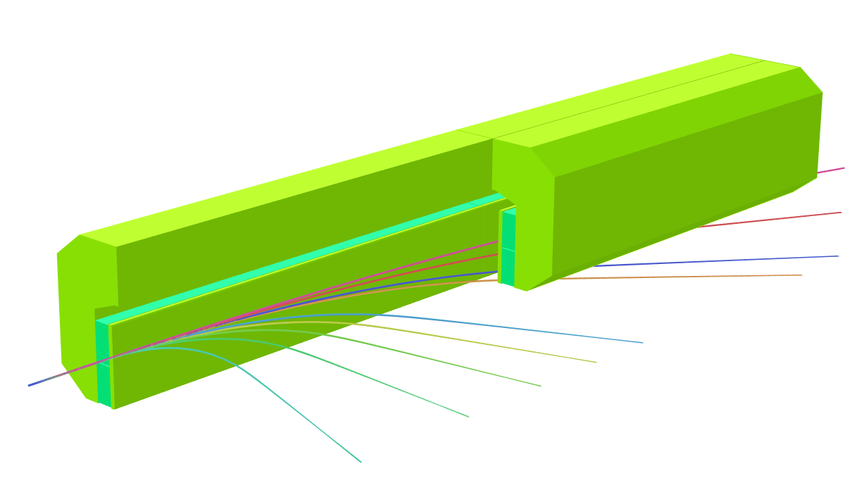
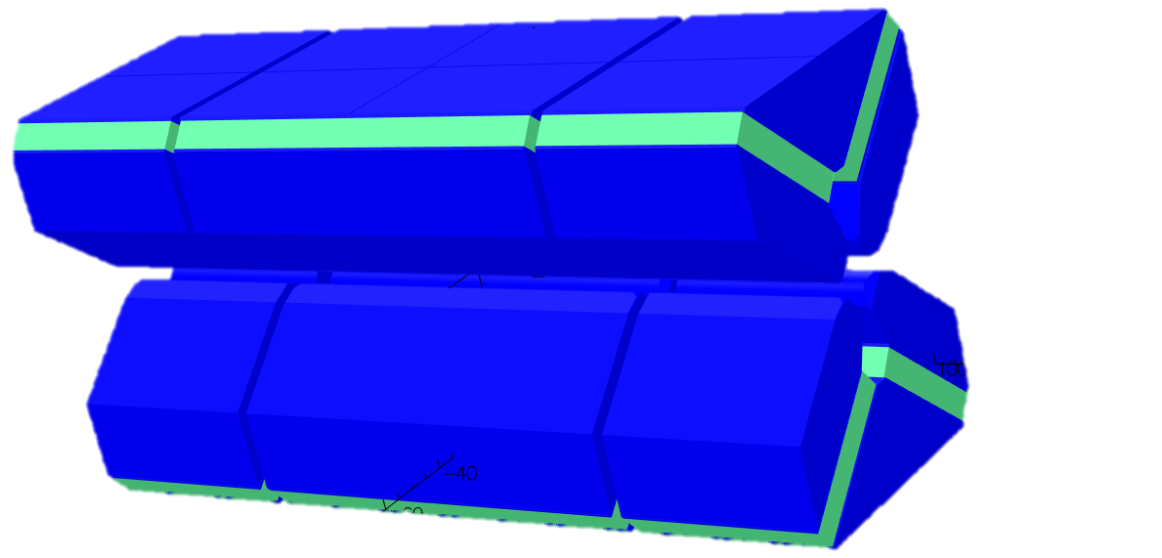
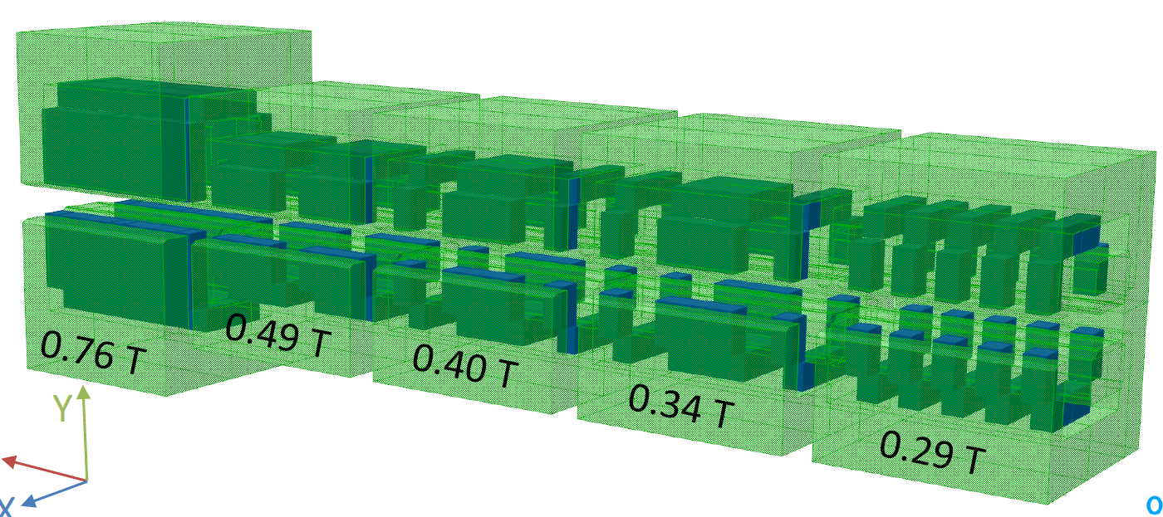
Other PM applications
ASTeC’s magnet group are working on several other projects using PM-based magnets
FEBE @ CLARA (Full Energy Beam Exploitation)
  PM spectrometer dipole for novel acceleration experiments
  C-shaped dipole, 600 MeV, 20 mm gap, 1 m length, modular
EPAC @ CLF (Extreme Photonics Application Centre)
  Investigation of ZEPTO triplet to capture
  plasma-accelerated beam immediately after IP
  10 mm gap, 200-300 T/m gradient
Diamond-II PM magnets
  PM alternative to DQ magnet: 0.7 T + 33 T/m; ~10% adjustment
  Longitudinal gradient dipoles: 0.29-0.76 T, 25 mm gap (ESRF design)
  STFC to build prototype for DLS
ILC damping rings
  ZEPTO quadrupoles and sextupoles – under discussion

Slide 14

Summary
The ZEPTO project has produced several successful prototypes
  The tunable magnet concept works well
  Large magnetic forces need to be dealt with carefully
  Magnetic centre shift can be an issue
We are working towards commercialisation of this idea
  Demonstration of a ZEPTO quadrupole on Diamond is a step towards this
Thanks for your attention!
The ZEPTO team in 2020
Ben Shepherd
Project Leader
Alex Bainbridge
Magnet Designer
Nick Krumpa
Mechanical Engineer

