Slide 1
Non-linear optics from Off-Energy Closed Orbits
David K. Olsson, Åke Andersson, Magnus Sjöström
ESLS20, 16-17/12-20, ESRF, Grenoble (Online)

Slide 2
Outline
Motivation
Description of scheme
Application to the MAX IV 3 GeV ring
Thermal drift
Singularity issue
Effect on performance
Summary and Future Work

Slide 3
Motivation
Find a general method of characterising and correcting the non-linear optics.
Reliable
Not too time consuming
Simultaneous characterisation of all (dispersive) sextupoles
Increase non-linear optics performance.
Lifetime
Injection
Inspired by work done at ESRF presented during ESLS 2017.

Slide 4
Description of Scheme

Slide 5
The Off-Energy Orbit Response
$$u\left(s\right)=\sqrt{β\left(s\right)β_{θ}}θ\sin{[ν_{0}φ_{0}\left(s\right)−ν_{0}φ_{0θ}]}$$
Inserting the expanded beta function and keeping only order $δ$ and lower:
$$β=β_{0}+β_{1}δ$$
$$u_{δ}\left(s\right)=\sqrt{β_{0}\left(s\right)β_{0θ}}+\frac{1}{2}\left[\sqrt{\frac{β_{0}(s)}{β_{0θ}}}β_{1θ} +\sqrt{\frac{β_{0θ}}{β_{0}\left(s\right)}}β_{1}(s)\right]δθ\sin{[ν_{0}φ_{0}\left(s\right)−ν_{0}φ_{0θ}]}$$
Taking the difference to get only the momentum dependent part:
$$\frac{u_{δ}\left(s\right)−u_{−δ}(s)}{2δ}=\frac{1}{2}\left[\sqrt{\frac{β_{0}(s)}{β_{0θ}}}β_{1θ} +\sqrt{\frac{β_{0θ}}{β_{0}\left(s\right)}}β_{1}(s)\right]θ\sin{[ν_{0}φ_{0}\left(s\right)−ν_{0}φ_{0θ}]}$$
The Off-Energy Orbit Response is approximately linear with chromatic sextupole strengths, m.

Slide 6
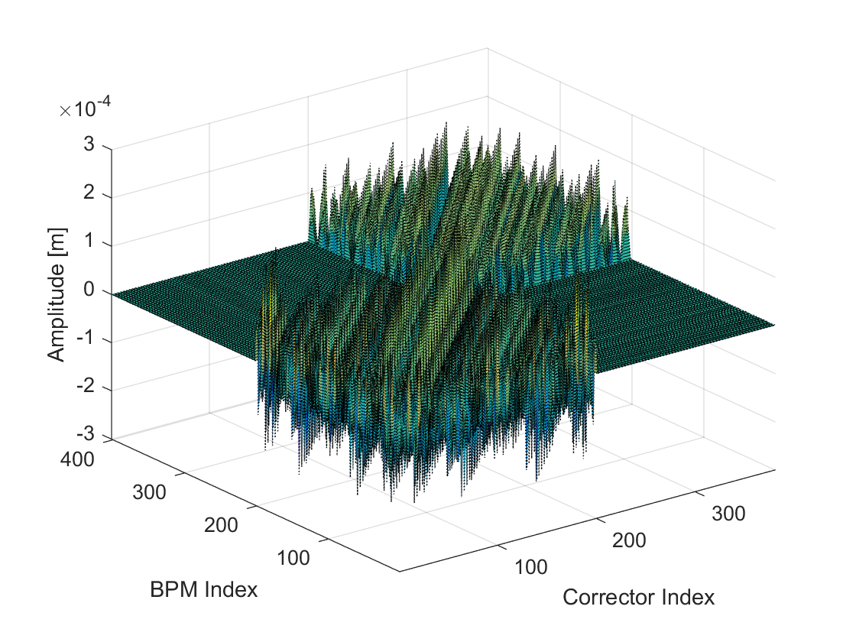
The Off-Energy Orbit Response Matrix
Collecting the off-energy orbit response of all dipole correctors.

Slide 7
Non-linear optics from Off-Energy Closed Orbits
NOECO scheme minimises the difference between measured and model OEORM .
Data from each BPM is weighted by its noise level.

Slide 8
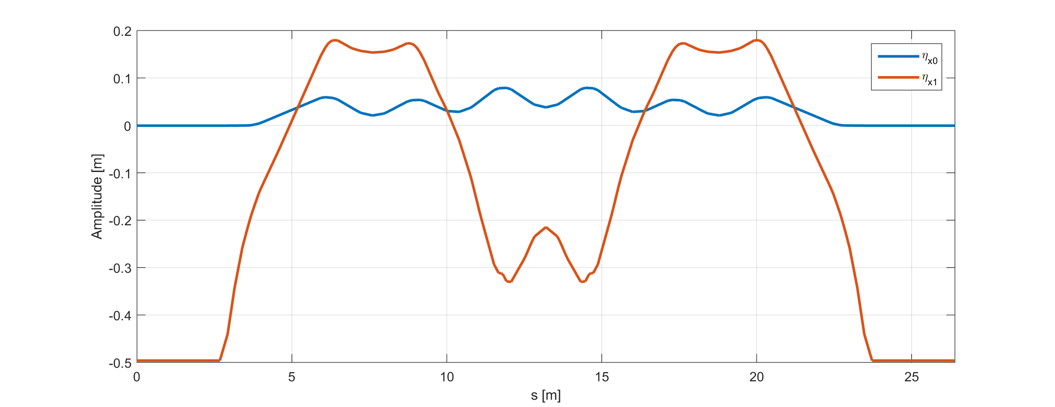
Non-linear optics from Off-Energy Closed Orbits
Fitting parameters at the MAX IV 3 GeV ring:
101 individually controlled sextupole circuits -> 101 fitting parameters.
Dipole corrector kick strengths -> 380 fitting parameter.
200 BPMs with potential horizontal and vertical gain errors -> 400 fitting parameters.
Nominal 1st and 2nd order dispersion of the MAX IV 3 GeV ring.

Slide 9
Application to the MAX IV 3 GeV Ring

Slide 10
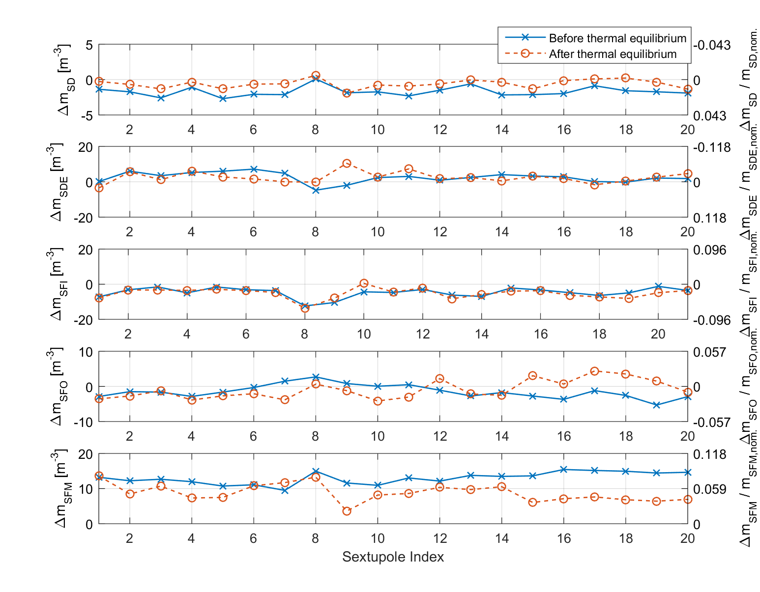
Thermal Drifts
Fit results affected by the thermal drift of the beam position after magnet cycling.
Sufficient equilibrium took hours to achieve.
Found sextupole settings when measuring directly after, or 2 h after magnet cycling.

Slide 11
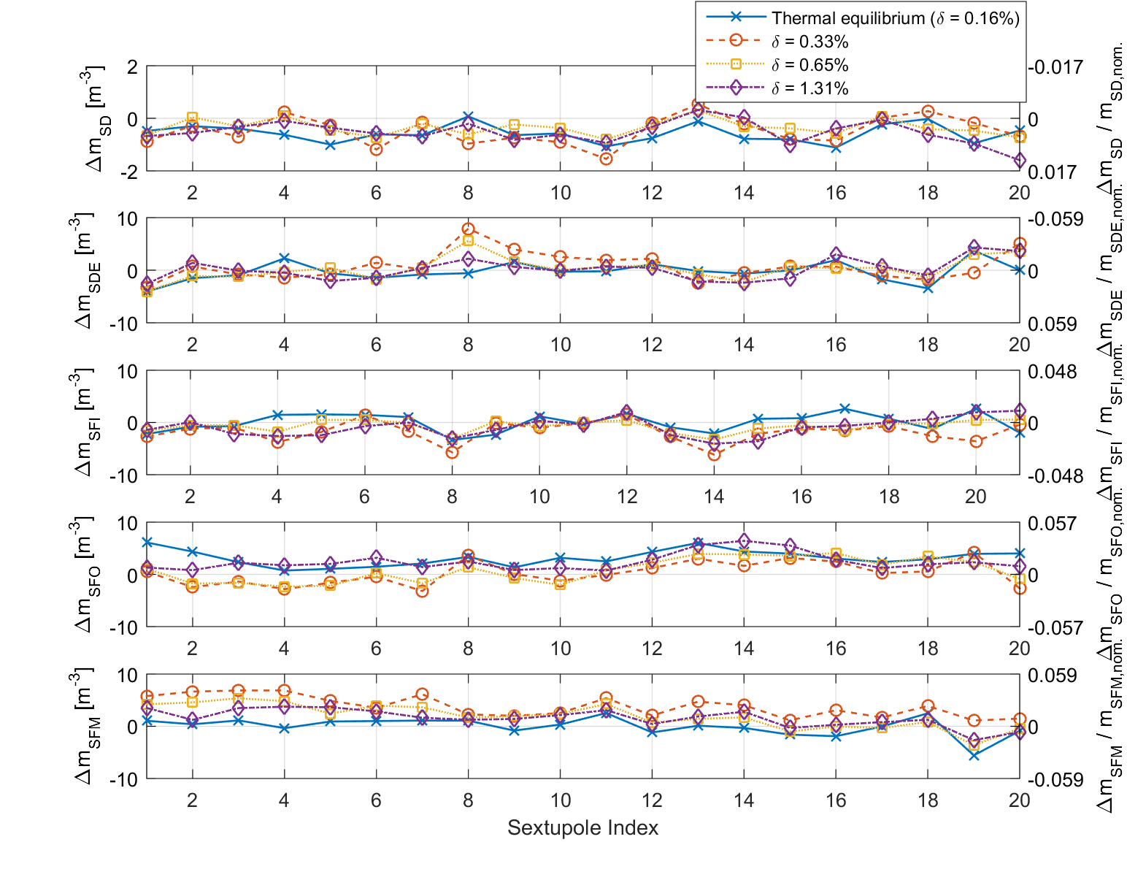
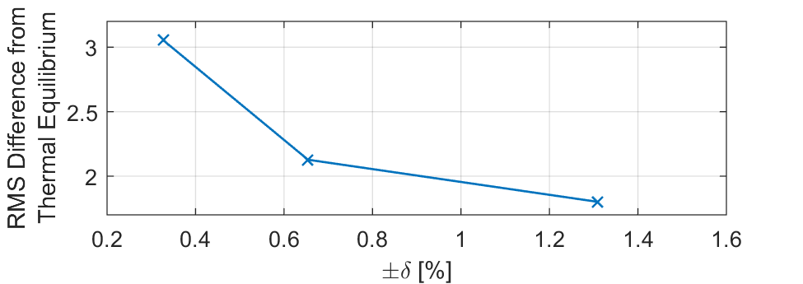
Thermal Drifts
Added orbit feedback to measurement procedure.
Thermal signal was drowned out by increasing the measurement signal.
Measuring at increasing energies showed convergence towards results from thermal equilibrium.
RMS difference vs. shift in measurement momentum.
Found sextupole settings when measuring with different shifts in momentum.

Slide 12
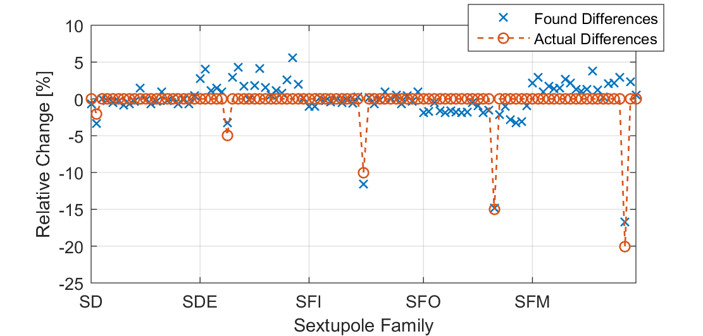
Proof of Concept Measurements
Detection of intentional sextupole errors: -2% SD, -5% SDE, -10% SFI, -15% SFO, -20% SFM
 | Measured $ξ_{x}/ξ_{y}$ | Fitted $ξ_{x}/ξ_{y}$
Before errors | +1.1200 / +0.8531 | +1.0169 / +0.9889
After errors | +0.5342 / +1.3590 | +0.5047 / +1.6117

Slide 13
Singularity Issues
The SDend and SFm sextupoles of R3 are flanking the short straight section.
No BPMs or dipole correctors between the two.
No measurement points -> singularity in the fitting procedure.
CM
CM
CM
CM
CM
BPM
BPM
BPM
BPM
BPM
BPM
BPM
BPM

Slide 14
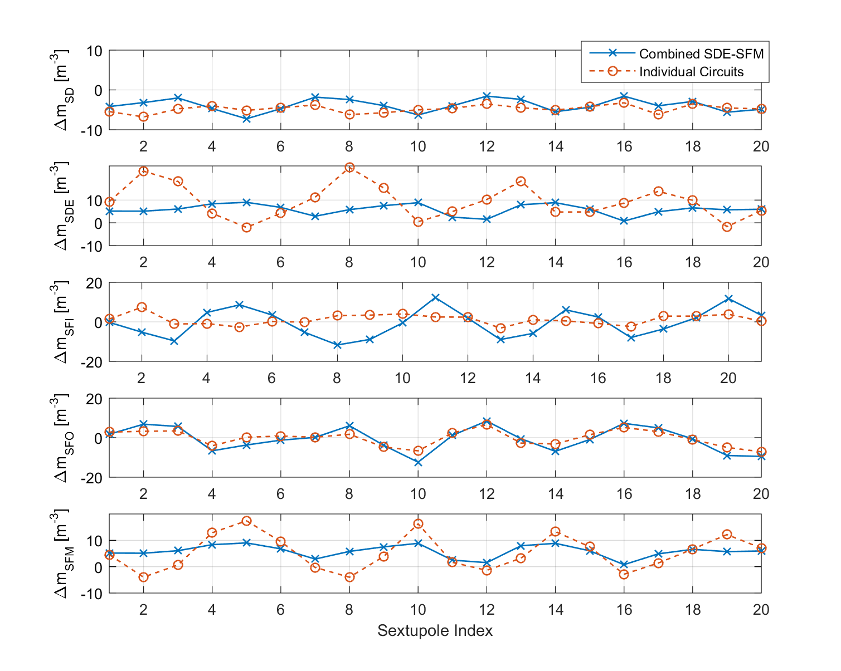
Singularity Issues
Found sextupole settings when fitting each circuit individually or when combining the neighbouring SDE and SFM circuits.

Slide 15
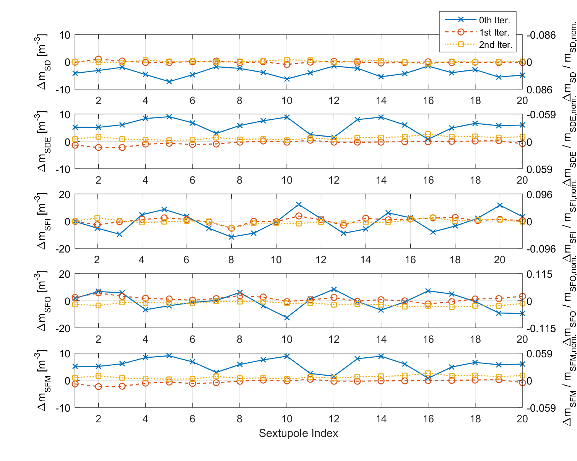
Iterative Correction of 2nd Order Optics
Corrections applied iteratively.
Sextupole errors from non-sextupole magnets.
Sextupole fields in other magnets.
Alignment errors.
Etc.
Found sextupole settings after each iteration of corrections were applied to the machine.

Slide 16
Chromaticity Convergence
Measured chromaticity and chromaticity from the NOECO fit with each iteration of applying correction to the sextupole circuits.

Slide 17
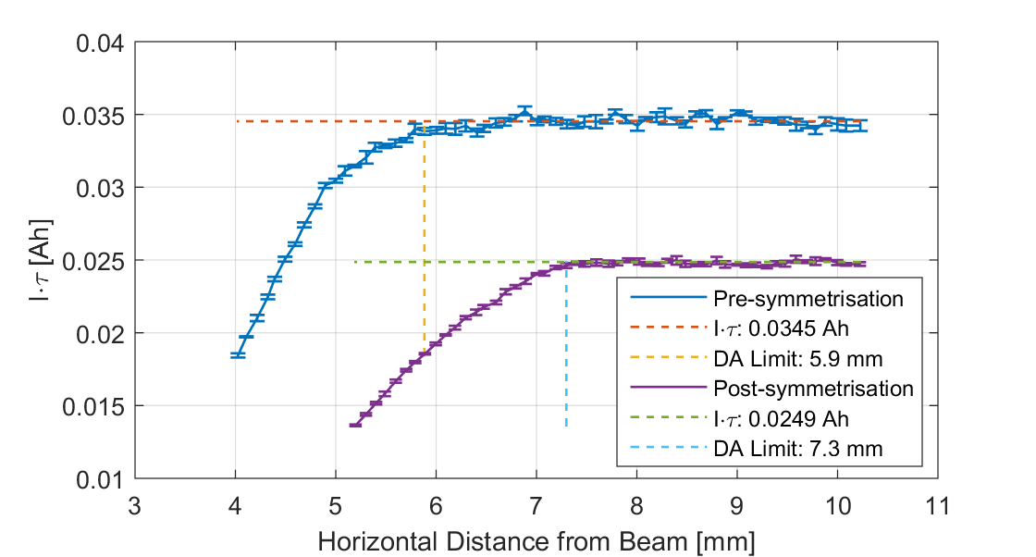
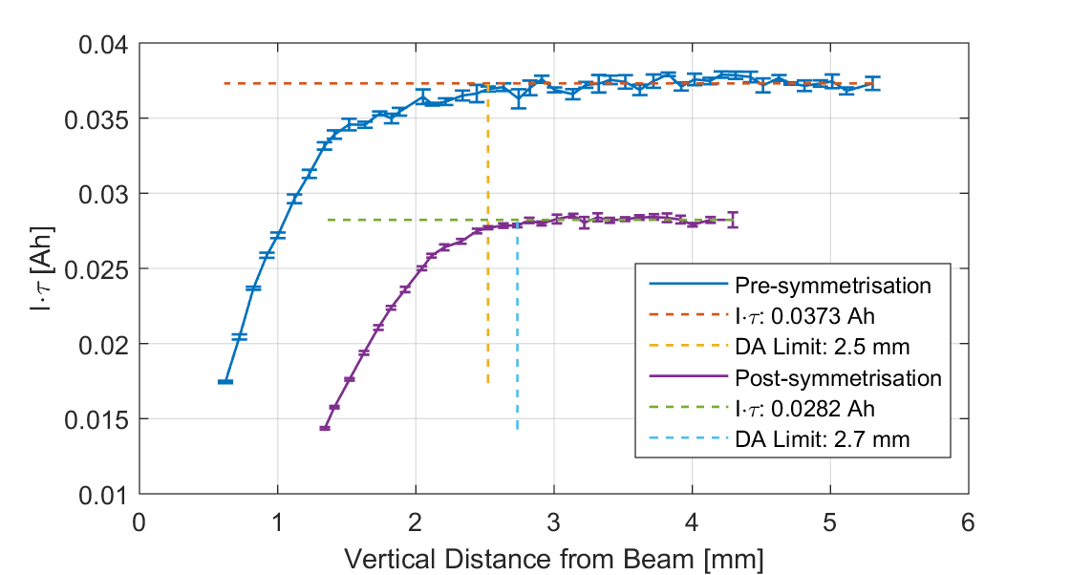
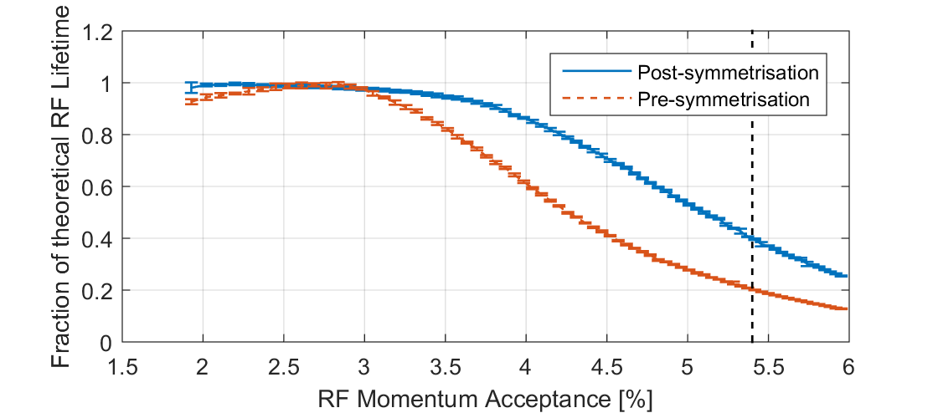
Effect on Dynamic Aperture
Top: Dynamic aperture as measured by scrapers.
Bottom: Measured Touschek lifetime relative to theoretical value

Slide 18
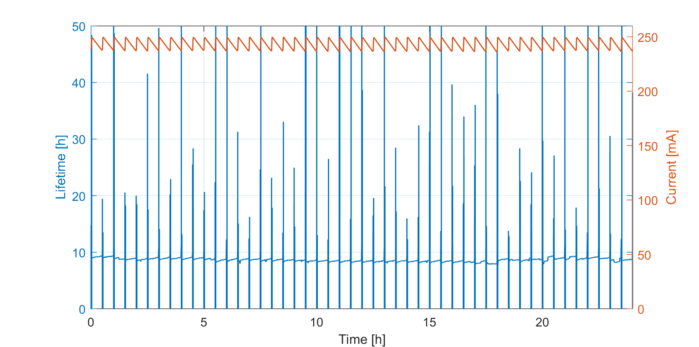
Effect on Dynamic Aperture
Data from: 6/11-19
Delivery conditions autumn 2019 using the previous optics. Lifetime around 10 h.

Slide 19
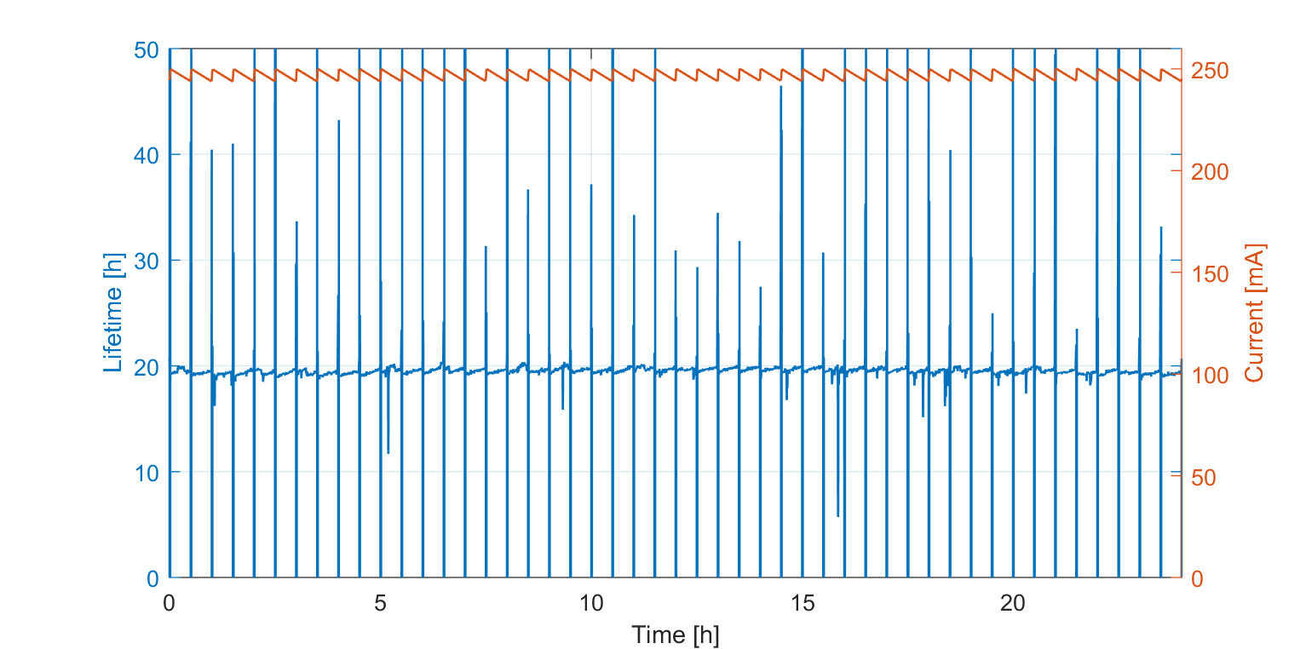
Effect on Dynamic Aperture
Data from: 15/2-20
Delivery conditions spring 2020 using the NOECO optics. Lifetime around 20 h.

Slide 20
Summary and Future Work
Characterisation and correction towards model values.
Peak sextupole corrections $\sim 8\%$.
Machine performance approaches model.
Can be applied to most lattices.
Can only characterise chromatic sextupoles.
Future work includes characterisation of octupoles via the amplitude dependent tune shift.

Slide 21
Thank You

Slide 22
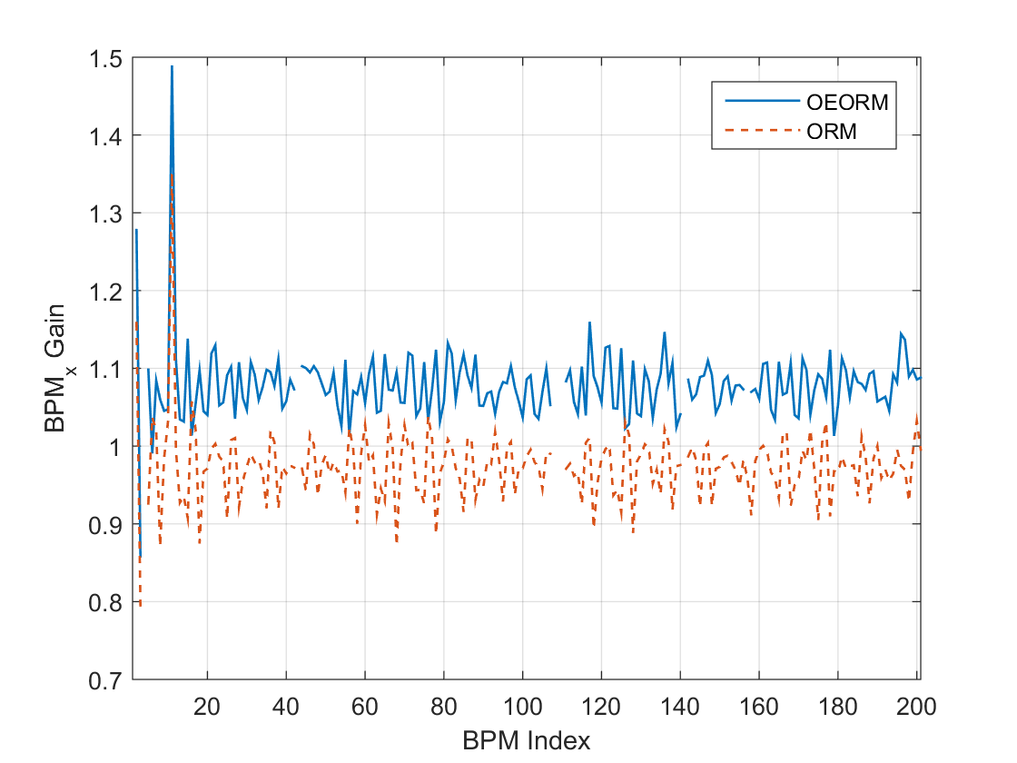
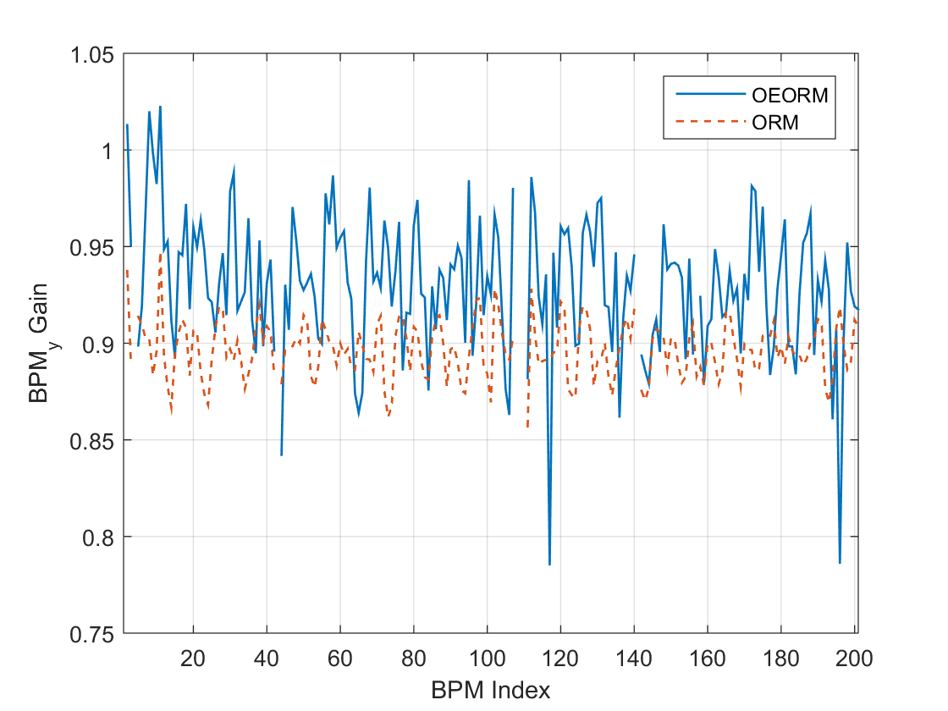
NOECO and LOCO BPM Gains
Horizontal BPM gains relative to nominal as found by LOCO and NOECO respectively.
Vertical BPM gains relative to nominal as found by LOCO and NOECO respectively.

Slide 23
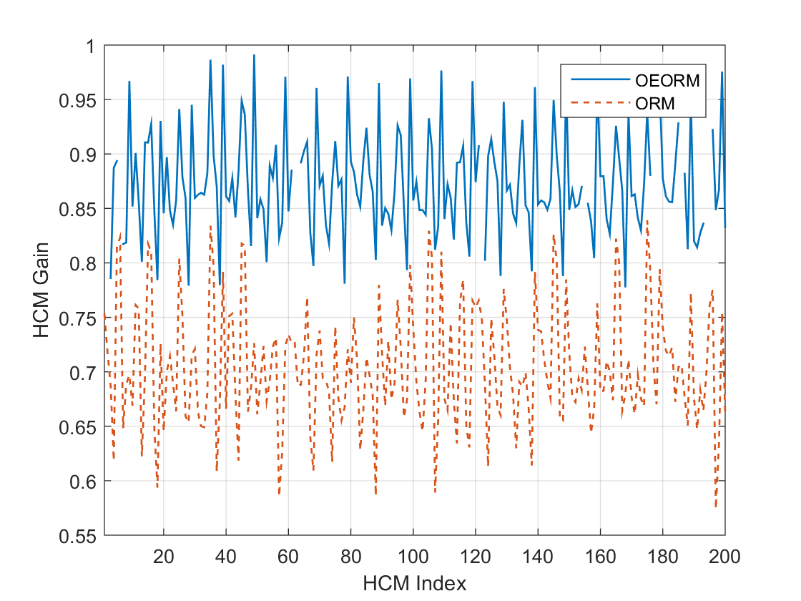
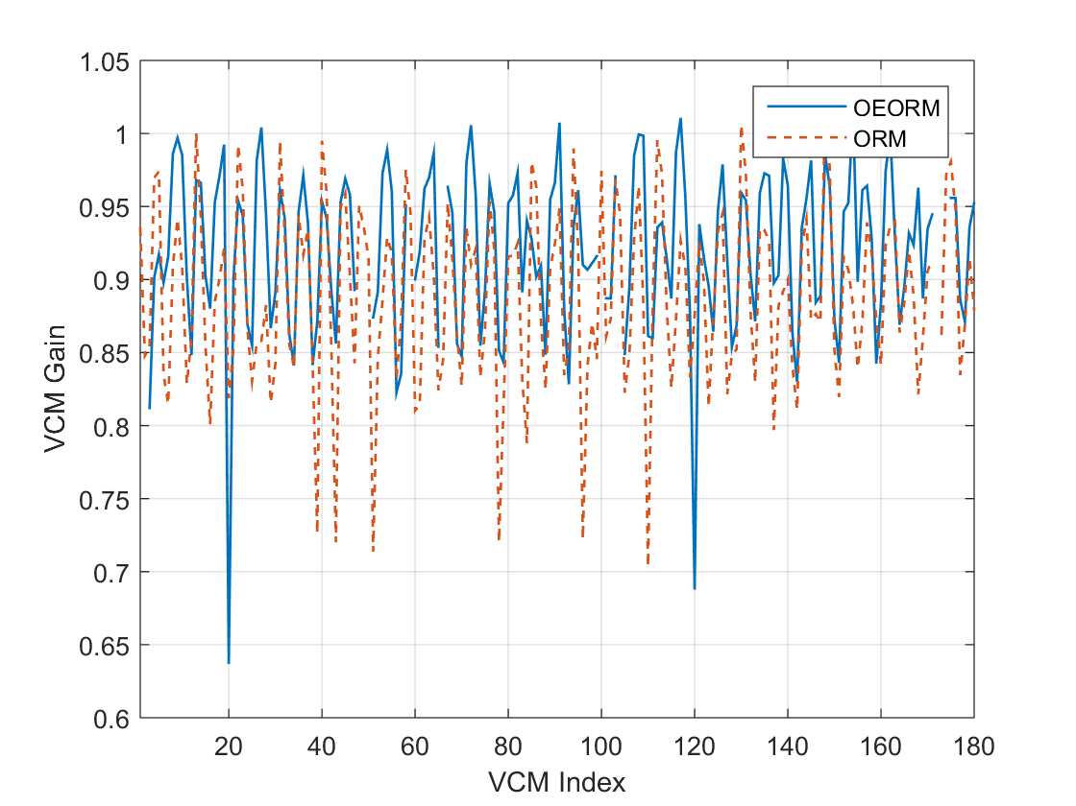
NOECO and LOCO CM Kicks
Horizontal CM kicks relative to magnetic measurements as found by LOCO and NOECO respectively.
Vertical CM kicks relative to magnetic measurements as found by LOCO and NOECO respectively.

Slide 24
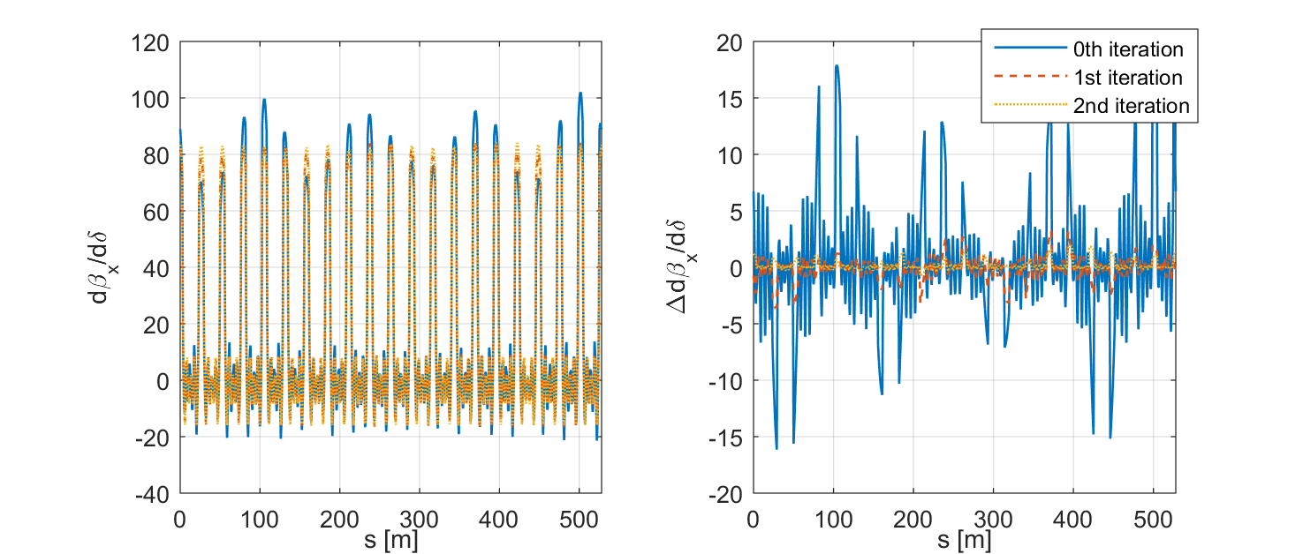
Chromatic Function Convergence
Horizontal chromatic functions with each iteration of the NOECO procedure.
Horizontal chromatic function error with each iteration of the NOECO procedure.

Slide 25
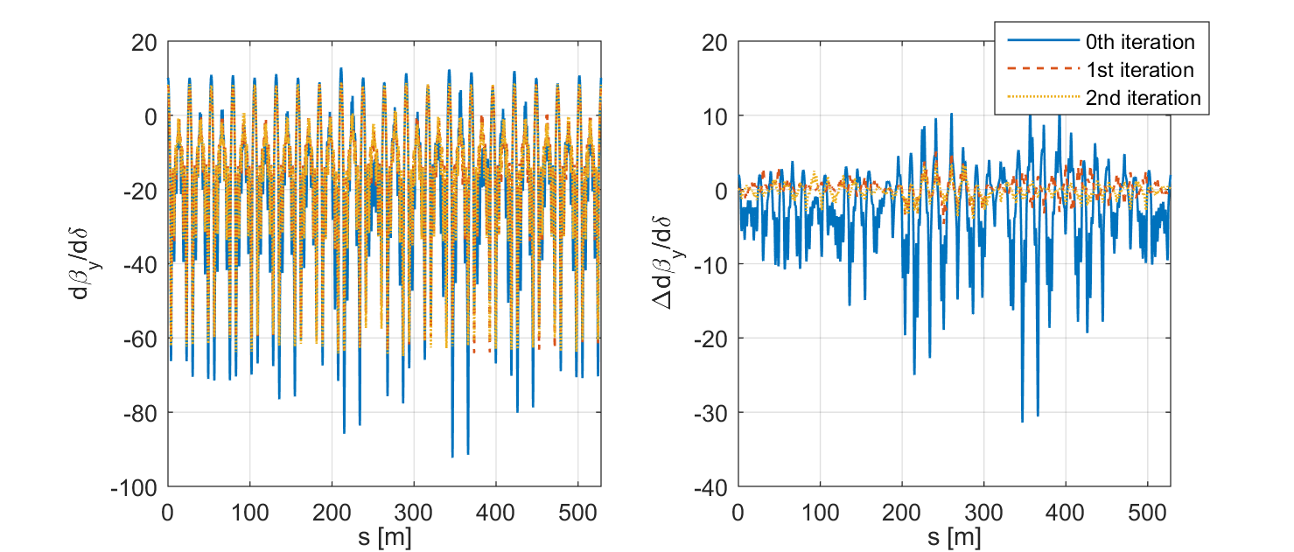
Chromatic Function Convergence
Vertical chromatic functions with each iteration of the NOECO procedure.
Vertical chromatic function error with each iteration of the NOECO procedure.

