Slide 1
Status and Development of the ASTRID2 Facility
Jørgen S. Nielsen
(on behalf of the machine group)
Center for Storage Ring Facilities (ISA)
Aarhus University
Denmark

Slide 2
ASTRID2
ASTRID2 is the “new” synchrotron light source in Aarhus, Denmark, since 2013
ASTRID2 main parameters
Electron energy: 580 MeV
Emittance: 12 nm
Beam Current: 200 mA (presently 180 mA)
Circumference: 45.7 m
6-fold symmetry
lattice: DBA with 12 combined function dipole magnets
Integrated quadrupole gradient
4 straight sections for insertion devices
Using ASTRID as booster (full-energy injection)
Allows top-up operation

Slide 3
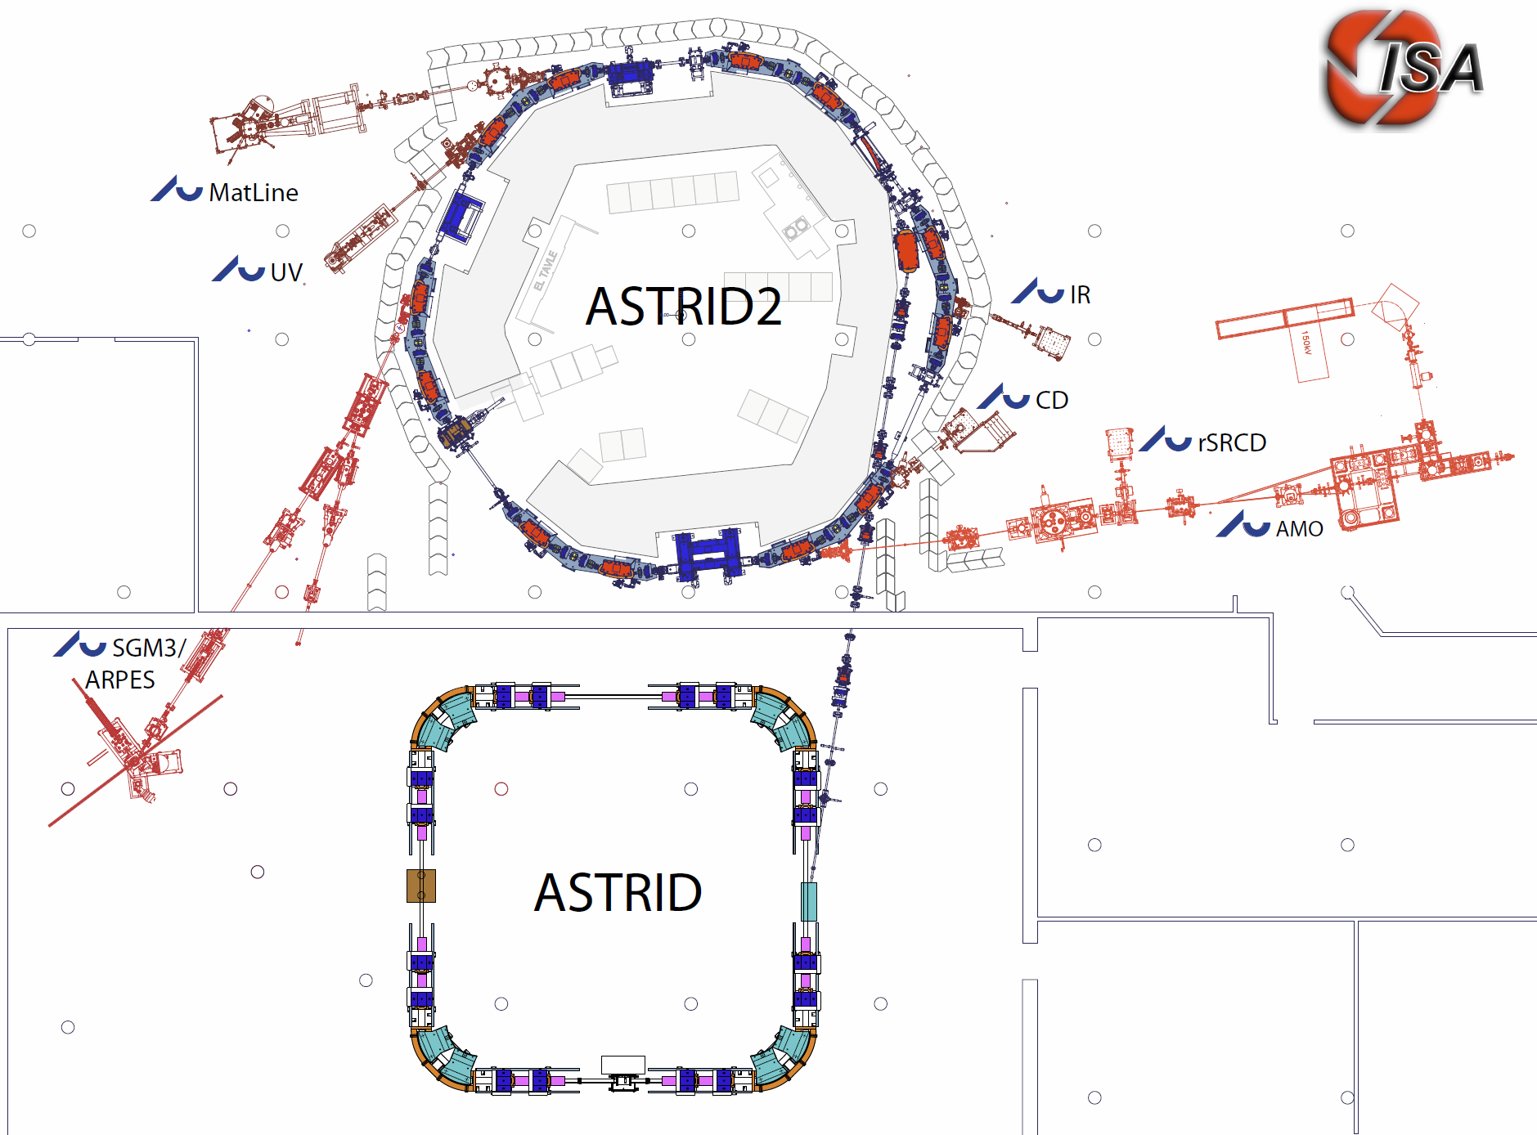
The ASTRID 2 facility
ASTRID2 main parameters
Circumference 45.71m
Energy 580MeV
Current 200mA
Characteristic energy 257eV
RF frequency 105MHz
Harmonic 16
Horiz. emittance 12nmrad
#Straight sections 6
Length of straight sections 2.82m
#ID’s 3
10m
Microtron (100MeV)
Notes:
Microtron, Booster, Inj. Bl., A2 ring, 6 beamlines, 7 experiments

Slide 4
Corona virus
Denmark was put in lock-down Friday March 13th
After 6 weeks of shutdown, the university slowly opened
Initially only 3 persons were allowed at our facility
From June more normal conditions
Partial lock-down again from December 9th
Now ~3 persons allowed on site (for us)
So far planned to January 3rd
Almost only local users
A dozen foreign users (Norway, France, Finland, Spain, Hungary) over the summer
Not really man-power for mail-in
Working on possibilities for remote measurements/experiments

Slide 5
User hours and reliability
Downtime: If current goes below 90% of top-up set current
Projected
until 15/12
2020 is until 31/10
2020 is until 31/10
MTTR
2018: 2.4 h
2019: 5.7 h
2020 (-Oct): 3.2 h
Notes:
User hours estimated per 15/12-20
MTBF 2018 was 52 h

Slide 6
Failures
2020 were until December a good year (apart from Corona!)
MTBF: 2018: 57 h, 2019: 98 h, 2020: 91 h (until now)
May: Facility-wide
Mains failure on a Saturday
34 h lost because of weekend
Sep.: Microtron
Failure of modulator HV charge supply
10 h lost because of weekend
Also lost some machine development in the following week
Dec.: Microtron
Water leak in klystron and klystron solenoid magnet
~1 week lost
Plus, various smaller issues
Note:
No operator or technician on call during evening and weekends

Slide 7
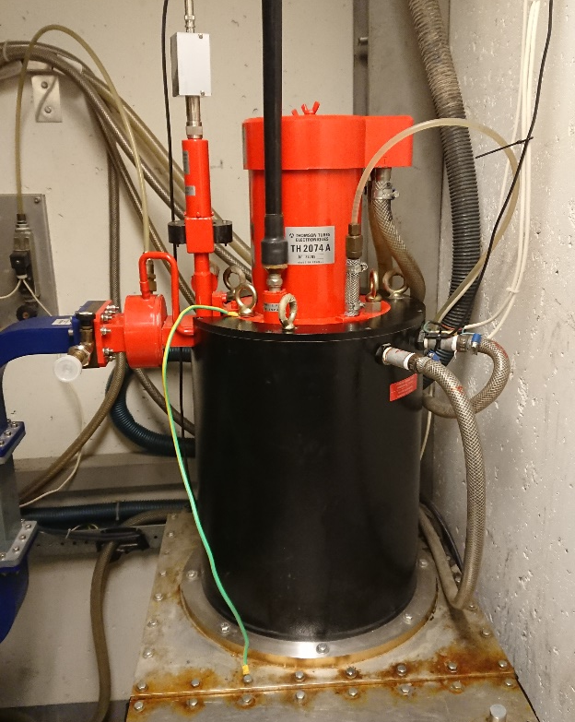
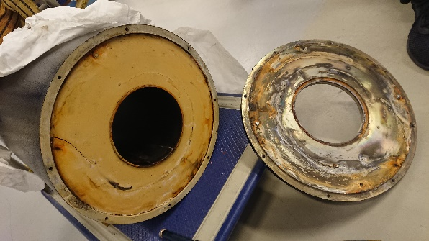
Microtron klystron problems
Following some long-time problems with the Microtron klystron, we in October replaced the Microtron klystron (Thomson TH2074A) with our spare (original) klystron
Had been running about 150.000 hours
The spare had earlier been used for about 90.000 h (changed 18 years ago)
Was replaced back then because of unfounded suspicion of a problem
2 weeks ago, the “new” klystron needed more and more drive power (+10 dB in 3 days!)
More and more power was reflected
Input cavity detuning
When dismounting, water was found inside the solenoid magnet
Bottom ~10 cm of klystron had been under water
Also, a leak in the klystron cooling was found
Solenoid bottom plate has been sealed (quick fix)
After water leak repair and cleaning, the klystron now again runs very nicely

Slide 8
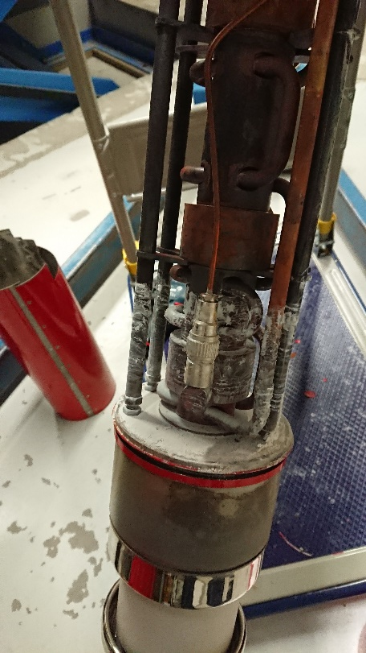
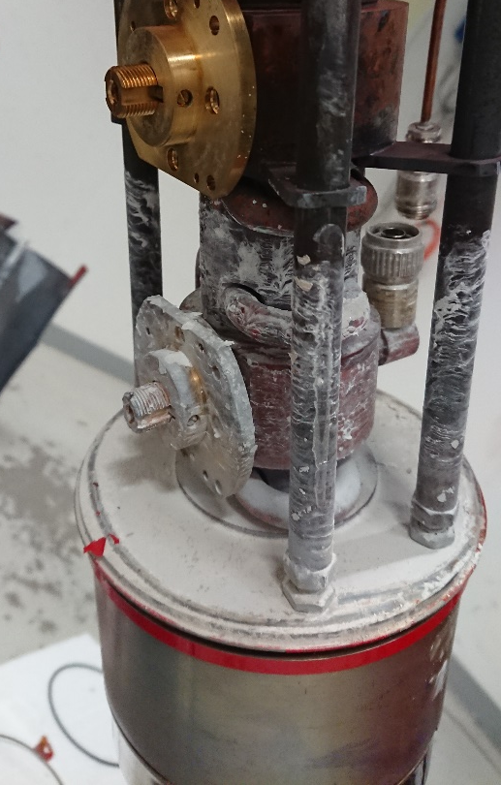
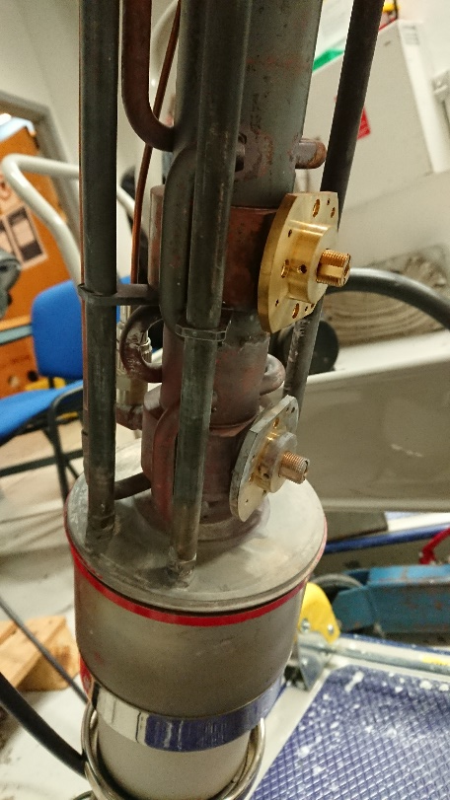
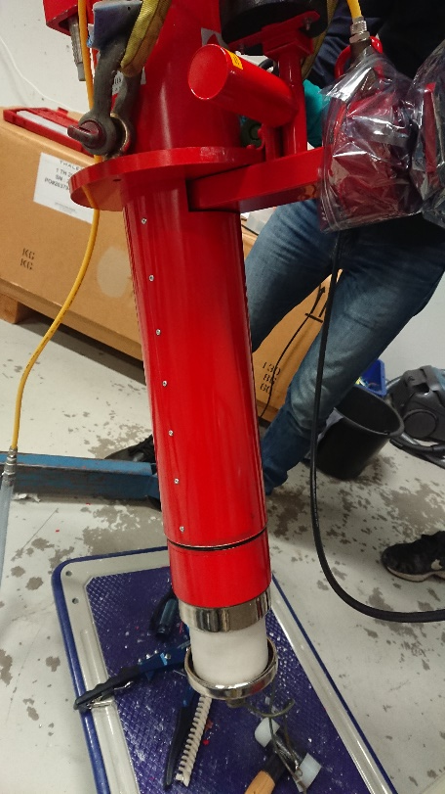
Microtron klystron problems 2
Backup plan: Borrow a Thales TH2157A, incl. solenoid from MAX-IV
Very grateful for the offer
Long-term plan: A new turn-key solid-state modulator and klystron
3 GHz, ~7.5 MW, ~2 µs pulse length, <10 Hz rep. rate
Water level clearly visible (lead oxides?)
Cleaned
Ready to re-install

Slide 9
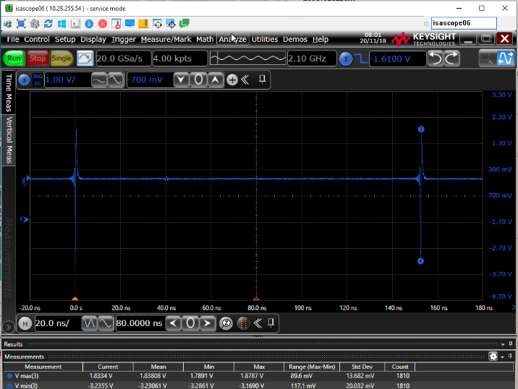
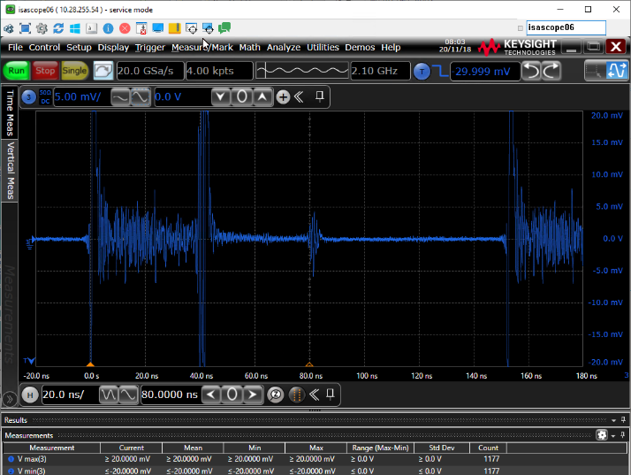
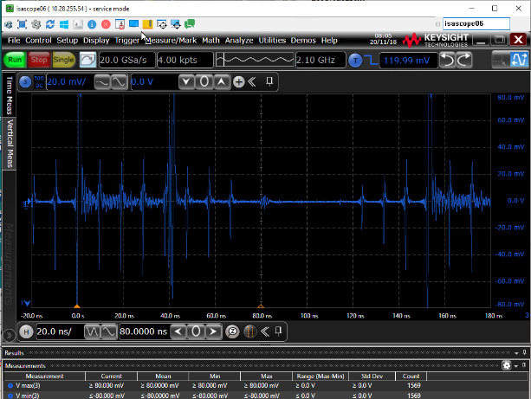
Single Bunch operation
Single Bunch operation in ASTRID2 has now been tested
Has (always) been a promised beam mode, but since the push from the users has been limited, so far not much priority has been given to the mode
Small ring (45.7 m) means high revolution frequency (6.559 MHz)
ASTRID: Single Bunch is created by kickout of all other bunches (vertical betatron sideband excitation)
ASTRID2: bunch cleaning is performed during injection bump (horizontal betatron sideband excitation)
Impurities (after one night of running) is smaller than 10⁻³ (limit of measurement)
Noise (beam induced excitations) in pickup
Reflections (due to imperfect cable termination in scope)
1 V/div, 23.4 mA
5 mV/div, 23.4 mA
Inject 1 multi-bunch train
20 mV/div, 25.7 mA
Notes:
Data are from 201117d

Slide 10
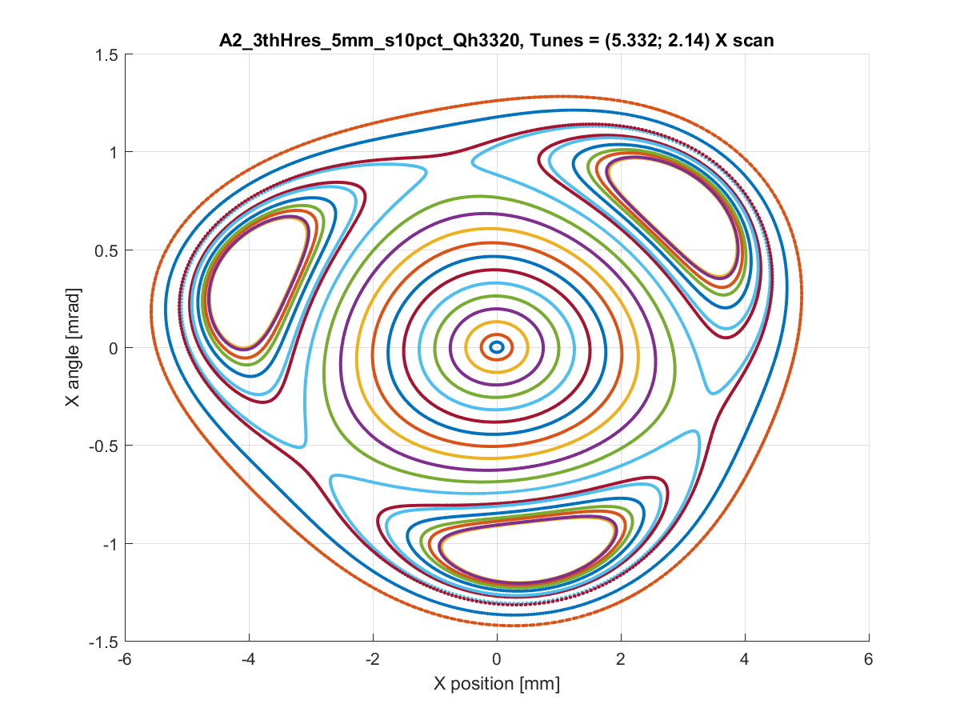
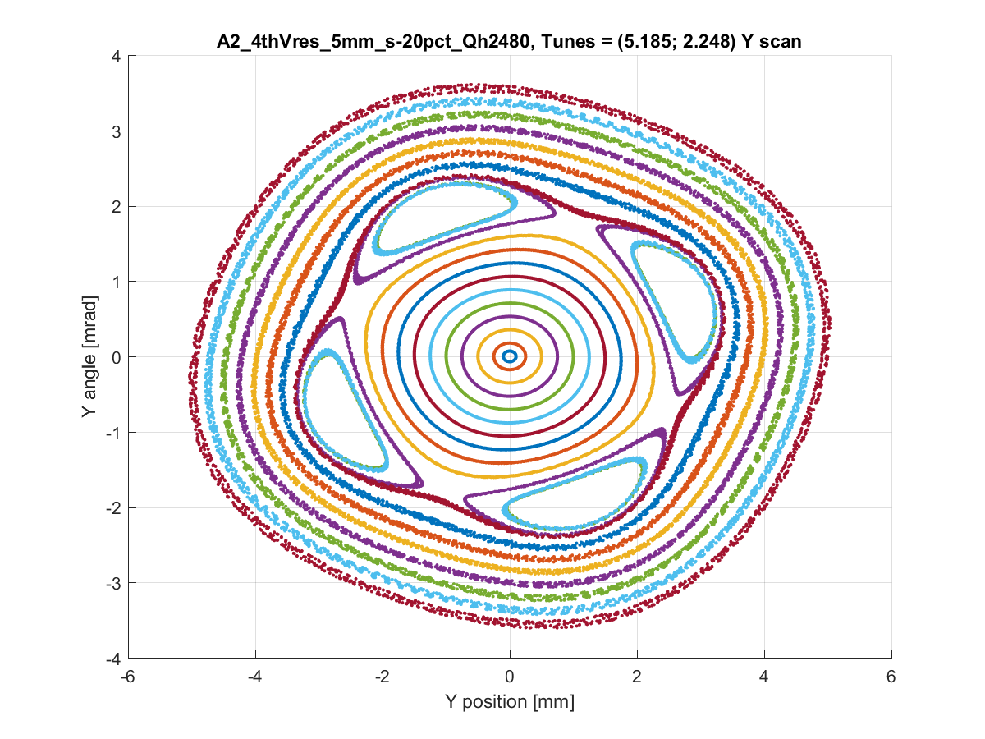
Trying TRIBs
We have tried to introduce Transverse Resonant Island Buckets (TRIBs) in ASTRID2, but so far with no success
David K. Olsson from MaxLab visited us for one day to help
Quite easy for us to run near the 3rd (H) and 4th (H and V) order resonances
The vertical sextupole family is split in 3 power supplies, so we can run the sextupoles asymmetrically
Theoretically (using MatLab AT) it is quite easy to achieve TRIBs
Hor: 3rd and 4th order using both (some) sextupoles or a (virtual) octupole
Ver: 4th order using both (some) sextupoles or a (virtual) octupole
Theoretical the TRIBs are not destroyed by introducing realistic skew quadrupoles
3rd order horizontal
4th order vertical

Slide 11
Thank you for your attention

Slide 12
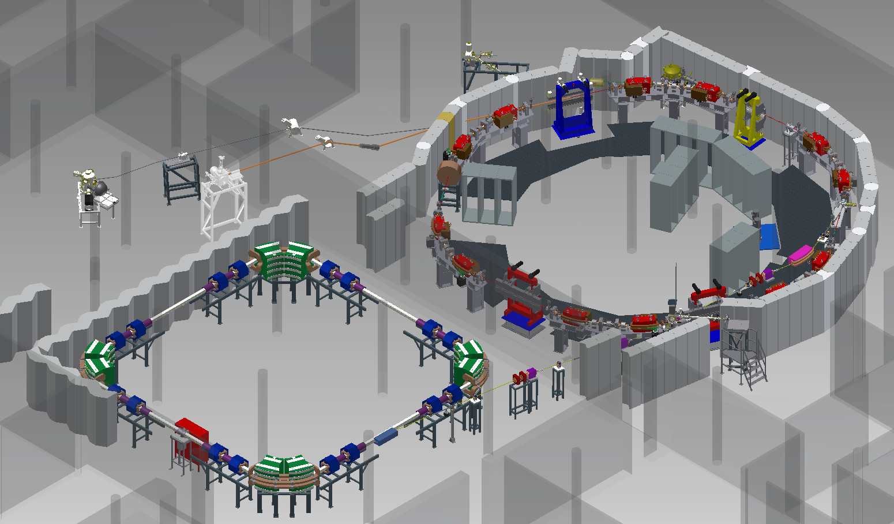
ASTRID2 Layout

