Slide 1
Open Questions for the Diamond-II Booster
Ian Martin,
Diamond: A. Aloev, L. Bobb, C. Christou, R. Fielder, A. Morgan, T. Olsson, A. Tipper, R. Walker
ASTEC/Cockroft: D. Angal-Kalinin, J. Jones, A. Wolski
28th European Synchrotron Light Source Workshop
17/12/2020

Slide 2
Diamond-II Injector Upgrade
Injection into D-II storage ring requires upgraded booster:
Increased extraction energy
Lower emittance
Shorter bunch length
Increased charge per shot (SB and MB)
Design for Booster-II:
Racetrack structure (fit in existing tunnel)
Unit cells built from combined-function magnets
Two dispersion-free straight sections
Quadrupole triplets in straights for tune control
Distributed trim sextupoles to counter eddy-currents
Engineering design is in progress
Many open questions yet to be resolved (how to model dipoles, raise injection energy, chamber thickness, …)
Parameter | Unit | Target | Booster-I | Booster-II
Energy Range | GeV | 0.1-3.5 | 0.1-3.0 | 0.1-3.5
Circumference | m | - | 158.4 | 163.264
Tunes |  | - | [7.18, 4.27] | [12.20, 5.36]
Nat. Chrom. |  | - | [-9.7, -6.3] | [-13.5, -11.9]
MCF |  | ⁻ | 2.5×10⁻² | 5.8×10⁻³
Emittance | nm.rad | <30 | 134 | 17.7
Energy Spread | % | - | 0.073 | 0.086
σ_{L} @2MV | ps | <40 ps | 60 | 39
U₀ | keV | - | 580 | 947

Slide 3
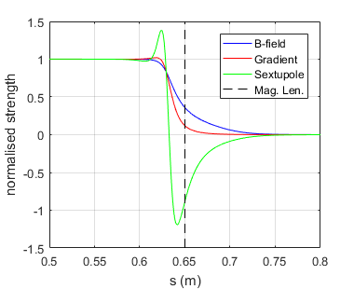
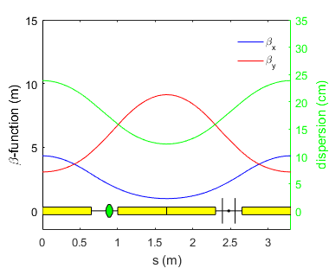
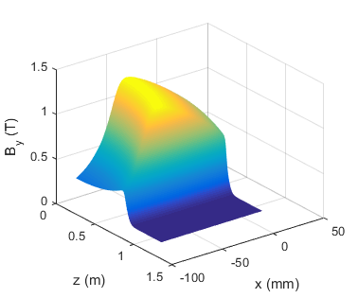
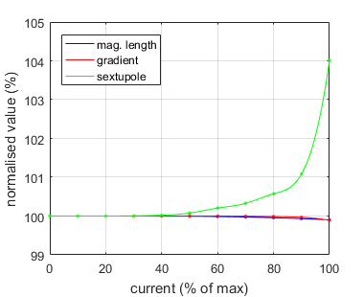
Combined-Function Dipoles for Unit Cell
The unit cell consists of alternating focussing / defocussing CF dipoles:
Dipole, quadrupole and sextupole components in single magnet
Magnetic length is different for each component
Saturation effects cause the normalised components to diverge at extraction energy
Q) How best to model the dipoles
Q) How should the saturation effects be compensated?
Fringe fields of BF dipole
Booster-II
Arc unit cell
BD dipole Field Map
Saturation effects in BD dipole

Slide 4
Combined-Function Dipoles for Unit Cell
Inspiration for modelling the dipoles taken from Einfeld et al., PAC’07.
Method:
Extract the multipole coefficients along the path from the 3D field map
Construct a hard-edge model of the magnet where the physical length matches the dipole magnetic length and the gradient and sextupole components match the central values of the 3D field map
Construct a sliced model of the magnet where the local values match the s-dependent coefficients
Adjust the edge angles of the hard edge model until the transfer matrix matches the sliced model (including the usual fringe-field integral in the vertical plane)
Add thin-lens sextupoles at the ends of the hard edge model, adjusting the strength to get the same overall integrated sextupole component as found from the 3D field map

Slide 5
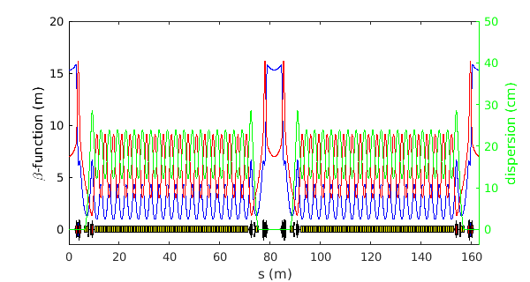

Combined-Function Dipoles for Unit Cell
Significant impact found on optics using the new hard-edge model (50% of peak strength, i.e. linear part of ramp):
Tunes: [12.201,5.356] => [12.129,5.198]
Chromaticity: [2.00,2.00] => [1.69,2.40]
Ideal model
Effective hard-edge model

Slide 6

Combined-Function Dipoles for Unit Cell
Significant impact found on optics using the new hard-edge model (50% of peak strength, i.e. linear part of ramp):
Tunes: [12.201,5.356] => [12.129,5.198] => [12.201,5.356]
Chromaticity: [2.00,2.00] => [1.69,2.40] => [2.00,2.00]
Tunes and chromaticity can be restored by re-designing the magnets with altered bulk gradient and sextupole strength.
Note: Still left with divergence in optics approaching extraction energy. Present thinking is that this will be corrected by modifying the power supply ramp profile for the matching quadrupoles and trim sextupoles (WIP).
Ideal model
Adjusted hard-edge model

Slide 7
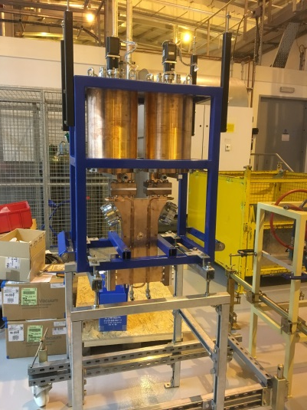
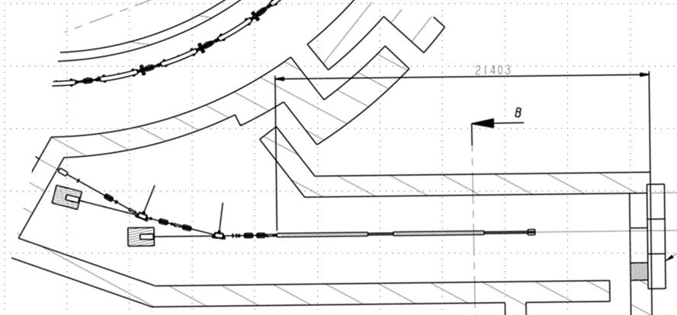
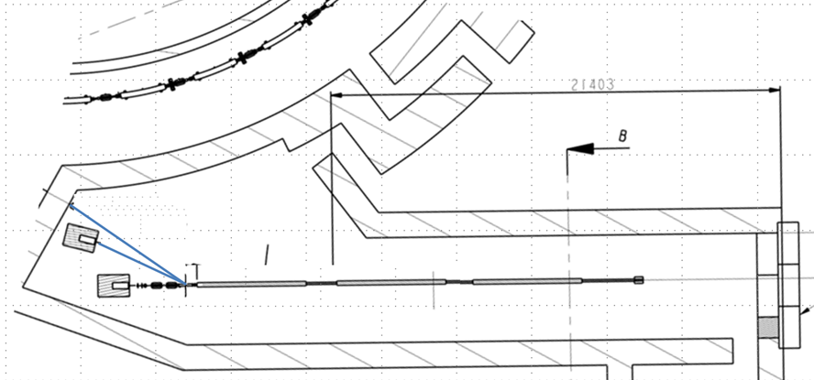
Injection Energy
Altering the injection energy from 100 MeV to 150 MeV is under consideration:
Should enable increased charge/shot in both SB and MB
Reduced dynamic range for booster RF and power supplies
Lower remnant field issues at injection energy
Could be achieved via several methods:
Higher gradient in existing two structures (new modulator, stressed klystrons, arc-rate)
SLED cavity (sub-optimal flat-top for multi-bunch, increased arc-rate)
Extra accelerating structure (cost of new modulator/structure, re-configure LTB)

Slide 8
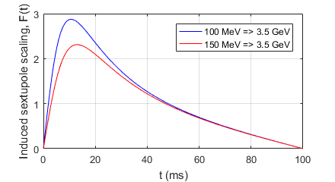
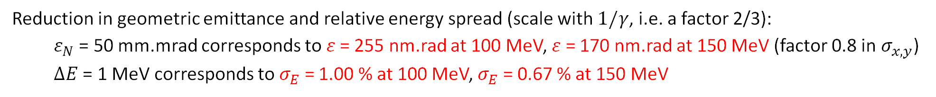
Injection Energy
Dynamic range for power supplies and RF cavity, avoiding remnant fields:
100 MeV => 3.5 GeV has ratio of 35.0 (injection energy is 2.9 % of extraction energy)
150 MeV => 3.5 GeV has ratio of 23.3 (injection energy is 4.3 % of extraction energy)
Reduction in geometric emittance and relative energy spread (scale with $1/γ$, i.e. a factor 2/3):
$ε_{N}$ = 50 mm.mrad corresponds to$ε$ = 255 nm.rad at 100 MeV, $ε$ = 170 nm.rad at 150 MeV (factor 0.8 in$σ_{x,y}$)
$ΔE$ = 1 MeV corresponds to $σ_{E}$ = 1.00 % at 100 MeV, $σ_{E}$ = 0.67 % at 150 MeV
Gas Lifetime scales as $τ_{G}∝γ^{2}$, so going from 100 MeV => 150 MeV would increase it by factor 2.3
Assuming CO-equivalent P_{ave} = 10⁻⁷ mbar, $τ_{G}$ ~ 20 s at 100 MeV, $τ_{G}$ ~ 50 s at 150 MeV
Vacuum chamber eddy current scale factor benefits from reduced dB/dt:
100 MeV injection: Max F(t) = 2.9, occurs at 195 MeV
150 MeV injection: Max F(t) = 2.3, occurs at 288 MeV

Slide 9
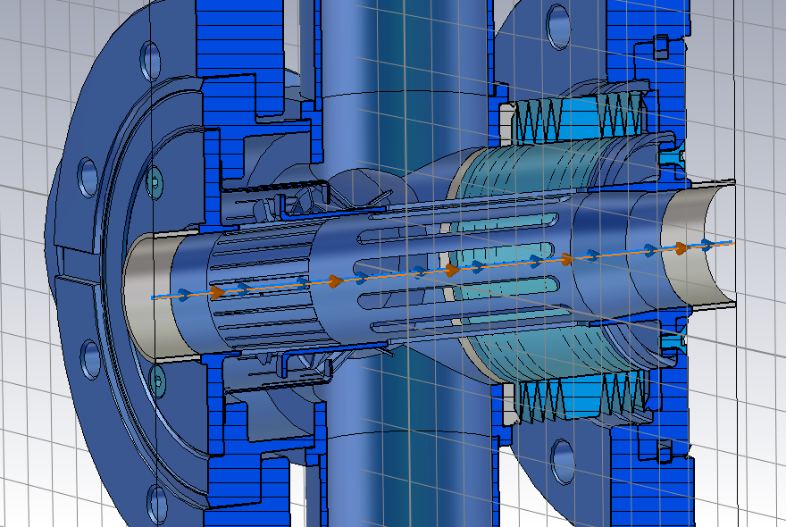
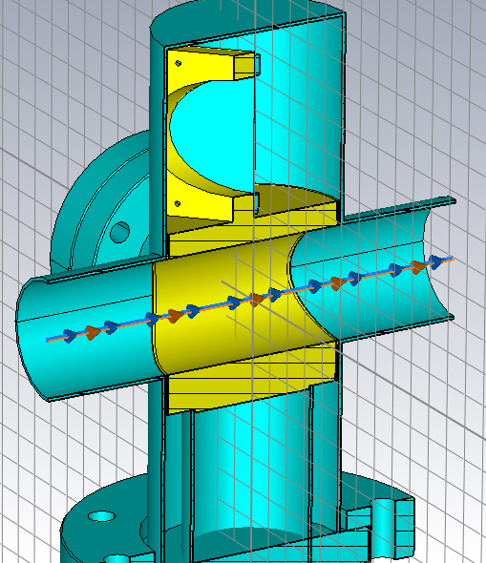
Collective Effects (SB)
Impact on collective effects harder to quantify; investigate through particle tracking:
EGUN/PARMELA simulations of upgraded electron gun complete (up to 16 nC single bunch)
Impedance database for main vacuum chamber components in progress
Working on including impedance into ELEGANT booster model
Once complete, can then track injected bunch through the ramp for different initial bunch charges and injection energies
Component | Quantity | Total loss factor (V/pC) | Total H-kick factor (V/pC/mm) | Total V-kick factor (V/pC/mm)
BPM block | 44 | 0.25 | 0.01 | 0.01
Pumping cross | 38 | 0.7 | 0.15 | 0.15
Ceramic break | 2 | 0.4 | 0.03 | 0.03
Resistive wall | 140 m | 7.4 | 1.8 | 1.8
5-cell RF cavity | 2 | 5.2 | 0.003 | 0.003
Pumping/bellows assembly
Screen housing

Slide 10
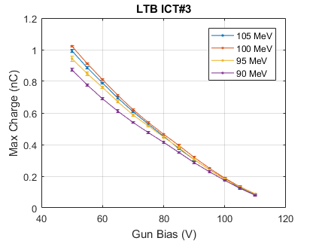
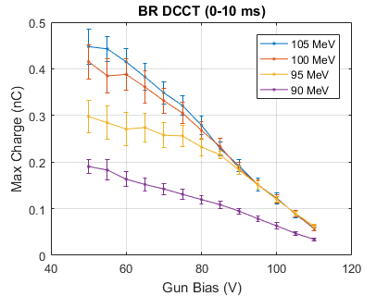
Machine Tests on Existing Booster
To complement the simulations, tests at different injection energy have been carried out on existing booster.
Main findings:
Capture efficiency into the booster for high-charge bunches if the injection energy is increased.
Capture efficiency into the booster seems relatively insensitive to beam energy for low charge bunches.
Some dependence on charge to the end of the LTB with beam energy, but much less marked

Slide 11
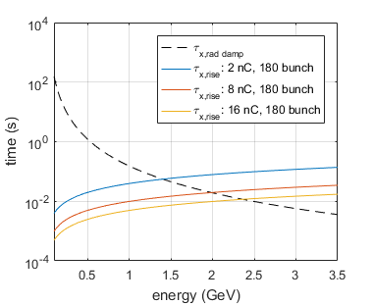
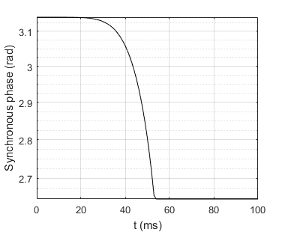
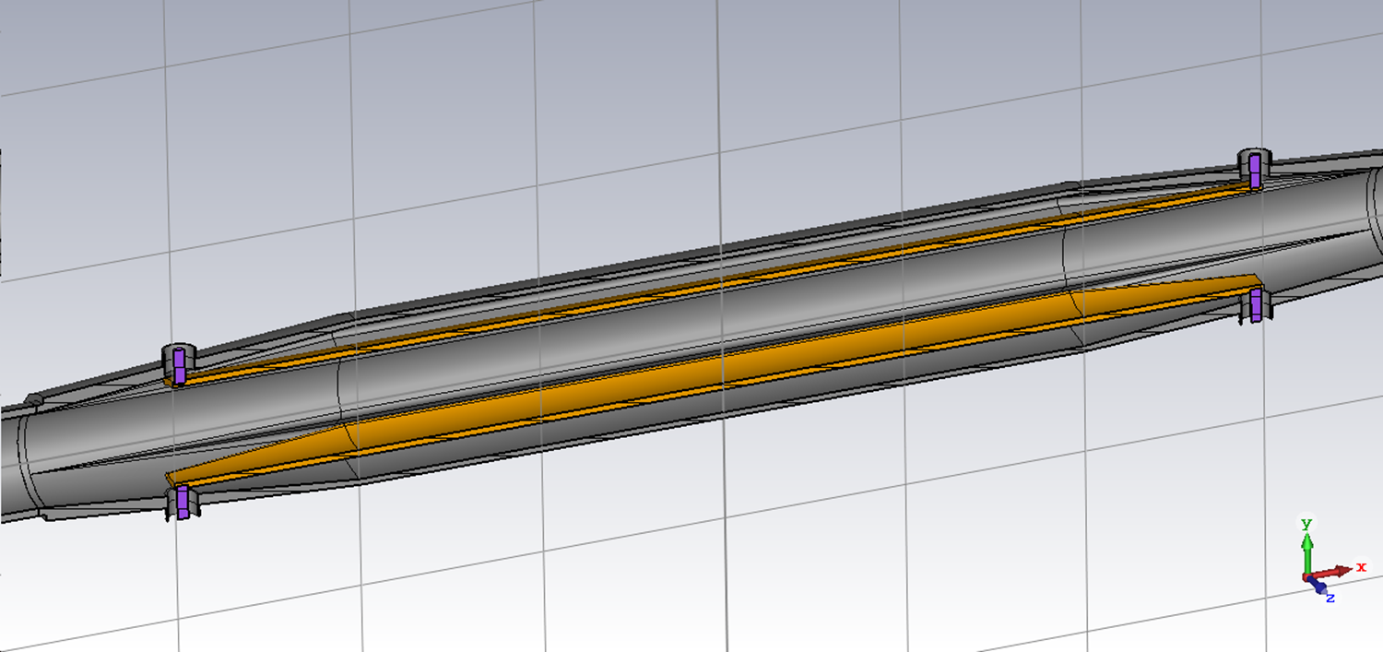

Collective Effects (MB)
The vacuum chamber for Booster-II will be stainless steel, ~1 mm thick
Will resistive-wall coupled bunch instability be an issue for large MB currents?
RW Impedance: $Z_{⊥,RW}\left(ω\right)=\left(1−i\operatorname{sgn}\left(ω\right)\right)\frac{L}{ωb^{3}}\sqrt{\frac{Z_{0}c}{4π}\frac{2|ω|}{πσ}}$
Coherent tune shift: $Ω_{μ}−ω_{β}=−i\frac{ecI_{0}}{4πE_{0}ν_{β}}\sum_{p=−∞}^{∞}{Z_{⊥,RW}\left(ω_{p}\right)}$
Growth time: $τ_{μ}=\frac{1}{Im\left(Ω_{μ}\right)}$
Challenges for a multi-bunch feedback:
Changing beam energy
Drifting betatron tunes
Change in synchronous phase
Reset conditions before next shot
D-II striplines

Slide 12
Conclusions
Engineering design of the booster is progressing. Aiming to minimise the impedance of the various vacuum chamber components:
Constant cross section through the arcs (23.8 mm inner diameter)
Combined pumping and bellows assembly with internal RF fingers
Shielding for the diagnostic screens when not in use
Number of ceramic breaks reduced from 22 to 2
Tapered transitions where possible
Many additional questions still to resolve:
What thickness should be chosen for the stainless steel vacuum chamber? (1 mm? 0.7 mm? 0.5 mm?)
Can we run the linac at the new storage ring RF frequency, or will we need a dual-frequency system? (Linac design frequency = 499.654 MHz, new storage ring RF frequency = 499.5 MHz)
Will we need emittance exchange in the booster to aid storage ring injection?
…

