Slide 1
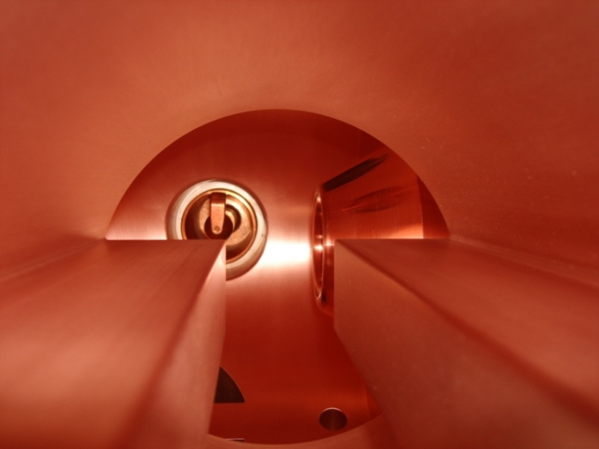
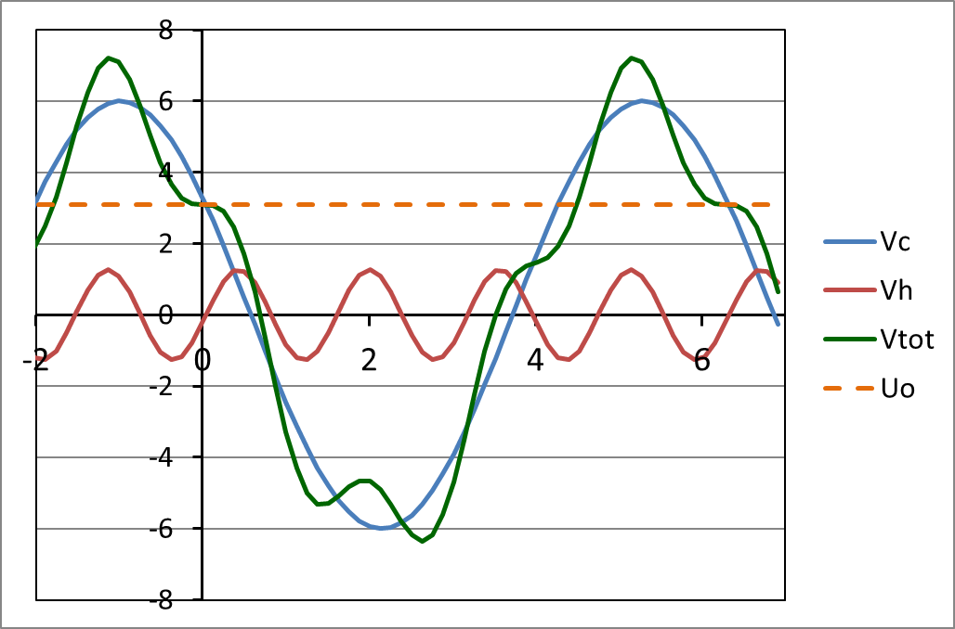
ESLS workshop
16-17 December 2020
4th harmonic RF project at the ESRF
Jörn Jacob
On behalf of RF and BD Group

Slide 2
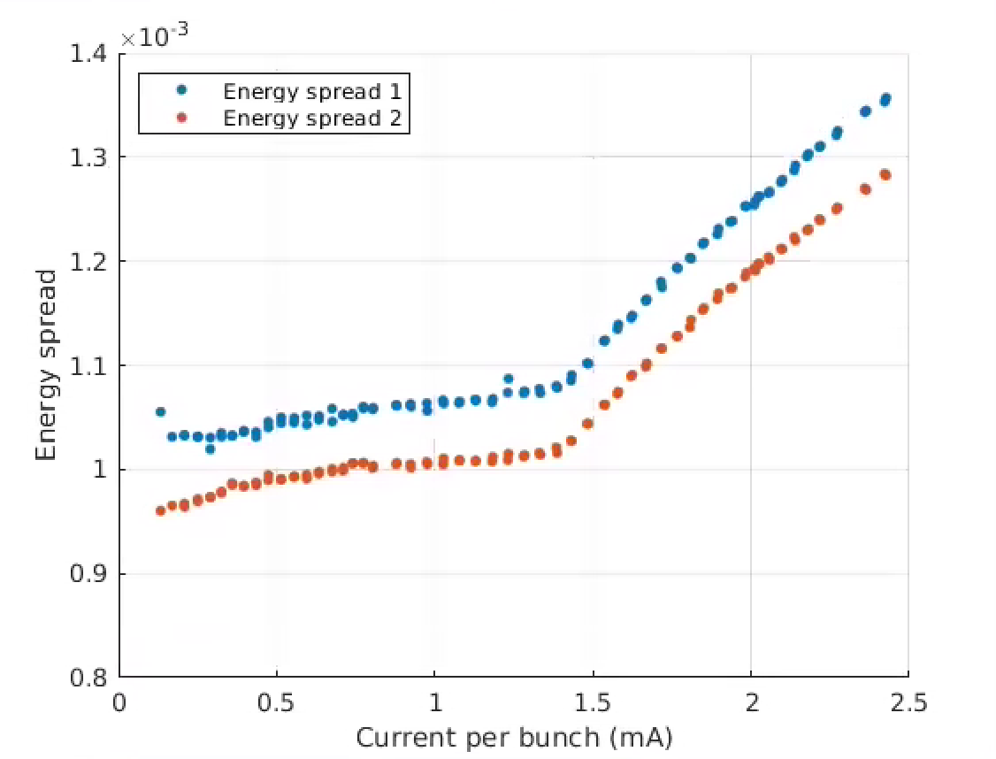
Lifetime in EBS
For all modes: Hor. Emit. ε_{z} = 135 pm | Multibunch 7/8 filling | 16-bunches | 4-bunches
Total current | 200 mA | 92 mA | 40 mA
Current per bunch | 0.23 mA | 5.75 mA | 10 mA
Bunch length (calc.) | 13 ps | 31 ps | 37 ps
Vert. Emit. ε_{z} set at | 10 pm | 20 pm | 20 pm
Touschek Lifetime | 33 h | 3.5 h | 2.5 h
computed, not measured
Threshold ~1.4mA
Measured MWI factor 2 lower than GdfidL computation
[S. White, N. Carmignani et al.]

Slide 3
4th harmonic RF system for bunch lengthening
Harmonic RF system at 1.41 GHz
Bunch lengthening by a factor 2.5 to 3
1st Priority for high I / bunch (16b and 4 x 10 mA)
Reduced Touschek scattering, IBS and microwave instability:
Increased lifetime → less frequent injections, reduced loss rate and radiation load
Improved overall stability
Room for smaller In-Vacuum ID gaps
Could alleviate possible impact from future lattice developments like mini-beta straights
Reduced emittance and energy blow up
Reduced heat-load and stress of critical chambers, like ceramic chambers or In-Vacuum IDs
Today maximum 30 mA in 16 bunch and 16 mA in 4 bunch operation until installation of new ceramic chambers in 1 year rom now
2nd step: for multibunch operation
Intrinsically less Touschek scattering, very low IBS, no MWI
7/8 filling → strong transient beam loading (TBL) almost impossible to avoid
Phase transients spoil bunch lengthening
Minimize R/Q of harmonic cavities
Longer term: R&D anti-TBL broadband cavities [N. Yamamoto / KEK]
V [MV]
Vtot
Vc = 6.0 MV
Uo = 3.1 MV
Vh,opt = 1.27 MV
ω_{RF} t
Principle: 4th harmonic RF system for bunch lengthening on EBS

Slide 4
4th harmonic 1.41 GHz RF system for bunch lengthening
E020 copper cavity as proposed by Naoto Yamamoto / KEK:
Accelerating mode | R/Q Geometry | Q₀ Losses | R_{s} | Diameter | Comment
TM010 Standard shape | 140 Ω | 15000 | 2.1 MΩ | 137 mm | Scaling of ESRF main cavity
TM020 higher order mode | 46 Ω | 33000 | 1.5 MΩ | 335 mm | TM010 becomes a LOM
TM020 / TM010 | 1/3 | 2.2 | 0.7 | 2.4
3 times less transient beam loading for TM020 mode (∼ R/Q)
Substantially more bunch lengthening for non symmetric filling (like 7/8 + 1)
Paid with 30 % more power for given voltage per cavity

Slide 5
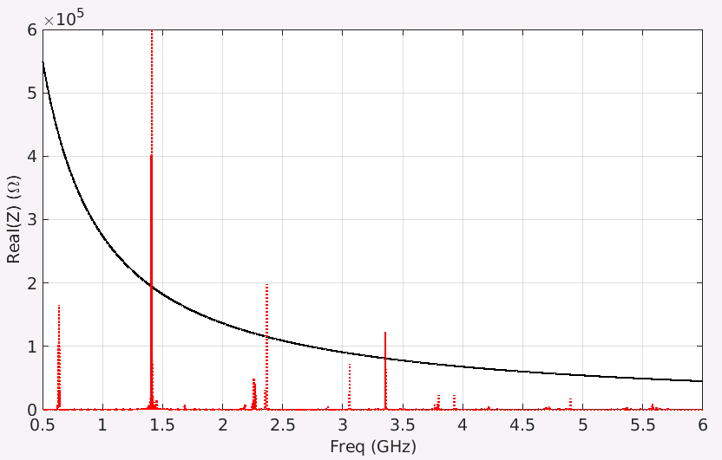
Study of multicell E020 cavities
Multicell:
More compact
Less auxiliaries
Simpler control
What we need to ensure
TM020 and TM010 be coupled from cell to cell
TM010 to be damped at the extremities of the structure
HOM to be damped
530 mm
LOM damping by 4 coaxial antennas at each end disc
[A. D’Elia]

Slide 6
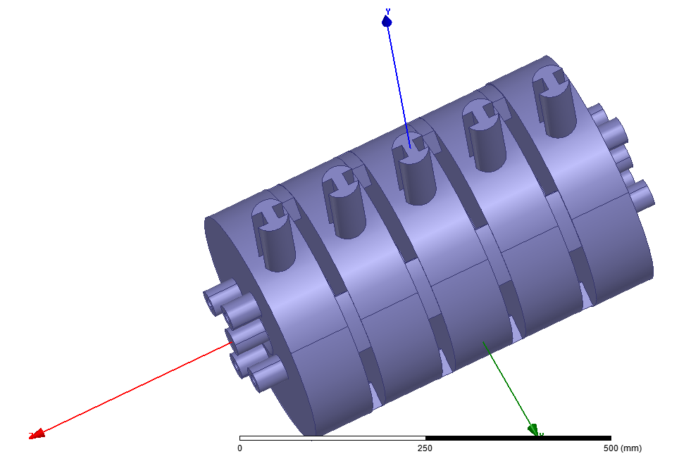
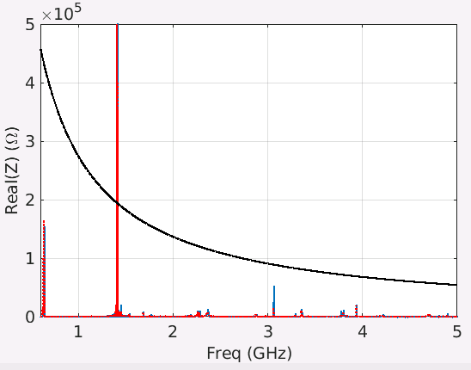
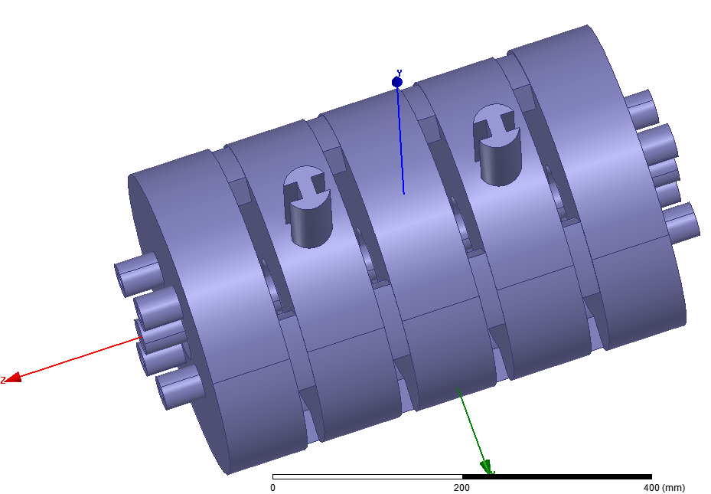
HOM and LOM damping
5 HOM Couplers in red
2 HOM Couplers in blue
LCBI Threshold

Slide 7
Elliptical beam pipe
EBS beam stay clear with margin: horiz/vert = 45 mm / 8 mm
 | Elliptical | Round
R/Q (Ohm) | 43.75 | 44
Q₀ | 23176 | 23772
Optimization of coupling slots:
Q₀ → 28000
a=8mm
b=45mm
20mm

Slide 8
Still considered 4th Harmonic Cavity options for ESRF-EBS
Requirements for optimum bunch lengthening:
V_{nom} = 6.0 MV at 352.37 MHz ⇒ V_{h,opt} = 1.27 MV at 1409 MHz
TM020 – mode | 5 x single-cell cavities | 2 x 3-cell cavities | 1x 5-cell cavity
Total R/Q (at least) | ≈ 200 Ω | ≈ 240 Ω | ≈ 200 Ω
Q₀ | ≈ 33000 | ≈ 28000 | ≈ 28000
Total R_{s} | 6.6 MΩ | 6.7 MΩ | 5.6 MΩ
P_{cav} : Dissip. for 1.27 MV | 122 kW | 120 kW | 144 kW
Number of power couplers | 5 | 2 x 2 | 2
Minimum P_{cav} / coupler | 25 kW | 30 kW | 72 kW
40 % Overhead (SWR, losses, RF feedback, working point uncertainties) | 10 kW | 12 kW | 29 kW
Generator power per coupler | 35 kW | 42 kW | 101 kW
Total generator power | 175 kW | 168 kW | 202 kW
 | considered for EBS | considered for EBS | rejected
→ Still preliminary design ⇒ cavity parameters to be refined when all auxiliaries are connected !

Slide 9
Beam loading diagram with harmonic cavity for bunch lengthening
V_{gr}
V_{acc}(φ) = V_{c} sin(φ_{s} + φ) + V_{h} sin(nφ_{h} + nφ)
Optimum Working point (1st & 2nd derivatives = 0):
φ_{s} = π - arcsin[ n²/(n²-1) U₀/V_{c} ]
V_{h,opt} = sqrt[ V_{c}²/n² - U₀²/(n²-1) ]
φ _{h,opt} = (1/n) arcsin[- U₀ / (V_{h,opt} (n²-1) ]
Optimum tuning (min power) ⇔ load angle = 0:
ψ such that V_{gr} // V_{c}
ψ_{h} such that V_{ghr} // V_{h}
Beware, in the vector diagram:
Main RF turns at φ = ωt
Harmonic RF at nφ = nωt
θ
V_{g}
-ψ
φ
V_{C}
V_{b}
-ψ
φ_{s}
I_{beam}
V_{br}
V_{bhr}
ψ_{h}
V_{bh}
φ_{gh} = π/2 – n φ_{h}
V_{gh}
-nφ_{h}
V_{ghr}
ψ_{h}
V_{h}
nφ
☞ φ_{harm} = n φ_{gh}
θ_{h}

Slide 10
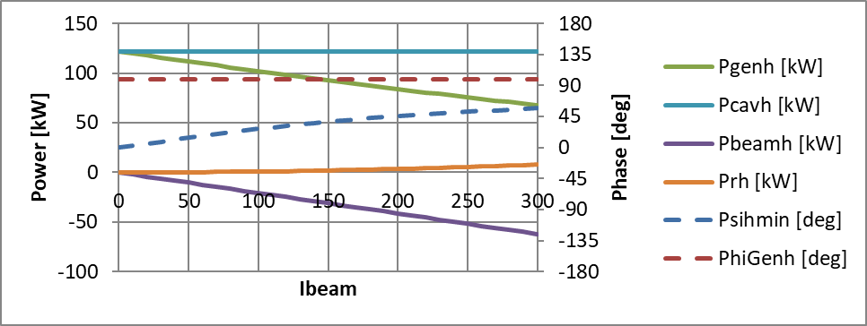
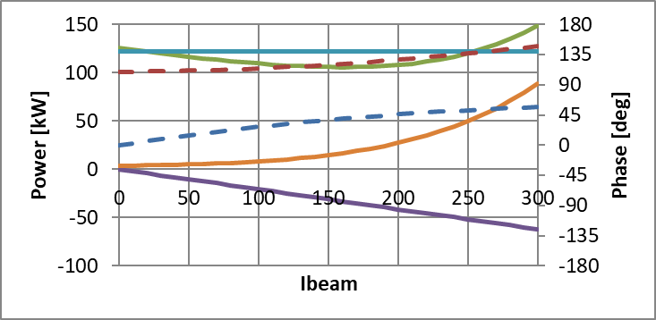
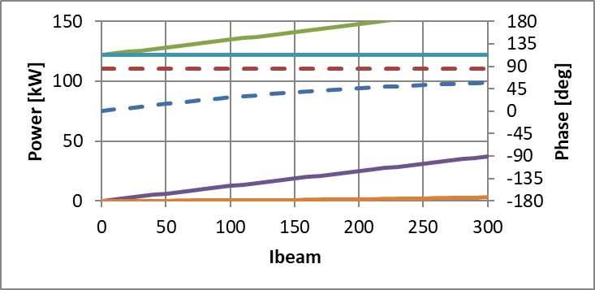
Beam loading for FIVE 4th Harmonic active NC monocell cavities
ESRF - EBS
4th harm. = 1409 MHz
5 cavities on TM020
Coupling: β_{h} = 1
V_{RF-main} = 6.0 MV
V_{h} = V_{h,opt} = 1.27 MV
ψ_{h-load} = 0 , nφ_{h,opt} = -9.4 deg
nφ_{h} = nφ_{h,opt} +15 deg
cav detuning ψ_{h-load} = +10 deg

Slide 11
International Collaboration
Lifetime will be an issue for many future 4th generation light sources
Harmonic RF for bunch lengthening will be required at many places
Work in international collaboration has started, formal agreements in progress:
Longitudinal beam dynamics studies for harmonic RF system (ESRF, SOLEIL, KEK, BESSY, SLS)
Benchmarking of different codes: ELEGANT, MBTRACK, HEADTAIL
Dedicated tests with existing SC passive (SLS) and NC passive (BESSY) harmonic cavities
2 shifts at SLS scheduled in March and April canceled due to COVID-19
ESRF: internally RF and BD collaboration
Study and test of a broadband modulation cavity for TBL compensation (ESRF, SOLEIL, KEK)
Robinson stability requires fast RF feedback:
Development of a common digital low level RF system DLLRF, using a common µTCA platform (ESRF, SOLEIL, exchange with BESSY)
SOLEIL - SigmaPhi – ESRF collaboration for 40 kW CW 1409 MHz SSA development:
SOLEIL: Development of 700 to 750 W transistor modules
ESRF: Development of a cavity combiner
SigmaPhi: Power supplies, control and system integration
Objective: first 40 kW amplifier in 1 year from now

Slide 12
TM030 Cavity combiner for 1409 MHz Solid state amplifier
WR650 waveguide
Variable coupling
Diam 24 mm
Aluminum
100 mm
600 mm
TM030
Compact simple cavity combiner:
Max 60 x 700 to 750 W modules
40…45 kW output power
Can be tailored to actual need by:
removing RF modules
re-adjusting output coupler
2 to 4 % losses, depending on achieved antenna machining tolerance
Cooling and movable mechanics under design
[V. Serrière]
Tuner
Diam 100 mm
60 coaxial inputs, 7-16, with short E-field antennas

Slide 13
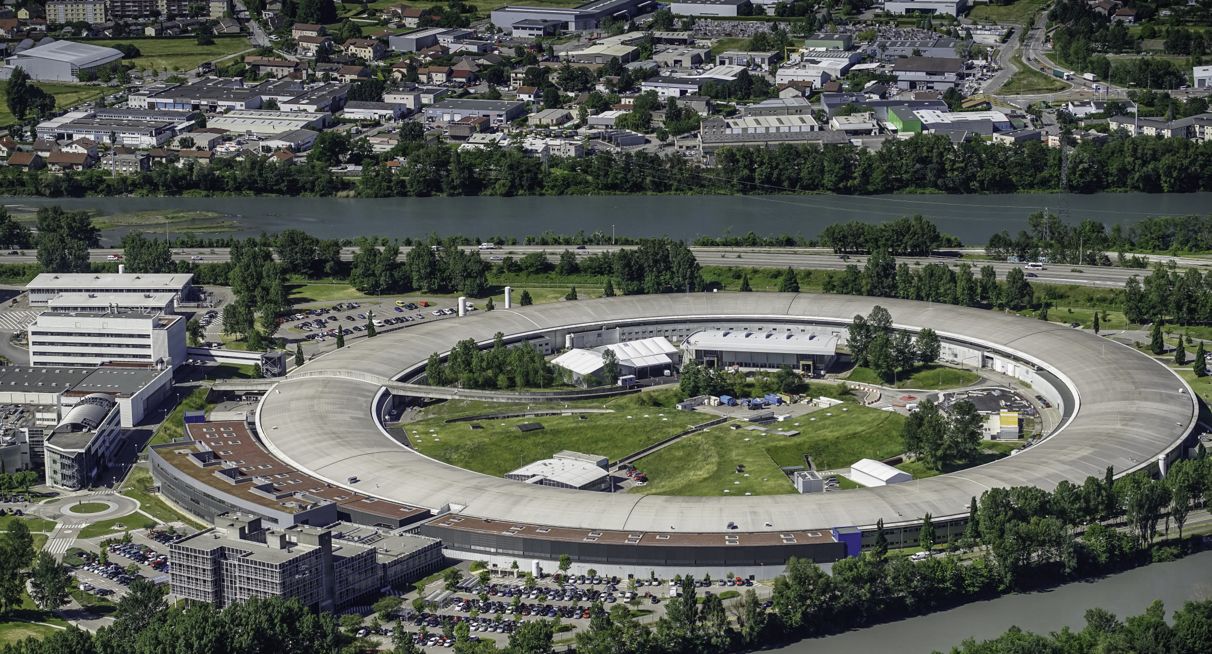
Many thanks for your attention

