Slide 1
Status MLS
28th ESLS Workshop, 16-17 Dec, ESRF, Grenoble
Jörg Feikes for the MLS team
1/22

Slide 2
Outline
Standard and COVID Operation
Special modes at MLS
Steady State MicroBunching(SSMB) experiment
2/22

Slide 3
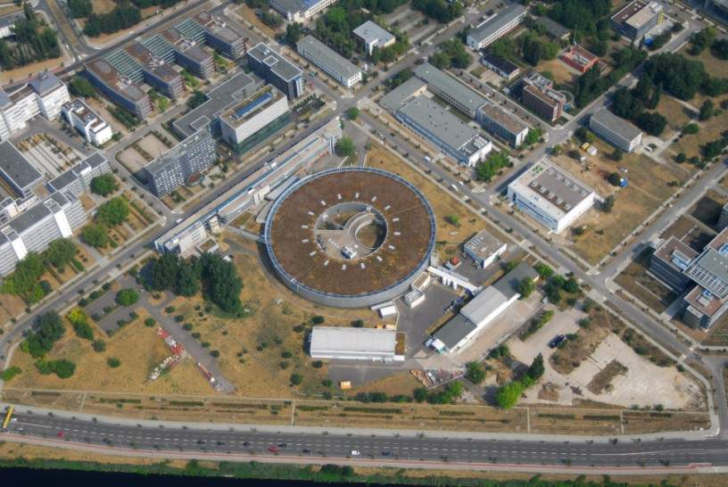
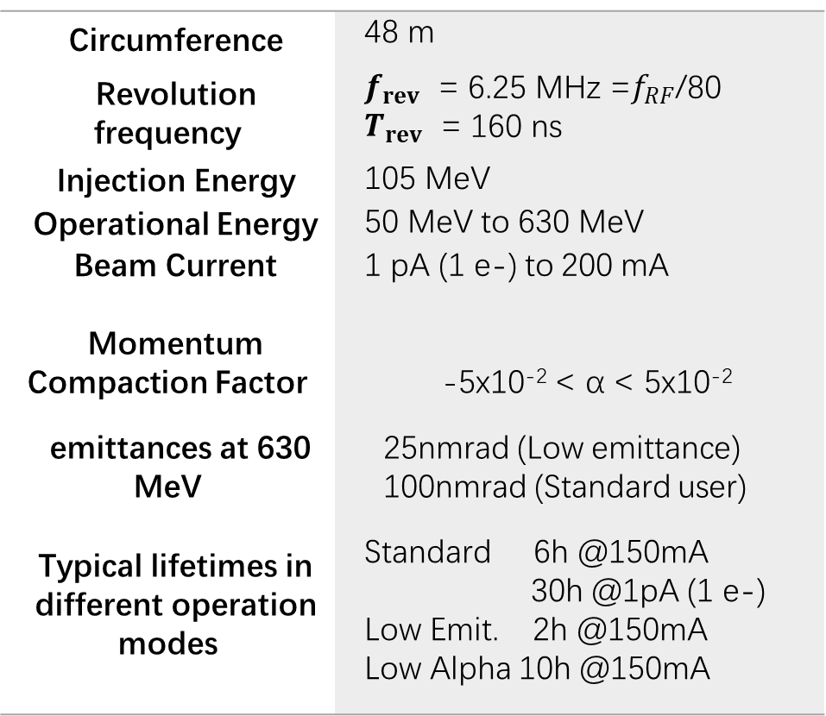
The Metrology Light Source
Circumference | 48 m
Revolution frequency | $f_{rev}$ = 6.25 MHz =$f_{RF}$/80 $T_{rev}$ = 160 ns
Injection Energy | 105 MeV
Operational Energy | 50 MeV to 630 MeV
Beam Current | 1 pA (1 e-) to 200 mA
Momentum Compaction Factor | -5x10⁻² < α < 5x10⁻²
emittances at 630 MeV | 25nmrad (Low emittance) 100nmrad (Standard user)
Typical lifetimes in different operation modes | Standard 6h @150mA 30h @1pA (1 e-) Low Emit. 2h @150mA Low Alpha 10h @150mA
BESSY II
Metrology Light Source (MLS)
located south of Berlin, Germany
owner and main user: Physikalisch-Technische Bundesanstalt (PTB)
operated by „BESSYII“-staff (Helmholtz-Zentrum-Berlin)
3/22

Slide 4
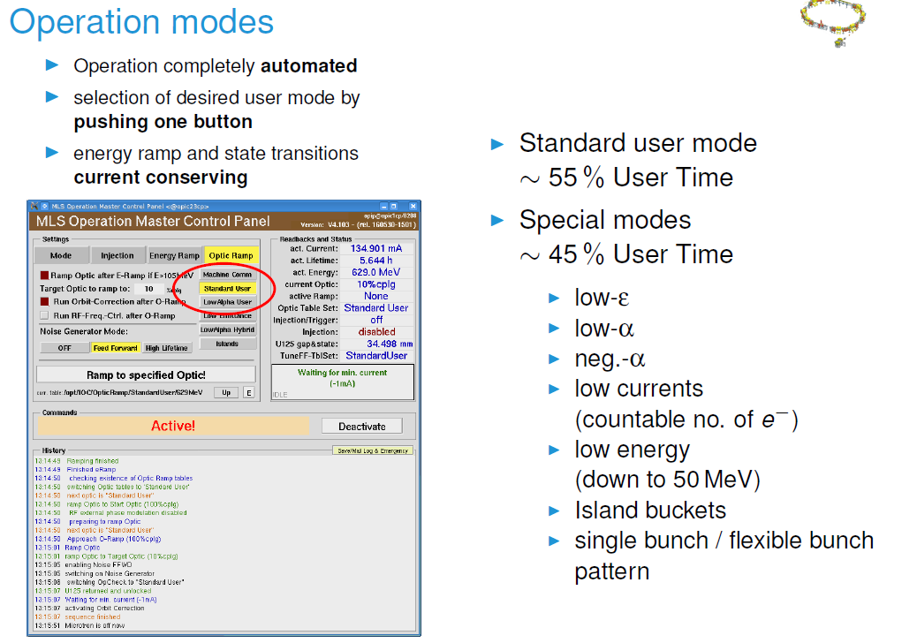
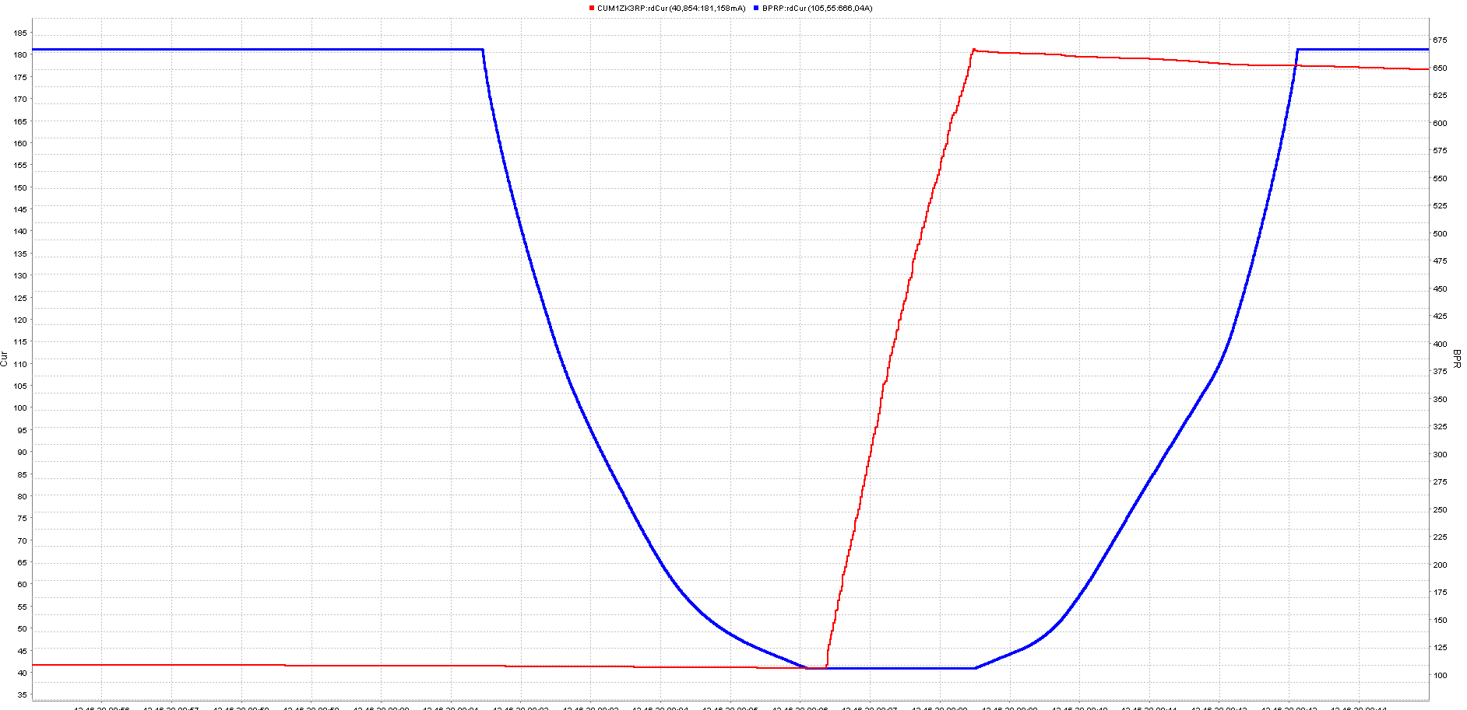
MLS operation and control is fully automated from the start in 2008 using a state-machine
-> PAC2009,,Vancouver Talk by Thomas Birke, „Automated operation of the MLS“, recently the most popular MLS paper !
energy ramp
Dipole current 660A
Beam current 180mA
15 min
Beam current 42mA
Dipole current 105 A
Yesterday at the MLS
4/22

Slide 5
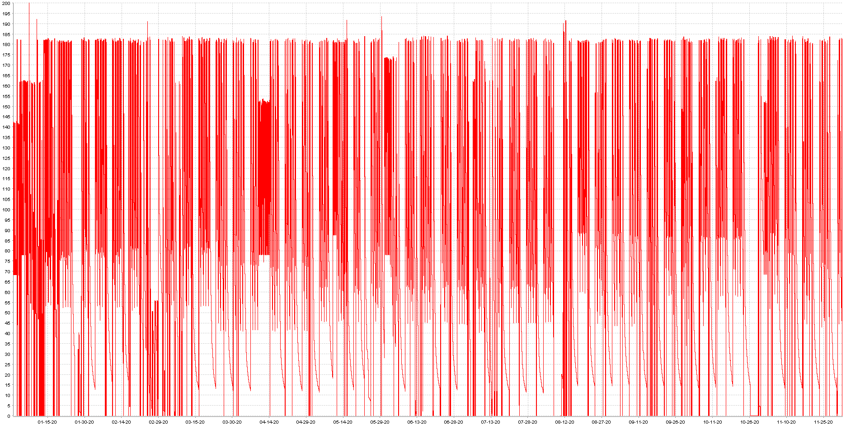


MLS delivered beam to user throughout complete 2020
Standard Operator schedule
Monday- Friday: 7h–15h and 15h-23h -> 1 operator/shift, 23h-7h -> no operator present for MLS
Sat + Sun -> no operator present for MLS
180mA
beam current I/mA
0mA
2020, Jan $1^{st}$
$$2020,Dec 1^{st}$$
5/22

Slide 6
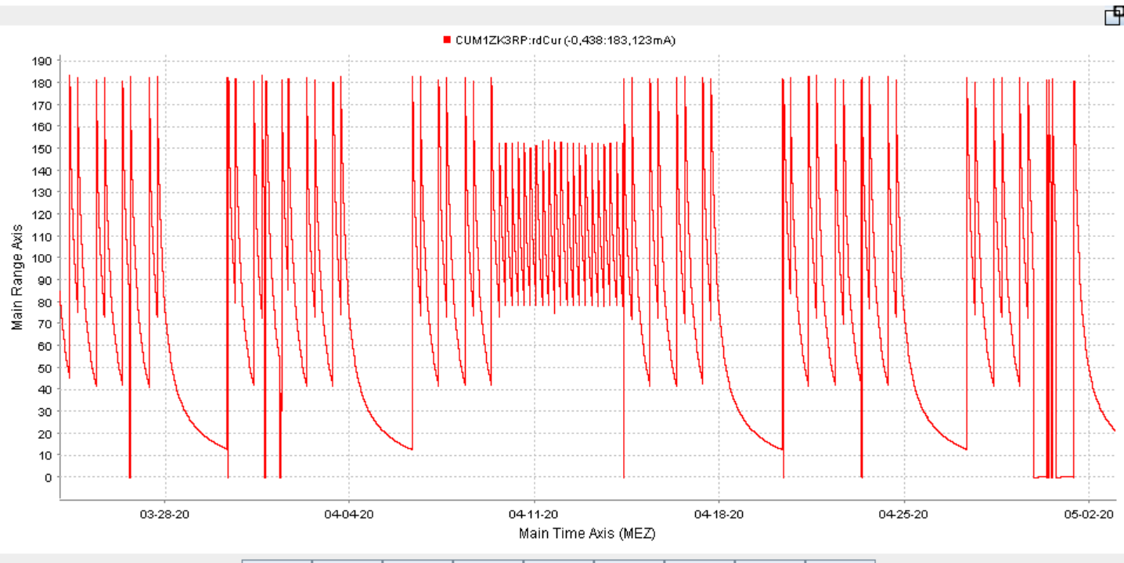
Special COVID Mode operation 24th March - 3rd May 2020 and again since November 9th
Monday – Friday 1 shift/day 9 a.m. - 5 p.m., allowing 2 injections/day establishing 24h user operation
no machine studies or special modes which would require intervention of an expert to reestablish SU operation
During this whole period 2 faults occured where users had to wait for fresh beam on start of the next shift
180mA
Grateful to the HZB OP-Team !
March 24th
May 3rd
6/22

Slide 7
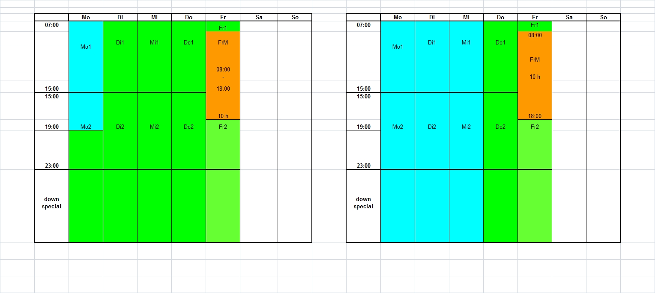
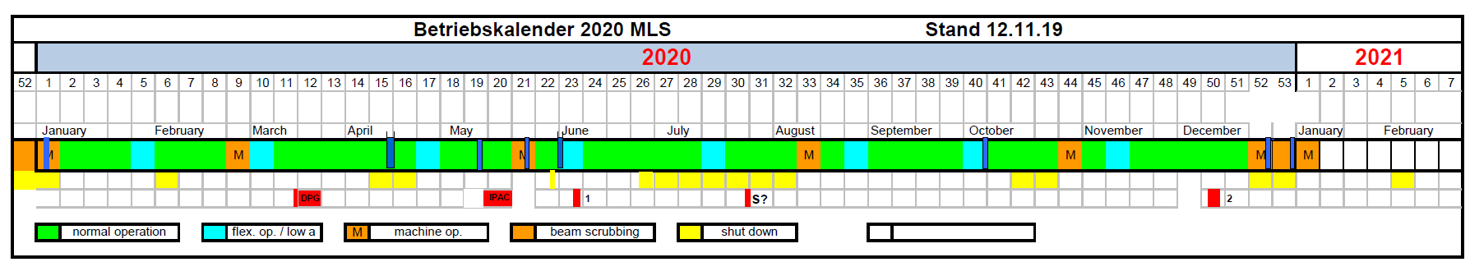
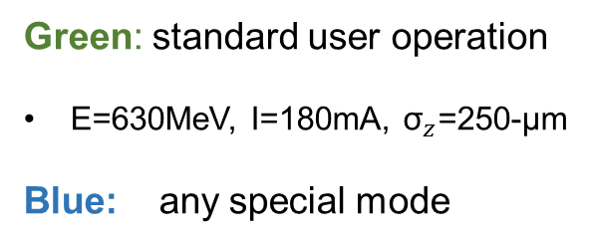
„Special modes“ at MLS
7h
MoTue WedThu Fri
MoTue WedThu Fri
Green: standard user operation
E=630MeV, I=180mA, ${\text{σ}}_{z}$=250-µm
Blue: any special mode
Low alpha
Low emittance
Low current
Low energy
Island buckets
…
23h
„green“ week
„blue“ week 8/y
7/22

Slide 8
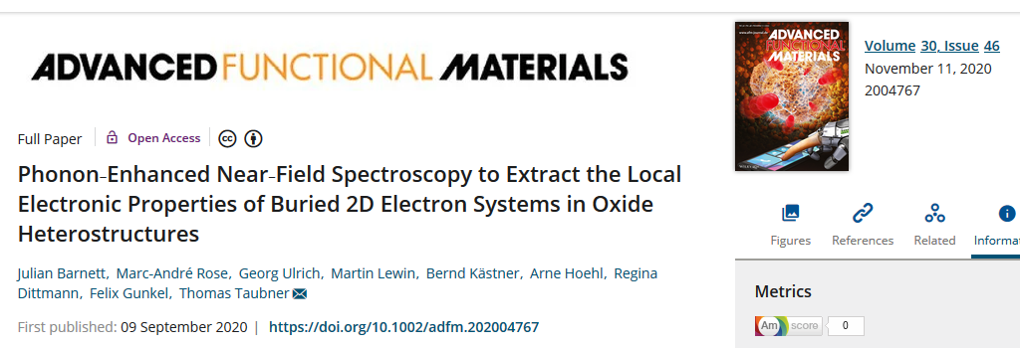
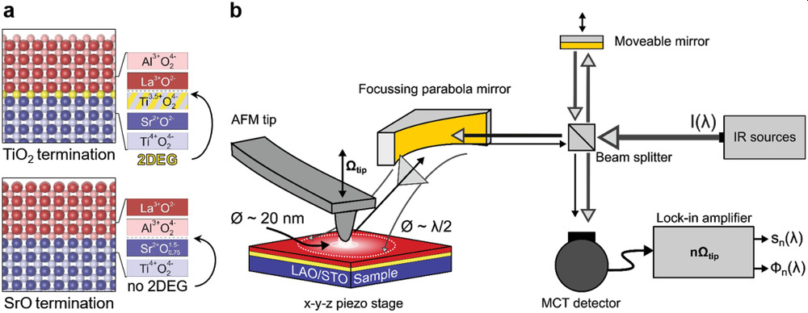
MLS – special modes
What makes a „low interest Mode“ a „winner mode“ ?
A beamline scientist: „every single special mode shift recently led to an high impact paper“
Results of several high rated papers could only be aquired in „special modes“ like „low alpha“ or „low emittance“.
Why are these special modes so succesfull at MLS ?
sufficient beam time availablility for special modes -> the MLS lab (PTB), users and beamline scientists strongly support the flexible operation -> flexibility = advantage of a small SR source
Only common development of machine states and permanent comunication of users and machine staff prepares an experimental environment which can make the experiments succesful
-> e.g. THz based s-SNOM microscopy.
8/22

Slide 9



SSMB Proof-of-Principle experiments at MLS
A PoP experiment was successfully performed at the Metrology Light Source, Berlin by a collaboration of Tsinghua University Bejing, HZB and PTB and later Shanghai Light Source
  Alex Chao, Xiujie Deng, Wenhui Huang, Lixin Yan, Chuanxiang Tang, Huan Wang, Zizheng Li,
  Yao Zhang, Zhilong Pan, Hsin-Chu: Hao-Wen Luo, Poshun Wu, Ci-Ling Pan, Make Ying
  Helmholtz-Zentrum Berlin, Jörg Feikes, Arnold Kruschinski, Ji Li, Aleksandr Matveenko, Yuriy Petenev, Markus Ries
  Arne Hoehl, Roman Klein, Jana Puls
  Bocheng Jiang, Chao Feng, Xiaofan Wang, Changliang Li, Weishi Wan

Slide 10
Recent publications:
two paper on single particle effects smearing microbunches in Physical Review Accelerator and Beams
Widening and distortion of the particle energy distribution by chromaticity in quasi-isochronous rings,
X. J. Deng, R. Klein, A. W. Chao, A. Hoehl, W. H. Huang, J. Li, J. Lubeck, Y. Petenev, M. Ries, I. Seiler, C. X. Tang, and J. Feikes, Phys. Rev. Accel. Beams 23, 044001
Single-particle dynamics of microbunching, X. J. Deng, A. W. Chao, J. Feikes, W. H. Huang, M. Ries, and C. X. Tang, Phys. Rev. Accel. Beams 23, 044002
Publication on PoP experiment recently accepted for publication by Nature
Experimental Demonstration of the Mechanism of Steady-state Microbunching X. Deng, A. Chao, J. Feikes, A. Hoehl, W. Huang, R. Klein, A. Kruschinski, J. Li, A. Matveenko, Y. Petenev, M. Ries, C. Tang and L. Yan.

Slide 11
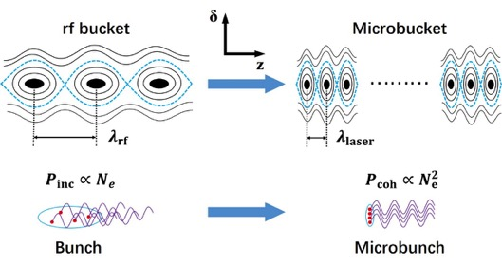
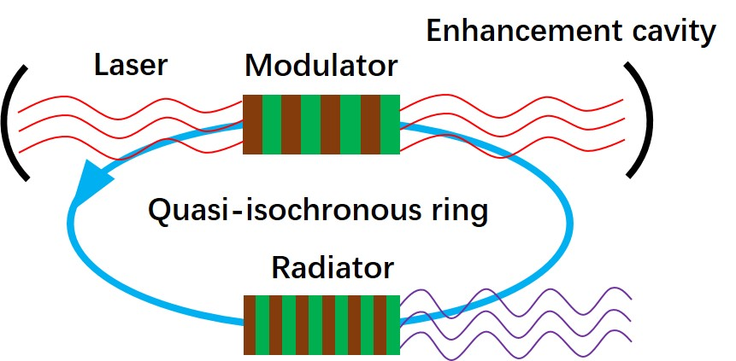
What is steady-state microbunching (SSMB)^{[1]}?
FELs are single-pass devices. SSMB aims for microbunching in storage rings. The main difference from a conventional storage ring is to replace the RF cavity modulation by laser modulators. --- The 6 orders of magnitude extrapolation asks for a proof-of-principle test.
Two key ingredients of SSMB: microbunching for high N_{e}² peak power, steady state for high repetition rate.
SSMB is not an FEL. No consecutive energy heating/emittance growth. No FEL mechanism invoked. Laser modulator is the key – causing microbunching and maintaining steady-state.
Radiator is only a passive device, much shorter than that in a high-gain FEL, e.g. a simple dipole.
[1] D. F. Ratner and A. W. Chao, Steady-State Microbunching in a Storage Ring for Generating Coherent Radiation, Phys. Rev. Lett. 105, 154801 (2010).
11/22

Slide 12
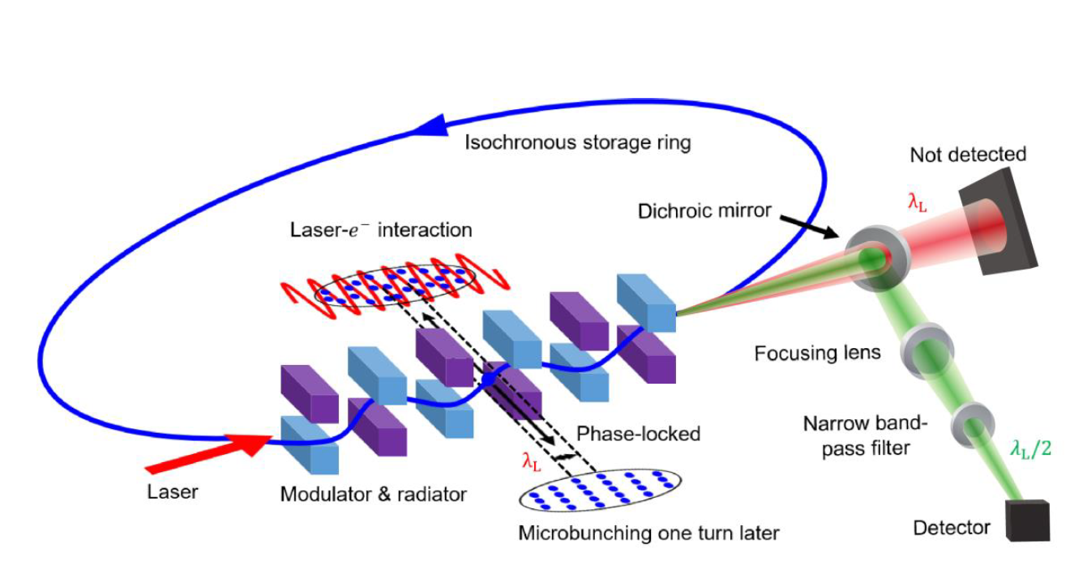

SSMB PoP Phase I
Electron beam is stored in an isochronous configuration at MLS. The beam is modulated by a single-shot laser. The laser is turned off, the beam makes one turn and returns to the modulator, which now serves as the radiator in the next turn. The ring must have a high precision and stability to store the beam in isochronous condition and to maintain phase space correlations for microbunching after a full turn.
$$C=48 m α≈−2×{10}^{−5} E=250 MeV$$
$$λ=1064 nm$$
12/22

Slide 13
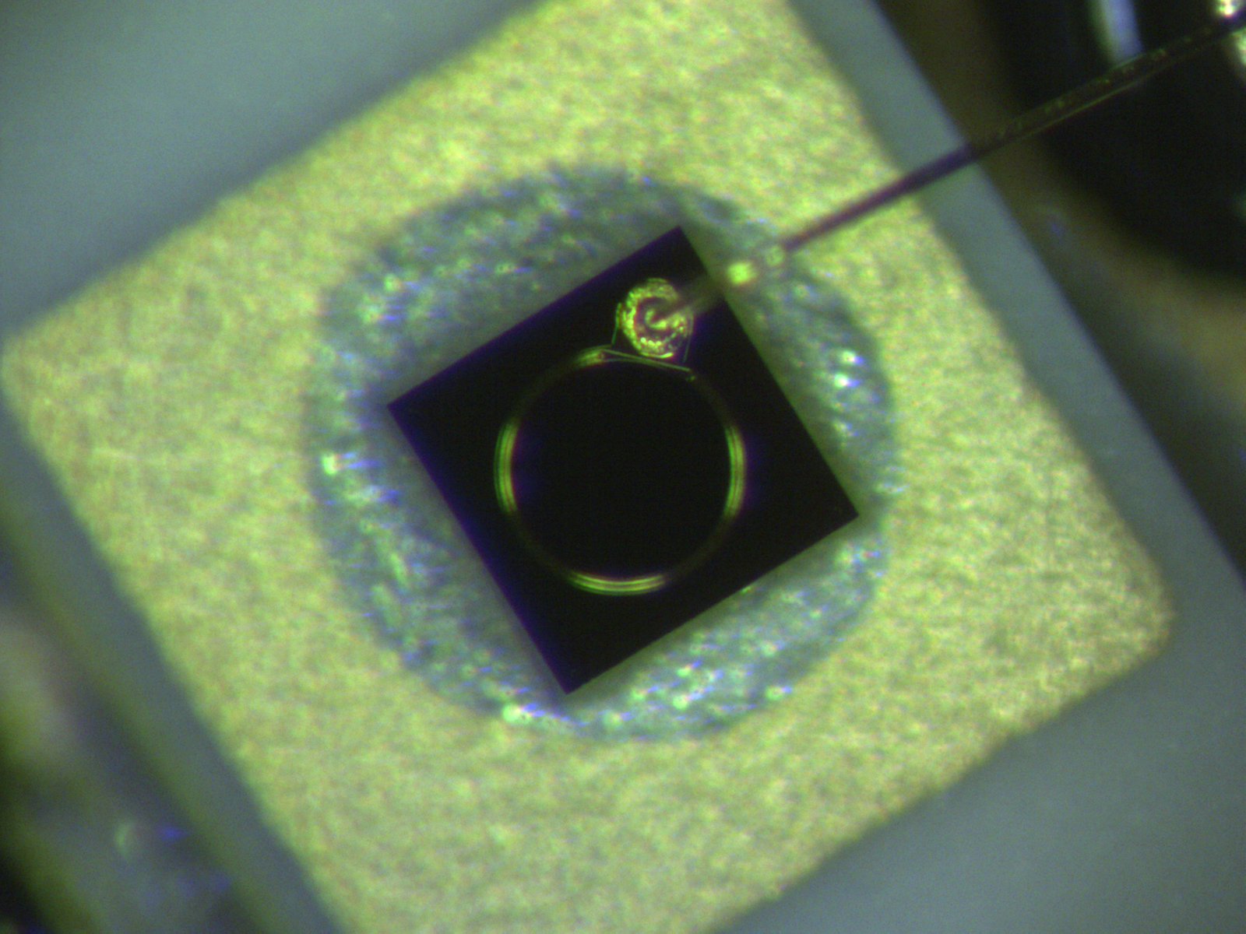
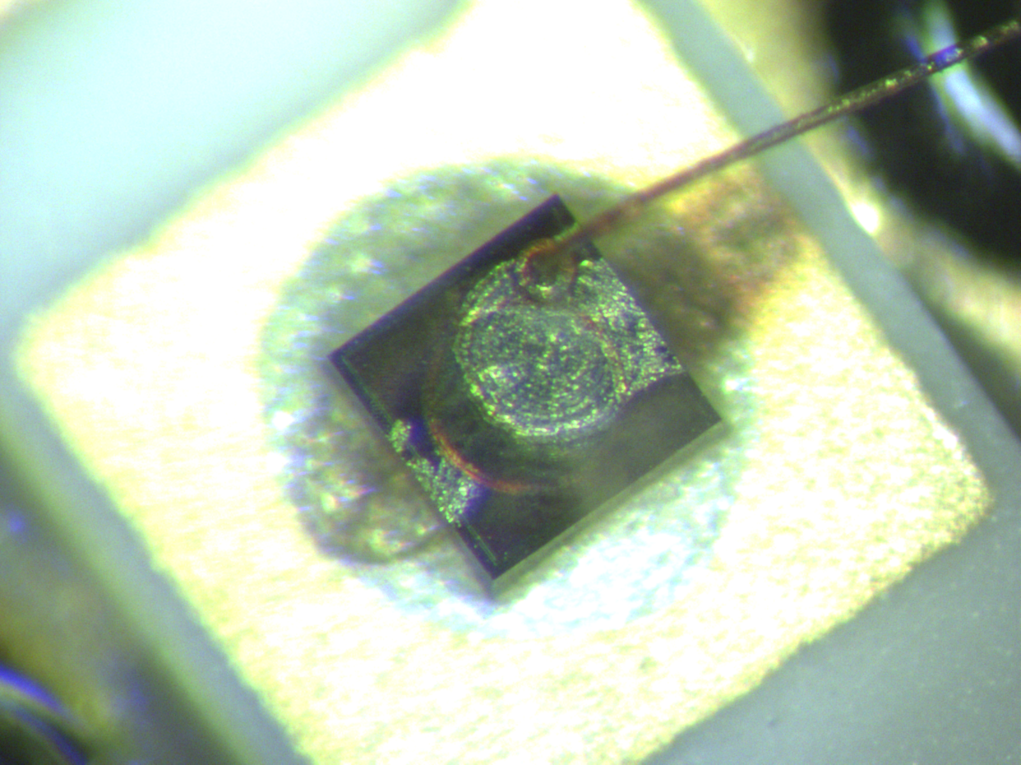
coherent detection was only possible at 532nm (second harmonic)
-> Laser induces strong detector saturation at 1064nm preventing to observe a coherent signal at 1064nm after one turn
-> due to the strong impact the diode signal even at 532nm was still distorted due to saturation effects making evaluation
of the coherent signal after one turn difficult
-> occasionally damage of photo diodes used for coherent light detection by high laser power
new photodiode
damaged photodiode
13/22

Slide 14
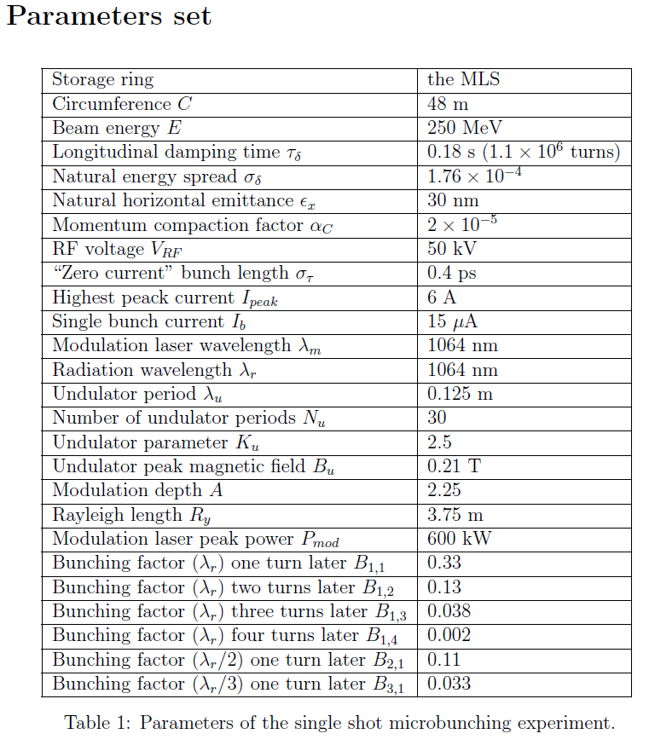
Parameter setting for optimum SSMB machine state was defined by Deng Xiujie
Low !
Negative and very Low !
14/22

Slide 15
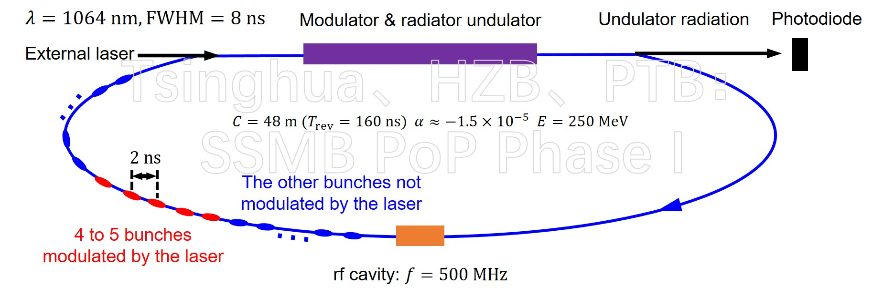
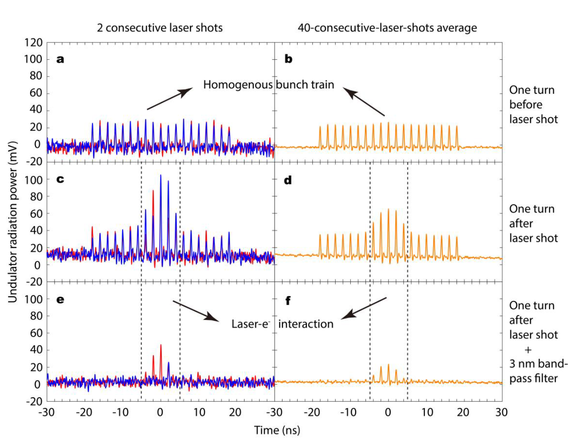
Success only two years after first steps
Strongly fluctuating coherent signal
due to unstable Laser emission
-> averaging needed
The undulator radiation (2nd harmonic) intensity amplification of the 4 to 5 bunches in the middle of the bunch train one turn after modulated by the laser indicates the formation of microbunches and generation of coherent radiation.
One important feature of the coherent radiation: narrow-banded.
15/22
15/27

Slide 16
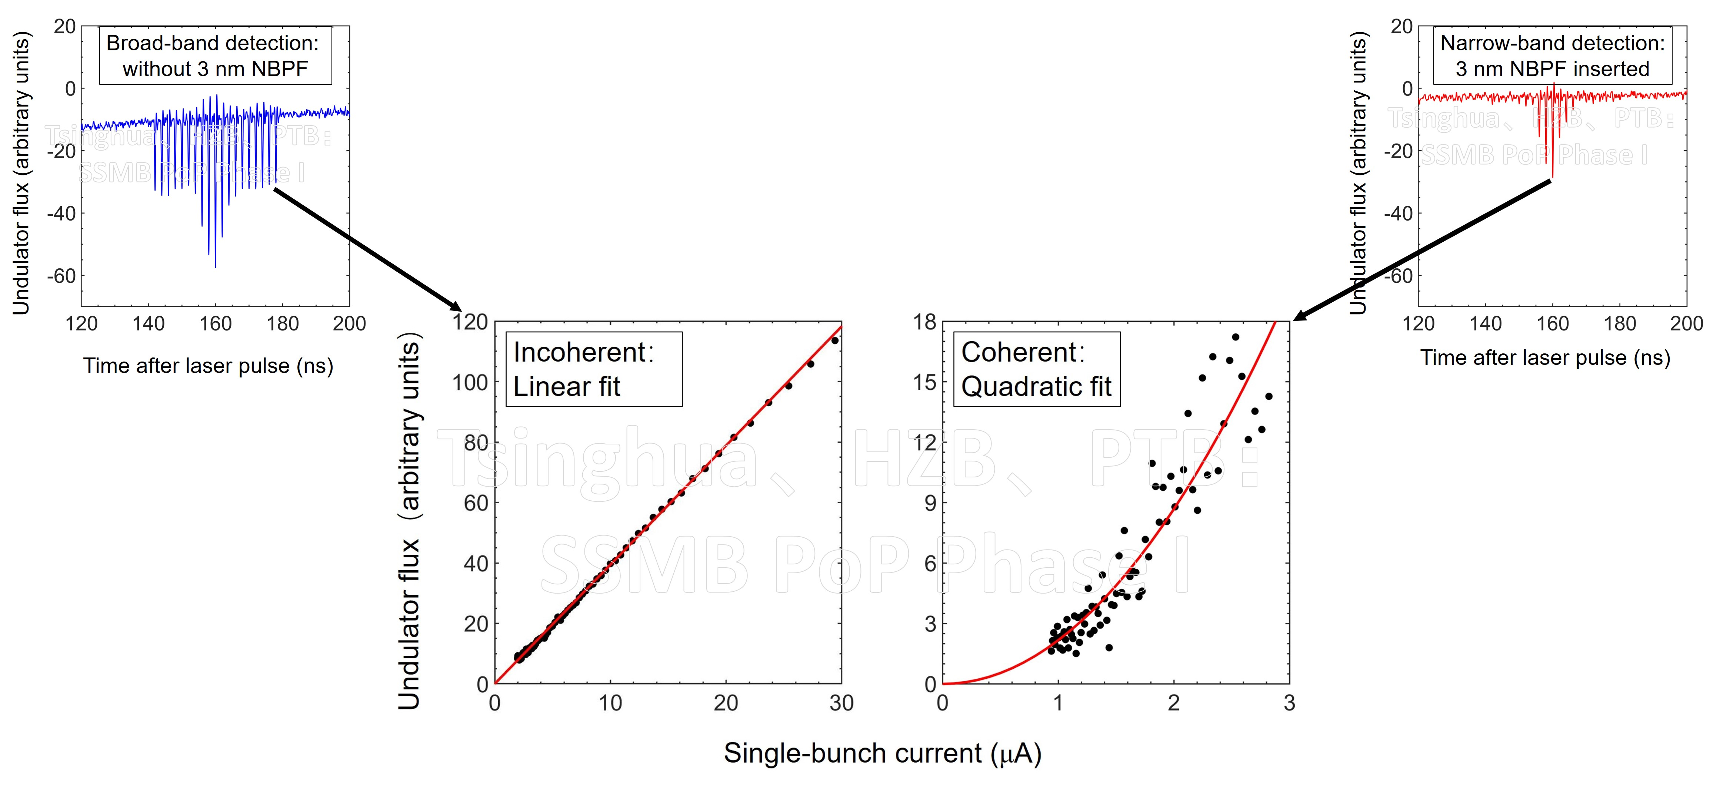
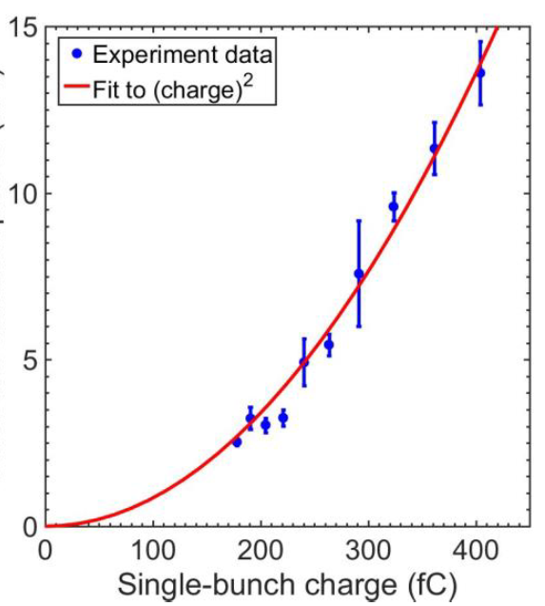
The quadratic beam current scaling of the coherent radiation demonstrates unequivocally the formation of microbunching as well as its small band width
The coherent signal comes from 2nd harmonic radiation. 1. harmonic radiation is blocked together with the Laser light. Fundamental mode is expected to have a much higher radiation power
Broad-band incoherent
radiation of usual bunch
Narrow-band coherent
radiation of microbunches
single bunch current (µA)
16/22

Slide 17
Significance of SSMB PoP Phase I
Our PoP test is essentially different from the other single-pass microbunching experiments. The key point here is to demonstrate that in a touchy isochronous storage ring, a microbunched electron beam can stay microbunched with definitive microbunching phase.
Once the one-turn microbunching phase is established with the electron beam stored stably in the required storage ring lattice, a multi-shot laser is expected to provide the microbunching bucket for 1000 turns in Phase-II using the same ring configuration but replace the single-shot laser by a 1000-shot laser.
The Phase-I experiment demonstrates phase stabilization in the optical wavelength range, validating the scaling from RF buckets to optical microbuckets and microbunches.
17/22

Slide 18
Potential of SSMB
SSMB focuses on longitudinal dynamics. This is parallel to the present tremendous efforts by the community of diffraction-limited rings, which focuses on the transverse dimension.
notice: the diffraction limit defines a natural limit of the development towards smaller source points transversely
-> machine development in transverse direction beyond this point not obvious
-> in contrast in the longitudinal direction the limit is still many orders away (mm -> nm) giving room for decades of future science and developments in longitudinal compactification
Features of SSMB: high-average-power, continuous-wave, narrow-band radiation, at wavelengths ranging from the THz to IR, EUV.
This implies tremendous potential in accelerator photon science and industry applications, for example the EUV lithography. High-power EUV source is urgently needed for the high volume manufacturing of EUV lithography and this is one of the main driving force behind recent SSMB developments.
The first SSMB Workshop http://indico-cdex.ep.tsinghua.edu.cn/event/38/ organized by the Tsinghua University 7th-9th Dec 2020 showed the strongly increasing attention to SSMB concepts especially throughout Asian countries with 80 participants from 22 institutions. A lot of SSMB concepts based on ERL, Ring FEL or isochronous storage rings were presented. Interest in Low alpha lattices is increasing again.
18/22

Slide 19
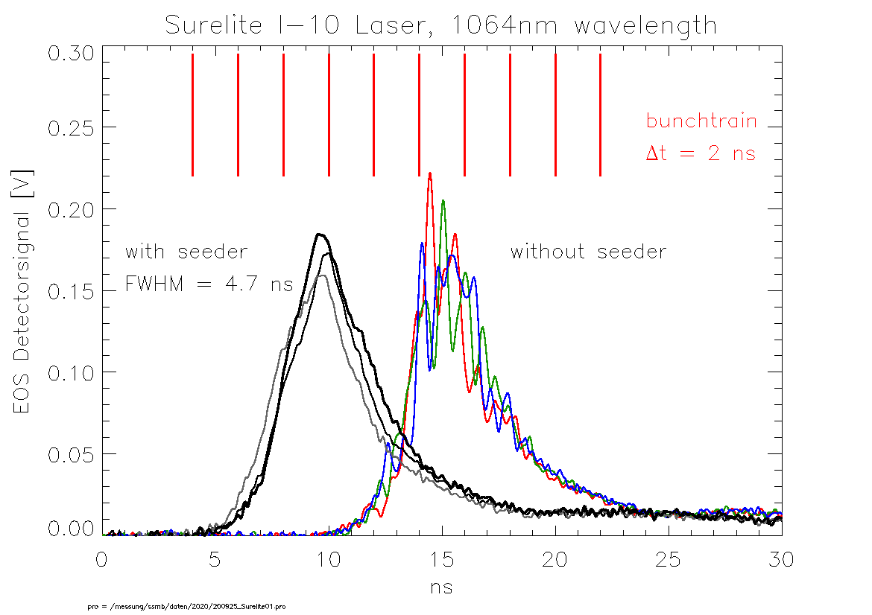
Recent Progress and further Development
DAWA Laser removed and sent back to Tsinghua university. An new seeded and more stable Laser aquired and prepared for installation in the MLS bunker
Roman Klein,
Arne Hoehl, PTB
General specification approved
Confirmed puls length <5ns
Pulsform improved to true Gaussian
19/22

Slide 20
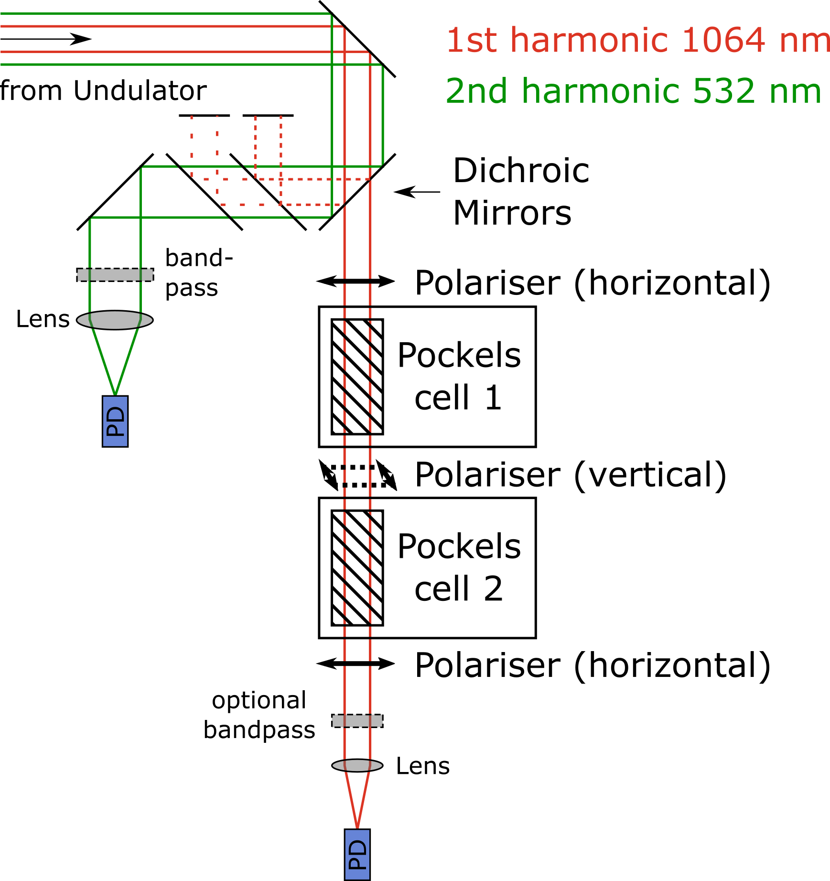
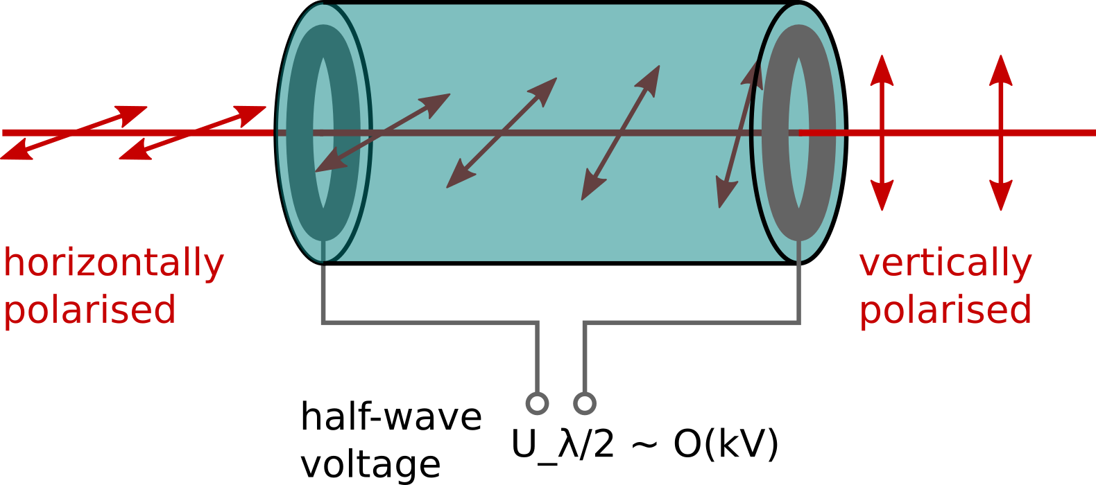
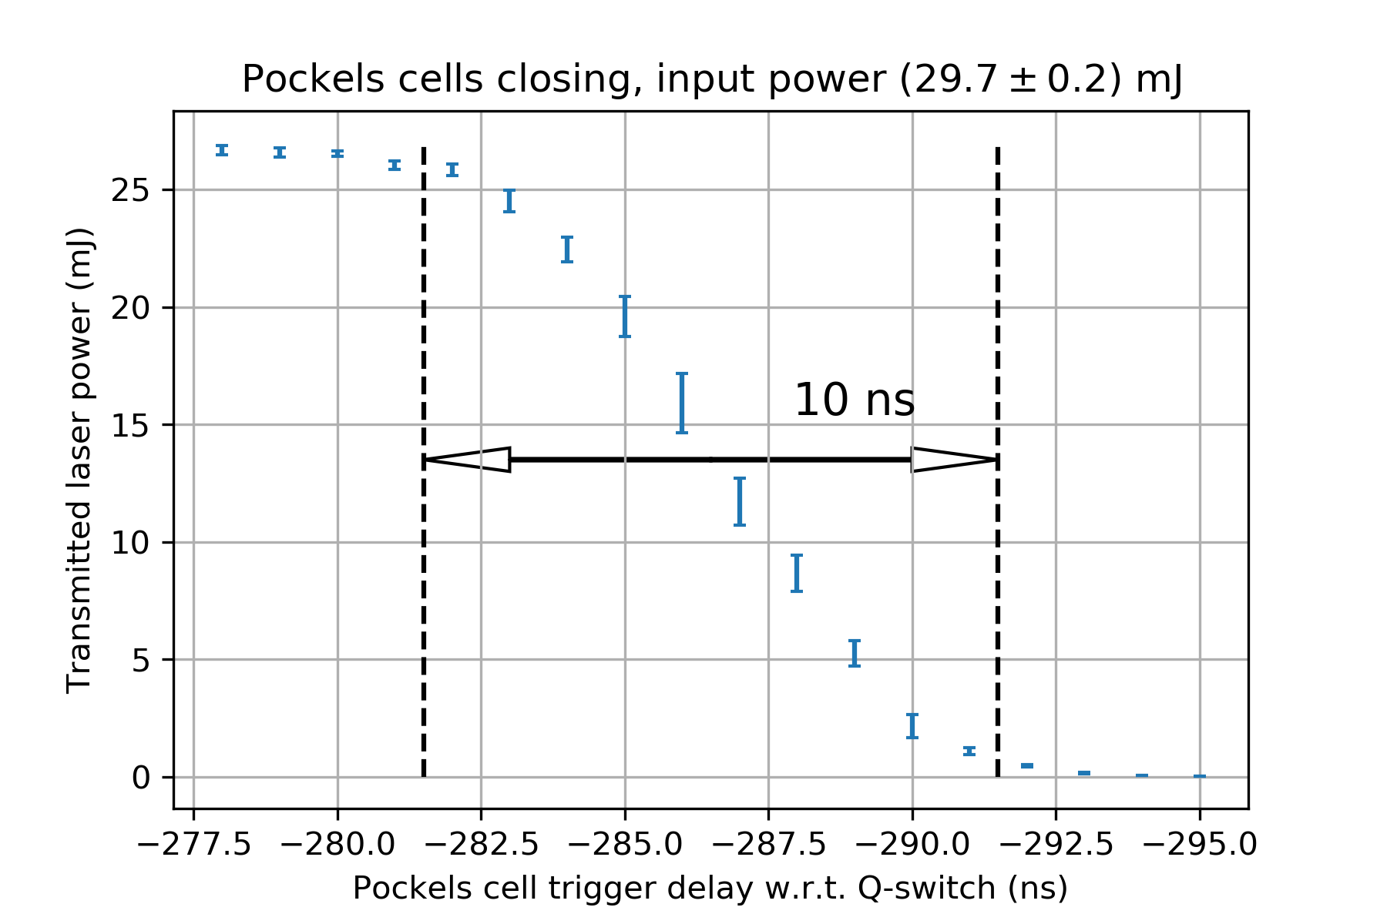
New detection setup using fast optical switches
developed to block out laser pulse thus allowing
first order detection of coherent signal at 1064nm
Mounted between crossed polarisers: Fast optical switch O(ns)
+
Pockels cell 3
Master thesis
Arnold Kruschinski
20/22

Slide 21
The next steps
With stable laser and 1064nm detection leading to intense coherent signal, detailed studies on micro bunch behavior possible:
Dependence on machine parameter like α0, chromaticities, bunching factor etc
Achieve multiple turns radiating coherently
Influence of Nonlinear alpha, positive vs negative alpha ..
Collective effects !
…
PoPII:
Replace the single-shot laser by a 1000-shot laser, but use the same MLS ring lattice.
- Can test a quasi-SSMB. Microbunch lifetime ~ 1000 turns.
- The SSMB Collaboration is preparing Phase-II but very unfortunately delayed by COVID19.
Special acknowledgement to Andreas Jankowiak (HZB) and Mathias Richter (PTB) for their strong support which made this experiment possible.
21/22

Slide 22
?
22/22

Slide 23
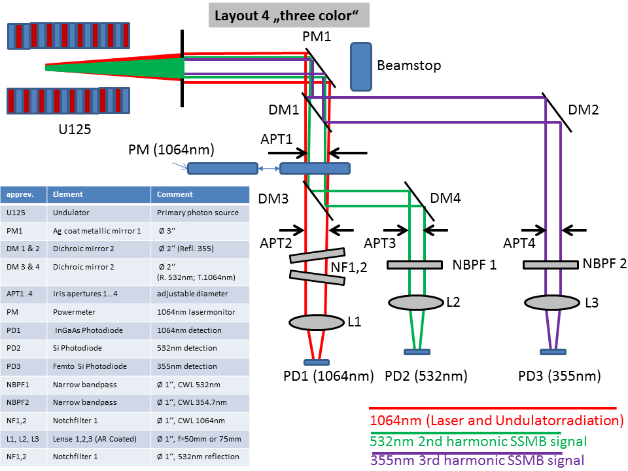
The optical detection box
To reduce impact of laser induced detector saturation-> signal detection on higher harmonics implemented
Roman Klein,
Arne Hoehl, PTB
23/22

