Slide 1

Storage ring for Novosibirsk low emittance light source SKIF
A. Bogomyagkov
Budker Institute of Nuclear Physics Novosibirsk, Russia
28th ESLS-2020, 16-17 December 2020

Slide 2
Specifications and constraints
Beam energy 3 GeV (less construction time)
Circumference < 500 m (available ground area)
Natural horizontal emittance ≤100 pm (zero current, zero coupling, no IDs)
Injection complex à la NSLS II (150-200 MeV linac and full energy small size booster synchrotron) (short construction term)
Traditional off-axis horizontal plane injection with four-kicker bump (reliability)
Sufficient number of beamlines (users requirements)
  From wigglers and undulators (straight sections)
  Hard X-ray from strong field dipoles
  Soft X-ray and VUV from weak field magnets
Simple, proven solutions when possible (reliability) (short construction term)

Slide 3
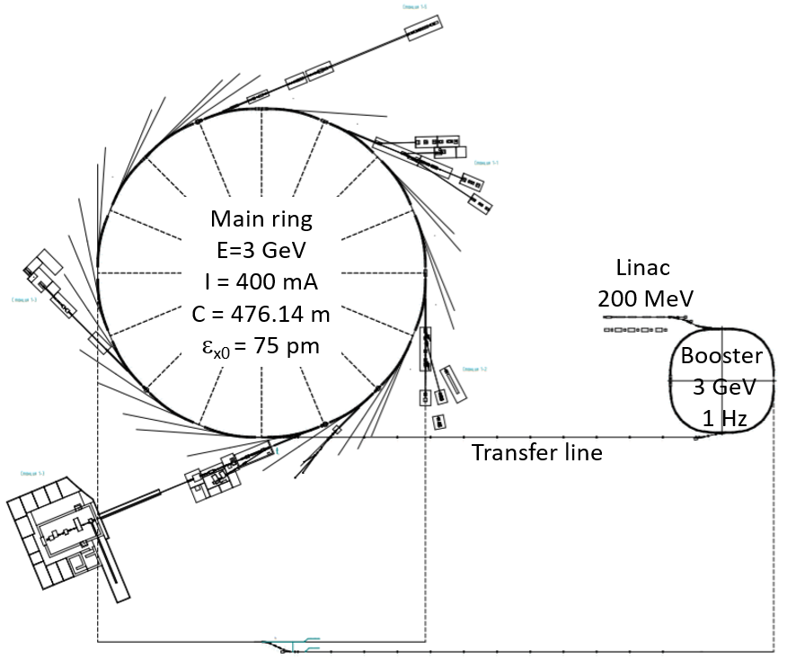
Configuration
To complete construction and to start operation before the main building and ring, the injection facility is in separate building.
Linear accelerator with maximum energy 200 MeV
Small size booster synchrotron with maximum energy 3 GeV and orbit length 158.7 m
Electron storage ring 16-fold symmetry with 3 GeV energy and 476 m circumference

Slide 4
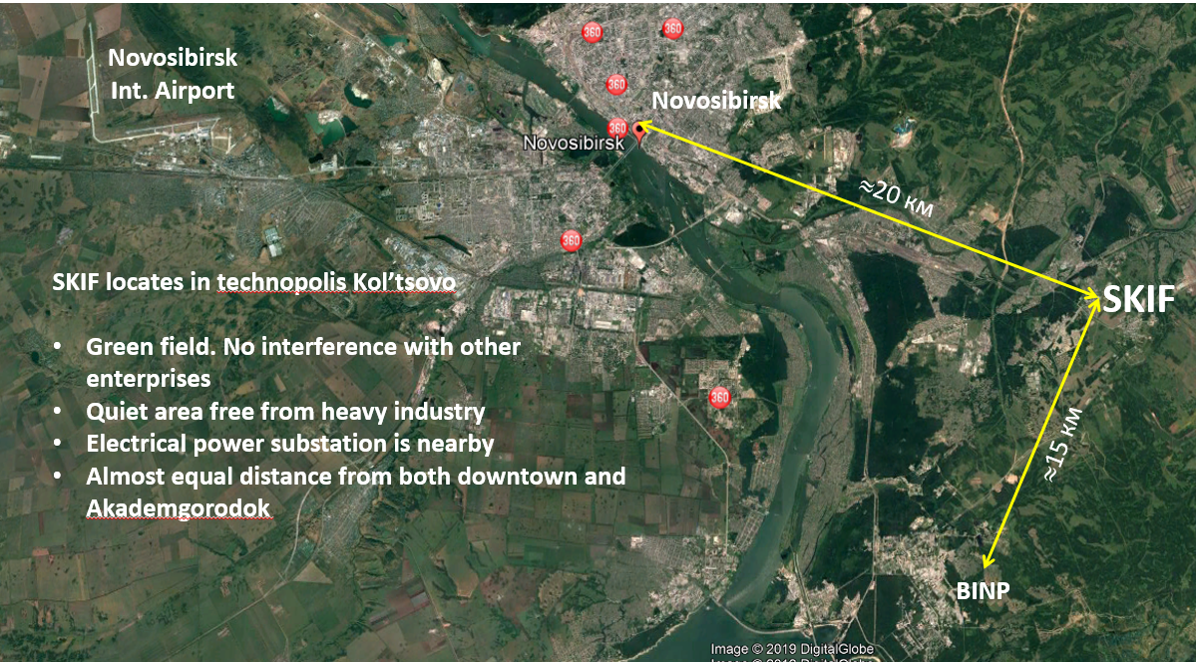
SKIF Location: Kol’tsovo Science Town

Slide 5
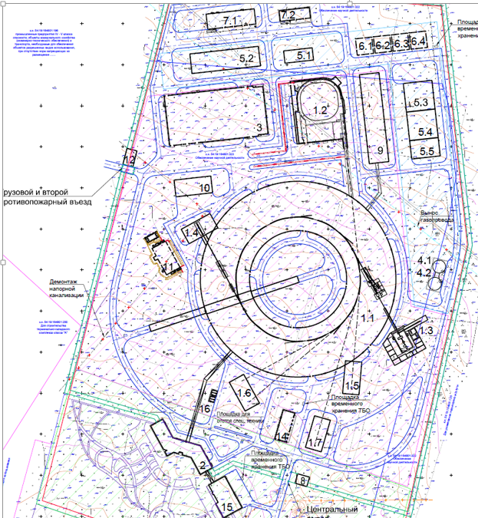
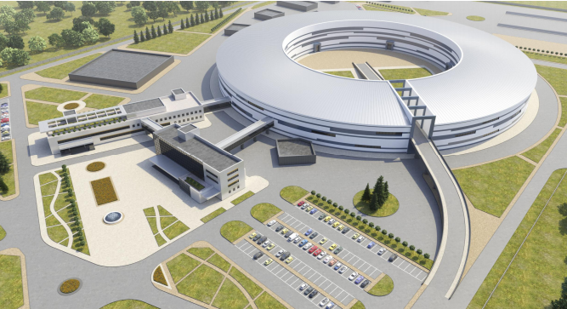
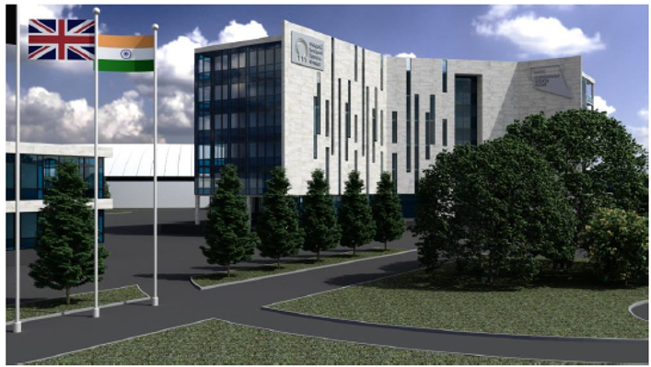
Site and architecture

Slide 6
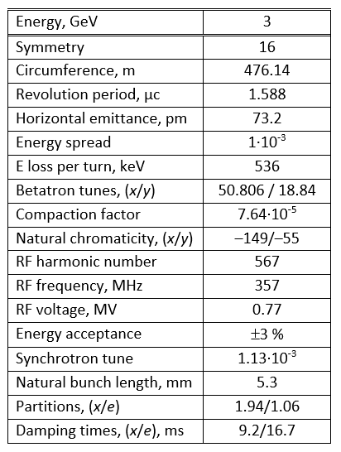
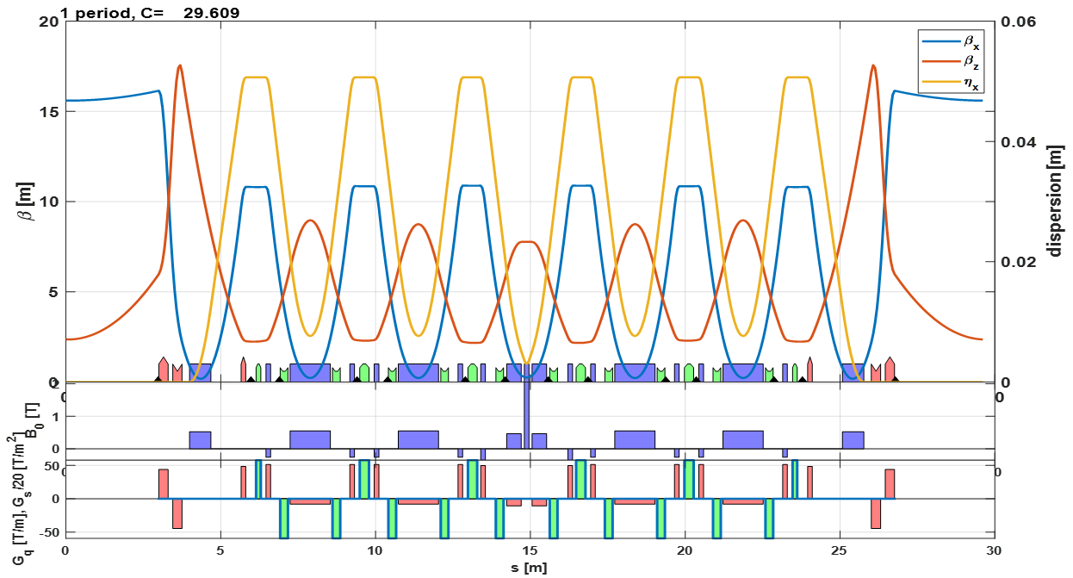
Super-period optics and parameters

Slide 7
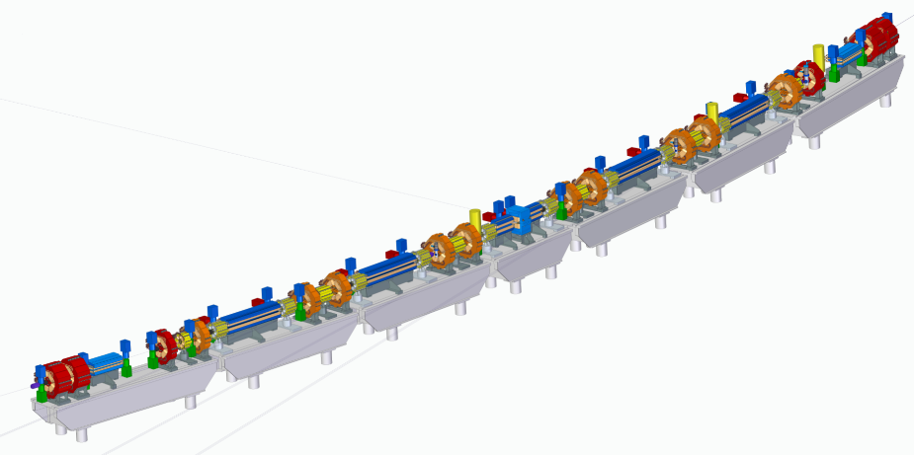
Super-period layout
Matching
section
Cell 5 (low field)
Cell 4 (low field)
Cell 3 (high field)
Cell 2 (low field)
Reversed magnet (orange)
Cell 1 (low field)
Low field dipole (dark blue)
Matching
section
Pump
High field dipole (blue)
Sextupole
(yellow)
Normal quad
(red)

Slide 8

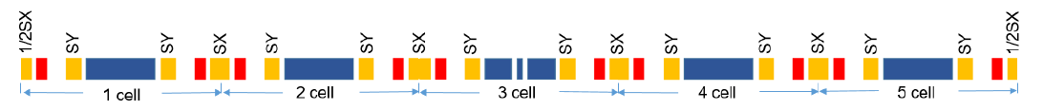
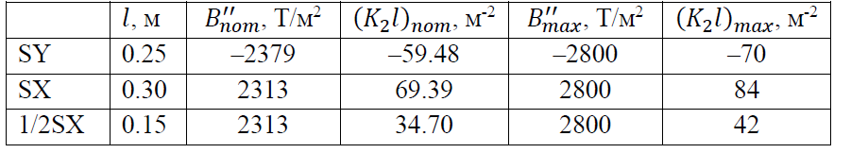
Chromaticity correction
Квадруполь
∅30 мм
70 Т/м
300 А х 10 витков
8 mm SR gap
We use only two sextupole families to compensate natural chromaticity and optimize dynamic aperture and momentum acceptance. No other multipoles (octupoles or harmonic sextupoles) are applied.

Slide 9
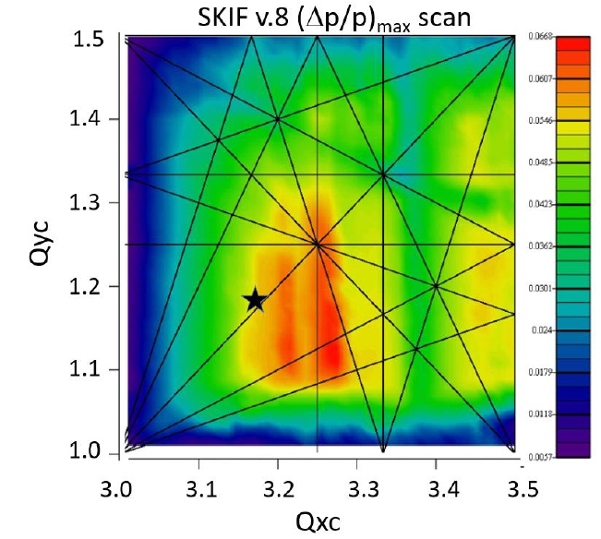
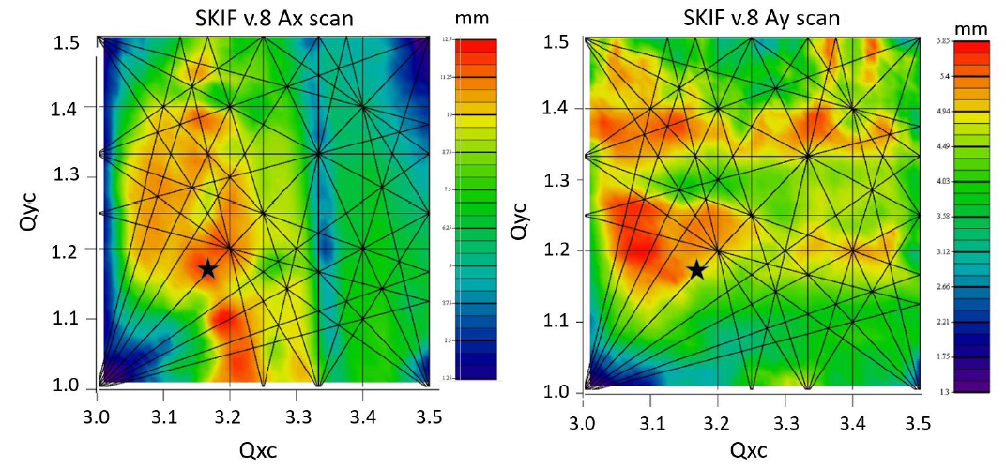
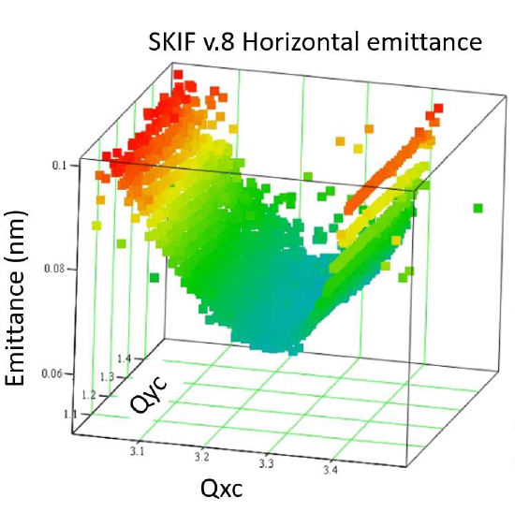
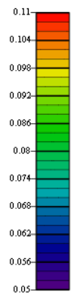
Dynamic aperture scan for one super-period
Квадруполь
∅30 мм
70 Т/м
300 А х 10 витков
8 mm SR gap
Tunes are for one super-period.
Chosen tune point
Betatron tunes, phase advances between chromatic sextupoles and their strength were carefully adjusted to maximize dynamic aperture and momentum acceptance.

Slide 10
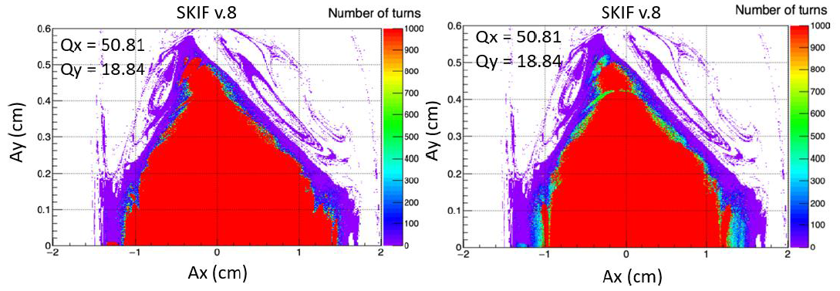
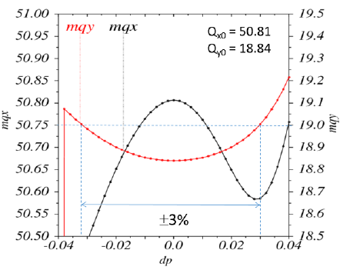
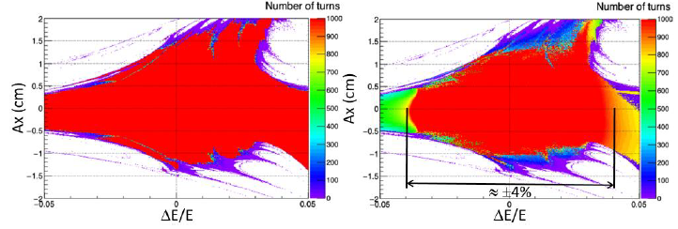
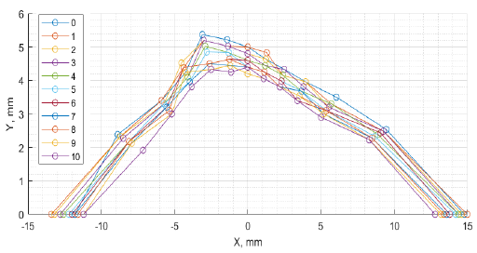


Dynamic aperture and momentum acceptance
RF off
RF on
RF off
RF on
Survival plots. Red is stable during 1000 revolutions. Only two sextupole families are enough to get sufficient dynamic aperture and momentum acceptance.

Slide 11
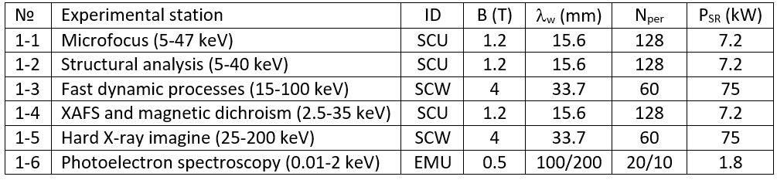
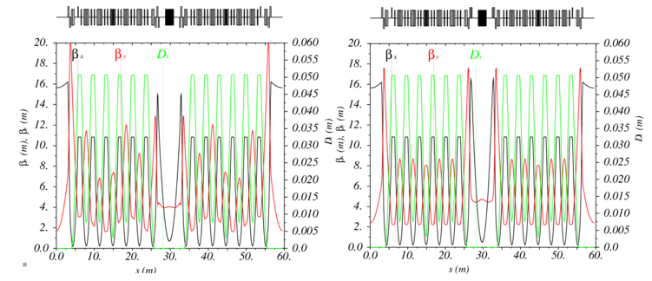
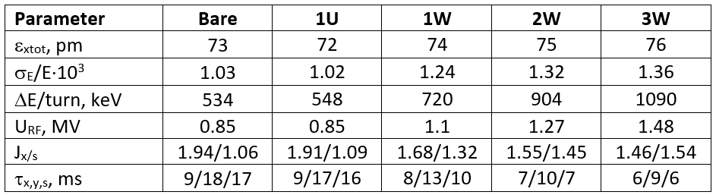
Insertion devices
Квадруполь
∅30 мм
70 Т/м
300 А х 10 витков
8 mm SR gap
To extend the spectrum in the hard X-ray region, we plan to use superconducting IDs.
For baseline lattice, the emittance does not depend on IDs.
Before correction
After correction
Optics with 1 SCW

Slide 12
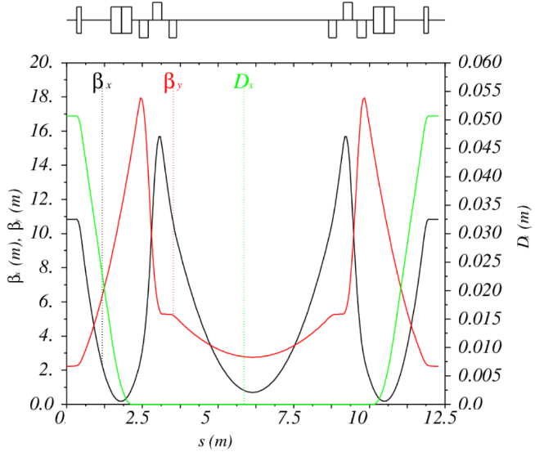
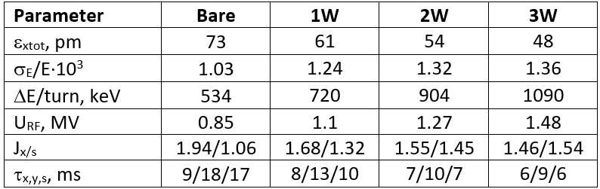
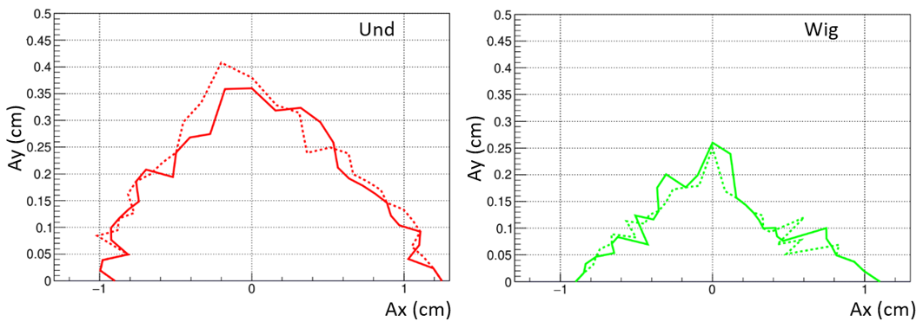
IDs, alternative drift optics
Квадруполь
∅30 мм
70 Т/м
300 А х 10 витков
8 mm SR gap
Low β_{x} in the wiggler section allows additional emittance reduction. For beta control we need quadrupole triplets instead of doublets.
Strong field IDs influence the DA (through the optical symmetry breaking). Mitigation of such influence is under way.

Slide 13
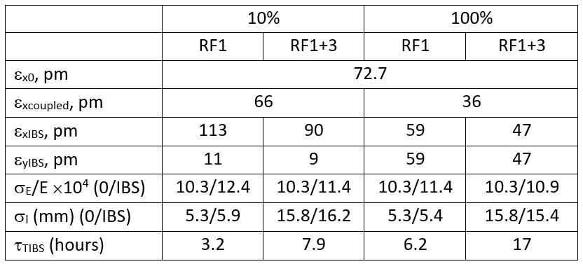
IBS bare lattice
400 mA in 510 bunches, U₀=534 keV/turn, V_{RF}=0.845 MV (ΔE/E=±3%)
RF1 – main accelerating system, RF1+3 – third harmonic RF elongate the bunch threefold

Slide 14
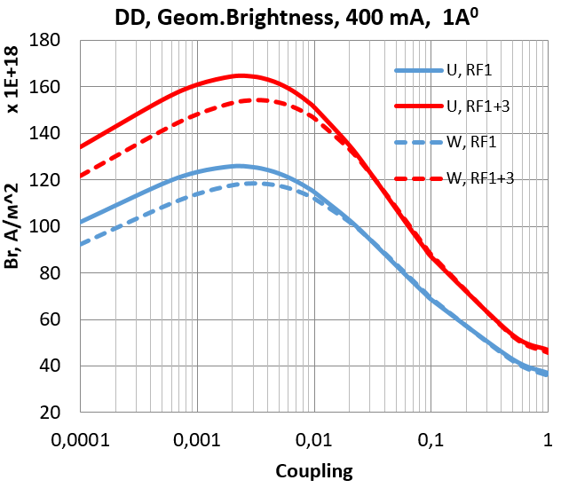


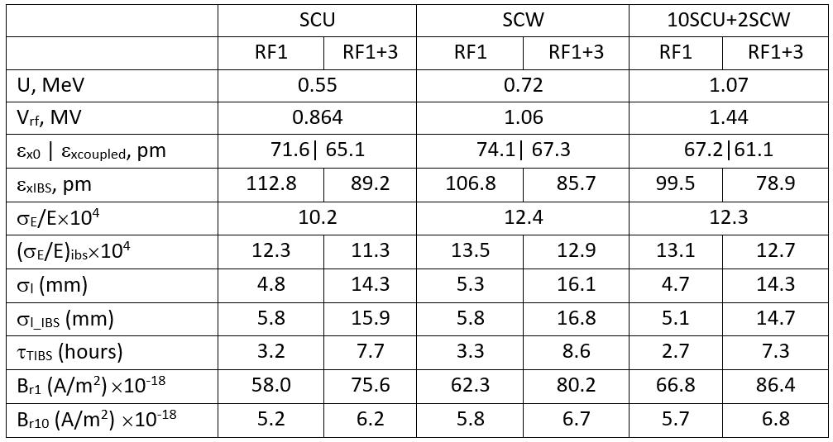
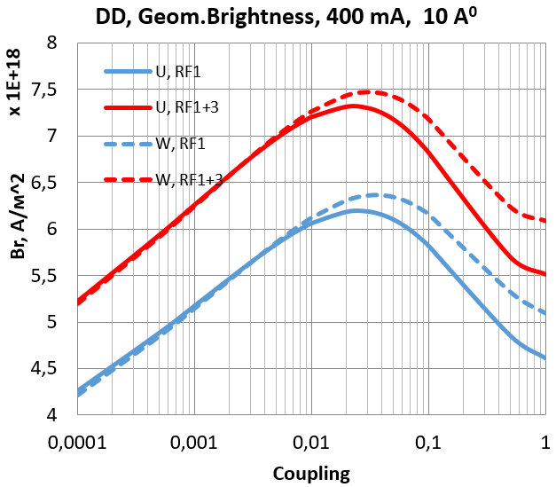
IBS with IDs
“Reduced” brightness (depends on the electron beam parameters):
400 mA in 510 bunches, κ = 10%, B_{r1} and B_{r10} – “geometrical brightness” for λ = 1 Å and λ = 10 Å.

Slide 15
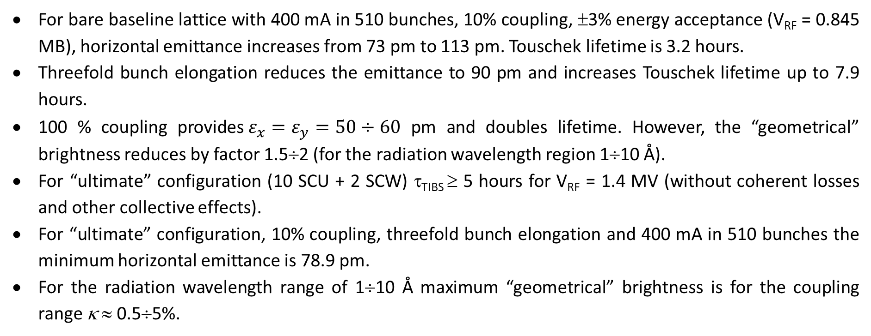
Emittance and lifetime with IBS
For bare baseline lattice with 400 mA in 510 bunches, 10% coupling, ±3% energy acceptance (V_{RF} = 0.845 МВ), horizontal emittance increases from 73 pm to 113 pm. Touschek lifetime is 3.2 hours.
Threefold bunch elongation reduces the emittance to 90 pm and increases Touschek lifetime up to 7.9 hours.
100 % coupling provides$ε_{x}=ε_{y}=50÷60$ pm and doubles lifetime. However, the “geometrical” brightness reduces by factor 1.5÷2 (for the radiation wavelength region 1÷10 Å).
For “ultimate” configuration (10 SCU + 2 SCW) τ_{TIBS} ≥ 5 hours for V_{RF} = 1.4 МV (without coherent losses and other collective effects).
For “ultimate” configuration, 10% coupling, threefold bunch elongation and 400 mA in 510 bunches the minimum horizontal emittance is 78.9 pm.
For the radiation wavelength range of 1÷10 Å maximum “geometrical” brightness is for the coupling range κ ≈ 0.5÷5%.

Slide 16
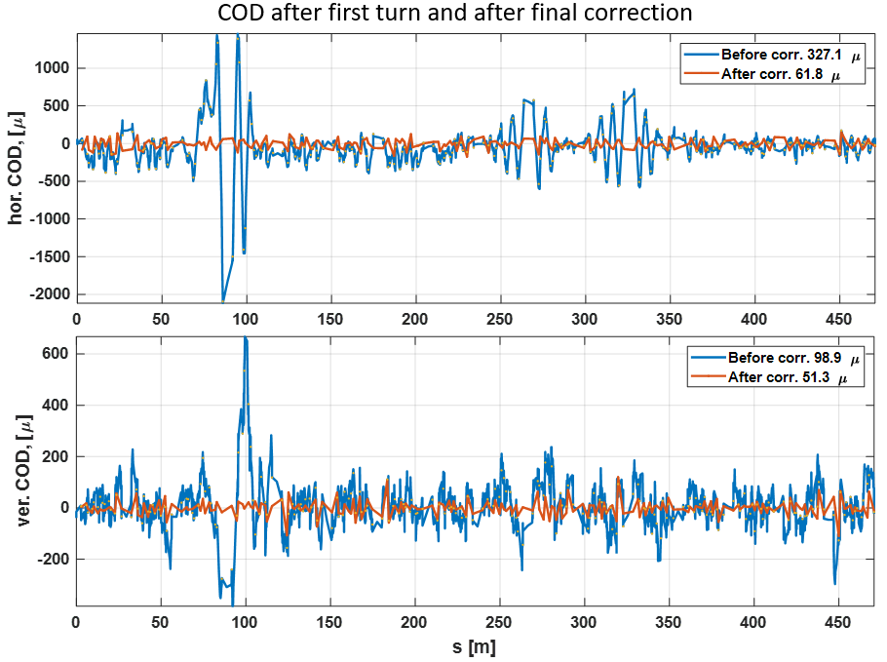
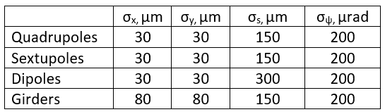
COD correction I
Even small COD in strong sextupoles generates significant optical and coupling errors reducing the dynamic aperture.
An algorithm to corrects the orbit, optics and coupling is as following:
Distribute random displacement in all elements (transverse 85 um and 150 um, longitudinal 1 mm, rotation around all three axes 200 μrad)
Correct the COD at 14×16=224 BPMs using 128 steering magnets (96 in sextupoles plus 32 individual)
Correct the beta-functions beating and tune point using 256 gradient correctors in sextupoles (!)
Correct the coupling using 256 skew-gradient correctors in sextupoles
$$Effective displacement= \sqrt{{80}^{2}+{30}^{2}}≈85 um$$

Slide 17
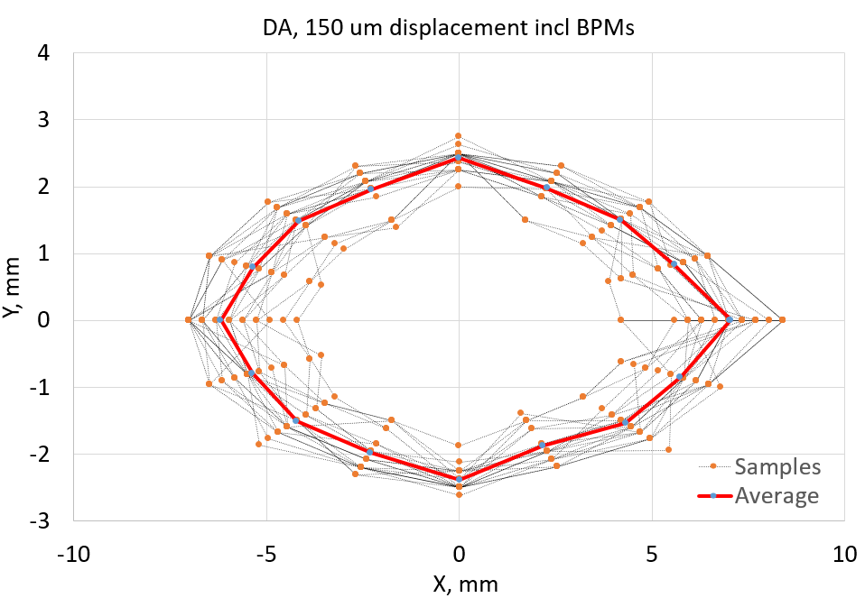
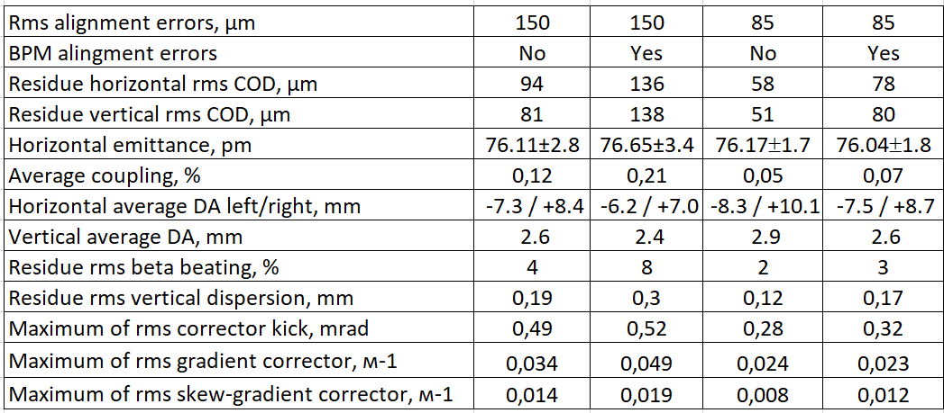
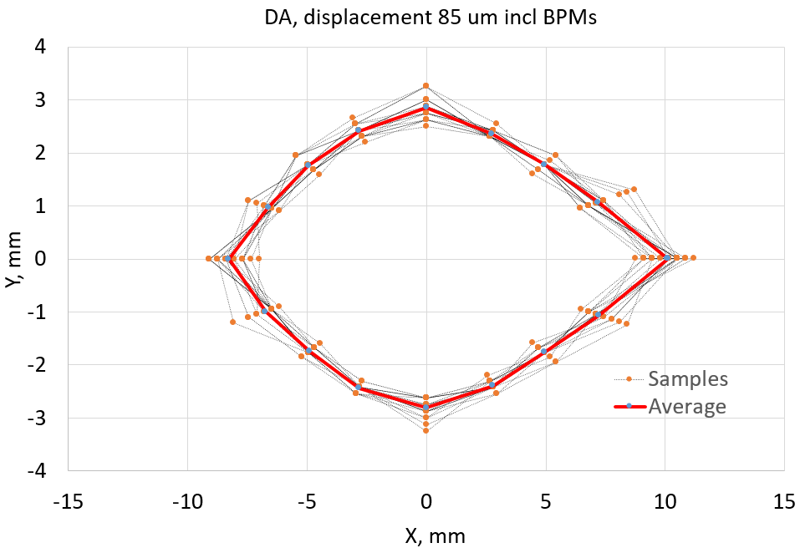
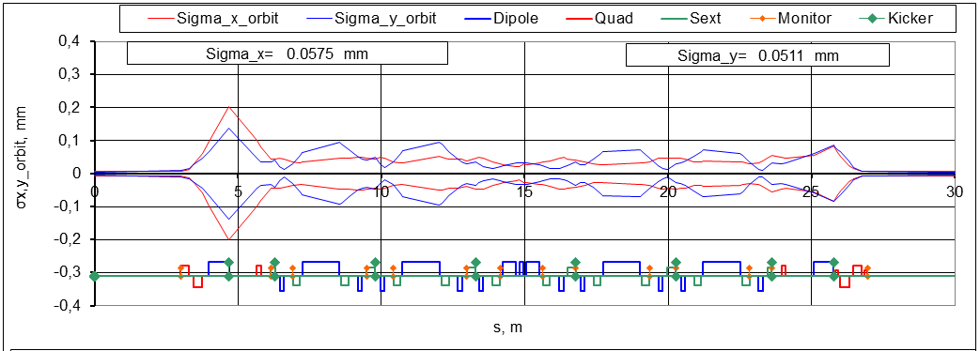
COD correction II
1σ envelop of the corrected orbit

Slide 18
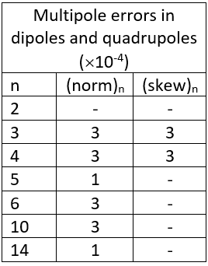
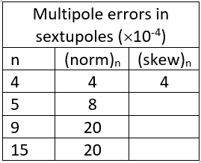
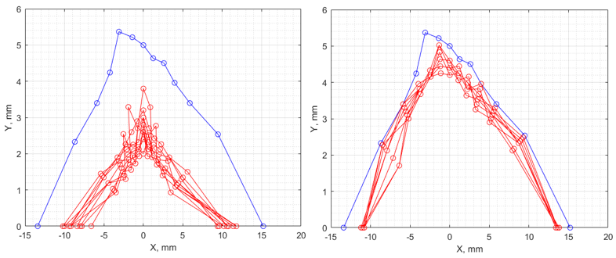
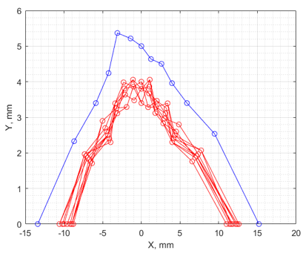
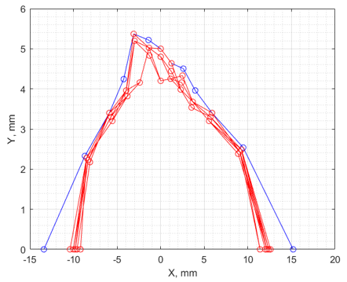
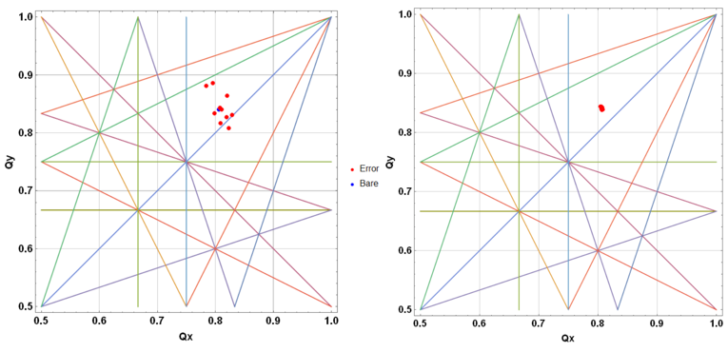
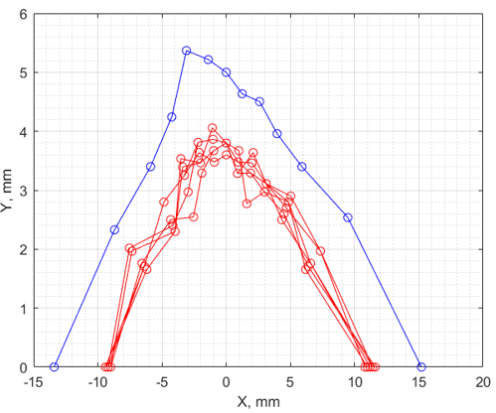
Multipole errors
Random quadrupole errors
Errors in dipoles and quads
Errors in sextupoles
2×10⁻³
unacceptable
2×10⁻⁴
acceptable
Errors in all magnets
Preliminary results. Work in progress.

Slide 19
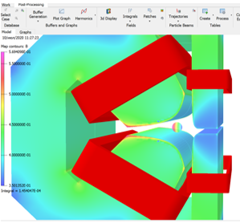
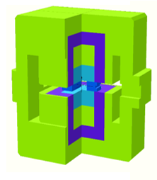
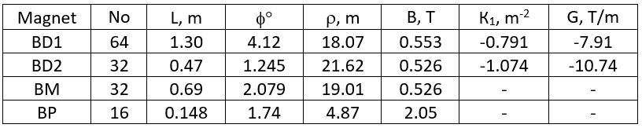
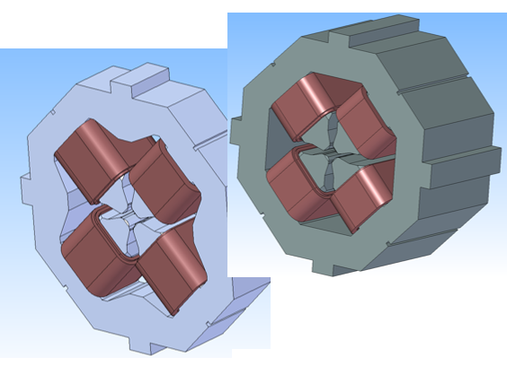
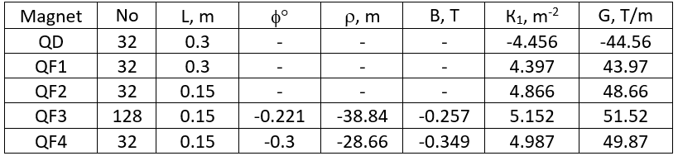
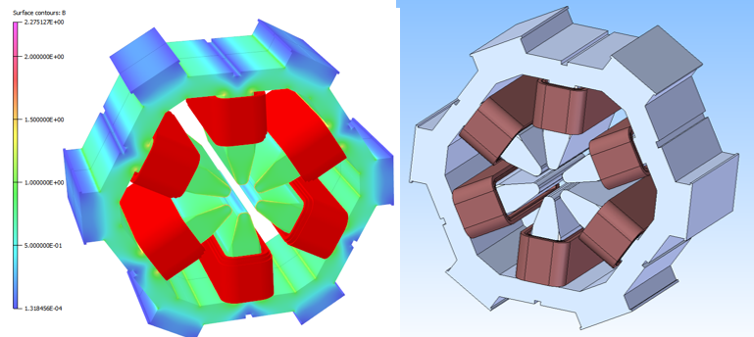
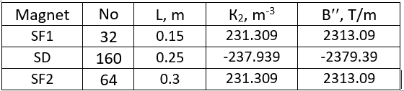
Magnets
Dipoles
Quadrupoles
Sextupoles

Slide 20
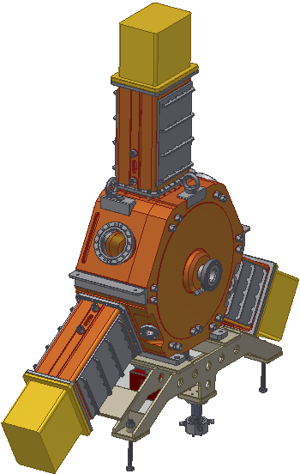






RF system
HOM spectrum
Threshold for $I_{beam}=0.4$ A
Main ring single cavity 357 MHz/160 kW CW SSPA
Single cavity fundamental data
$f_{0}$, MHz | 357
$R/Q$, Ohm | 150
$Q_{0}$ | 17000
$\frac{R}{Q}Q_{0}$, MOhm | 2.55
$V_{acc 1}$, kV | 400
$P_{Cu}$, kW | 31.4
$$P_{S max}, \text{W}\text{/}\text{c}{\text{m}}^{\text{2}}$$ | 15.7
Booster cavity SSPA: ¼ of the main ring SSPA
Notes:
Solid state amplifier

Slide 21
Vacuum system: basic approaches
Vacuum lifetime for 1 nTorr
Vacuum lifetime: > 10h (dynamic pressure of CO ≤ 2.5 nTorr).
Absorption of 200 kW of SR.
Low impedance design.
Material: aluminum alloys 6063.
Connections like in SuperKEKB, compensators like in PEPII type, BPMs like in MAX4/SIRIUS/Diamond.
Cryo-pump or distributed NEG coating in the narrow aperture straight sections.
Lumped compact combined pumps in the arcs. Expected conditioning time 3÷6 months. Advantage in compare to the NEG coating is unbaked system, less sensitive to micro-leaks, low wall impedance.
Process | Lifetime [h]
Elastic (Rutherford) | 43
Inelastic (bremsstrahlung) | 66
Total | 26

Slide 22



Vacuum system design
Flange
Design requirements:
Inner diameter of beam pipe, d [mm] | 27
Average distance between pumps, L [m] | 1
Total number of lumped pumps per arc | 24
Pumping speed of one pump for CO [l/s] | 120
Average photon flux [ph/s/m] at I=0.4A, E=3 GeV | 2E18
Initial/final desorp.coeff. [mol./ph] for CO | 1E-2/0.8E-6
Average photon dose for conditioning [ph/m] | 1.4E25 (777 Ah)
Lifetime at I=0.4 A during conditioning [h] | 3
Calculated conditioning duration [s] (worst case) | 8E6 (~3 months)
Profile in sextupole
Basic profile
Status:
All profiles are defined. BINP is ready for ordering.
Beam pipes are defined by BPMs and e-ph beams branching points positioning.
Universal port and flange connections are designed.
Design of smooth flange connection for prototyping is completed.
Bellow units is based on the PEP-II design.
Parameters of crotch-absorbers are defined. Design follows the ESRF absorbers.
Beam pipe gate valves (32 pieces) with RF contacts will be BINP design.
Universal port
Profile in quadrupole

Slide 23
Conclusion
Design of the new Novosibirsk 4th generation light source SKIF provides natural emittance 73 pm for 3 GeV beam energy and 476 m orbit length.
Only two sextupole families provide dynamic aperture and momentum acceptance sufficient for good beam lifetime and tradition well-proven injection.
SKIF has 16 6-m-long straight sections (14 are for IDs). Optical functions in the straight sections are optimized to accommodate strong field IDs.
30 beam lines are foreseen: 14 are from IDs, 8 high field permanent magnets (2.1 Т) and 8 from regular cell magnets (0.5 Т).
Magnet types are minimized for the cost and production time saving.
For all major systems the R&D is completed and design stage is started.
We would highly appreciate collaboration with mature SR labs all over the world!

