Slide 1
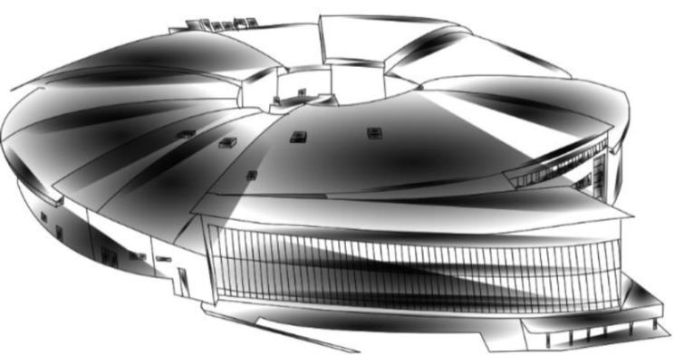
General status of ID magnetic measurements laboratory at ALBA
Dr. Josep Campmany
on behalf of Llibert Ribó, Roberto Petrocelli, Valenti Massana and Jordi Marcos

Slide 2
1
Measurements made in 2017-2019
2
New rotating coil shaft for measuring narrow gap devices
3
3D Helmholtz coils setup
4
Further improvements

Slide 3


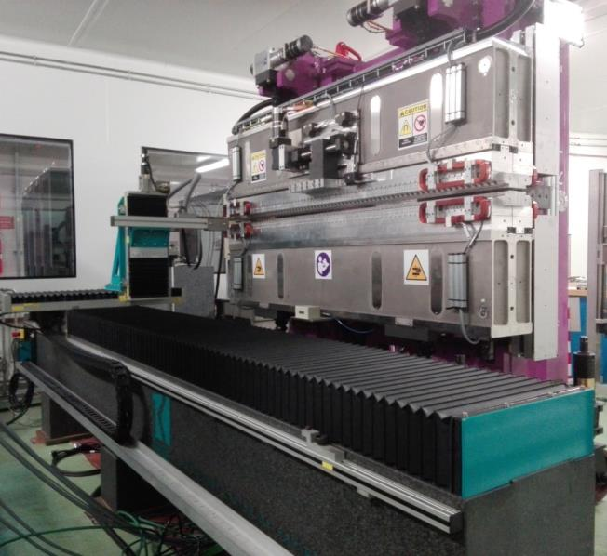

Measurements made in 2017-2019
LOREA undulator
2017/05/24→2017/07/21
Undulator for Phase-II beamline LOREA at ALBA
Undulator characteristics
Period [mm] | 125
Length [m] | 2.15
Minimum gap [mm] | 13
B_{vertical} [Tesla] | 1.09
B_{horizontal} [Tesla] | 1.06
B_{circular} [Tesla] | 0.76
B_{diagonal} [Tesla] | 0.45
Cross check of factory measurements using Hall probe and Flipping Coil benches

Slide 4



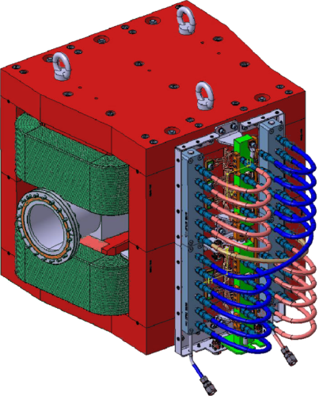
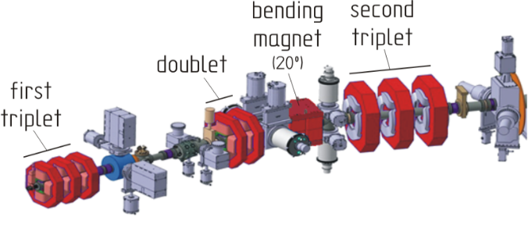
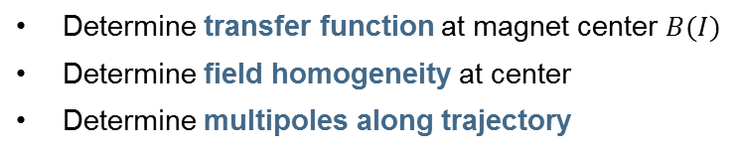
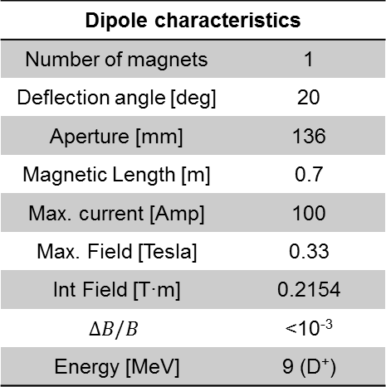
Measurements made in 2017-2019
LIPAc magnets
We have continued our collaboration with CIEMAT (Spain) carrying out measurements for LIPAc of magnets had been manufactured by Elytt Energy (Spain).
Dipole characteristics
Number of magnets | 1
Deflection angle [deg] | 20
Aperture [mm] | 136
Magnetic Length [m] | 0.7
Max. current [Amp] | 100
Max. Field [Tesla] | 0.33
Int Field [T·m] | 0.2154
$$ΔB/B$$ | <10⁻³
Energy [MeV] | 9 (D⁺)
High Energy Beam Transfer
3×quads second triplet
1×bending magnet
(first triplet and doublet quads already measured on 2016-17, see IMMW20 presentation)
Determine transfer function at magnet center $B(I)$
Determine field homogeneity at center
Determine multipoles along trajectory

Slide 5
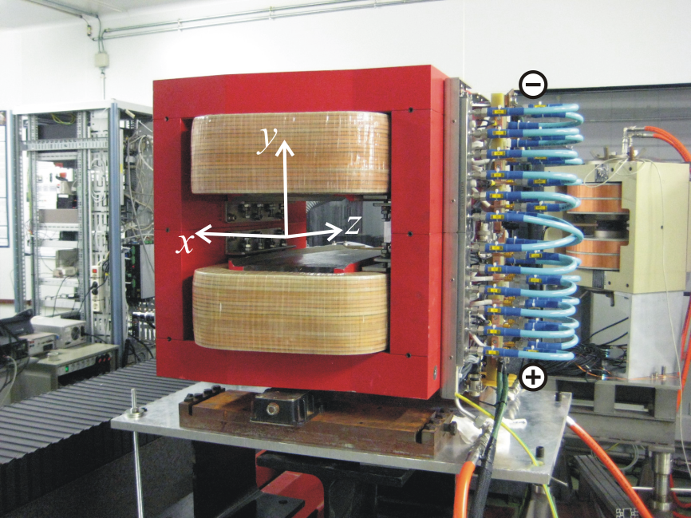
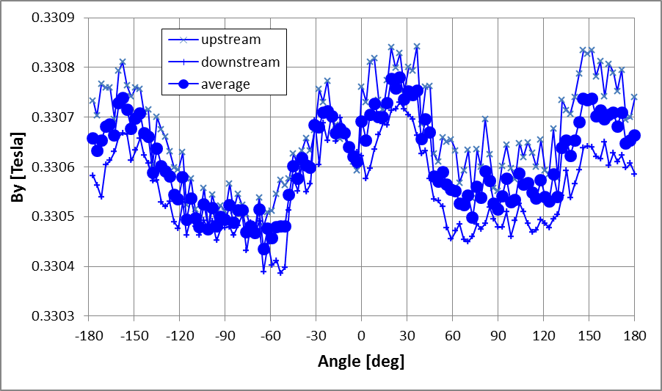
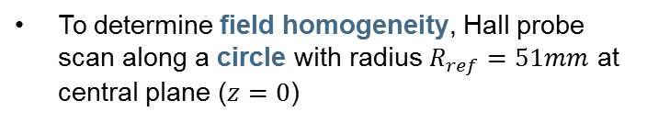

Measurements made in 2017-2019
Dipole for LIPAc HEBT: field homogeneity
2017/11/02→2017/11/29
To determine field homogeneity, Hall probe scan along a circle with radius $R_{ref}=51mm$ at central plane ($z=0$)
Field homogeneous within $0.5×{10}^{−3}$

Slide 6
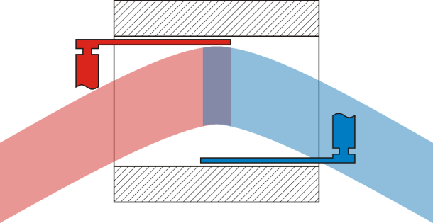
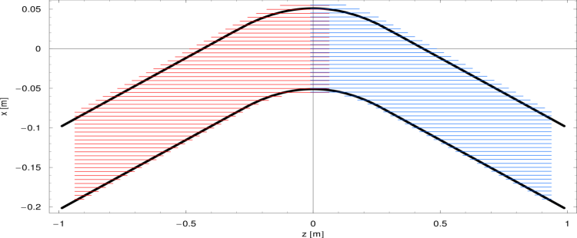
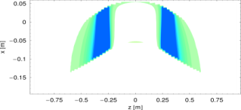
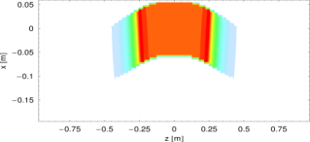
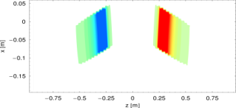
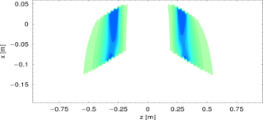
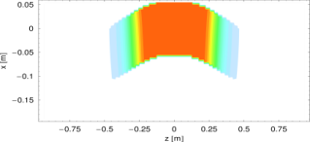
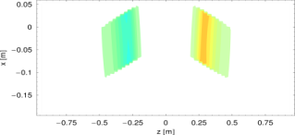
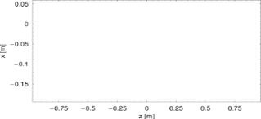




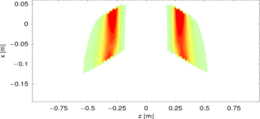

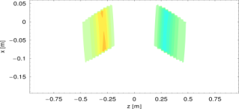
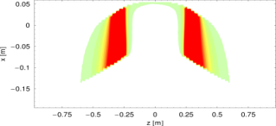

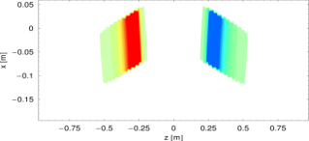








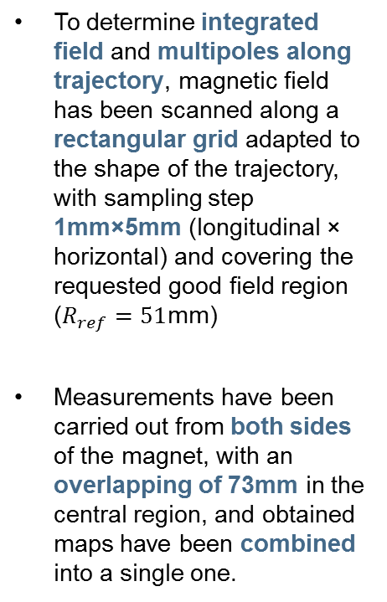
Measurements made in 2017-2019
Dipole for LIPAc HEBT: integrated field
Field maps have been measured at different vertical ($y$) positions
To determine integrated field and multipoles along trajectory, magnetic field has been scanned along a rectangular grid adapted to the shape of the trajectory, with sampling step 1mm×5mm (longitudinal × horizontal) and covering the requested good field region ($R_{ref}=51$mm)
Measurements have been carried out from both sides of the magnet, with an overlapping of 73mm in the central region, and obtained maps have been combined into a single one.
Usptream map
Downstream map
$$B_{x}$$
$$B_{y}$$
$$B_{z}$$
$y=−55$mm
$y=−25$mm
$$y=0$$
$y=+25$mm
$y=+55$mm

Slide 7
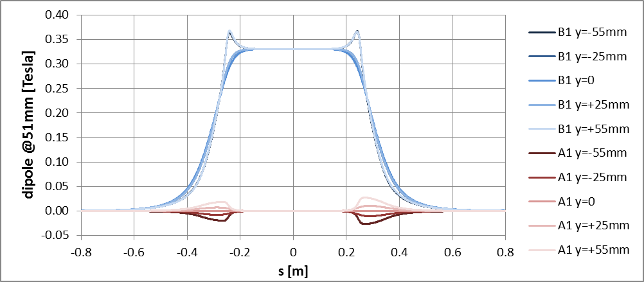
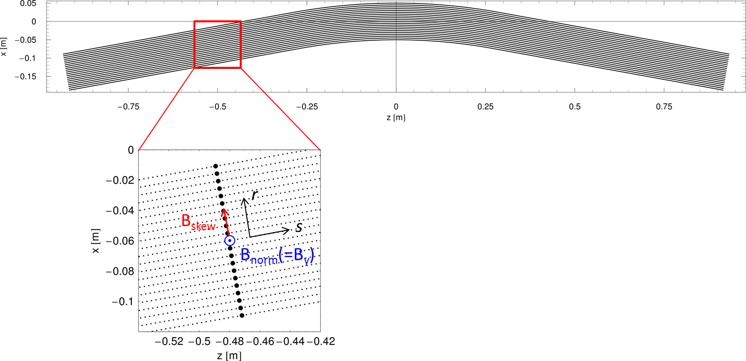
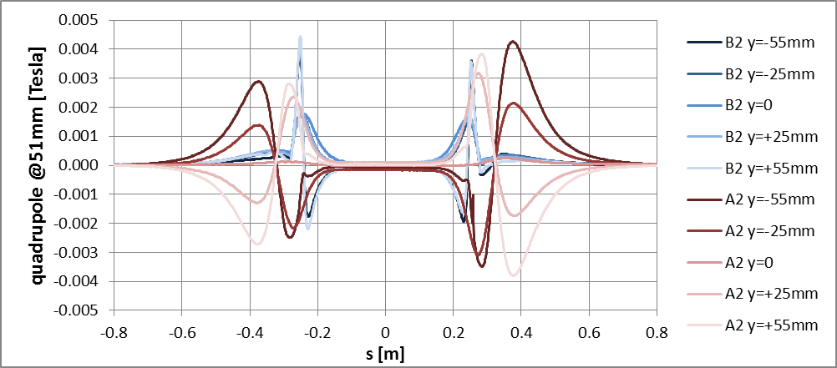
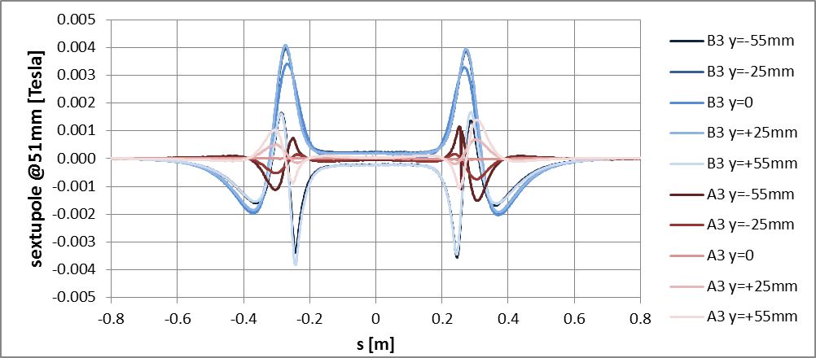
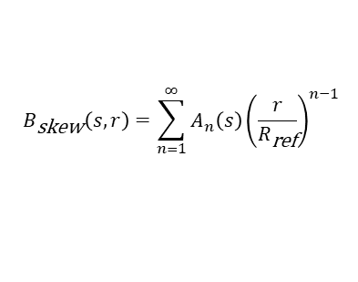
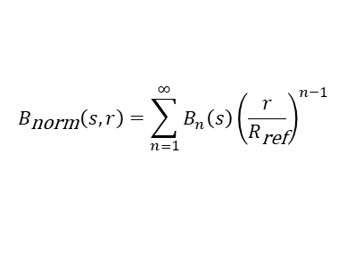
Measurements made in 2017-2019
Dipole for LIPAc HEBT: pseudomultipoles
(Pseudo)multipoles along trajectory at different vertical positions have been calculated from field maps
$$B_{\text{norm}}\left(s,r\right)=\sum_{n=1}^{∞}{B_{n}\left(s\right){\left(\frac{r}{R_{\text{ref}}}\right)}^{n−1}}$$
$$B_{\text{skew}}\left(s,r\right)=\sum_{n=1}^{∞}{A_{n}\left(s\right){\left(\frac{r}{R_{\text{ref}}}\right)}^{n−1}}$$

Slide 8
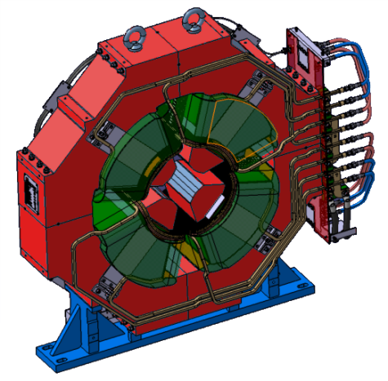
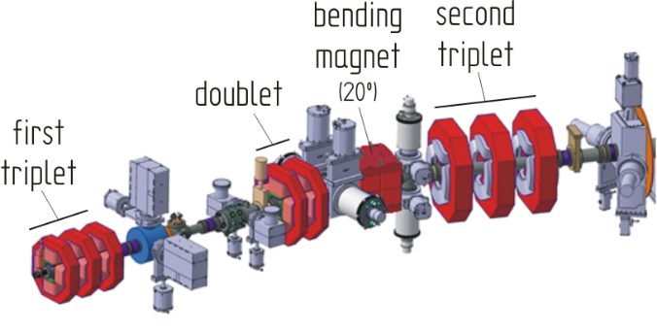
Measurements made in 2017-2019
Dipole for LIPAc HEBT
2017/11/02→2017/11/29
Determine transfer function for integrated gradient
Determine magnetic axis and roll angle
Determine harmonic content
Quadrupoles characteristics
Number of magnets | 3
Aperture [mm] | 136
Magnetic Length [m] | 0.250
Max. current [Amp] | 313
Gradient G₀ [T/m] | 12.75

Slide 9
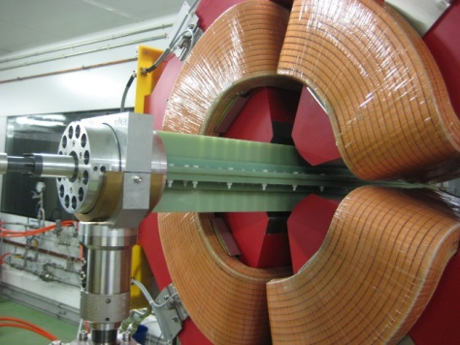
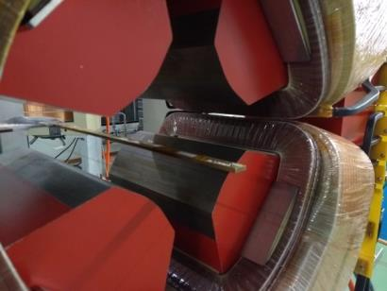


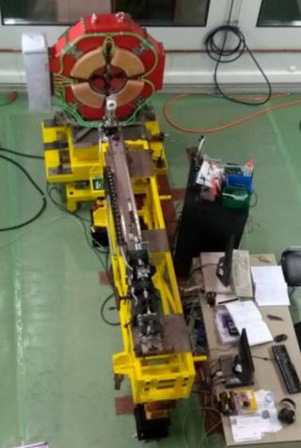
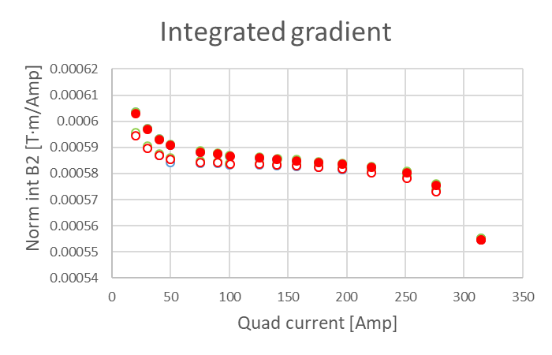
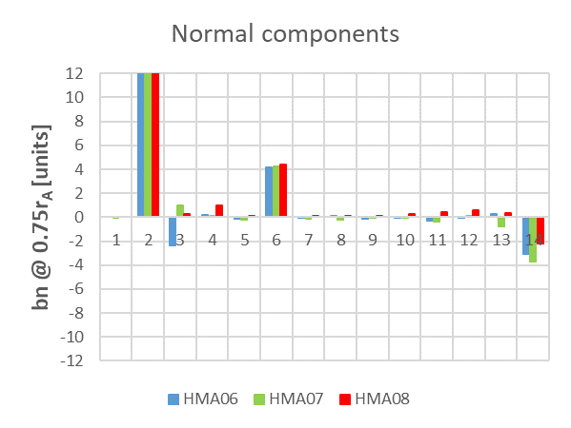
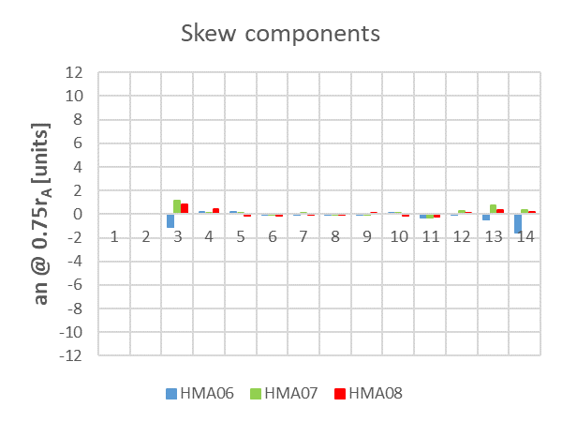
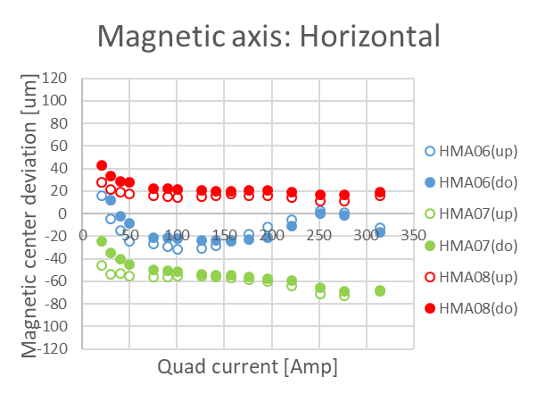
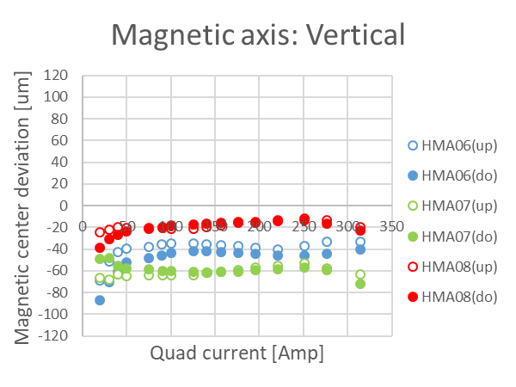
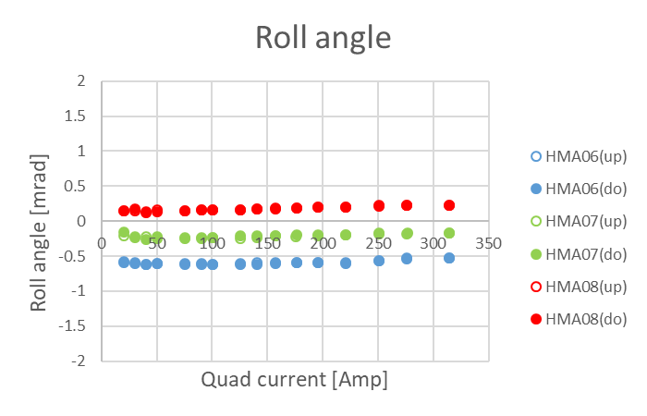
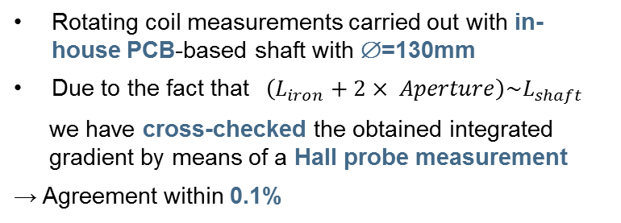
Measurements made in 2017-2019
Quadrupoles for LIPAc HEBT
Rotating coil measurements carried out with in-house PCB-based shaft with ∅=130mm
Due to the fact that$\left(L_{iron}+2× Aperture\right)\sim L_{shaft}$
we have cross-checked the obtained integrated gradient by means of a Hall probe measurement
→ Agreement within 0.1%
Transfer function
Harmonic content
Magnetic axis deviation
Roll angle

Slide 10
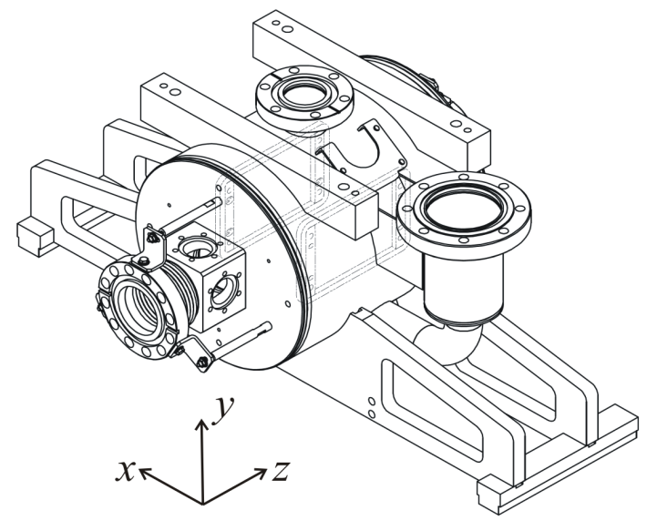
Solenoids for LIPAc SRF LINAC
2018/11/05→2019/03/22
Determine magnetic axis position and orientation
Superconducting RF LINAC
8×SC solenoids
Solenoid characteristics
Number of magnets | 8
Aperture [mm] | 50
Solenoid length [m] | 0.187
Max. current [Amp] | 210
Axial field [T] | 5.85

Slide 11
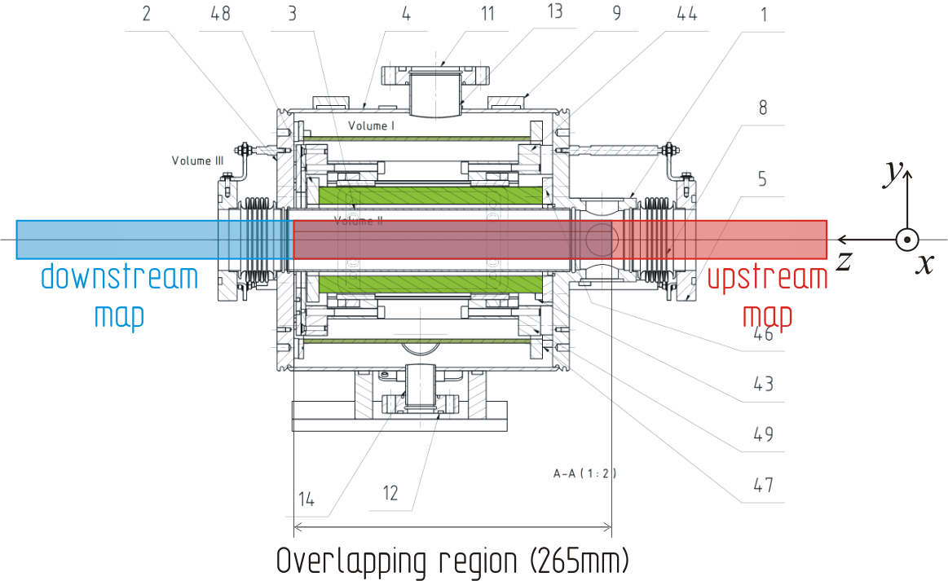
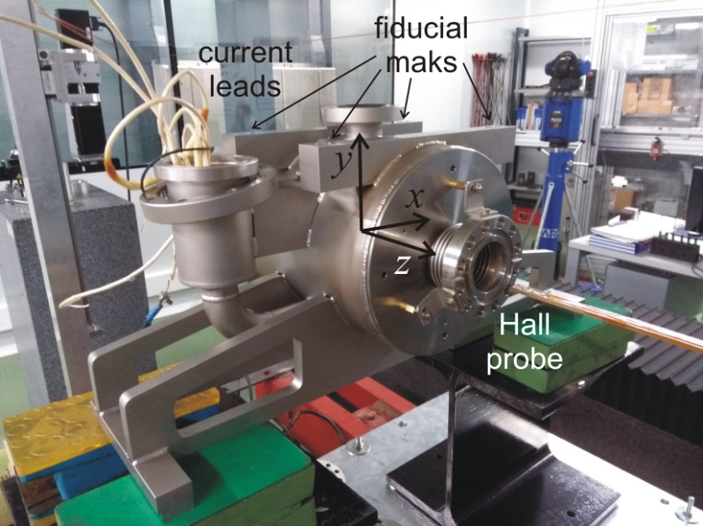
Measurements made in 2017-2019
Solenoids for LIPAc SRF LINAC
Characterization has been carried out at room temperature and low current (0.4Amp) using Hall probe bench.
Horizontal/vertical field maps have been measured from each side and the results have been combined into single horizontal/vertical maps.
solenoids

Slide 12
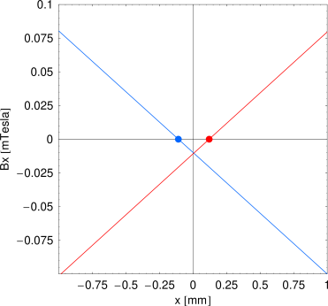
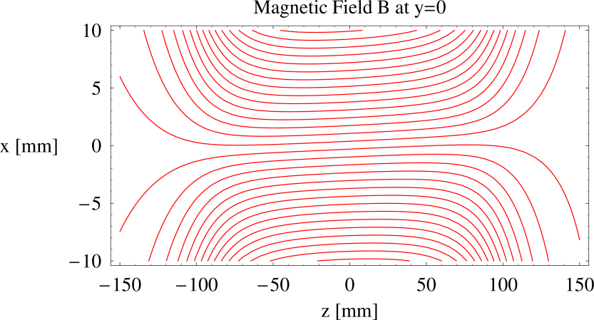
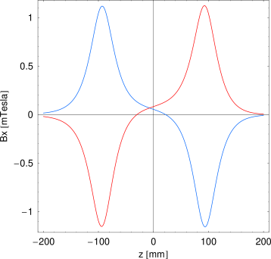
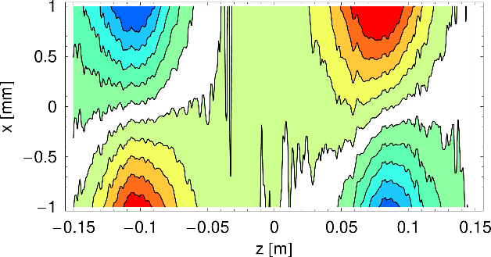
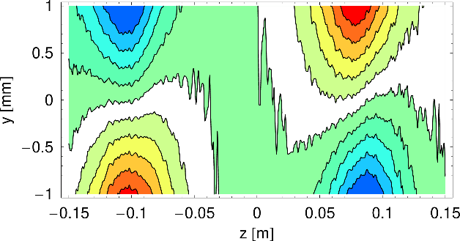
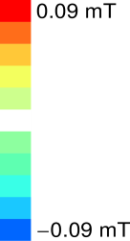










Measurements made in 2017-2019
Solenoids for LIPAc SRF LINAC
Todetermine the magnetic axis position/orientation we have analyzed the minor components of the magnetic field
Example: RADIA simulation of a solenoid rotated by 5mrad around $y$ axis
$$z_{in}$$
$$z_{out}$$
Determination of the edges of the solenoid
$$\left(\frac{∂B_{x}}{∂z}\right) \text{maximum}$$
$$x_{in}$$
$$x_{out}$$
$$z_{in}$$
$$z_{out}$$
Determination of $x_{in}$ and $x_{out}$ positions with $B_{x}=0$ at $z_{in}$ and $z_{out}$
Axis position $x_{axis}=\frac{{(x}_{in}+x_{out})}{2}$
Magnetic axis determined through the condition $B_{x}=0$ (H coordinate) and $B_{y}=0$ (V coordinate) on the edge region:
$$B_{x}\left(x_{axis},z_{edge}\right)=0 ; B_{y}\left(y_{axis},z_{edge}\right)=0$$
$$yaw={\left\langle \frac{B_{x}}{B_{z}}\right\rangle }_{center}; pitch={\left\langle \frac{B_{y}}{B_{z}}\right\rangle }_{center}$$
Misalignment angles estimated from the minor field components relative to the axial in the central solenoid region
Comparison of results obtained measuring from both sides allow to estimate errors
$B_{x}$ horizontal fieldmap
$B_{y}$ vertical fieldmap

Slide 13




Measurements made in 2017-2019
Solenoids for LIPAc SRF LINAC
Axis position
Axis alignment angles
Obtained field components along mechanical axis ($x=y=0$) for all 8 solenoids

Slide 14






Measurements made in 2017-2019
ESS PMQs
2017/12/14→2017/12/19
Measurement of a series of PMQs manufactured by Elytt Energy (Spain) for Tank 4 of DTL of ESS.
PMQ Characteristics
Number of magnets | 12
Gradient G₀ | 20 Tesla/m
Bore diameter | 24 mm
Mechanical length | 80mm
Sm₂Co₁₇ magnet blocks
PMQs have been characterized using a ∅=22mm PCB rotating coil with quadrupole compensation.
We have determined: (a) magnetic axis, (b) roll angle, (c) integrated gradient, and (d) harmonic content.
In order to minimize alignment errors between the rotating coil axis and the magnet, magnets have been measured in 4 different positions making use of the alignment pins.

Slide 15






Measurements made in 2017-2019
ESS PMQs
Integrated gradient
High harmonic content
Magnetic axis
Roll angle

Slide 16
New rotating coil shaft for measuring narrow gap devices
Needs:
Low emittance rings trend to use narrow radius multipolar magnets ( ø ~ 12 mm)
At these small radius, the imperfections and errors are more relevant
To this end, a specific new set of tools should be developed
Instrument to fulfill this aim:
We have chosen building a narrow shaft with coils to be applied to our new Rotating Coil bench
The shaft will follow the CERN scheme, with 5 parallel coils, the internal ones used to buck the signal of the external

Slide 17
New rotating coil shaft for measuring narrow gap devices
Concerns:
Coil sensitivity (number of turns of each coil)
Shaft rigidity (multilayer PCB length 550 mm, width 10 mm and thickness 2 mm)
    Sag
    Twisting during rotation
Shaft positioning (usual positioning requirements have tolerances below 30 µm)
Shaft alignment with respect to the magnetic structure to be measured
Solutions adopted:
Coil sensitivity: multilayer PCB, 30 turns per coil.
Shaft rigidity: guaranteed using ceramics (Al₂O₃) glued to PCB. All shaft is glued as a single piece.
Shaft positioning: high precision bearings with inner ø = 10 mm mounted on precision setup tables.
Shaft alignment The shaft has two reference surfaces allowing the horizontal alignment of the setup as well as the positioning of the shaft with respect to the magnetic structure to be measured.

Slide 18




New rotating coil shaft for measuring narrow gap devices
Design:
 | Shaft diameter | Circuits position | Turns per layer | Layers | Length
 | 10 mm | R = 1.9 mm A = 0.9 mm | N = 3 | 10 | 550 mm
 | 23 mm | R = 4.6 mm A = 2.3mm | N = 9 | 20 | 550 mm
Multilayer PCB
Glue
Reference surface
Al₂O₃ ceramics

Slide 19

3D Helmholtz coils setup
Motivation:
3D Hall probes at ALBA are built in-house by combining three orthogonally mounted 1D Hall sensors on a common circuit board
Hall sensors are assembled with an angular accuracy of ±3º. So far, the resulting misalignment angles can be mechanically determined with a precision of ~0.5º / ~ 10 mrad
We want to improve the accuracy in the determination of the misalignment angles down to ~0.2 mrad level
Our aim is to generate a magnetic homogeneous field within a volume covering all 3 sensors and with an arbitrary and well controlled orientation
To this end, we have designed and are building a 3D Helmholtz coil setup

Slide 20


3D Helmholtz coils setup
System requirements:
Magnetic field at the system’s center
The system will consist of 3 orthogonal pairs of Helmholtz coils
$$B={\left(\frac{4}{5}\right)}^{3/2}\frac{μ_{0}NI}{R}$$
No ferromagnetic parts
Linear system
Superposition principle can be applied
Air cooled coils will be used in order to keep the system as simple as possible
The objective is generating a homogeneous magnetic field, with a flux density as high as possible whilst keeping the system heating at a reasonable level, and ensuring a orthogonality between the field components generated by each coils better than 0.2mrad
Parameter | Specification
Magnetic field homogeneity | 10⁻⁴ within 15×15×15 mm³
Maximum system heating | 20ºC
Magnetic field orthogonality | 0.2 mrad

Slide 21




3D Helmholtz coils setup
Design parameters:
The magnetic design has been carried out using RADIA
Coils will be made of grade 2 enamelled copper wire with a conductor/total diameter of 1.5 mm / 1.571 mm. Using an orthocyclic winding layout, we expect attaining a filling ration close to 0.77. An external company will make the wiring

Slide 22

3D Helmholtz coils setup
Mechanical design
The mechanical implementation will consist of a set of interlocking aluminium pieces
Each piece has a rectangular groove with the proper dimensions to wind one of the coils.
The precise machining of the pieces will guarantee that upon assembly the relative positioning of the coils will be close to design values.
Reference surfaces machined on the pieces will allow to survey accurately their actual position and to correct any deviation by means of shims.
Mechanical pieces are currently being manufactured at ALBA workshop

Slide 23


Further improvements
New Hall probe bench adaptation:
The ALBA new Hall probe bench designed to measure closed structures has been proved feasible with the current existing prototype

Slide 24


Further improvements
Homogeneous field
Inhomogeneous field
Repeatability
< 10⁻⁴ for main components
< 5·10⁻⁴ for minor components
Repeatability
< 10⁻⁴ for main components
< 5·10⁻⁴ for minor components

Slide 25



Further improvements
Upgrades:
Short term (autumn 2019)
Increase the length in order to measure the XAIRA in-vacuum (2.75 m long) with the vacuum chamber installed
Long term (2020 and beyond)
Adapt the bench for measurements in-vacuum and at low temperatures (maintaining the Hall probes at room temperature).
Needed: belt fastening system with a flange with pass-through to extract the signal + long bellows and suspension structure (may be not needed) to connect the flange in the fasteners with the flanges in the magnetic structure

Slide 26
Thanks for your attention
?
Questions

