Slide 2
From SAC Nov 2015
New opportunities for single shot experiments at synchrotrons (XRD, XRI, XAS)
New perspectives for dynamic compression studies for a wide user community
X-FELs and SR will complement work at large laser facilities
PLANS at ESRF
We have demands from our users community to develop dynamic compression coupled to XRD, XAS, XRI, XES
Two main science cases identified:
Properties of matter under extreme conditions that go beyond those existing in our planet
Dynamic behavior of matter and materials under high strain rates
Strong complementarities with HED @ XFEL. Collaboration with HIBEF consortium.
Visit of HZBF to ESRF on 13 January
Participation to the European Cluster of Advanced Light Sources.
Richard Briggs, EUCALL Post Doc (2016 – 2018)

Slide 3
A HIGH POWER LASER FACILITY (HPLF) at ESRF
HPLF-I
Jan-March 2016: Feasibility study ~100 J laser + laser cabin on ID24.
April 2016 : Deliverable: full proposal w/cost estimates, model for operating the laser.
Mid 2016: CFT for 100 J laser (upgradable to 1kJ?), delivery in 2017.
Design studies for installation of laser, associated optics, shock diagnostics.
Allocation of two positions to this project
End 2017: Operating laser on ID24
Jan 2018: Start of User Operation of HPLF-I
Meeting with Amplitude (3 Feb), Quantel (25 Jan?) and LLE (22 Jan?)

Slide 4
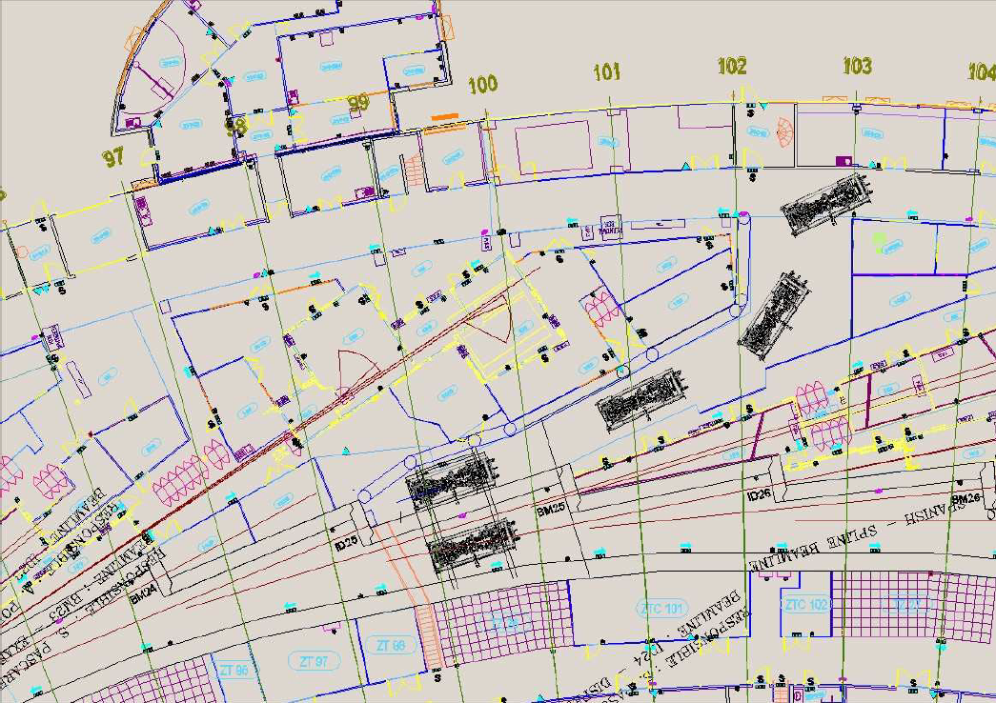
HPLF I on ID24

Slide 5
A HIGH POWER LASER FACILITY (HPLF) at ESRF
HPLF-I
Jan-March 2016: Feasibility study ~100 J laser + laser cabin on ID24.
April 2016 : Deliverable: full proposal w/cost estimates, model for operating the laser.
Mid 2016: CFT for 100 J laser (upgradable to 1kJ?), delivery in 2017.
Design studies for installation of laser, associated optics, shock diagnostics.
Allocation of two positions to this project
End 2017: Operating laser on ID24
Jan 2018: Start of User Operation of HPLF-I
Meeting with Amplitude (3 Feb), Quantel (25 Jan?) and LLE (22 Jan?)
HPLF-II
Autumn 2016: Second Workshop (rally user community around common EoI for ESRF-EBS)
Deliverable: ESRF-EBS CDR for HPLF-II:
2 or more beamlines (XRD, XRI, XAS, XES)
upgrade of laser power to 300 J
Nov 2017: Submission of ESRF-EBS CDR for HPLF_II to SAC/Council.

Slide 6
HPLF II (optimal solution)
ID27
ID28
EH1
EH1
EH2
EH2
HPLF

Slide 7
EMAIL to USERS COMMUNITY (AIRAPT, MEGABAR, ….)
Dear Colleague,
we inform you that we are taking first actions in the preparation of a proposal for a High Power Laser Facility (HPLF) for the Phase II of the ESRF Upgrade, triggered by the outcome of the 1st Workshop on Studies of dynamically compressed matter using X-rays (ESRF, 16-17 Feb. 2015). In the framework of the preparation of the second and final phase of its Upgrade Progamme, the ESRF has announced a call for Expressions of Interest to identify new and challenging experimental programmes and beamlines. This new phase called the ESRF - EBS, Extremely Brilliant Source, is due by 2022: it will deliver a new low emittance storage ring and complete the renewal of the ESRF public beamline portfolio initiated in Phase I of the programme.
We invite you to to contribute to the identification and definition of science cases that can be addressed by studies of dynamically compressed matter with X-rays, by submitting your Expression of Interest at:
http://www.esrf.fr/home/about/upgrade/ESRF-EBS-call-expressions-of-interest.html
The deadline for submission is 11 March 2016. The outcome of these Expressions of Interest, the science cases and possible implementation of this facility at the ESRF, will be then discussed at a 2nd Workshop on "Studies of dynamically compressed matter using X-rays" that will take place at ESRF on 5-6 December 2016. Please mark this date on your agenda.
As a user facility, the ESRF absolutely relies in the user input. We then look forward to receiving many Expressions of Interest and to fruitful discussions at the Workshop in December!

Slide 8
TEMPLATE FOR EXPressions of Interest

Slide 9
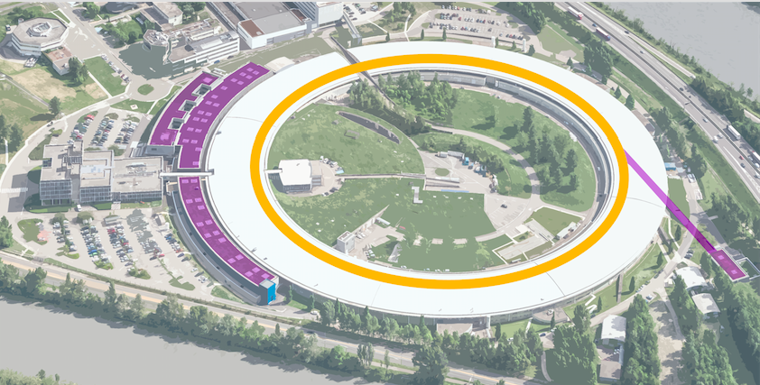
Esrf upgrade programme
Phase I – 180 M€ (2009-2015)
19 new endstations and beamlines
New 8 000m²experimental hall
Improvement of overall infrastructure and Accelerator systems
Phase II ESRF-EBS – 150 M€ (2015-2022)
a new high energy low-emittance source
a new portfolio of unique instruments
an innovative scientific instrumentation programme

Slide 10
EUCALL KICKoff MEETING 29-30 October 2015
The European Cluster of Advanced Laser Light sources (EUCALL)
Notes:
EUCALL addresses emerging overlap of technological and scientific applications between powerful optical lasers and X-ray lasers facilities.

Slide 11
Two types of light sources have emerged
Optical lasers
Development has revolutionized our life; mostly visible and near infrared spectral regime; applications from fundamental science to daily life
Synchrotron Radiation
Development has revolutionized scientific and technology applications; particular for hard x-ray domain with ability to determine atomic structure
Parallel development for long time, but more recently
Large optical laser facilities aiming at generation of x-rays and x-ray applications, but also developing user facility structures.
Through the development of x-ray FELs it becomes possible to enter the optical laser domain of ultrashort – coherent – intense light sources. And OL installations are integrated to accelerator-based facilities.
Specific challenges, new overlap and common interests
Research opportunities; technology overlap; availability/cost → efficiency

Slide 12
Focus of project
addresses emerging overlap of technological and scientific applications
defines a RI providing transnational access to a facility which combines
powerful optical lasers with high brightness X-ray, or short-wavelength, light sources
ADVANCED LASER LIGHT SOURCE RESEARCH INFRASTRUCTURE
Extreme Light Infrastructure (ELI)
distributed RI with 3 very high-power optical laser installations
European XFEL
single-site RI employing sc linear acc. for x-ray FEL applications
ESRF-EBS
single-site RI combining high power optical lasers with SR
LASERLAB-EUROPE
network of national OL light sources (30 organ. in 16 countries)
FELS OF EUROPE
network of national FEL light sources (14 organ. in 9 countries)

Slide 13
EUCALL AND ESRF
WP #3 – SYNERGY EXP DIV (ID24) + ADMIN (Anne Talucci)
ESRF plans to couple a high power laser (~100 J, ns-pulse) to X-ray beamlines to study dynamically compressed matter at local thermal equilibrium: identify complementarities, inform and discuss w/users community of different facility performance, identify applications, strengthen collaboration on common goals.
WP #4 – SIMEX EXP DIV (ID24, ID27) + ISDD (Adv. Anal. Mod., Manolo Sanchez del Rio and Mark Glass)
ESRF will share its developments on simulating virtual experiments at diffraction limited SR – from source to sample to data – within the OASYS environment. Design study of future high power laser and how it will be coupled to the beamlines. Target design with existing hydrocodes, evaluate expected modifications in X-ray observables. (36 person months)
WP #5 – UFDAC ISDD (Detector and Electronics, Nicolas Janvier)
Investigation and optimization of mechanisms to optimize transfer of detector data from disk or from the detector into the memory buffers of the FPGA and GPU coprocessor boards. (24 person months)
WP #7 – PUCCA ISDD (BM05, Eric Ziegler)
Conceptual design report to build a wavefront sensor for [8-25] keV. Wavefront analysis software package. (24 person months)

